Slide 1
Safe3D Iteration 1
Luigi Caprio
Chad Grubb
Jeremy Dorr

Slide 2
Task Mode | Task Name | Duration | Start | Finish | Predecessors | Resource Names
Auto Scheduled | Software Development Plan | 34 days? | Mon 6/6/16 | Thu 7/21/16
Manually Scheduled | Analysis/Software Requirements | 4 days | Mon 6/6/16 | Thu 6/9/16
Auto Scheduled | Conduct needs analysis | 1 day | Mon 6/6/16 | Mon 6/6/16 |  | Jeremy,Luigi,Chad
Manually Scheduled | Draft preliminary software specifications | 2 days | Tue 6/7/16 | Wed 6/8/16 | 2 | Chad,Jeremy,Luigi
Auto Scheduled | UML Activity Diagram | 1 day | Tue 6/7/16 | Tue 6/7/16
Auto Scheduled | UML Class Diagram | 1 day | Tue 6/7/16 | Tue 6/7/16
Auto Scheduled | Incorporate feedback on software specifications | 1 day | Thu 6/9/16 | Thu 6/9/16 | 3 | Jeremy,Luigi,Chad
Auto Scheduled | Analysis complete | 0 days | Thu 6/9/16 | Thu 6/9/16 | 6
Auto Scheduled | Design | 9 days | Fri 6/10/16 | Wed 6/22/16 | 1
Auto Scheduled | Develop functional specifications | 3 days | Fri 6/10/16 | Tue 6/14/16 |  | Jeremy,Luigi,Chad
Manually Scheduled | Iteration 1 Delivery | 0 days | Tue 6/14/16 | Tue 6/14/16 | 9

Slide 3
Sequence Diagram

Slide 4
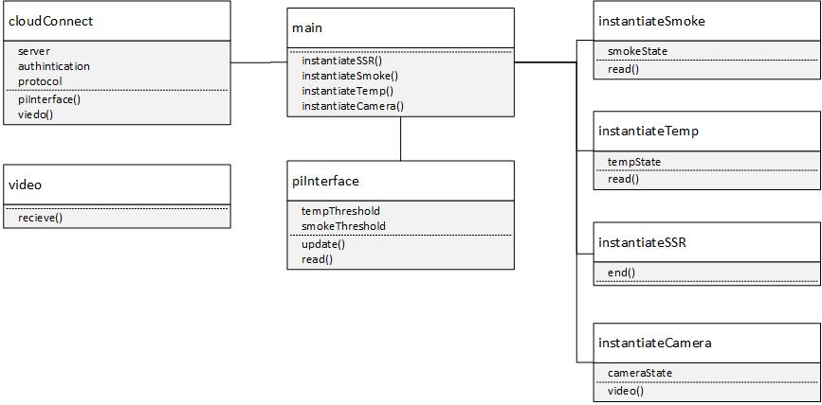
Raspberry Pi Software Class Diagram

Slide 5
Android Application Class Diagram

Slide 6
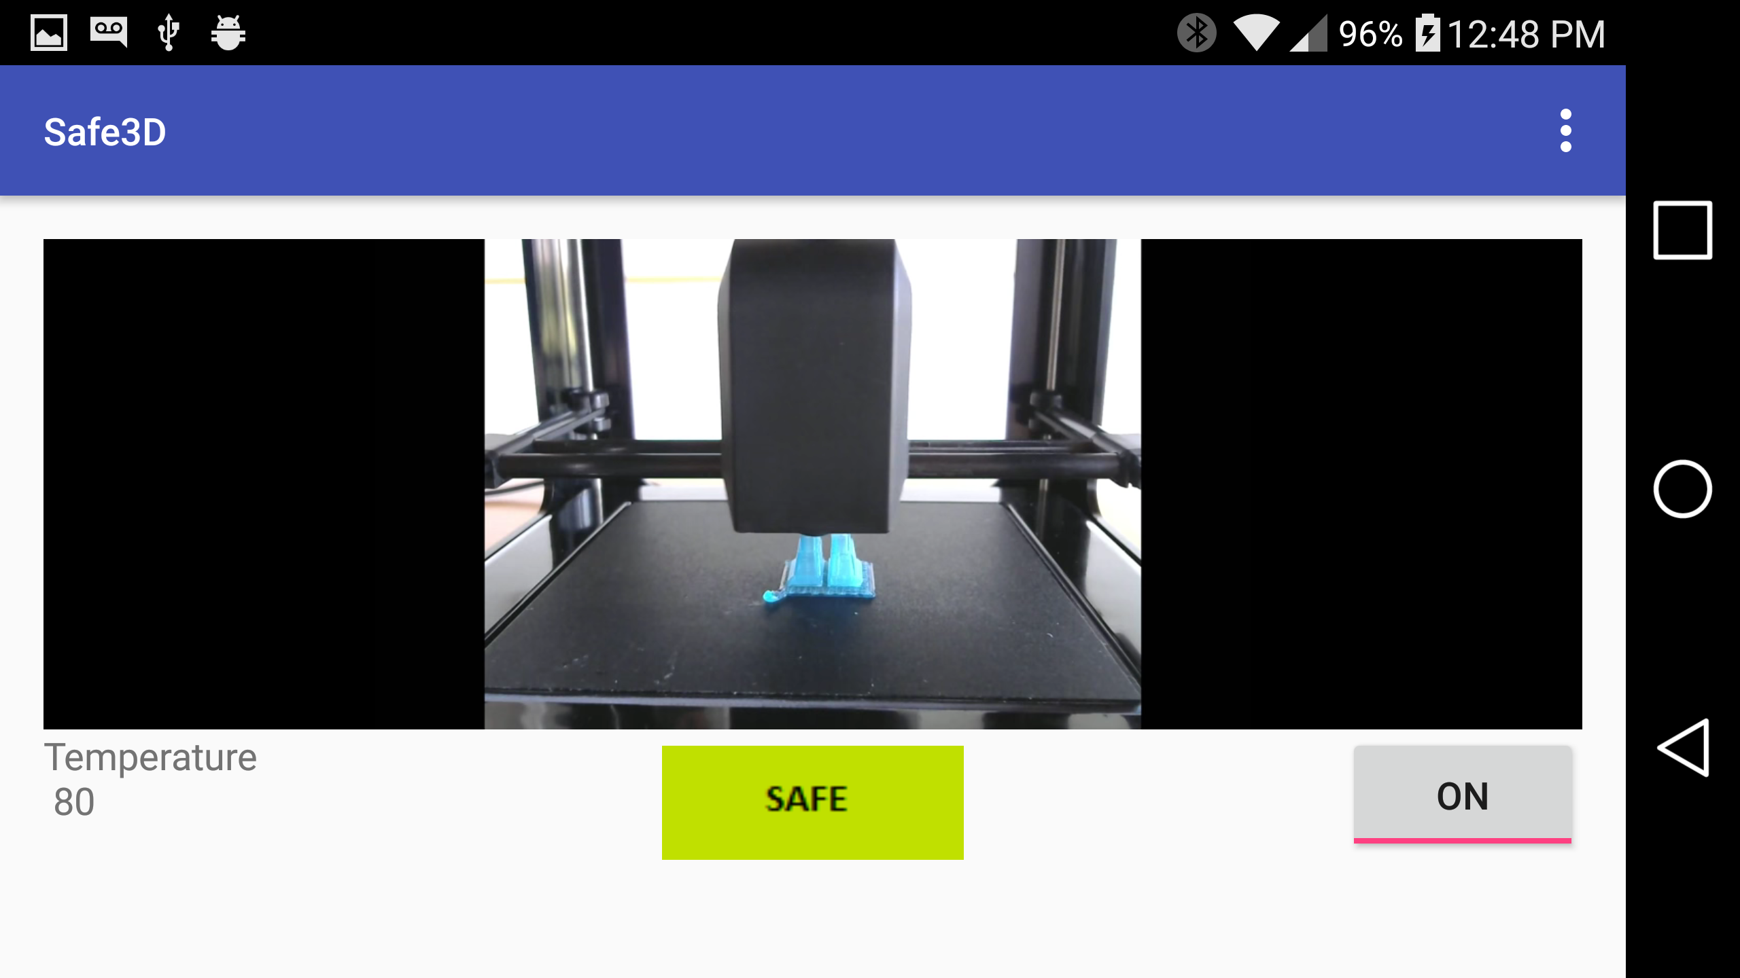
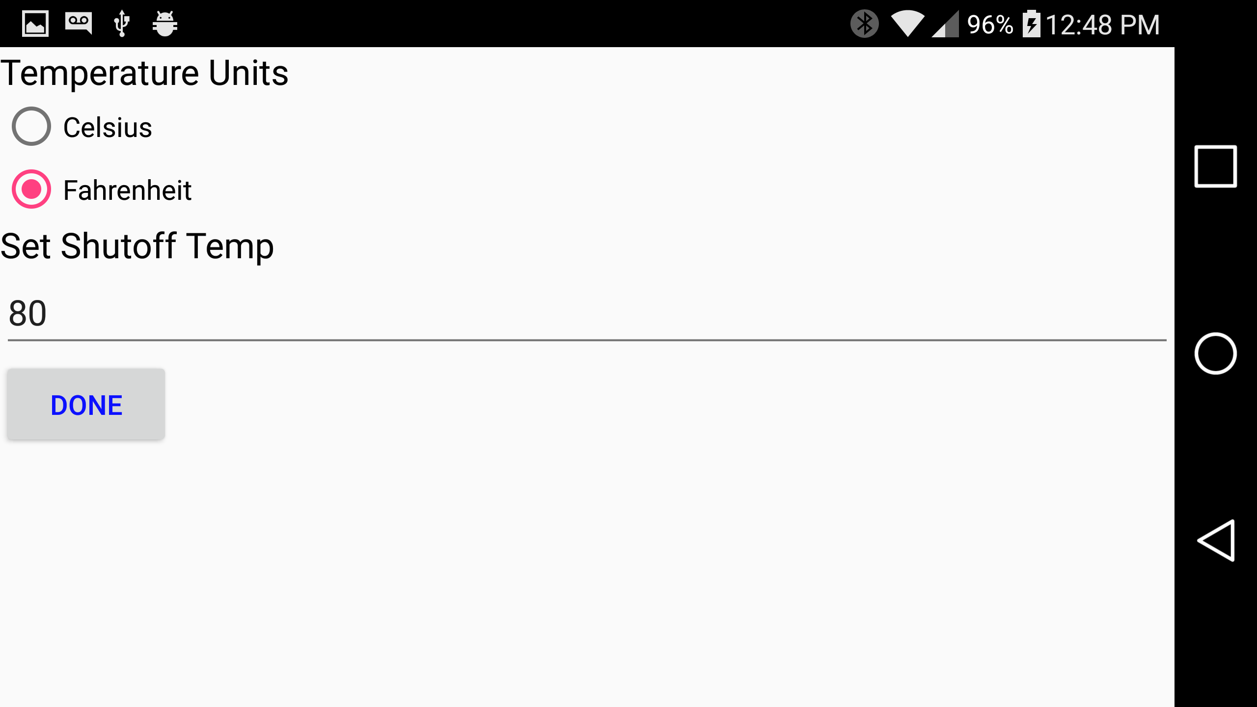
Screenshots

