Slide 1
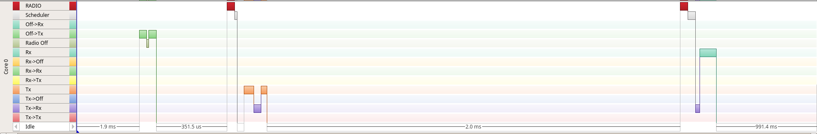
The hardware-accelerated TX-to-RX turnaround is so fast, that the CPU was not able to keep up: When it gained control after Tx ends (see Tx-Rx transition cleanup in purple in reaction to the red Tx end ISR), the radio is already in RX state (light green), therefore no Rx entry radio ISR (red) is scheduled.
This demonstrates nicely, why a scheduling approach is required on real hardware.
End
Start
End
Start
Radio Off
Tx
Rx
Schedule Tx
Schedule Rx

