Slide 1

Intro to JavaScript Unit Testing Using Angular
Presented By: Jeremy Edmondson
Technical Director, Improving Atlanta
Friday, May 14th, 2021

Slide 2
Materials
https://github.com/jeremye416/AngularUnitTesting

Slide 3
Unit Test Definition
A unit test is a piece of a code (usually a method) that invokes another piece of code and checks the correctness of some assumptions afterward. If the assumptions turn out to be wrong, the unit test has failed. A unit is a method or function.
https://livebook.manning.com/book/the-art-of-unit-testing-second-edition/chapter-1/11

Slide 4
System Under Test - Definition
SUT stands for system under test, and some people like to use CUT (class under test or code under test). When you test something, you refer to the thing you’re testing as the SUT.

Slide 5
Unit Test Phases (AAA)
Arrange: initializes objects and sets the value of the data
Act: invokes the method under test with the arranged parameters
Assert: verifies that the action of the method under test behaves as expected

Slide 6
Unit Test vs Integration Test
Unit Testing
Individual units of source code are tested to determine if they are ready to use
Test each part of the program and shows that the individual parts are correct
Can be performed at any time
Executed by the developer
Errors found easily
White Box Testing
Internal structure, design and coding of software are tested to verify flow of input-output and to improve design, usability and security
Integration Testing
Checks integration between software modules
Combines different modules in the application and test as a group to see they are working fine
Performed after unit testing and before system testing
Performed by the testing team
Difficult to find errors
Black Box Testing
Tested without having knowledge of internal code structure, implementation details and internal paths

Slide 7
Mocking (Spys)
Mocking = a replica or imitation
Objects have complex dependencies
Isolate the behavior of the object you want to test
Simulate the behavior of the real objects
Test one class in isolation
Classes aren’t isolated…
Simulate the real behavior to do unit testing in isolation

Slide 8
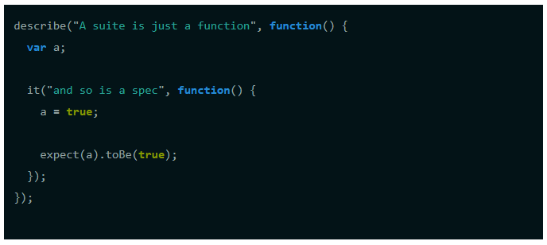
JavaScript Testing Tools
Jasmine (https://jasmine.github.io/)
Jasmine is a behavior-driven development framework for testing JavaScript code. It does not depend on any other JavaScript frameworks. It does not require a DOM. And it has a clean, obvious syntax so that you can easily write tests.

Slide 9
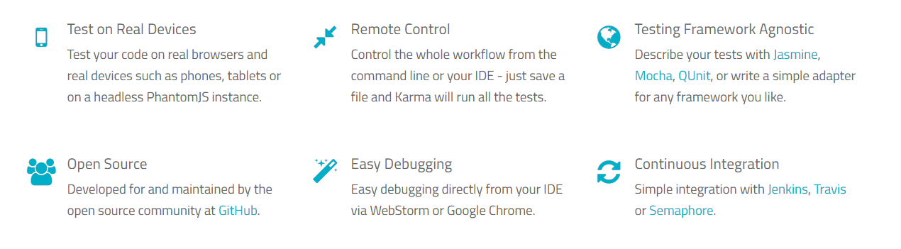
JavaScript Testing Tools
Karma (https://karma-runner.github.io/latest/index.html)

Slide 10
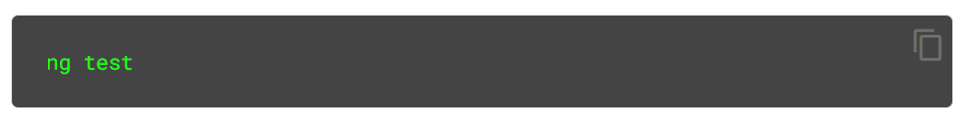
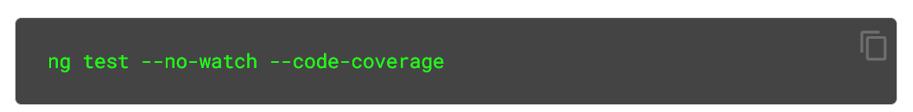
Unit Testing in Angular
https://angular.io/guide/testing

Slide 11
Demo Agenda (maybe)
Angular Things to Test
Components
Directives
Services
Pipes
Also…
Debugging Unit Tests
Code Coverage

Slide 12
Questions
jeremy.edmondson@improving.com

