Slide 1
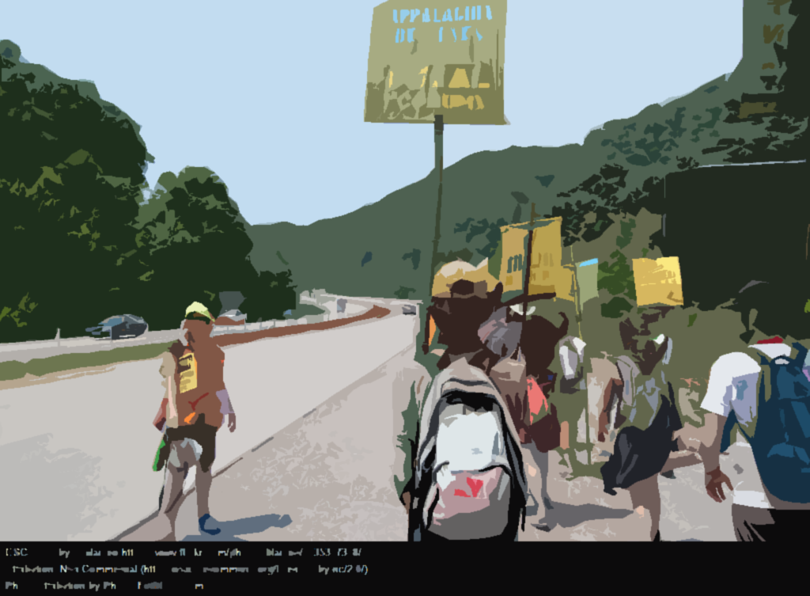
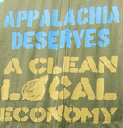

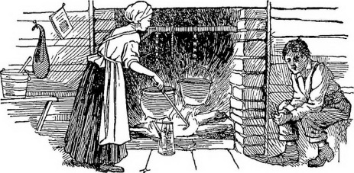
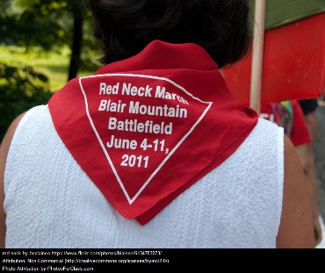
Wearing
The Red Bandana
“These mountaineers have been aptly called our contemporary ancestors. They are modern Robinson Crusoe without his knowledge of civilization. Steeped in ignorance, wrapped in self-satisfaction and complacency, possessed of little or no ambition, little sense of citizenship, little comprehension of law or respect for law, these people present a problem that demands and challenges the attention of thinking men and women.
Miriam Sizer, Hollow Folk, 1933
People came from all over the world to work with local miners at the Blair Mountain coal mines near Matewan, West Virginia. When met with dangerous working conditions, unfair pay and treatment, and brute force from the mine owners, the local and immigrant miners banded together and fought back for themselves and their families. This fight became violent.
https://flic.kr/p/ouQ6Nq
In order to tell fellow workers apart from strike breakers and sheriff's deputies, the miners wore red bandanas around their necks. Hence, the term “red neck.”
To paint these workers in an unflattering light, the story of the “red neck” was intentionally conflated with the (false) narrative of the Appalachian “hillbilly” as backward and unintelligent. At the time, it was seen as necessary for the influence of the “red neck” to be removed in order to make way for progress and industrialization. This conflation lives on in our contemporary culture.
https://www.flickr.com/photos/blaineo/6135317318

Slide 2
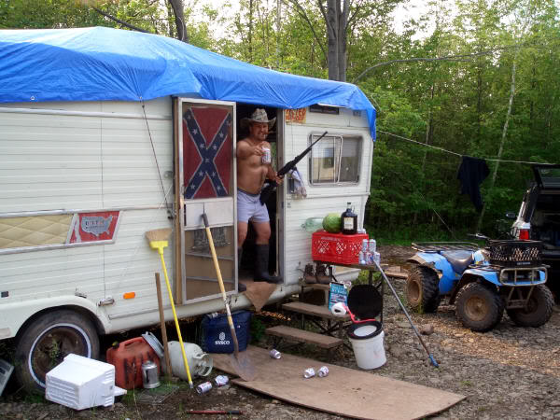
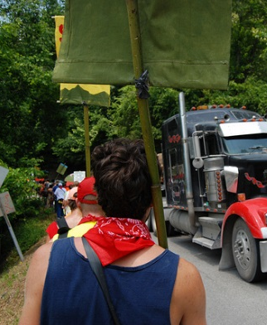
The term “Red Neck” was taken from the people of Appalachia...
We’re taking it back.

“We must stand together;
if we don’t, there will be no victory for any one of us.”
Mary Harris “Mother” Jones
“red neck” means
finding unity in difference for a
common cause.

Slide 3
“The universe is made of stories, not of atoms.”
(Muriel Rukeyser, “The Speed of Darkness”)
When stories are told about us and by us over generations, it is difficult to remember the true roots of these stories. The Social and Emotional Approaches to Teaching and Learning class intentionally utilized mindful and contemplative practices to untangle some of the stories about the people of rural Appalachia.

Add your voice: tweet your own definitions to #redneckredefined

