Slide 1
Overview
ECU – Engine Control Unit
Air/Fuel Ratio, Ignition Timing, Electronic Valve Control, Rev Limit, Turbo Boost
Tuning ECU parameters can substantially increase horsepower
Incorrect tunes can result in permanent vehicle damage or injury/death
Not covered by manufacturer warranty
!!! USE AT YOUR OWN RISK !!!

Slide 2
Pass-through Device
Use cases:
  Manage Diagnostic Trouble Codes (DTC), data logging, emissions and module reprogramming
Commercial: Many available; very expensive; support many protocols and interfaces. SAE J2534 compliant. Requires Windows (DLL).
Open source: N/A; ecuflash/romraider not 100% open. Lacks Linux support. MISS!

Slide 3
J2534 Standards
ISO 9141 – Road Vehicles Diagnostic Systems
ISO 14230 – Keyword Protocol 2000
ISO 11898 – Controller Area Network
ISO 15765 – Diagnostics on CAN
J1850PWM – Mostly used on Ford
J1850VPW – Mostly used on GM

Slide 4
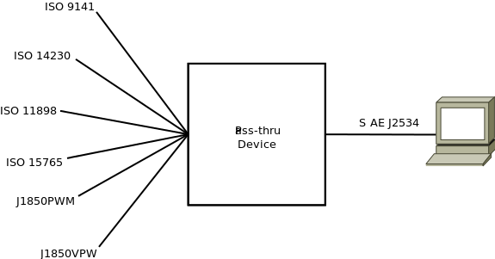
J2534 Illustrated

Slide 5
ISO 15765
Legislated due to US emissions laws
2007+ USDM vehicles
ISO 15765-1: General Information
ISO 15765-2: Network Layer Services
ISO 15765-3: Unified Diagnostic Services on CAN (and commonly OBD)
ISO 15765-4: Emissions Requirements
ISO 14229: Unified Diagnostic Services

Slide 6
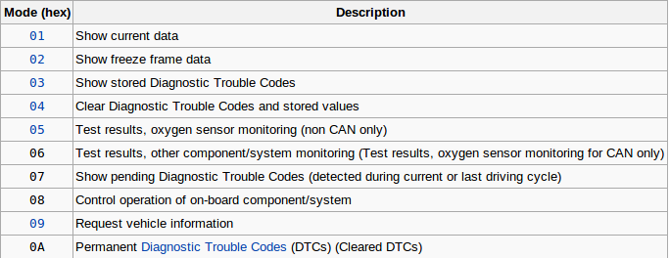
OBD Services
Functional Addresses: $7DF
Response accept range: $7E0 - $7E7
Coolant Temp Request: 7DF#0201050000000000

Slide 7
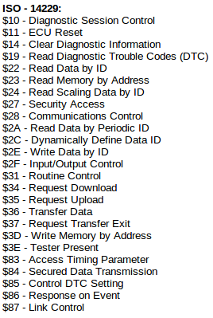
UDS Services
Diagnostic Trouble Code
  Clearing/Reporting
Suspend DTC Logging
Emissions
Read/write memory
On demand testing
Snapshot records
Reflashing/programming

Slide 8
ECU Security
UDS allows optional security mechanisms
UDS defines 33 security levels
Legislated services may not be protected
Typically seed/key authentication method
Seed may be static or dynamic
May implement lock-out features after a number of invalid attempts
Correct key must be passed to enter programming mode

Slide 9
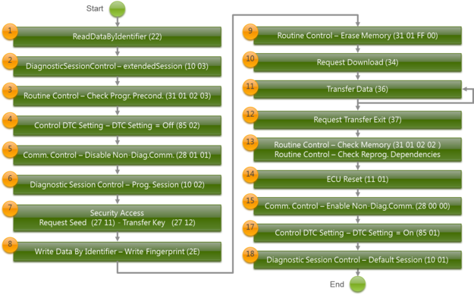
Reprogramming

Slide 10
ecutools
Open source ECU toolkit
Open pass-through device design
Open CAN interface design
Real-time remote tuning and diagnostics via WebSockets (RFC 6455)
Cloud based computing, data logging, archival, reporting, alerting, social integration, and API access
Module reprogramming & bootloaders

Slide 11
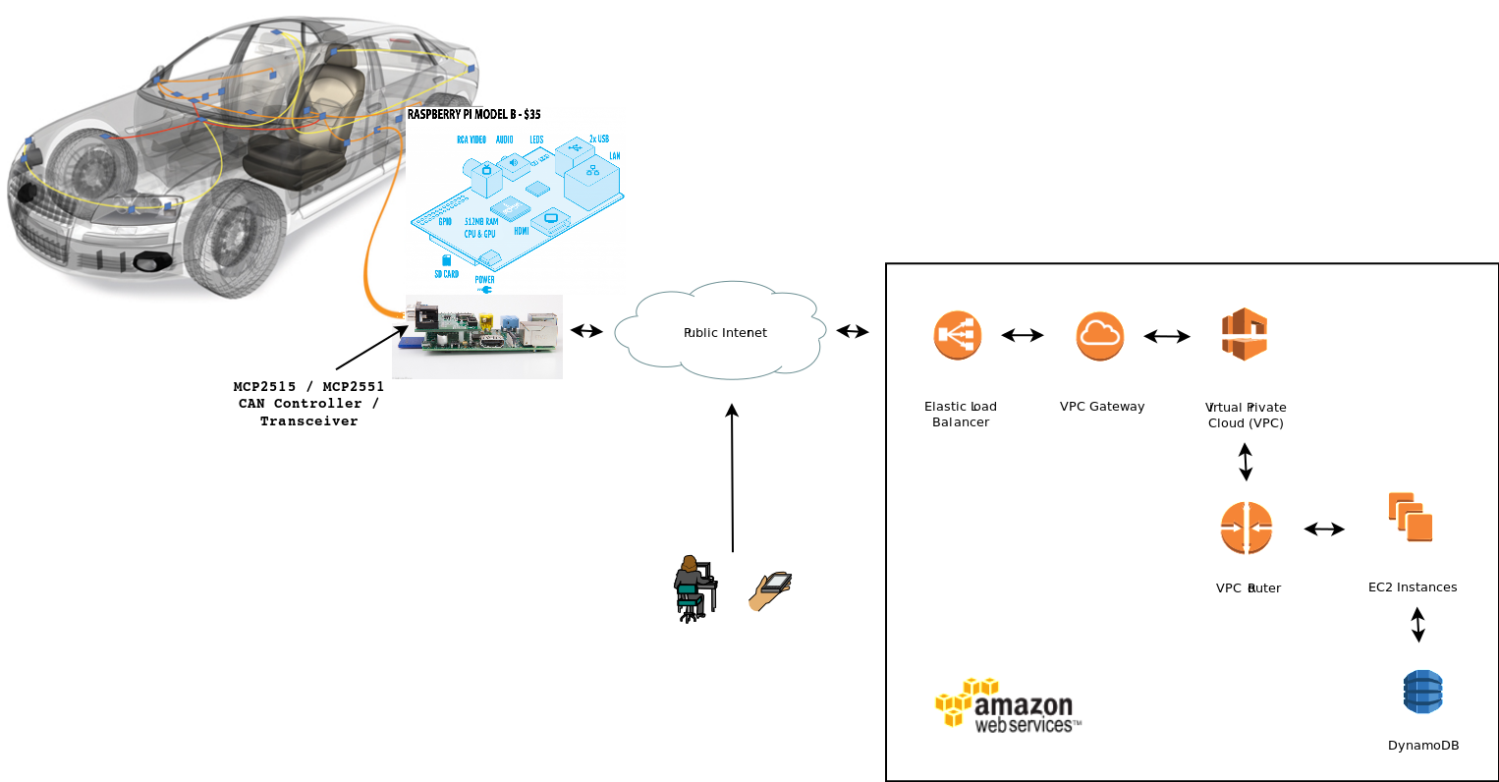
ecutools: Architecture

Slide 12
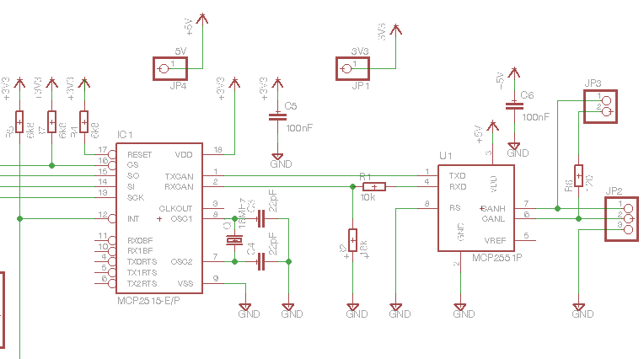
CAN Interface
An example of a simple MCU independent CAN interface

Slide 13
Microcontroller
Communicates via SPI to the MCP2515 CAN controller
Processor needed to implement ISO and SAE pass-through device standards
LAN/WAN interface for remote access via WebSocket protocol
Local storage for data logging and tuning profiles
Anything else you can imagine...

Slide 14
ecusim
ECU simulator
Command Line Interface (CLI)
Supports OBD-II and UDS service PIDs
Provides random and/or scripted responses
Verbose logging of ingress CAN frames
Very helpful while developing and testing client applications

Slide 15
ecudiag
ECU diagnostics
Command Line Interface (CLI)
Reads OBD and UDS diagnostic data (read/clear DTC, clear CEL, view snapshot data, etc)
Low level API; Sending/receiving raw CAN frames
Direct communication with the controller via SocketCAN

Slide 16
ecuprog
ECU Programmer
Command Line Interface (CLI)
Reprograms the ECU using UDS DiagnosticSessionControl programming mode
Requires custom bootloader to download new ROM image
Bootloaders must be written to ECU processor specifications

Slide 17
ecutuned
Microcontroller WebSocket daemon
Multi-user, real-time, cloud based 'tuning sessions' via the internet
OBD / UDS services fully supported
Local and remote data logging
Local and remote administration, configuration, tuning, and diagnostics
Modular design encourages custom integration

Slide 18
ecutools.io
SaaS offering on top of ecutuned
Free & paid subscriptions available
Administer, configure and manage all aspects of the online account, pass-through device, and ECU
Real-time diagnostics, tuning and alerting
Data logging, storage & archival
Reporting and analytics tools
Manage multiple vehicles

Slide 19
CAN Security
Connecting ECUs to public networks raises security concerns
ecutools.io offers SSL encrypted HTTP and WebSocket connections
ecutools.io offers user and network access controls with detailed auditing
ecutools.io offers encrypted data log storage and archival
eutools.io offers sandboxed tuning sessions

Slide 20
Resources
Raspberry Pi:
  http://www.raspberrypi.org
CAN Interface Schematic:
  http://lnxpps.de/rpie
ecutools.io:
  http://ecutools.io
  https://github.com/jeremyhahn/ecutools
Let's connect:
  http://www.linkedin.com/in/jeremyhahn

