Slide 1
Five tools for building successful news applications
Jeremy Bowers
The Washington Post

Slide 2
Don't be a tool.
Use them.

Slide 3
What this is not
  A list of software
  An instruction manual
  Specific to any particular technology

Slide 4
#1: Pick the right projects.

Slide 5


Slide 6
#2: Invest sweat equity.

Slide 7


Slide 8
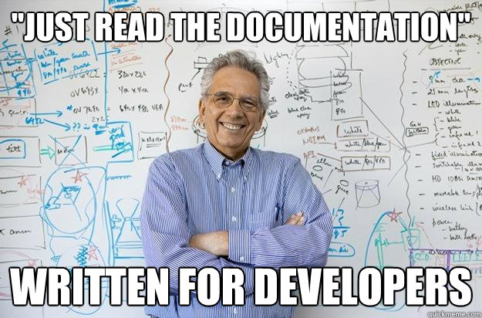

Slide 9
#3: Punch above your weight.

Slide 10
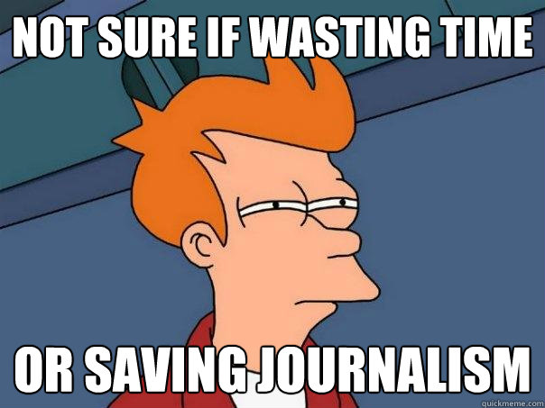

Slide 11
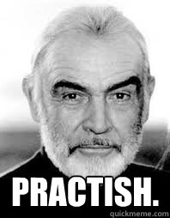

Slide 12
#4: Make unlikely allies.

Slide 13
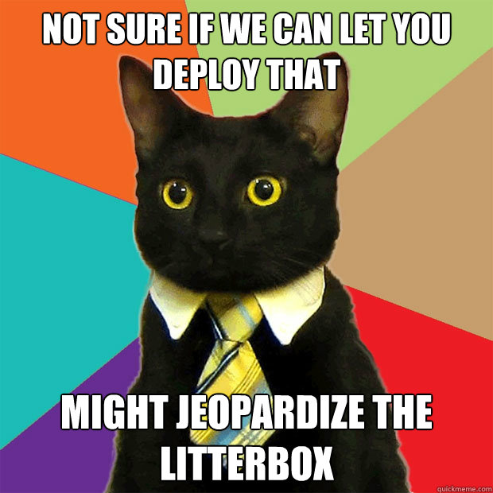

Slide 14


Slide 15
#5: Spread the knowledge.

Slide 16


Slide 17
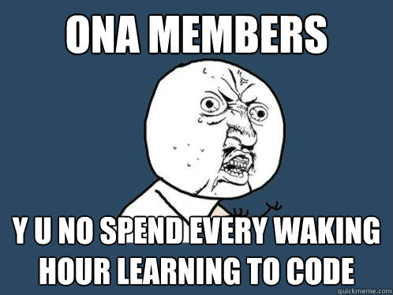

Slide 18
Go build apps.

