Slide 1
For more than a century, the rhythm of America’s seasons has been quietly shifting. Each winter storm and summer downpour carries the imprint of changing climate forces—some natural, others unmistakably shaped by human decisions. From industrial-era pollution that once suppressed rainfall, to modern warming that fuels stronger moisture cycles and more extreme rain events, decades of atmospheric change are written into the long-term rise and fall of seasonal precipitation. By tracing these patterns across regions and through time, we can see how human activity has intertwined with Earth’s natural climate systems, reshaping when, where, and how much rain falls each year.

Slide 2
Since the Industrial Revolution, greenhouse gases have warmed and moistened the atmosphere, allowing winter storms to carry more moisture and produce heavier cold-season precipitation. At the same time, early industrial sulfate pollution suppressed cloud formation in summer, limiting rainfall that would otherwise have increased. As air pollution declined, both winter and summer precipitation began to show clearer signs of strengthening.
Land clearing, farming, and deforestation have altered how the surface stores and releases moisture, reshaping seasonal rainfall patterns. In summer, irrigation can boost humidity and enhance local storms, while over-plowed drylands become hotter and drier, reducing rainfall. In winter, changes to vegetation and soil modify surface energy and moisture, subtly influencing storm tracks and cold-season precipitation.

Slide 3
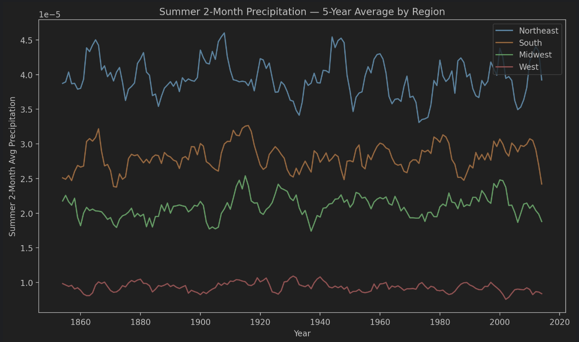
You can see that from 1900 to 1930, industrial emissions were gradually increasing. This period looks a bit “wetter,” but the greenhouse-gas effect was not yet strong or clearly visible. At the same time, sulfate aerosols from industrial areas also started to rise. These aerosols have the opposite effect: they reduce the sunlight reaching the surface and change cloud properties, which tends to suppress summer rainfall.
You can see that around the 1930s, the summer rainfall in the Midwest and the South dropped sharply. This was the famous Dust Bowl drought. It was a classic case of “human land use + climate” working together. Because of over-farming and poor agricultural practices — especially during the Great Depression when land was abandoned — the soil structure broke down, dust storms formed, rainfall decreased, and the region fell into years of severe drought. But after the New Deal introduced policies like the Soil Conservation Act and the Soil Conservation Service, rainfall and climate gradually recovered.
In the 1950s, there was another major drought, along with the peak of industrial pollution. Around this time, summer rainfall in the South, the West, and parts of the Midwest dropped again. After World War II, industrial emissions and sulfate aerosols from coal power plants rose quickly, forming a heavy pollution belt over the eastern and midwestern U.S. Studies show that these aerosols created a clear “drying effect” in summer and fall, which partly cancelled out the rainfall increase that greenhouse gases would normally cause — especially in the Southeast and South. At that time, there were no air-quality regulations, so large amounts of SO₂ and other pollutants were freely released.

Slide 4
