Slide 1
Apogee Simulation Architecture
Developed by:
Jeremy Jestel

Slide 2
Tech Stack

Slide 3
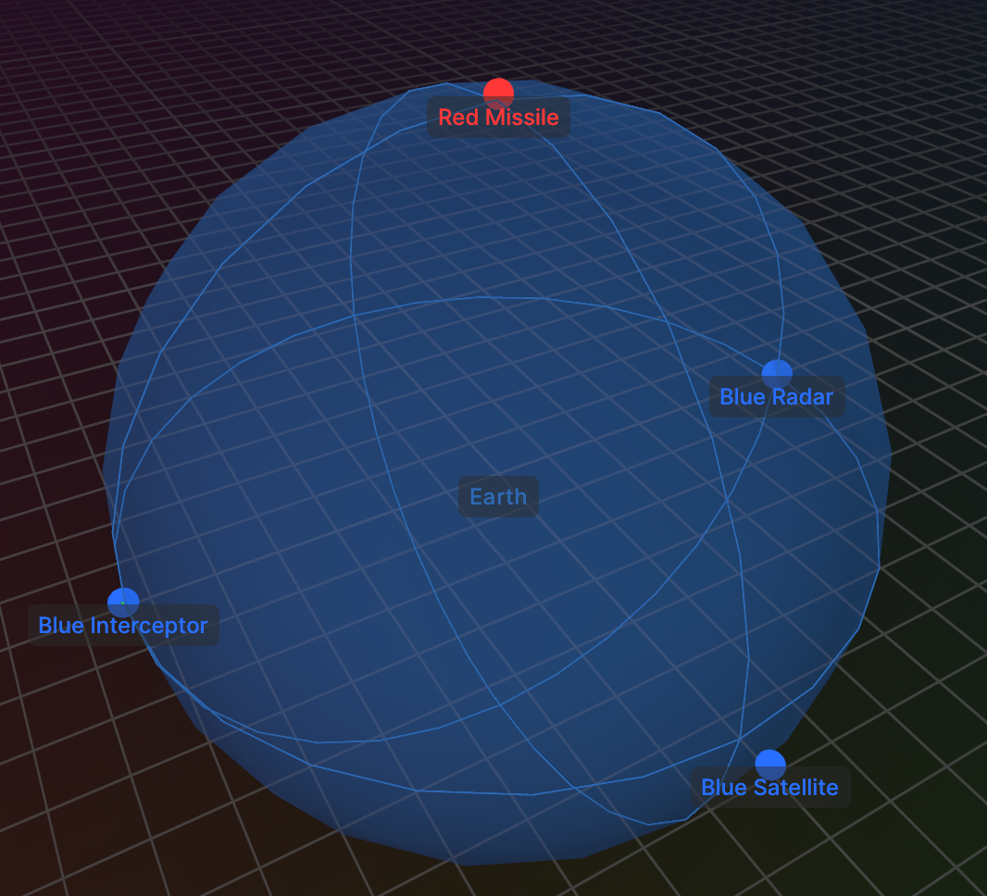
Purpose
Apogee enables high fidelity simulation of missile interception scenarios with a modular framework of systems. Simulations can be adjusted and run using the simple GUI powered by Rerun.io and Matplotlib

Slide 4
Entities
Satellite
The blue satellite orbits the earth in a known trajectory
Missile
The red missile launches from land and navigates to the predetermined point of collision with the blue satellite
Radar
The blue radar tracks the missile as it enters its coverage area and queues the interceptor
Interceptor
The blue interceptor is launched from the surface and guides itself to intercept the missile

Slide 5
Satellite Systems

Slide 6
Missile Systems

Slide 7
Radar Systems

Slide 8
Interceptor Systems

