Slide 1
Apogee Progression

Slide 2
Idea
Thought is to have two slides for each capability new feature, one explaining what it is and its significance
Another explaining difficulties in developing it, resources used and developer reflections

Slide 3
Simulation Architecture

Slide 4
Main Sim Loop
Create Entities from scenario saved or from manually changing parameters
Loop through all timesteps
  Loop through all entities
    System.Update() (Sensors, Guidance, Estimation, Controls)
    Each system has if statements to decide which models and functions to use to get its outputs
    System.Log() (Telemetry)
    System.Step() (Motion)
    Update Global time

Slide 5
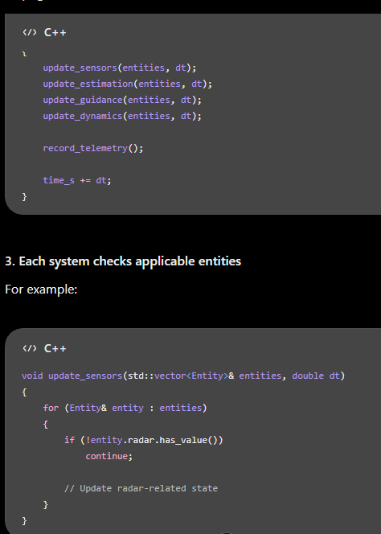
Hierarchy
Entities are the top level objects with components that have state with systems which manipulate that state
Entities have initial state and optional list of components, (kinematics, radar, guidance)
Similar to work project, have standalone function for each component update, loops entities and if entity has that component then execute that string of updates, further customization done there via if entity.motion_model.orbital, call system that takes in current kinematic state and control and outputs the new state with just math

Slide 6
Coordinate Systems And Transforms

Slide 7
Feature Description
Different systems care about different coordinates
Choosing the right makes calculations more useful for specifica cases

Slide 8
Developer Notes
ECI versus ECEF
ENU versus NED
Since only 3 DOF assumption is pointing and velocity vector are same, important for prop nav and radar
Kinematic State

Slide 9
Missile Guidance With LOS

Slide 10
Feature Description

Slide 11
Developer Notes
What is the default coordinate structure for calculations
Seems to be R vec of ECEF XYZ works, maybe use a NED coords for local
Best way to do the lin alg math for easy vector manipulation in C++

Slide 12
Missile Guidance Without LOS

Slide 13
Feature Description

Slide 14
Developer Notes

Slide 15
Radar Tracking

Slide 16
Feature Description

Slide 17
Developer Notes

Slide 18
Satellite orbit

Slide 19
Feature Description

Slide 20
Developer Notes

Slide 21
C++ Structure

Slide 22
Feature Description

Slide 23
Developer Notes
Using C++ Eigen to do Matlab adjacent vector calculations
Established an apogee namespace to centralize math lin alg types
Creating an apogee namespace
What is the bounds of what should be in namespace?

Slide 24
Problems Overcome

Slide 25
Earth Occlusion of LOS
How do I calculate whether or not 2 bodies (points) have LOS or are occluded by the earth using lin alg?
Pointing Vector is d = B-A
Treat vector pointing A to B is D(t) = ||A + td||
Minimizing the square has simpler math properties, would have to use chain rule without square
D^2(t)= A dot A + 2t (A dot d) + t^2 (d dot d) Squaring norm is same as dotting norm with self
d/dt D^2’(t) = 2t (d dot d) + 2 (A dot d)
0 = 2t (d dot d) + 2 (A dot d)
-(A dot d)= t(d dot d) Can do division because dot products are scalar output
t = - (A dot d) / ||d||^2 d dot d is a norm squared
Can then calculate that point and if its norm is < radius of earth then no LOS

Slide 26
Misc Loose Ends

Slide 27
Coding
Const Expr

Slide 28
Development References

Slide 29
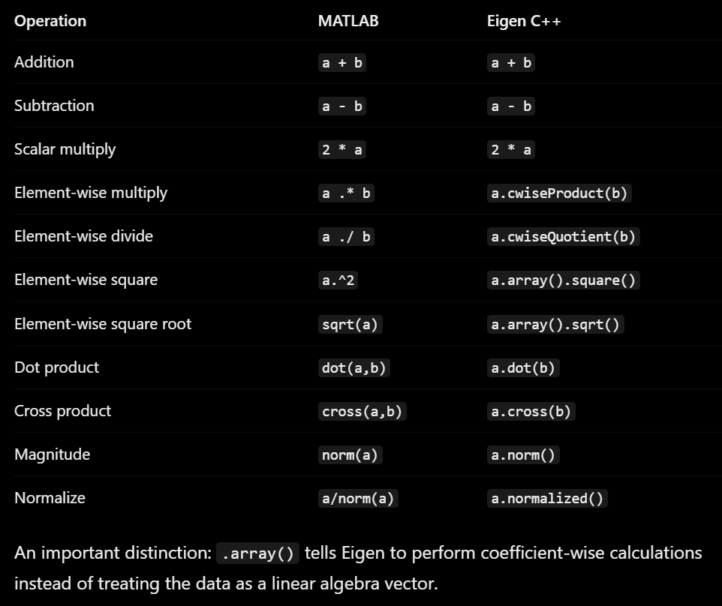
Eigen Syntax

