Slide 1
JavaScript VM in Coq
Jeremy Johnston
Vipul Puntambekar
Yangfan Xu
Amruta Parulekar
Supervisor:
Dr. Kevin Hamlen
17 October 2012

Slide 2
JavaScript
Programming language of the Web.
A Scripting Language which conforms to ECMASCRIPT 3 language standards.
Features similar to other languages
Functional Languages
Imperative Languages
Prototype Based Languages
Designed to be Dynamic
Weakly Typed Language

Slide 3
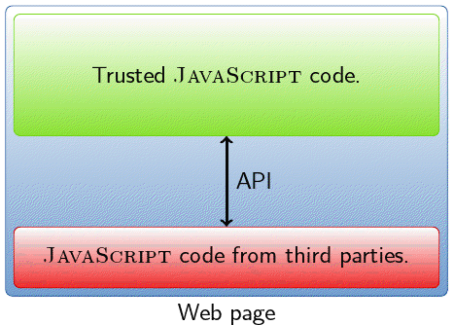
How it works on the Web
Secret Data Compromised
Martin Bodin M2 ENS LYON. A Certified JavaScript Interpreter] June 2012

Slide 4
Motivation
Need for a Formal Analysis of JavaScript
No Formal Investigation of full core language on the scale defined by informal ECMA specification
Detect security vulnerability
Cross Site Scripting Vulnerability
Browser and Plugin Coding Errors
Will prove as a basis for analyzing other real world scripting language like JSON, jQuery, CoffeeScript,etc.

Slide 5
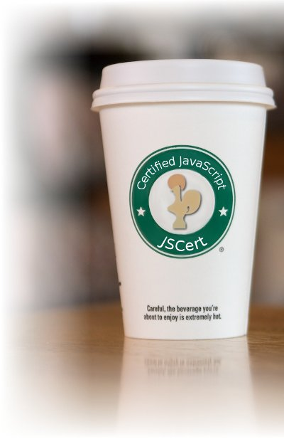
JSCert
JSCert project aims to build models of JavaScript in the Coq proof assistant and to design automated tools based on those semantics.
This project is an ongoing collaboration between INRIA and Imperial College.
[http://www.jscert.org]

Slide 6
JSCert’s Feature
Be able to handle with most challenging JavaScript features, including
Prototype inheritance.
Interplay between scoping rules and ‘with’ statement.
Separation logic to provide tractable reasoning about JavaScript code
Establish natural layers of abstraction on top of basic reasoning
With principled code – stay within these layers of abstraction and the reasoning is straightforward.
With arbitrary code – break open the appropriate abstraction layers until re-establish the invariants of the abstraction.
[P. Gardner, S. Maffeis, and G. Smith. POPL 2012]

Slide 7
JSCert’s Operational Semantics
Semantics of JSCert follows closely the small-step JavaScript semantics
In small-step semantics, the subterm in evaluation position is reduced step by step and these transitions are reected at the top level.
The semantics has two main parts: that one-step evaluation relations for the three main syntactic categories of the language, and definitions for all of the native objects that are provided by an implementation.
Also, JSCert deﬁnes a big-step operational semantics for a large subset of JavaScript that represents faithfully the inheritance, prototyping and scoping mechanisms described in the ECMAScript 3 standard
In big-step semantics, a term is directly related to its result, and the behavior of a term is expressed in terms of the behavior of its subterms.
[S. Maffeis, J.C. Mitchell, and A. Taly. APLAS 2008]
[A. Charguéraud. Pretty-Big-Step Semantics. Submitted October 2012]

Slide 8
Martin Bodin
Proposed future works:
Making a modular interpreter for varying standards
Add exceptions and error handling using Pretty-Big-Step semantics
Defining a bytecode for JavaScript, similar to ActionScript
Analysis of and implementing the eval function
Implementing type conversion
[M. Bodin. MS ENS LYON 2012]
[A. Charguéraud. Pretty-Big-Step Semantics. Submitted October 2012]

Slide 9
The eval function
Takes in any string representing a JavaScript expression, and tries to evaluate or execute the expression
The expression could be an entire program in its own right!
A call to eval runs within the same lexical and variable environment as the environment in which it was called
[Ecma-262 version 5.1]

Slide 10
The eval function
Bodin proposes parsing with CAML, and making a Coq Verifier, referencing techniques of CompCert
Gardner addresses simple eval but largely leaves it untouched, referencing Charlton and Reus for future work on complex eval
Yet eval is used in upwards of 69% analyzed codebases
[Bodin. MS ENS LYON 2012]
[P. Gardner, S. Maffeis, and G. Smith. POPL 2012]
[G. Richards, C. Hammer, B. Burg, and J. Vitek. ECOOP 2011]

Slide 11
References
M. Bodin. “A Certified JavaScript Interpreter”. M2 ENS Lyon. June 2012.
A. Chargueraud. “Great-Step Semantics”. 2012.
A. Chargueraud. “Pretty-Big-Step Semantics”. Submitted October 2012.
P. A. Gardner, S. Maffeis, and G. D. Smith. “Towards a program logic for
JavaScript”. In POPL ’12. ACM, 2012.
S. Maffeis, J. C. Mitchell, A. Taly. “An operational semantics for JavaScript”. In: Ramalingam, G. (ed.) APLAS 2008. LNCS, vol. 5356, pp. 307–325. Springer, Heidelberg 2008.
G. Richards, C. Hammer, B. Burg, and J. Vitek. “The Eval that Men Do -- A Large-scale Study of the Use of Eval in JavaScript Applications”. In Proc. 25th European Conference on Object-Oriented Programming, ECOOP ’11, LNCS. Springer-Verlag, July 2011.
ECMA-262 v5.1 via http://www.ecma-international.org/publications/standards/Ecma-262.htm
JSCert site at http://www.jscert.org
W3 School’s JavaScript tutorial at http://www.w3schools.com/js/default.asp

