Slide 1
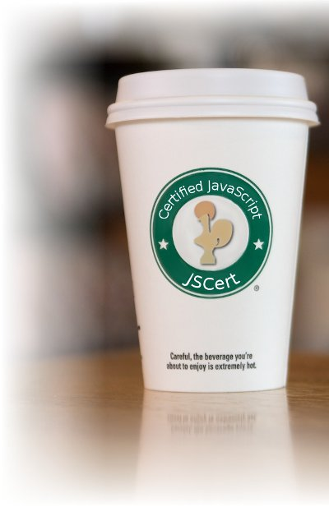
JSCert
JSCert project aims to build models of JavaScript in the Coq proof assistant and to design automated tools based on those semantics.
This project is an ongoing collaboration between INRIA and Imperial College.

Slide 2
JSCert’s Feature
Be able to handle with most challenging JavaScript features, including
Prototype inheritance.
Interplay between scoping rules and ‘with’ statement.
Separation logic to provide tractable reasoning about JavaScript code
Establish natural layers of abstraction on top of basic reasoning
With principled code – stay within these layers of abstraction and the reasoning is straightforward.
With arbitrary code – break open the appropriate abstraction layers until re-establish the invariants of the abstraction.
P. Gardner, S. Maffeis, G. D. Smith. Towards a Program Logic for JavaScript. Proc. of POPL '12. 2012.

Slide 3
JSCert’s Operational Semantics
Semantics of JSCert follows closely the small-step JavaScript semantics
In small-step semantics, the subterm in evaluation position is reduced step by step and these transitions are reected at the top level.
The semantics has two main parts: that one-step evaluation relations for the three main syntactic categories of the language, and definitions for all of the native objects that are provided by an implementation.
Also, JSCert deﬁnes a big-step operational semantics for a large subset of JavaScript that represents faithfully the inheritance, prototyping and scoping mechanisms described in the ECMAScript 3 standard
In big-step semantics, a term is directly related to its result, and the behavior of a term is expressed in terms of the behavior of its subterms.
S. Maffeis, J.C. Mitchell, and A. Taly. An operational semantics for
JavaScript. In Proc. of APLAS’08, LNCS, 2008.
A. Charguéraud. Pretty-Big-Step Semantics. Submitted 2012.

