Slide 1
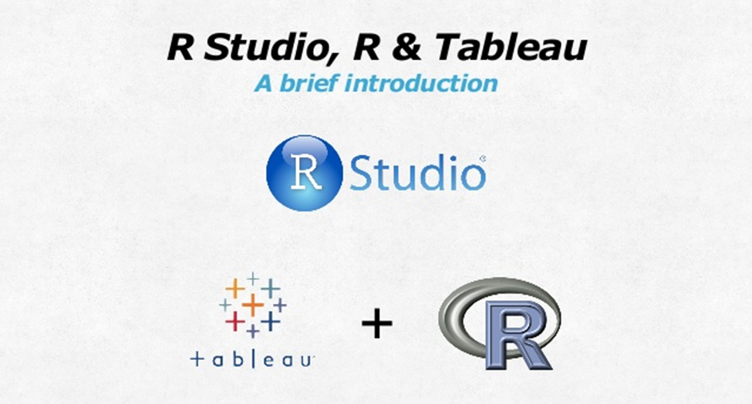

Slide 2
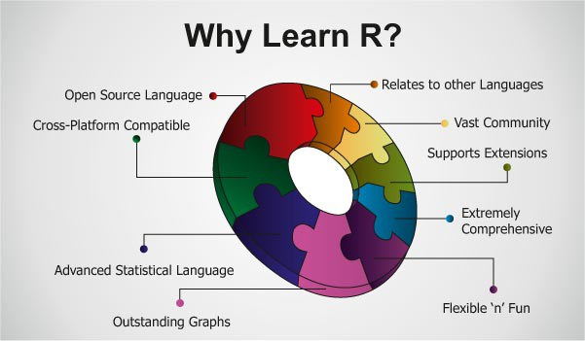

Slide 3
What is R?
The facts:
R is a language and environment for statistical computing and graphics
Freely available and maintained by volunteers
R is extensible; can be expanded by installing “packages”
How to get it:
http://www.r-project.org/ (or Google “Download R”)
Available for Windows, Mac, Linux
Free to install, no catches
Also highly recommended:
R Studio: a free IDE for R
http://www.rstudio.com/
If you install R and R Studio, then you only need to run R Studio

Slide 4
Installing R
R must be installed on your system! If it is not, go to www.cran.r-project.org
Click on
Windows > base > R-version-win32.exe > Run
and follow the instructions to install the programme

Slide 5
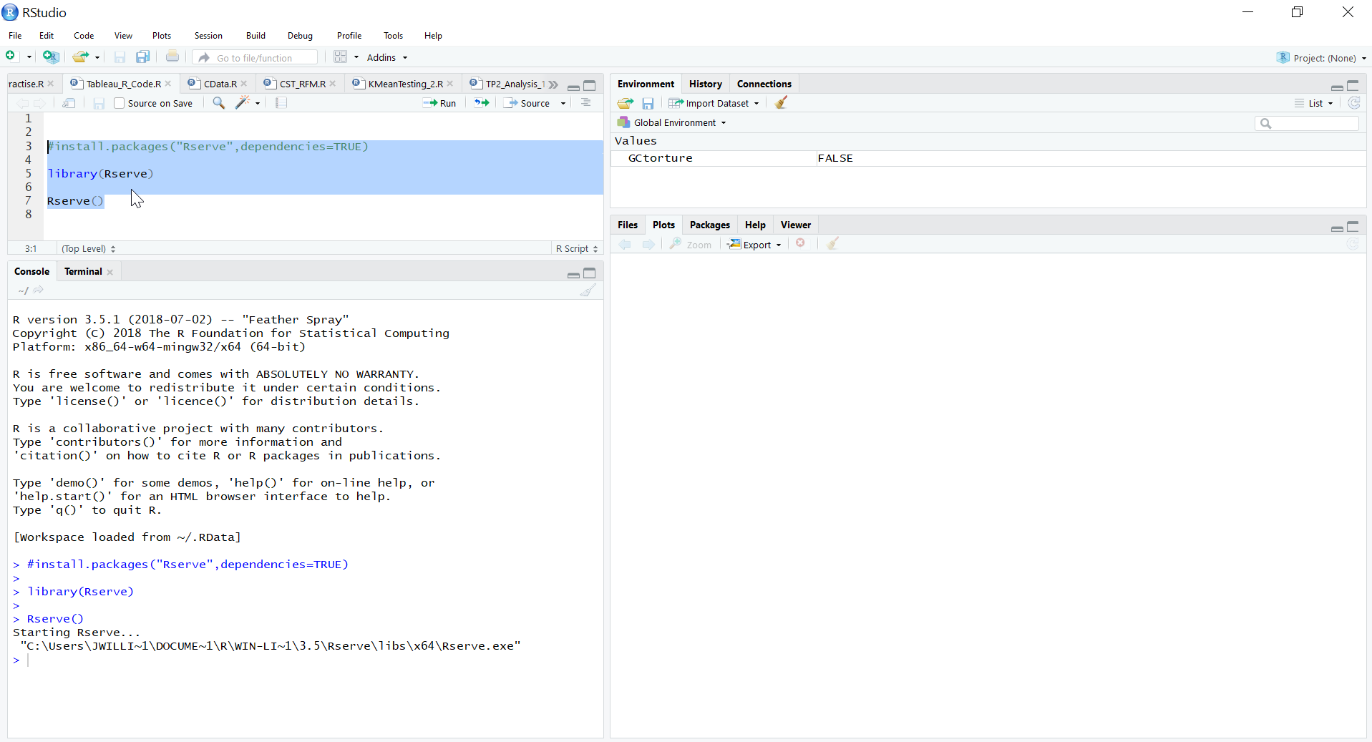
RStudio screen

Slide 6


Tableau and R
What are the benefits of using Tableau and R?
Access R packages or functions for quantitative analysis
Take advantages of Tableau's data visualization capacities

Slide 7
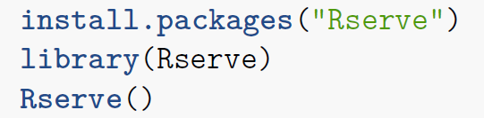

Tableau and R Integration
How is Tableau integrating with R?
Install Rserve Package
Create Calculation Field in Tableau
Use one of the four functions:
SCRIPT_BOOL: Return a Boolean
SCRIPT_INT: Return an Integer
SCRIPT_REAL: Return a Real
SCRIPT_STR: Return a String
Input Data
Pass R Script and Data into R
Rserve
Output Data
Interactive Data Visualization

Slide 8
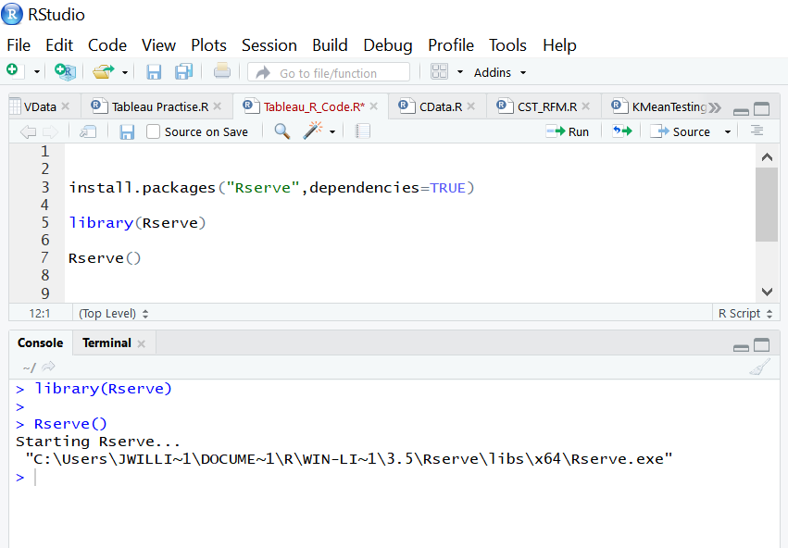


Rserve Package
Very Important!
Remember to keep Rstudio open to use Rserve in Tableau.

Slide 9
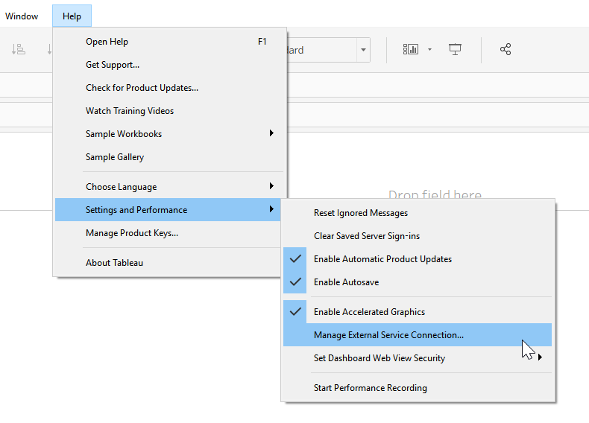
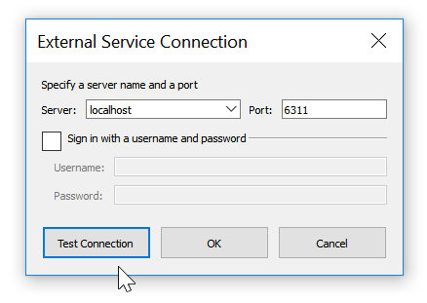
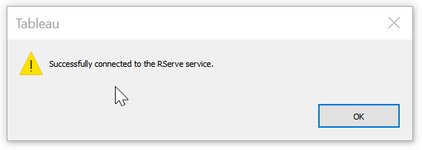
Tableau (1)
Go to Help -> Setting and Performance -> Manage External Server Connection and set it.
Make sure you choose "localhost" and test it. That's all.

Slide 10
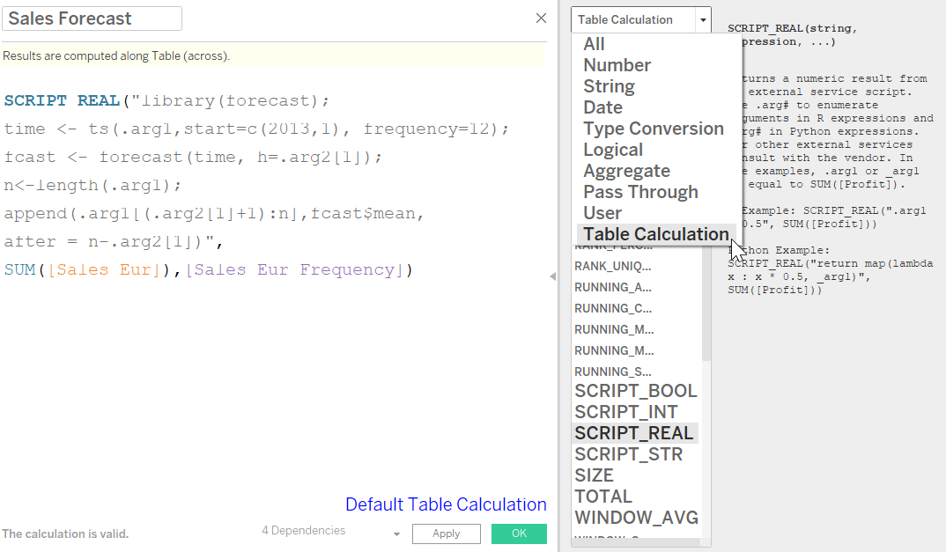
Tableau (2)

Slide 11
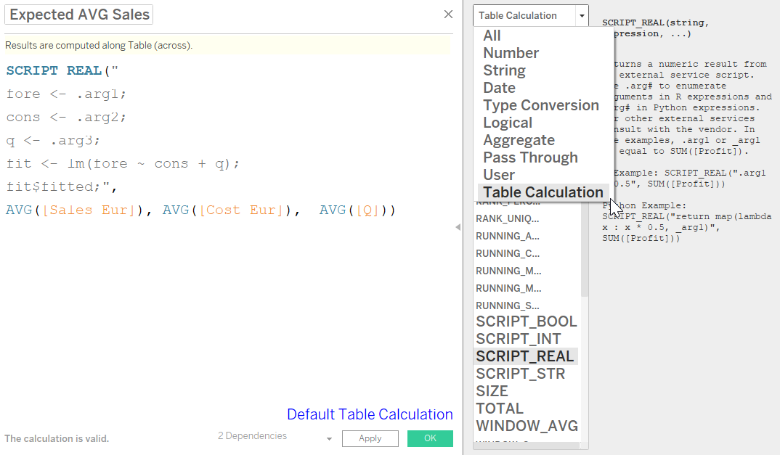
Tableau (3)

Slide 12
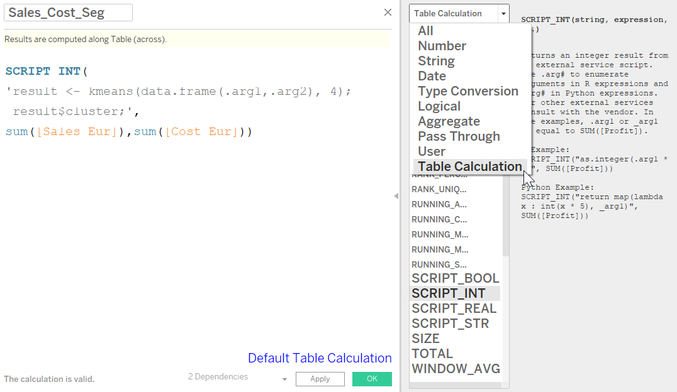
Tableau (4)

Slide 13
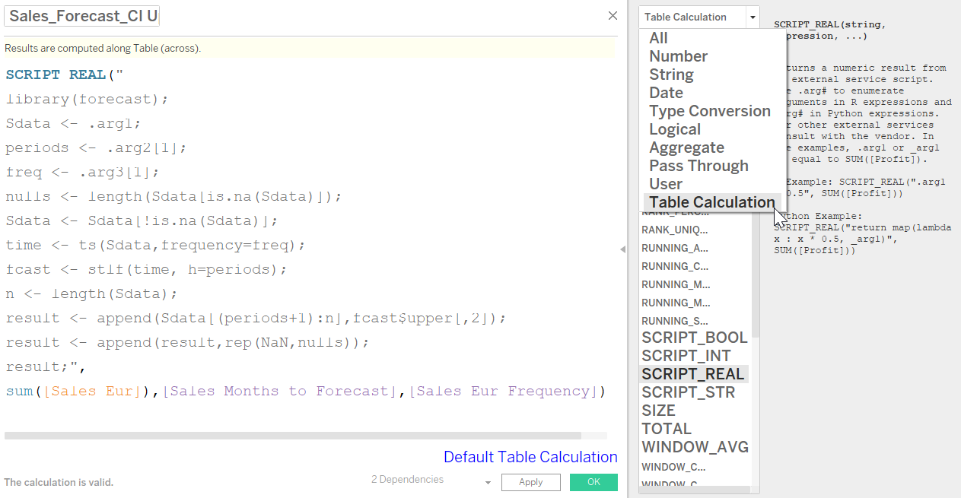
Tableau (5)

Slide 14
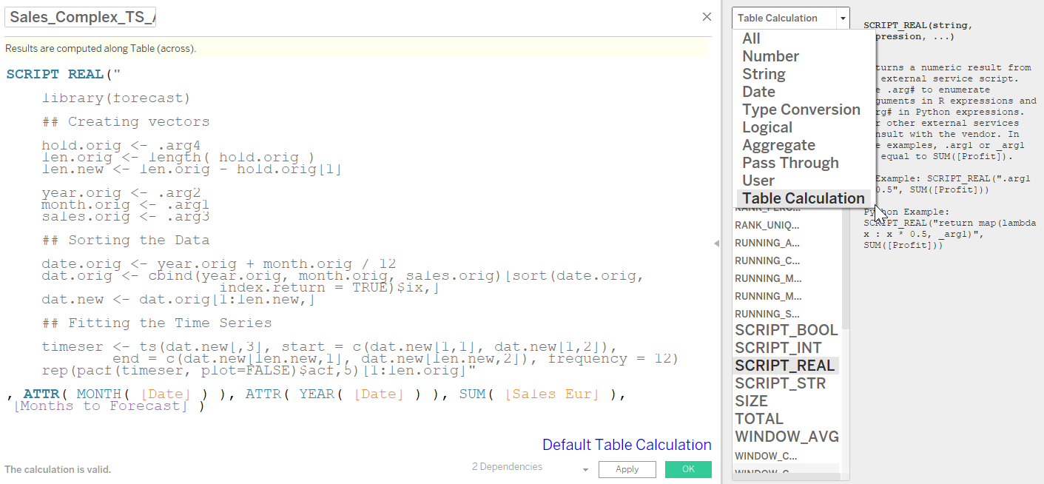
Tableau (6)

Slide 15
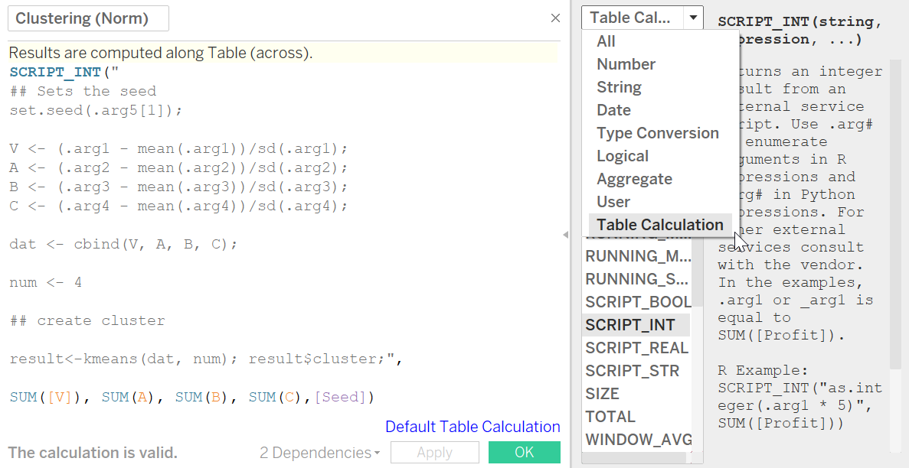
Tableau (7)

Slide 16
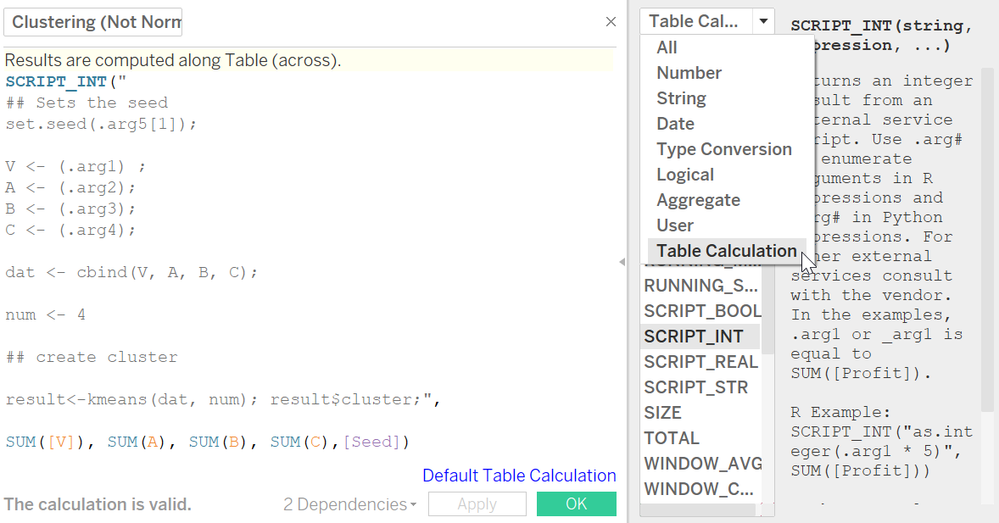
Tableau (8)

Slide 17
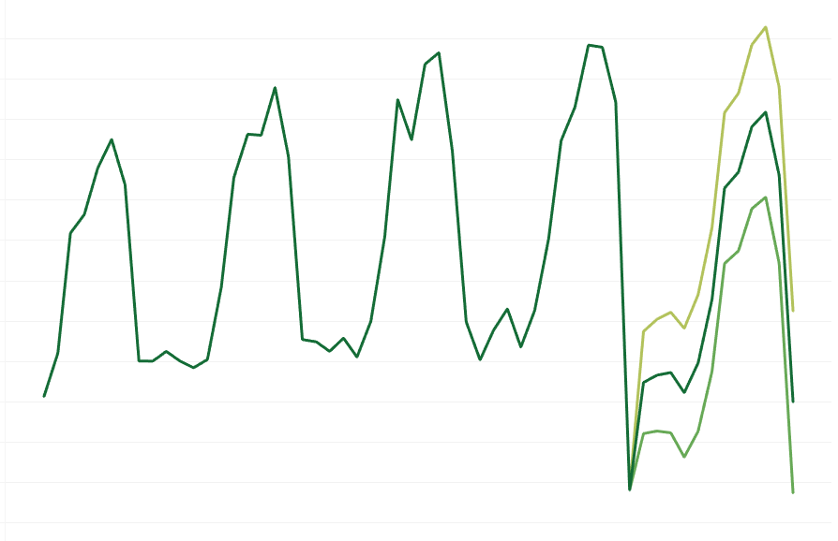
Tableau (9)

Slide 18
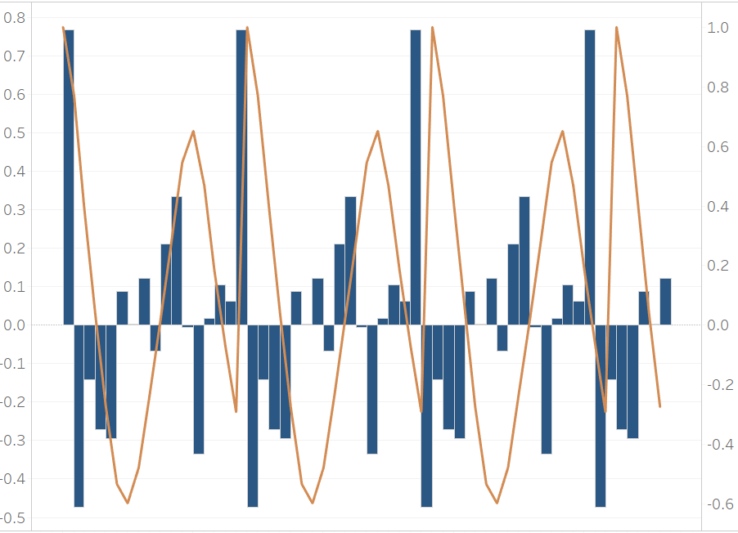
Tableau (10)

Slide 19
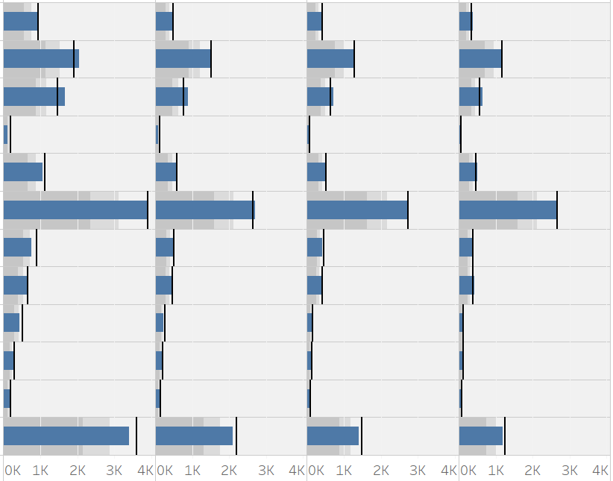
Tableau (11)

Slide 20
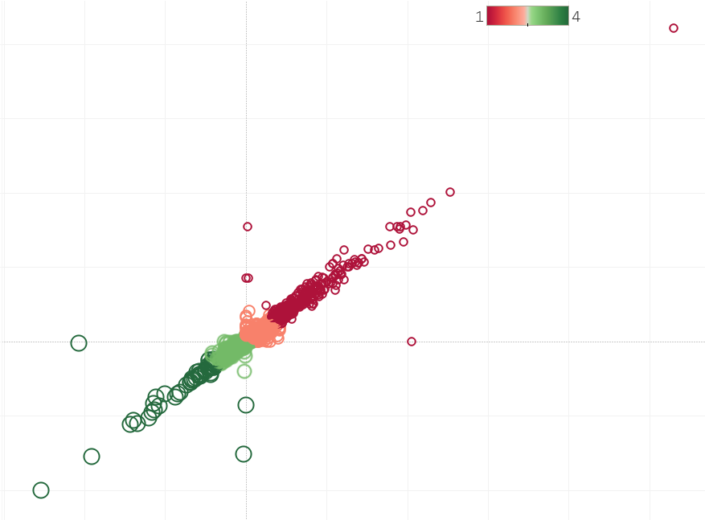
Tableau (12)

Slide 21
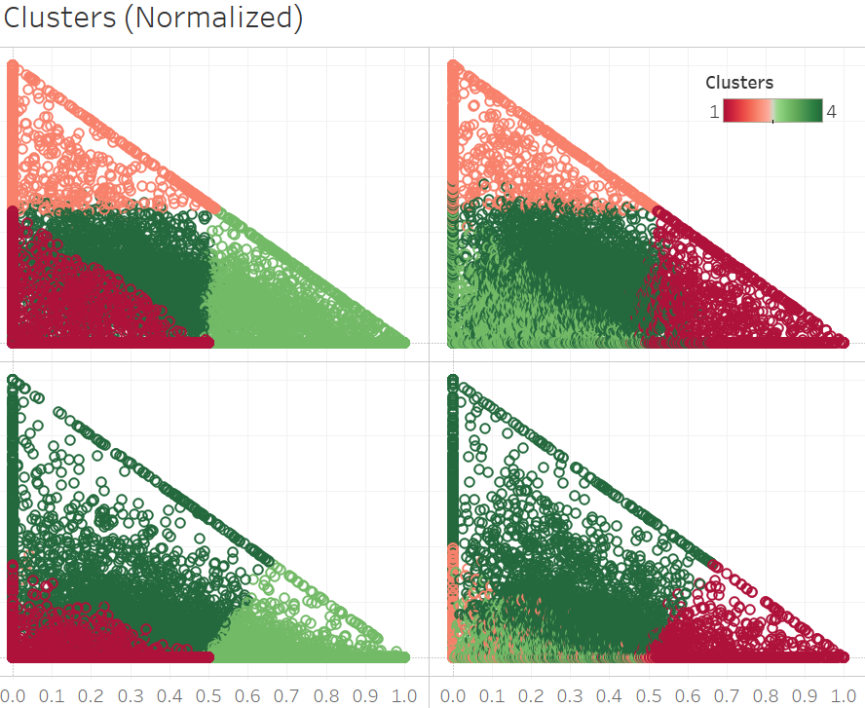
Tableau (13)

Slide 22
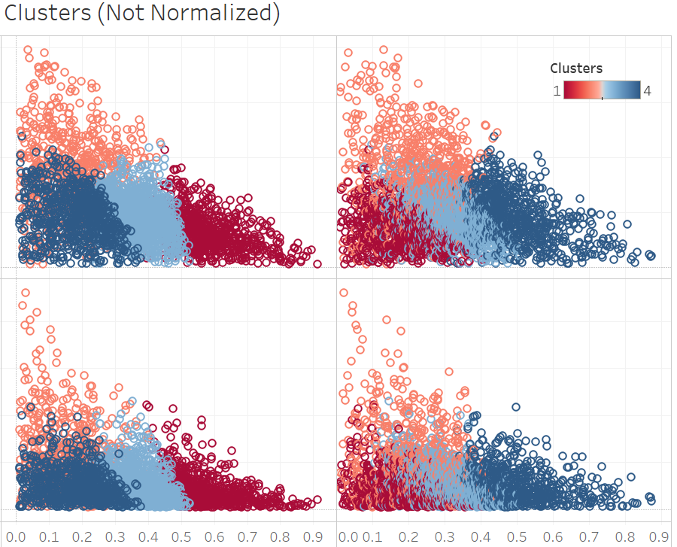
Tableau (14)

Slide 23
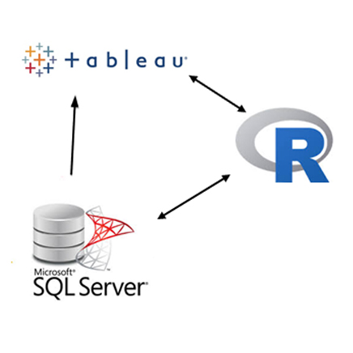
Tableau + R + MS SQL Server

Slide 24


