Slide 1
The problem with standard simulations
Chong, Saglam, and Zuckerman, Curr. Opin. Struct. Biol., 2017.

Slide 2
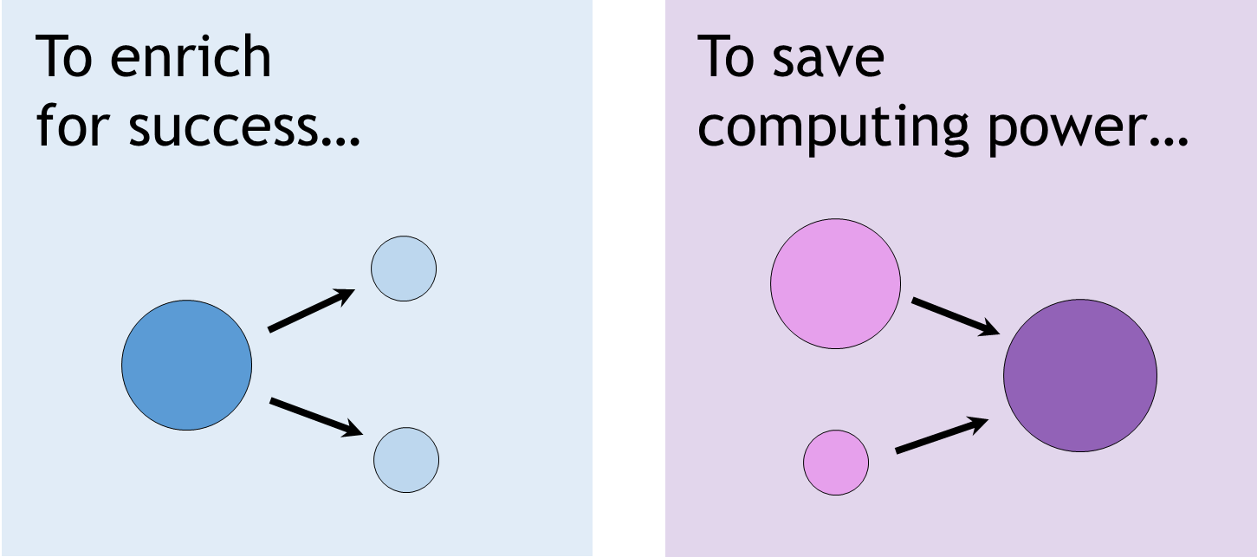
Weighted ensemble MD focuses on transitions
Resampling procedure
von Neumann & Ulam “splitting strategy” (1950s)
Huber & Kim, Biophys. Journal (1996)
Zuckerman & Chong, Ann. Rev. Biophys. (2017)
Generates unbiased, continuous pathways and rates with orders of magnitude less computing than standard MD.
Efficiency scales exponentially with the barrier.

Slide 3

How does resampling work?
τ = 100 ps
time = 0 ps
flux $=\frac{p_{target}}{τ}$
Run MD
probability =
progress coordinate

Slide 4
τ = 100 ps
time = τ
flux = 0
probability =
progress coordinate

Slide 5
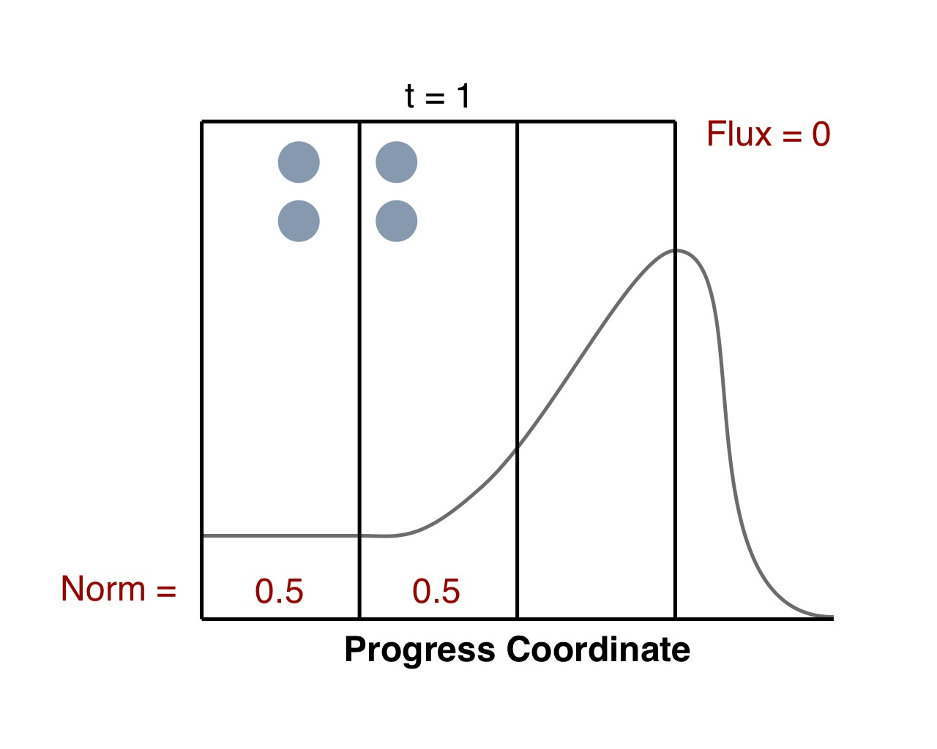
τ = 100 ps
time = τ
flux = 0
Run MD
probability =
progress coordinate

Slide 6
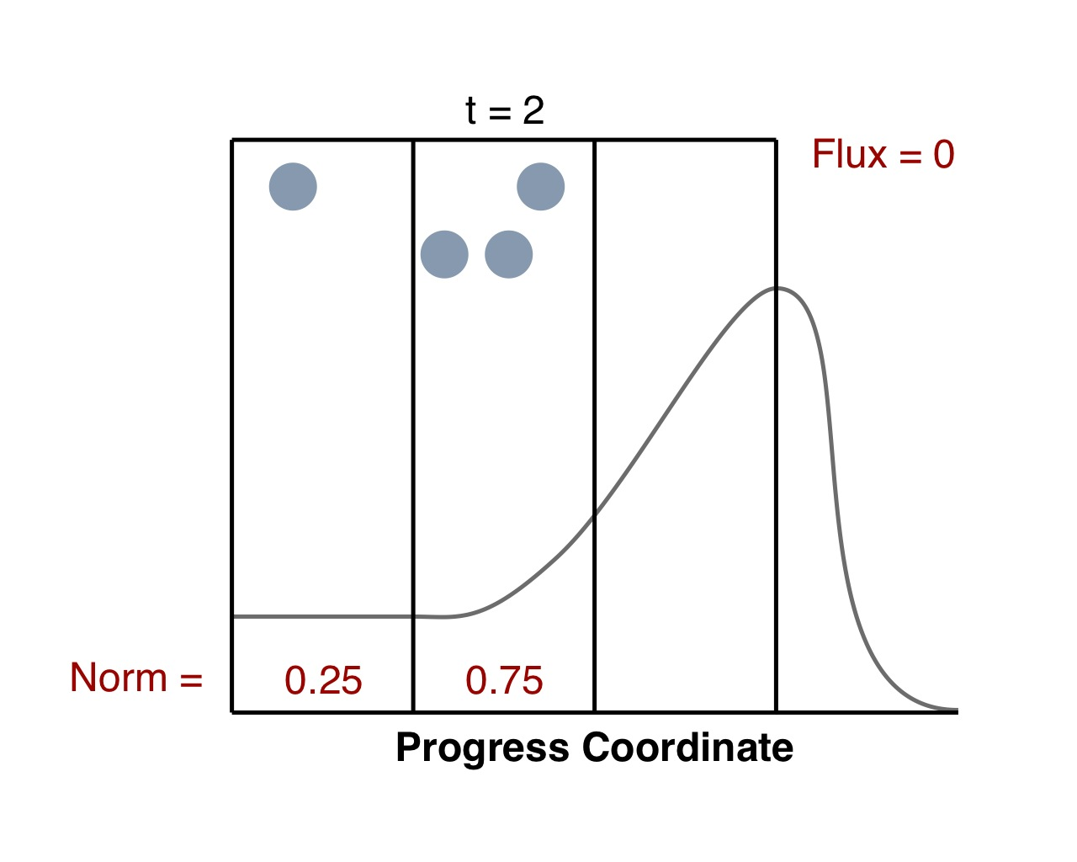
τ = 100 ps
time = 2τ
flux = 0
probability =
progress coordinate

Slide 7
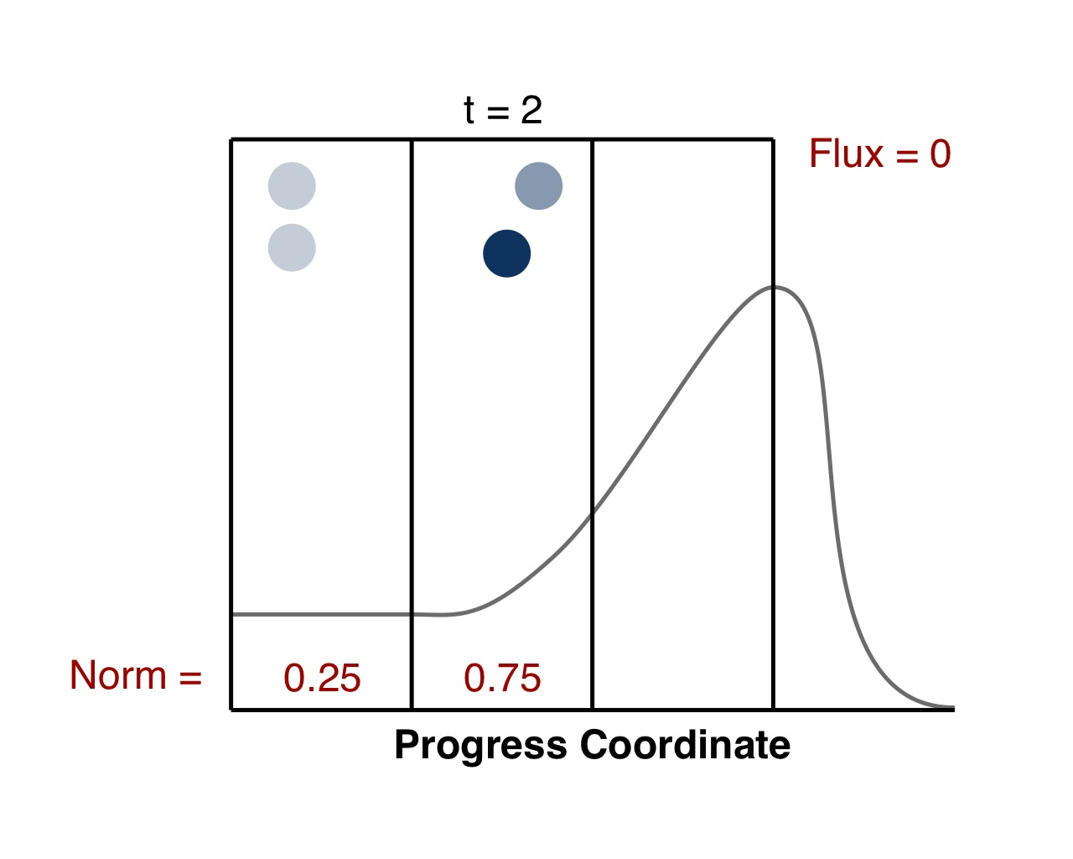
τ = 100 ps
τ = 200 p
time = 2τ
flux = 0
Run MD
probability =
progress coordinate

Slide 8
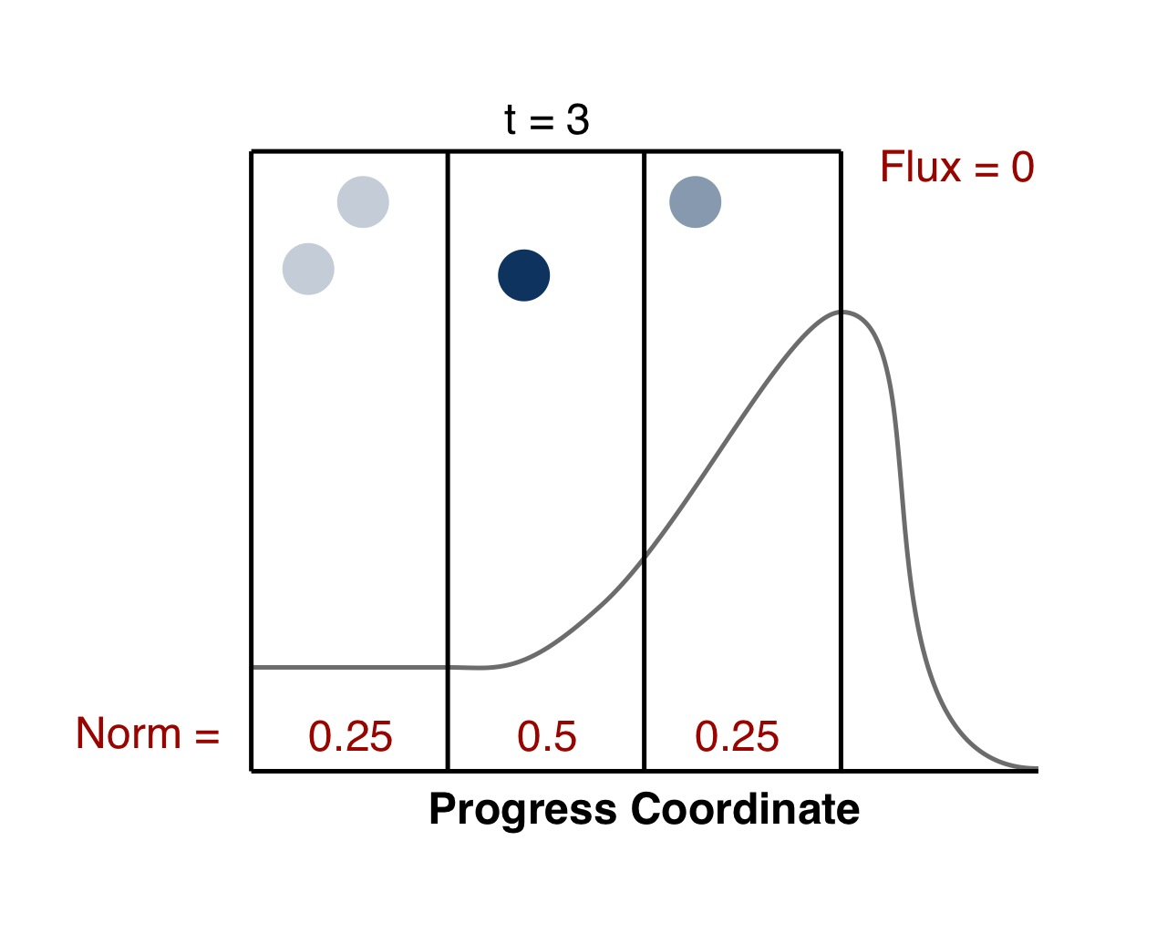
τ = 100 ps
τ = 300 ps
time = 3τ
flux = 0
probability =
progress coordinate

Slide 9
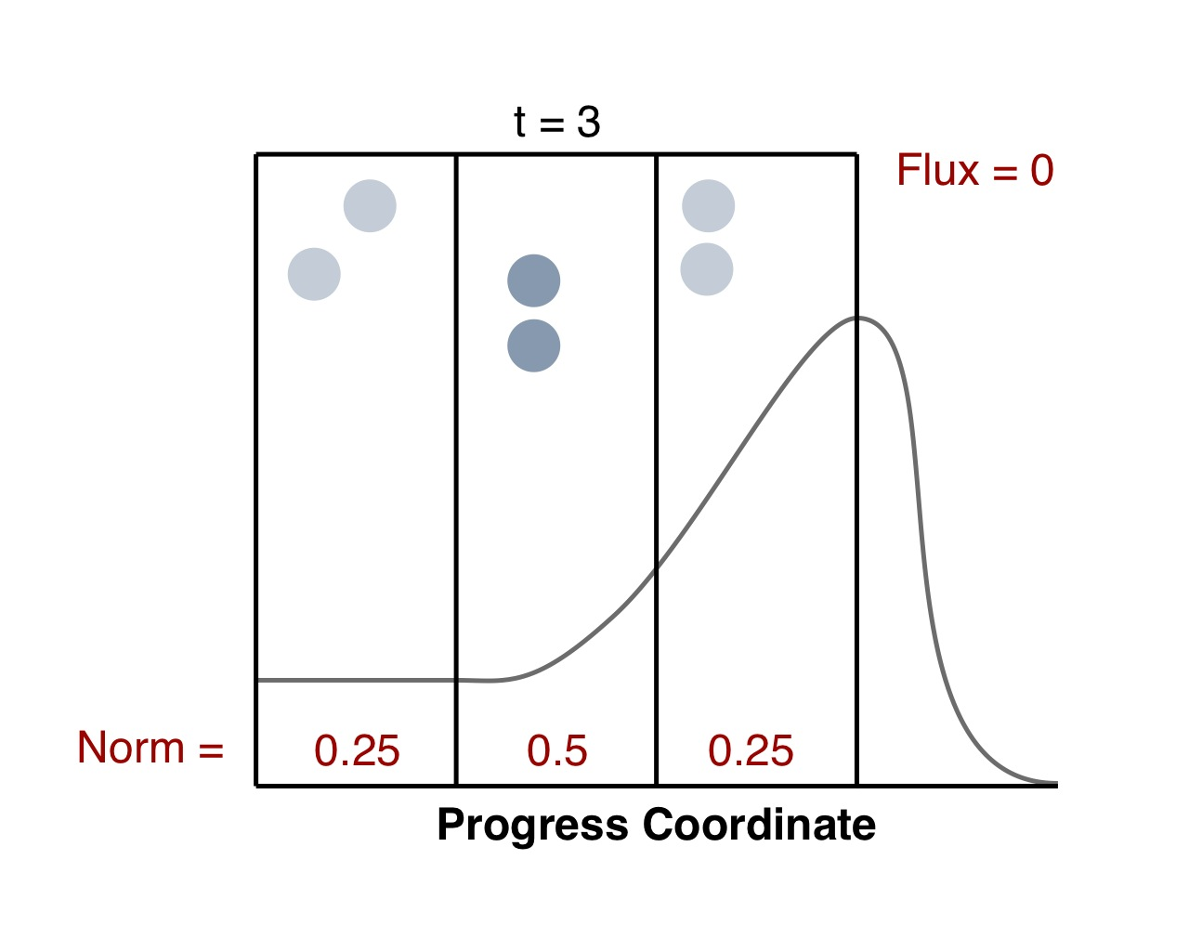
τ = 100 ps
τ = 300 ps
time = 3τ
flux = 0
Run MD
probability =
progress coordinate

Slide 10
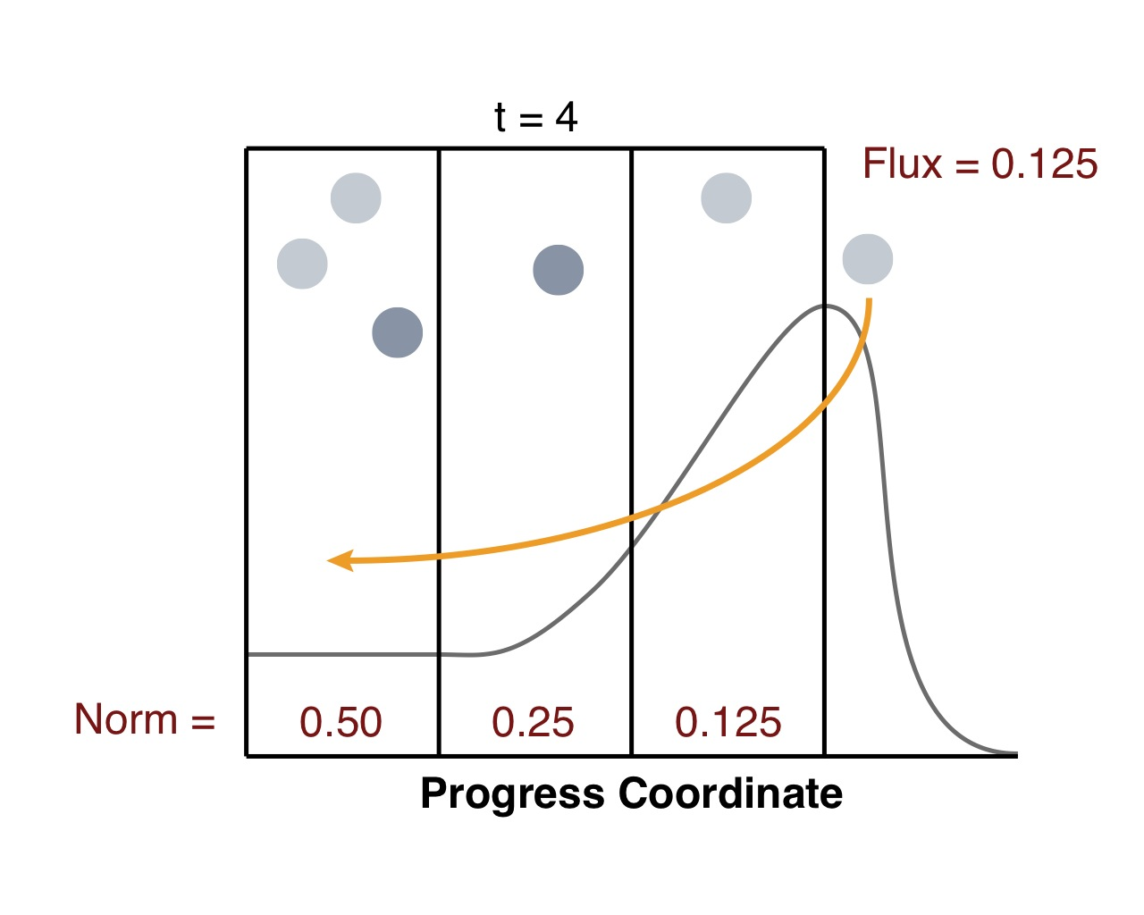
τ = 100 ps
τ = 400 ps
t = 3τ
time = 4τ
flux = 0.00125 ps⁻¹
probability =
Probability =
progress coordinate

Slide 11
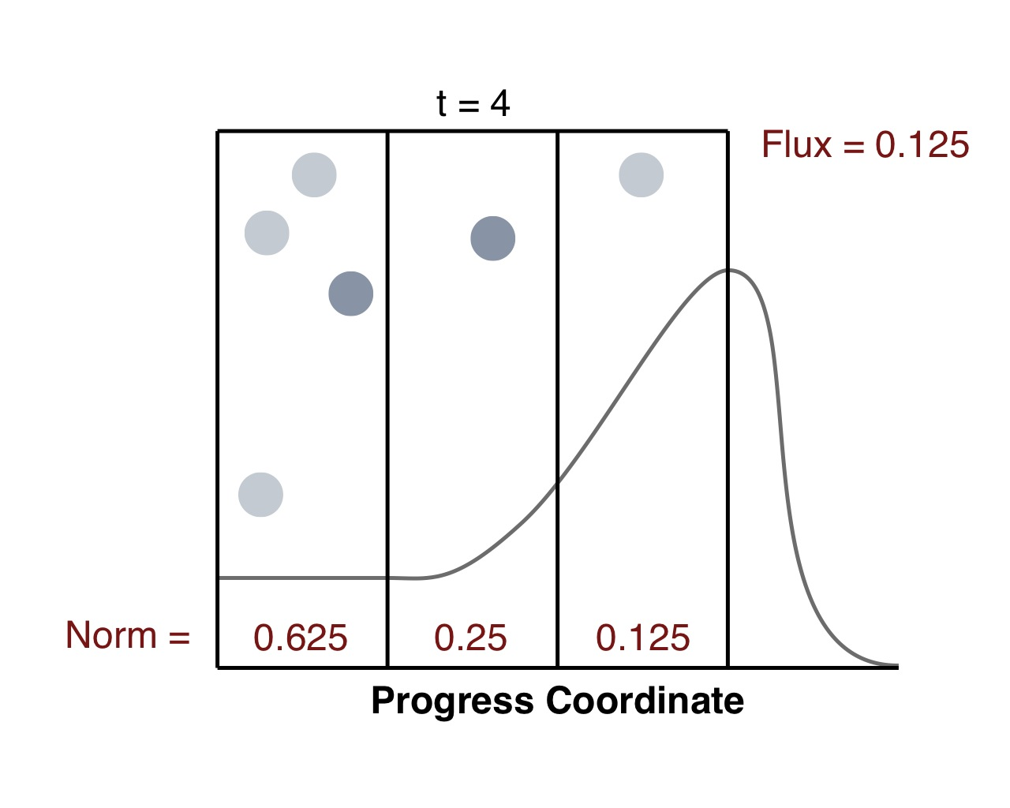
τ = 100 ps
τ = 400 ps
time = 4τ
flux = 0.00125 ps⁻¹
probability =
progress coordinate

Slide 12
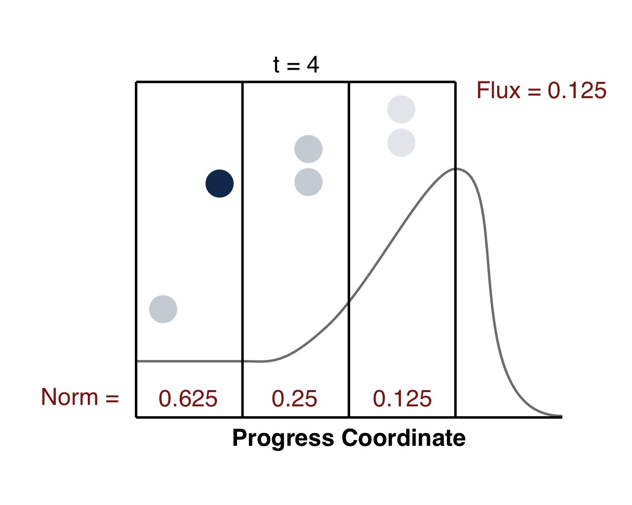
τ = 100 ps
τ = 400 ps
time = 4τ
flux = 0.00125 ps⁻¹
Flux = 0.5
Run MD
probability =
progress coordinate

Slide 13

No free lunch!
May miss slow motions orthogonal to the progress coordinate.
Worse case is “brute force” sampling of orthogonal motions.
However, we can switch progress coordinates “on-the-fly.”

Slide 14
Weighted ensemble MD greatly extends accessible timescales
Protein folding
Surface
side chain
rotation
Protein binding
Loop motions
Large-scale conformational transitions
Bond vibration
Hinge bending
10⁻¹⁵
(fs)
10⁻¹²
(ps)
10⁻⁹
(ns)
10⁻⁶
(μs)
10⁻³
(ms)
10⁰
(s)
Standard MD (Anton)
Weighted ensemble MD
Notes:
protein

