Slide 1
Indirect Costs Jeremy M. Berg

Slide 2
The Basics
Indirect costs are real research costs, just those that are not readily attributable to specific projects
Paid by granting agencies is a fraction (the Indirect Cost Rate) applied to Direct Costs of a grant (with exclusions)
Indirect Cost Rates are negotiated ~every 4 years with the cognizant federal agency (Health and Human Services or the Office of Naval Research)

Slide 3
Indirect Cost Structure
Indirect costs are often called ”F & A” costs
Facilities
Administration
Facilities includes building depreciation, maintenance (but not purchase of) large equipment
Administration includes staff and other costs associated with regulatory compliance
Administrative component capped at 26% (since 1991)
Exclusions include equipment purchases and patient care costs associated with clinical trials

Slide 4
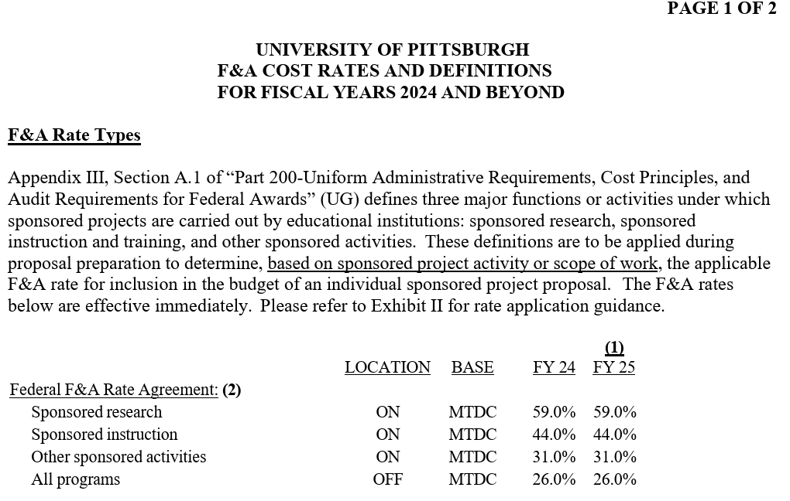
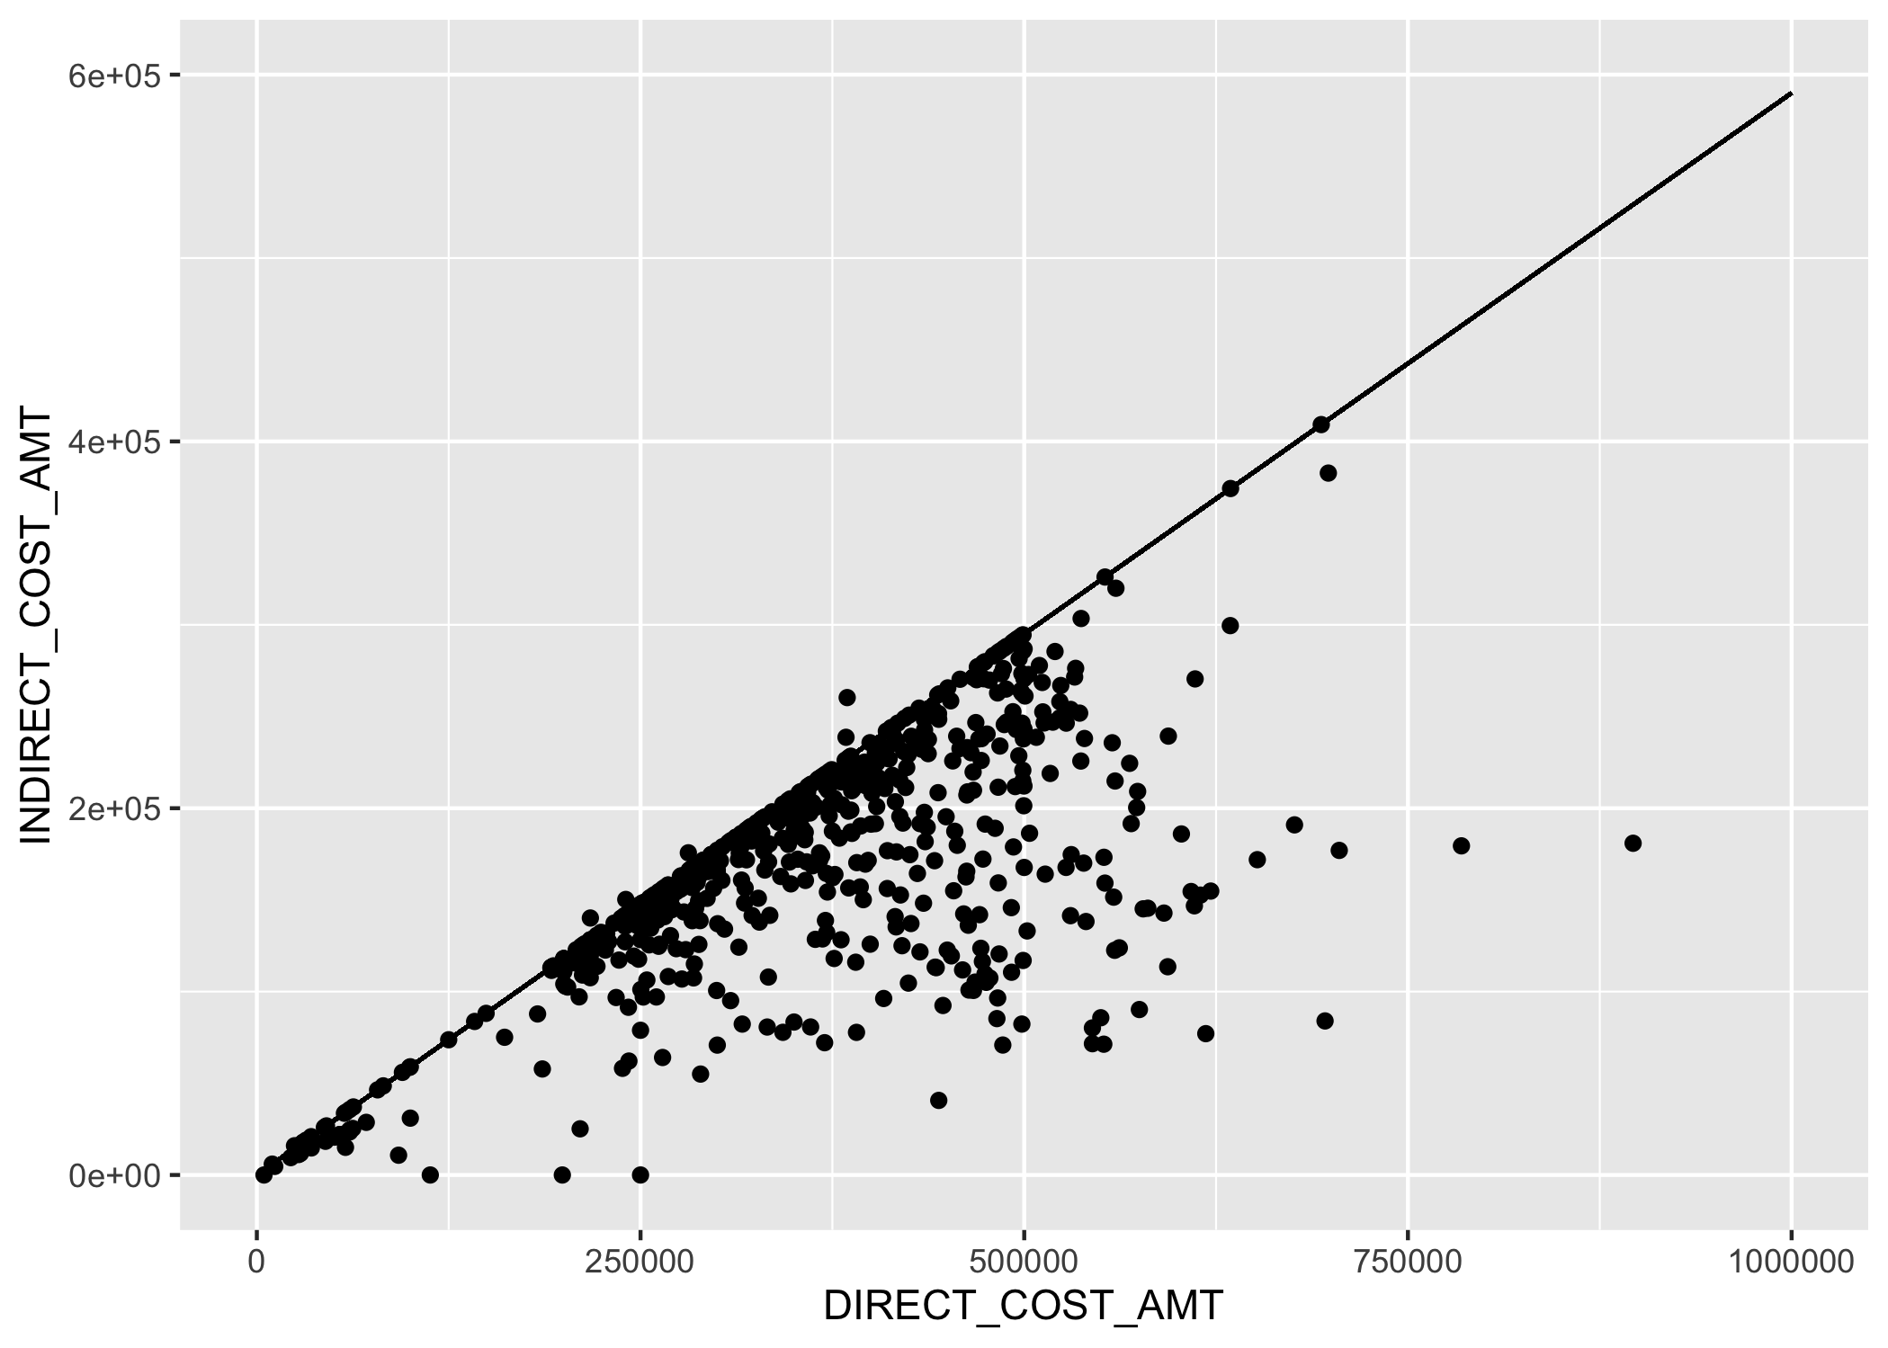

Finding Indirect Cost Rates
Slope = 0.590

Slide 5
The “NIH”Notice
Supplemental Guidance to the 2024 NIH Grants Policy Statement: Indirect Cost Rates
Notice Number: NOT-OD-25-068
https://grants.nih.gov/grants/guide/notice-files/NOT-OD-25-068.html
Award recipients are subject to a 15 percent indirect cost rate!

Slide 6
The ”NIH” Notice
Rationale:
“Yet the average indirect cost rate reported by NIH has averaged between 27% and 28% over time. And many organizations are much higher—charging indirect rates of over 50% and in some cases over 60%.”
This is comparing indirect costs/total costs with indirect cost rates.
But actual indirect cost recovery is affected (substantially) by exclusions (Modified Total Direct Costs).

Slide 7
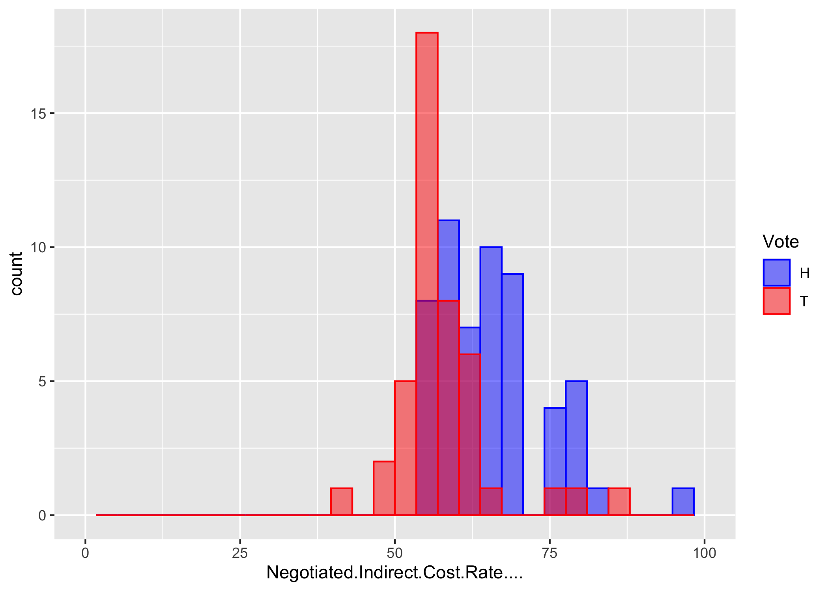
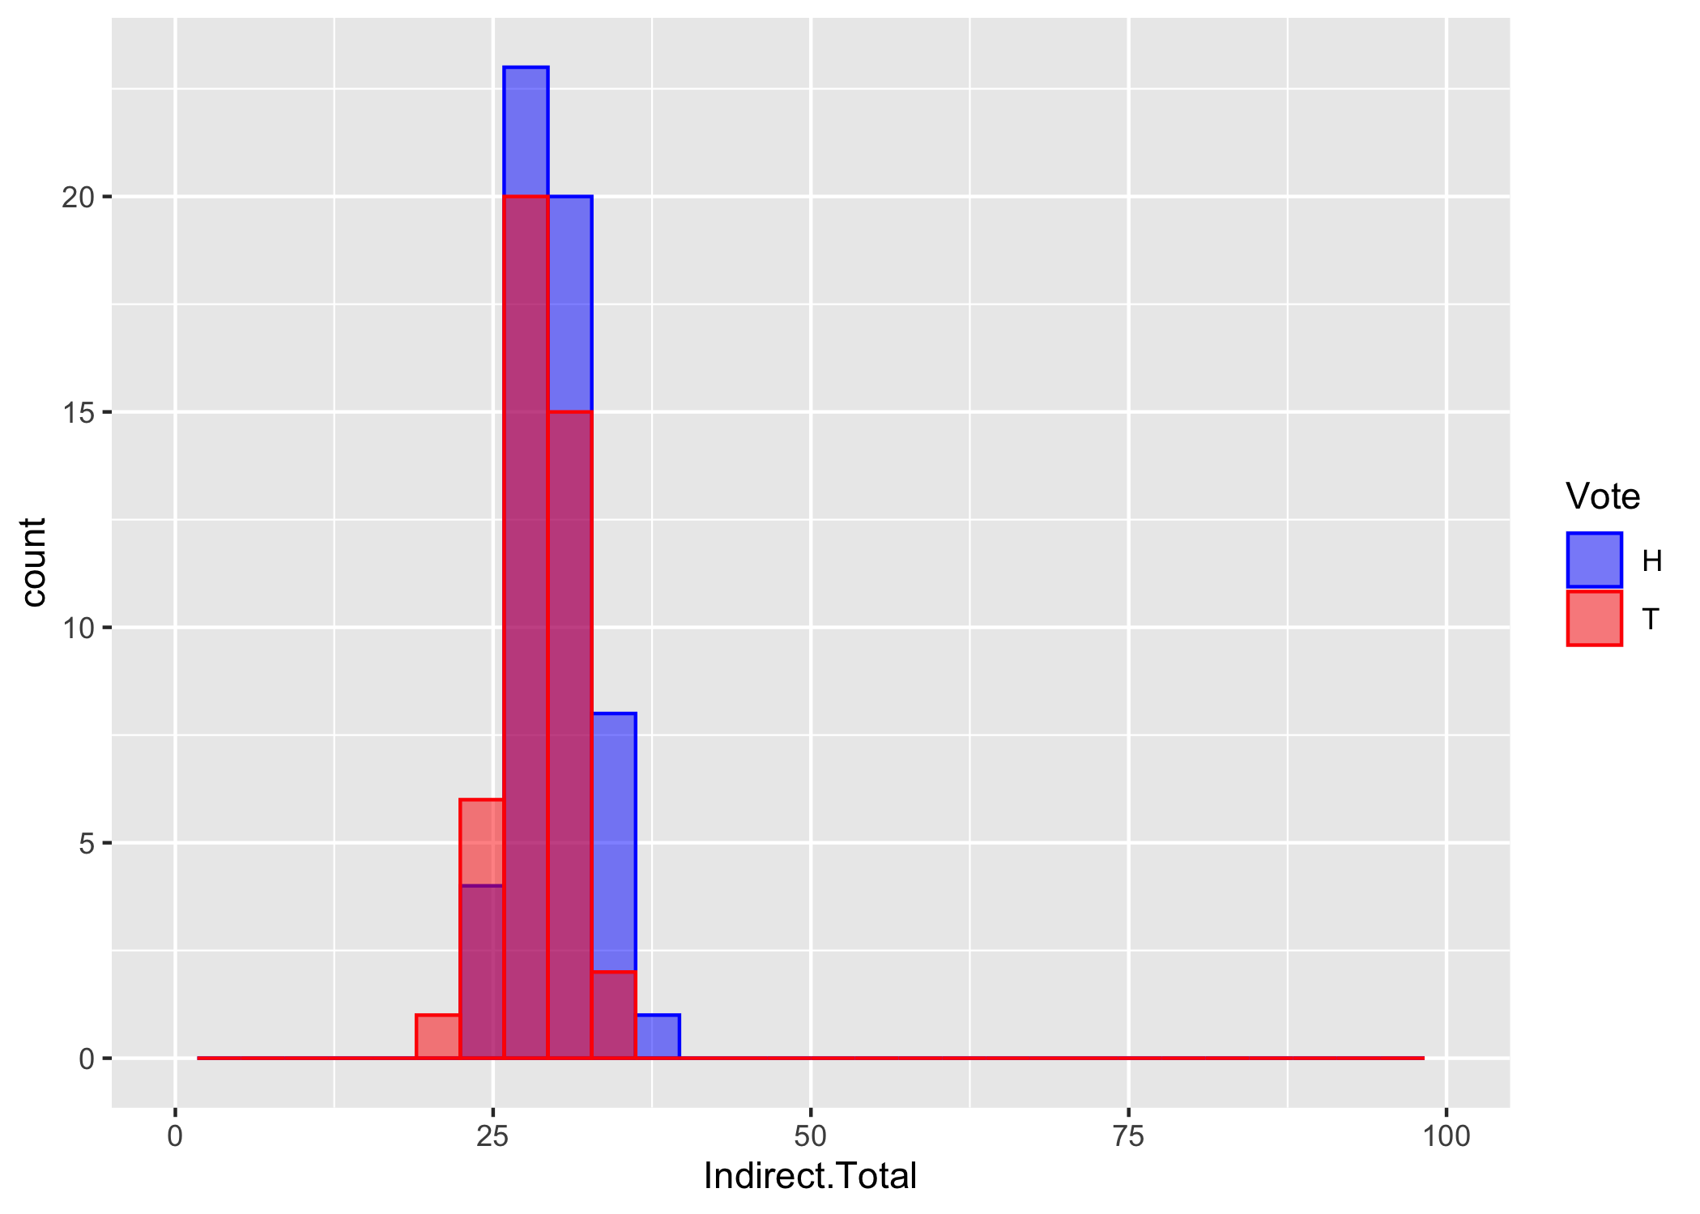
Results for Top 100 Institutions Research Grants Only (Excludes Contracts and Training)
Indirect cost rates:
Mean 62%, SD 9
Indirect cost fraction of Total costs:
Mean 29.1%, SD 2.9
H Institutions in states that voted for Harris, T Institutions in states that voted for Trump

Slide 8
Observations
Indirect cost rates do vary substantially between institutions with a range of 43% to 96.9% (IQR 11.4%)
The distribution of actual indirect cost recovery over total costs received is much narrower with a range of 27.4% to 37% (IQR 3.7%)
The rationale in the Notice of 27% versus 50-60% is incorrect accounting, comparing two different entities (rates versus actual recovery)

Slide 9
Resources
Videos about Indirect Costs
From Sally Rockey when she was Deputy Director for Extramural Research at NIH
(Quite detailed but remarkably accessible)
https://www.youtube.com/watch?v=1XvVibv2opQ
From AAU (Very accessible)
https://www.youtube.com/watch?v=NtqK8SyxFMc

