Slide 1
Java 8 - λ & Streams

Slide 2
Why do we care?
Notes:
Java is “behind the times”, we need to modernize it
People, including myself, desperately wanted some functional paradigms to come to java, but why? What value do they add?
Java is an OO language, is that not good enough? Aren’t they wildly poopular?

Slide 3
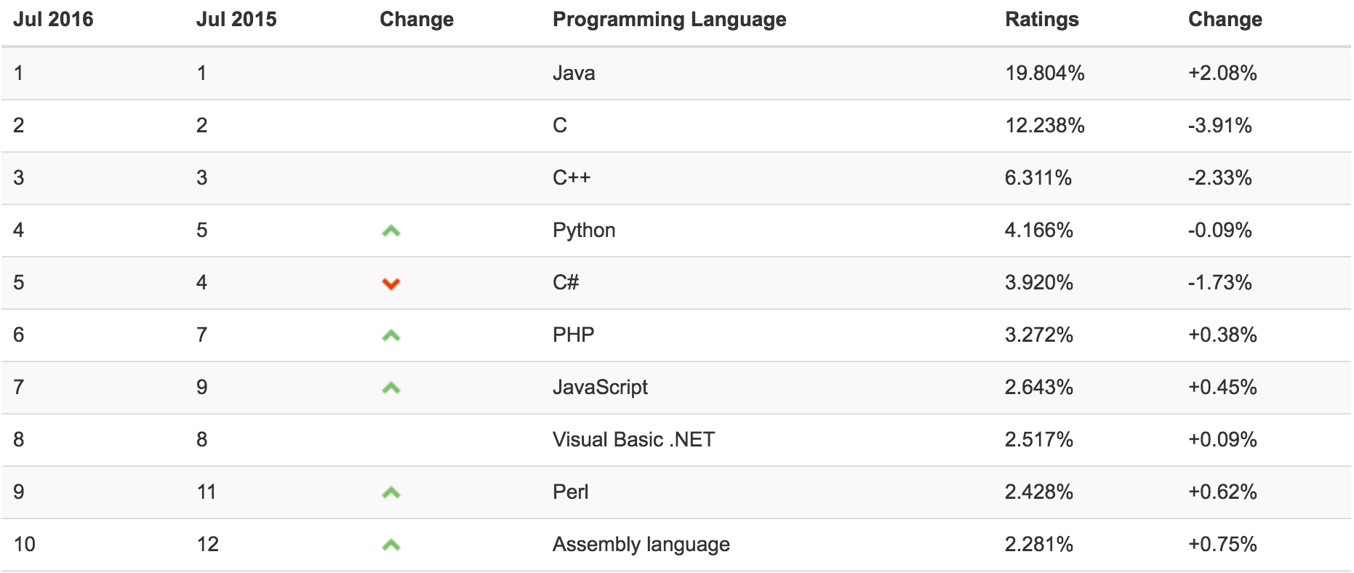
Source: http://www.tiobe.com/tiobe_index
Notes:
So the top languages are all OO languages. What about functional languages?

Slide 4
What is a functional language?
Data exists as inputs and outputs to functions
  No state
Functions do not create side effects
Structures are typically immutable

Slide 5
Why were they created?
Predictability
Scalability
Immutability
Notes:
Purely functional languages are very predictable. Functions should not ever have side effects, meaning every invocation of function F for a given set of arguments will return the same data every time it is called. This allows a functional program to be scaled out to multiple cores or multiple machines easily. Immutability is a very important part of parallel processing, and functional languages typically enforce immutability at a language level.

Slide 6
Why does nobody use pure functional languages?

Slide 7

define break (void))
(define return (void))
(define continue (void))
(define $current-handler (void))
(define g$y (void))
(define g$x (void))
(begin
(set! g$y 0)
(call/ec
(lambda (break)
((lambda ($seq16 $loop17)
(begin
(begin
(if (set? $seq16)
(for-set $seq16 $loop17)
(if (tuple? $seq16)
(for-tuple $seq16 $loop17)
(if (py-list? $seq16)
(for-py-list $seq16 $loop17)
(if (dict? $seq16) (for-dict $seq16 $loop17) (void)))))
((lambda () (begin (py-print g$y)))))))
(py-list* 1 2 3)
(lambda (i16)
(call/ec
(lambda (continue)
(begin
(set! g$x i16)
((lambda ()
(begin (py-print g$x) (set! g$y (+ g$x g$y)))))))))))))
Notes:
This is a very simple “main” function
Random fact, javascript syntax was originally parenthesized like lisp, but at the last minute he changed it to be more “java” like

Slide 8
Why were OO languages created?

Slide 9
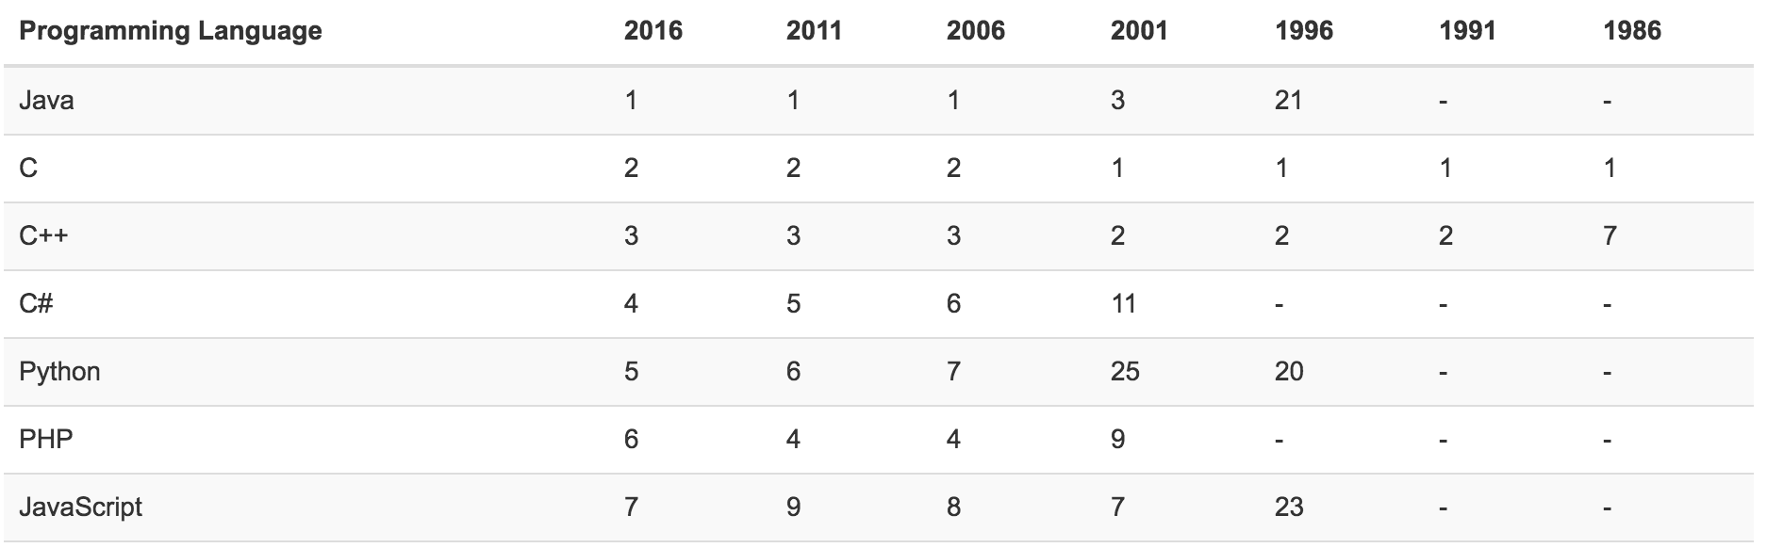
Source: http://www.tiobe.com/tiobe_index

Slide 10
Performance & Readability
Mutable collections
Garbage collection was slow
  Create less objects (singletons, pass by reference)
Objects and state are easy to understand

Slide 11
Downsides of OO
Scalability is a challenge
  How to share state between machines?
Performance gains usually negligible
  How many people routinely iterate over billions of elements?
Mutability creates unexpected side effects
Notes:
On point 3, ever heard of ThreadLocal?

Slide 12
Can we marry the two paradigms?

Slide 13
Benefits of merging
Easy to read code
Allows benefits of both to be leveraged
Better scalability for OO languages
Allows compiler to be smarter

Slide 14


Examples of great mergers

Slide 15
How did Java implement it?

Slide 16
Three Huge Changes
Lambdas
Method references
Stream API

Slide 17
What is a Lambda (λ)?
Lambdas are small blocks of code declared inline
x => x * x
(x, y) => x + y

Slide 18
Method References
Allow existing methods to be referenced directly
String::valueOf
this::myPrivateFunc
instanceVar::myFunc

Slide 19
Stream API
Stream
Filter
Map
Reduce

Slide 20
Demo time

Slide 21
Problems with implementation
Parallel streams are broken
A lot of missing operations due to support for parallel

Slide 22
Some frameworks to fill the gap
jOOλ (https://github.com/jOOQ/jOOL)
  Aims to add back the missing sequential operations
Rx for java
  A lot of similar features as the stream API

