Slide 1

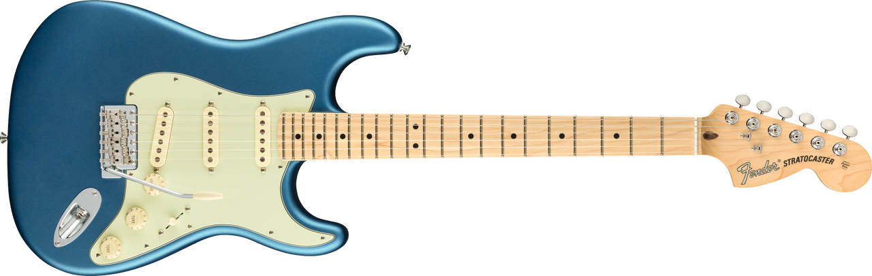
Visual Identification of Electric Guitars
Classifying guitars — Stratocaster vs. Telecaster
Jeremy Mitaux
Notes:
Hi, I'm Jeremy. My project trains a deep-learning model to recognize what kind of guitar is in a photo — specifically a Fender Stratocaster vs. a Telecaster — straight from a marketplace listing image.

Slide 2

Introduction
What is my project
Predict a guitar’s model from a photo
A CNN image classifier: Fender Stratocaster vs. Telecaster
Why I'm interested
Combines a personal interest in guitars with deep learning
Wanted to do an image classification problem
Notes:
The long-term goal is a flip-finding assistant: point it at a listing photo and have it tell you what the guitar actually is, so you can catch listings that just say 'Fender Strat' or are mislabeled. The core learnable sub-problem is identifying make/model from an image — that's what I built. It's a real computer-vision task because different models have distinct silhouettes, headstocks, and pickup layouts.

Slide 3
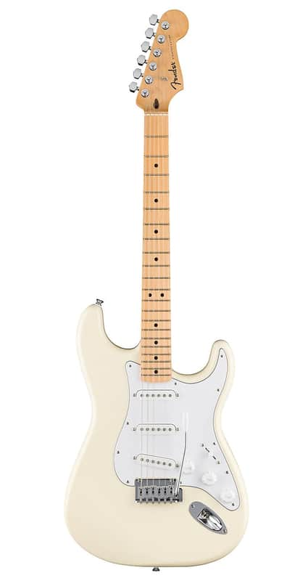
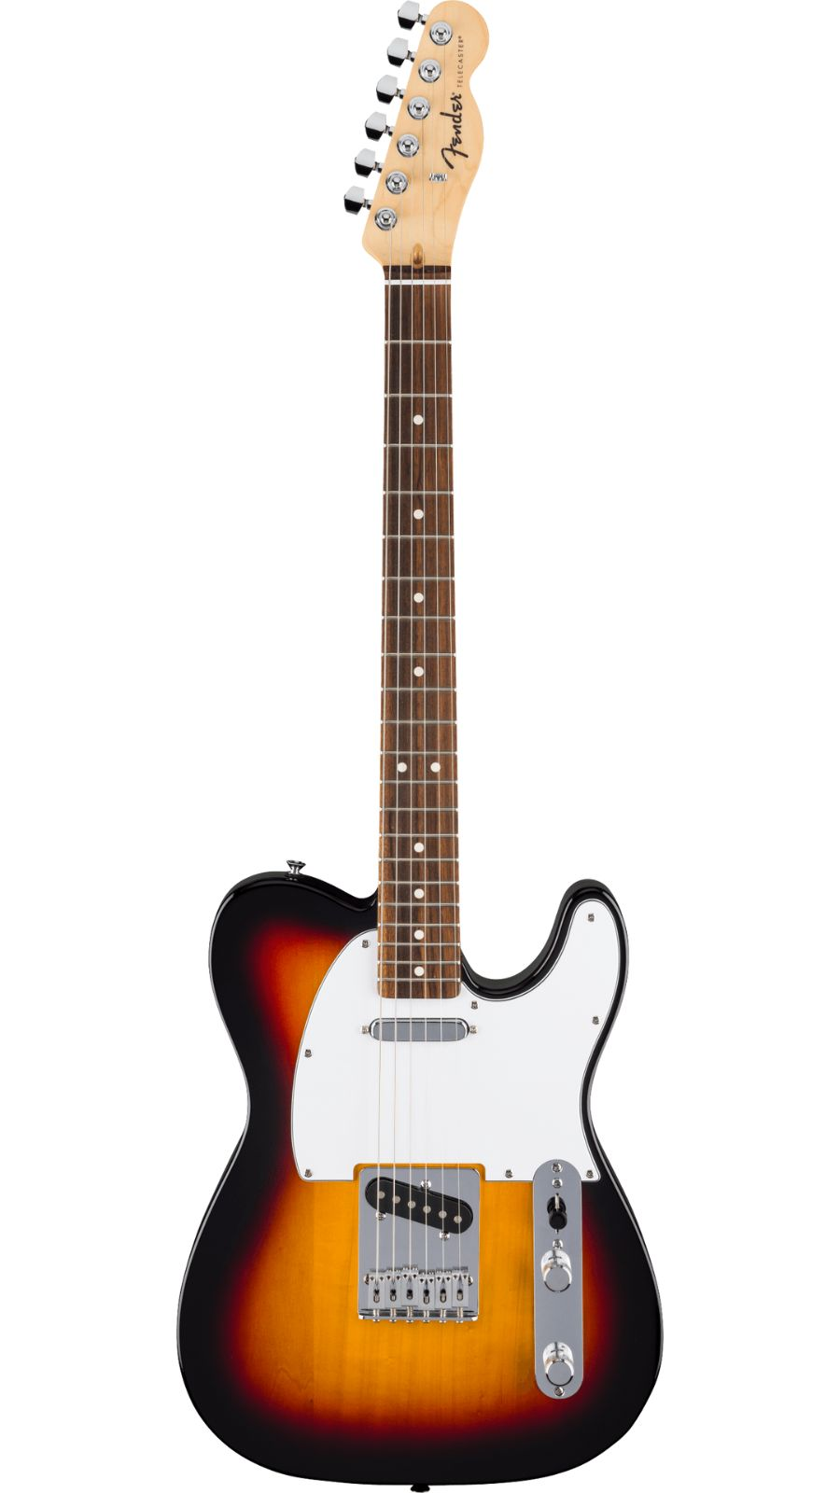

Dataset
What data
6,195 photos from 1,333 real Reverb.com listings
862 Stratocaster / 471 Telecaster — built from scratch, no existing dataset
Data Cleaning
Scraped Reverb via the Apify API; labeled by model from listing metadata
Filtered out parts, wrong brands, cheap accessories
Split grouped by listing — no guitar appears in both train and test
Notes:
There's no off-the-shelf dataset, so I built one from live Reverb listings. I scraped per-model, then labeled each listing by its structured make/model metadata rather than guessing from keywords, and filtered out parts, wrong-brand sellers, and cheap accessories. One important detail: each listing has up to 5 near-duplicate photos, so I split the data BY LISTING — every photo of one guitar stays in a single split. A naive per-image split would leak duplicates into both train and test and fake a high accuracy.

Slide 4
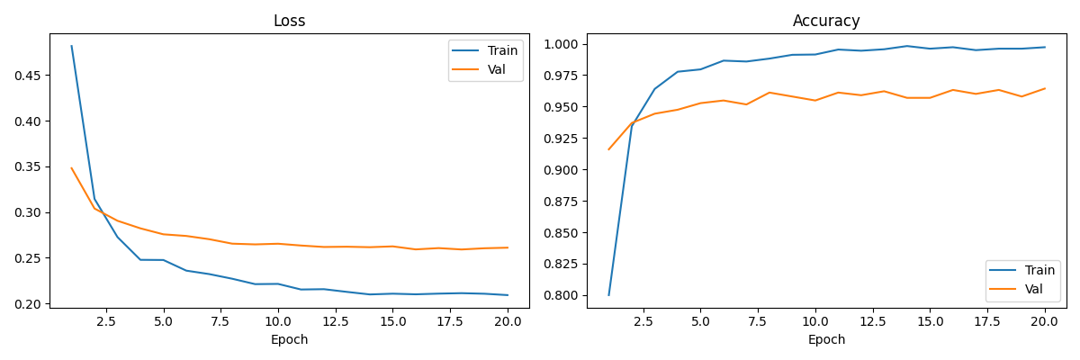
Your Model
What model
EfficientNet-B0 CNN, pretrained on ImageNet
Fine-tuned with a 2-way head (AdamW, cosine LR, label smoothing)
Why I picked it
Strong accuracy at a small size — trains fast on a laptop GPU (Apple MPS)
Transfer learning works well with a modest ~1,300-listing dataset
Body shape / headstock / pickups are real signals a CNN can learn
Notes:
I used EfficientNet-B0, a convolutional neural network pretrained on ImageNet, and fine-tuned it for two classes. I picked it because it hits a great accuracy-to-size ratio — it trains quickly on my Mac's GPU — and transfer learning lets a pretrained backbone do well even with only ~1,300 listings. I also handled class imbalance with a weighted sampler and used data augmentation to reduce overfitting.

Slide 5
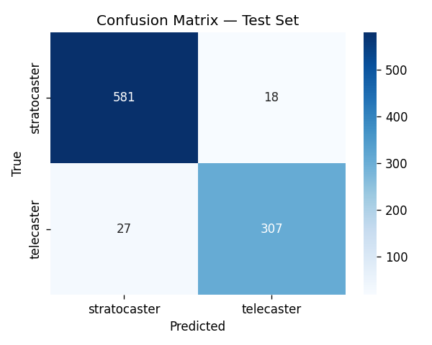
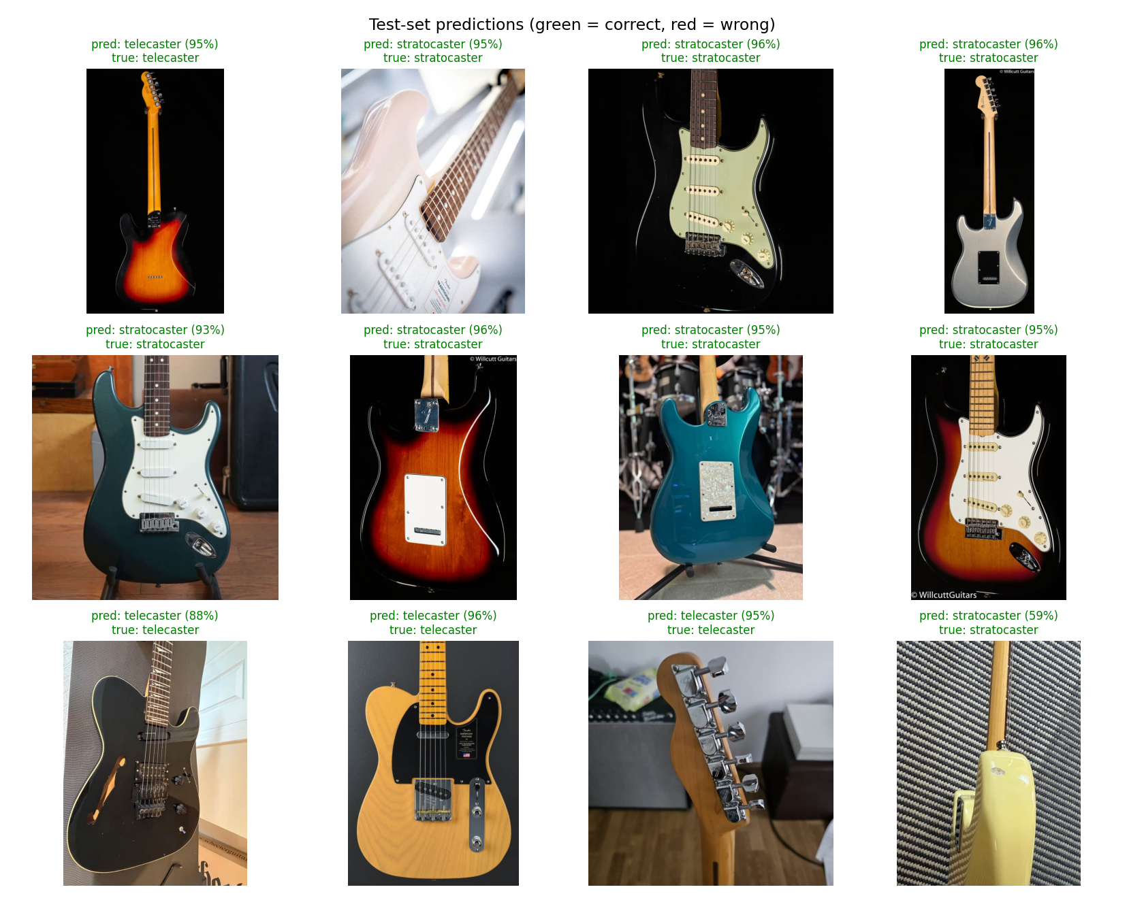
Your Results
Headline metric
95.2% test accuracy on 933 held-out images (200 listings)
Macro-F1 0.95 — vs. a 64.2% majority-class baseline
Per-class F1: Stratocaster 0.96, Telecaster 0.93
How did it work
Worked well — but Strat vs. Tele is a visually easy 2-class problem
Read it as a strong proof of concept, not a final number
Notes:
The model got 95.2% accuracy on a held-out test set of 933 images. I report a few things for honesty: macro-F1 of 0.95, and the majority-class baseline of 64.2% — that's what you'd get always guessing 'Stratocaster' — so you can see the real lift. The confusion matrix shows errors are balanced, not one class collapsing into the other. The big caveat: Strat vs. Tele is a visually easy distinction, so this is a strong result on an EASY problem — I'd expect it to drop as look-alike models get added.

Slide 6

Demo
Notes:
I used EfficientNet-B0, a convolutional neural network pretrained on ImageNet, and fine-tuned it for two classes. I picked it because it hits a great accuracy-to-size ratio — it trains quickly on my Mac's GPU — and transfer learning lets a pretrained backbone do well even with only ~1,300 listings. I also handled class imbalance with a weighted sampler and used data augmentation to reduce overfitting.

Slide 7
Conclusions
What worked
Full pipeline works end-to-end: scrape → label → train → evaluate, reproducible
Group-aware split gives an honest accuracy (no photo leakage)
What I changed from the proposal
Dropped year (only 44% of listings had one, and it was messy free-text)
Pivoted from country-of-origin (Strats look identical) to make/model — a real visual signal
What I'd do next
Scale to more models (Les Paul, SG, ES-335) — pipeline already supports N classes
Notes:
Overall it worked like I expected — the pipeline is fully reproducible and the group-aware split means the accuracy is honest. Two things I'd flag: I changed scope from the proposal. I dropped predicting the year, because only 44% of listings had one and it was messy free text. And I pivoted away from guessing country of origin — American vs Mexican Strats look identical, so that model was really learning backgrounds, not guitars. Make/model is a genuine visual signal. If I kept going, I'd add more models like the Les Paul, SG, and ES-335 — the code already scales to N classes; I stopped at two when my scraping credits ran out. That harder problem is the more interesting next step.

