Slide 1

Keyboard and Mouse Input
Class 8
Making Games With Python and PyGame
https://inventwithpython.com/pygame/

Slide 2
The Keyboard
Notes:
Note from Chuck. If you are using these materials, you can remove the UM logo and replace it with your own, but please retain the CC-BY logo on the first page as well as retain the entire last page.

Slide 3
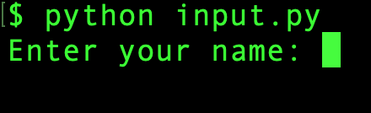
The Keyboard In PyGame
So far, when we wanted to ask the user to input something, we used the input() function. This works fine, but the whole program has to stop and wait for the user to finish typing before moving on. That won’t work for most games!
We could be here for a while…
Notes:
Note from Chuck. If you are using these materials, you can remove the UM logo and replace it with your own, but please retain the CC-BY logo on the first page as well as retain the entire last page.

Slide 4
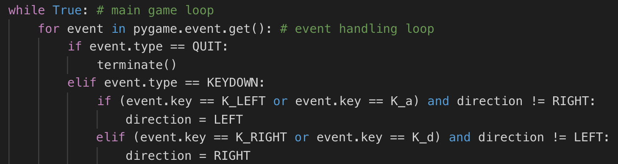
The Keyboard In PyGame
Luckily for us, PyGame has a solution! Remember pygame.event.get()? One of the types of events that it can “listen” for is a key being pressed on the keyboard. Here is an example (using the arrow keys):
Notes:
Note from Chuck. If you are using these materials, you can remove the UM logo and replace it with your own, but please retain the CC-BY logo on the first page as well as retain the entire last page.

Slide 5
The Keyboard
Each key on the keyboard has its own ”code” in PyGame. For instance K_LEFT is the left arrow key, while K_a is the ”a” key. Let’s try this out for ourselves!
Notes:
Note from Chuck. If you are using these materials, you can remove the UM logo and replace it with your own, but please retain the CC-BY logo on the first page as well as retain the entire last page.

Slide 6
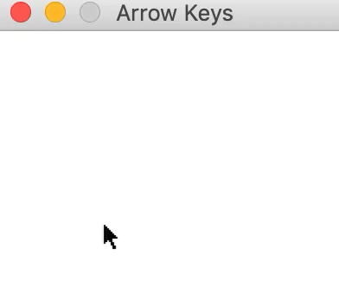
Now You Try
I have given you a program which makes colored arrows appear whenever you press an arrow key. Change the program so that the correct arrows also light up when you use the “A”, “W”, “S”, and “D”. Keys. Here’s an example:
Notes for your version:
“W” = up
“S” = down
“A” = left
“D” = right
Notes:
Note from Chuck. If you are using these materials, you can remove the UM logo and replace it with your own, but please retain the CC-BY logo on the first page as well as retain the entire last page.

Slide 7
The Mouse
Notes:
Note from Chuck. If you are using these materials, you can remove the UM logo and replace it with your own, but please retain the CC-BY logo on the first page as well as retain the entire last page.

Slide 8
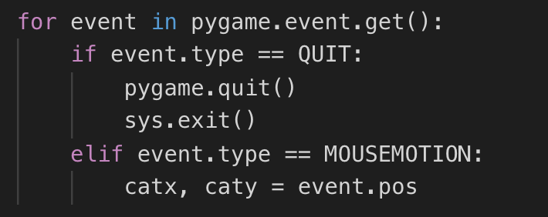
The Mouse In PyGame
PyGame also lets us control the mouse. Whenever we move the mouse or click a button, an event is triggered. We can find the (X, Y) position of the mouse pointer using this event, like this:
Moving the mouse or clicking a mouse button are events, just like pressing a key on the keyboard.
Notes:
Note from Chuck. If you are using these materials, you can remove the UM logo and replace it with your own, but please retain the CC-BY logo on the first page as well as retain the entire last page.

Slide 9
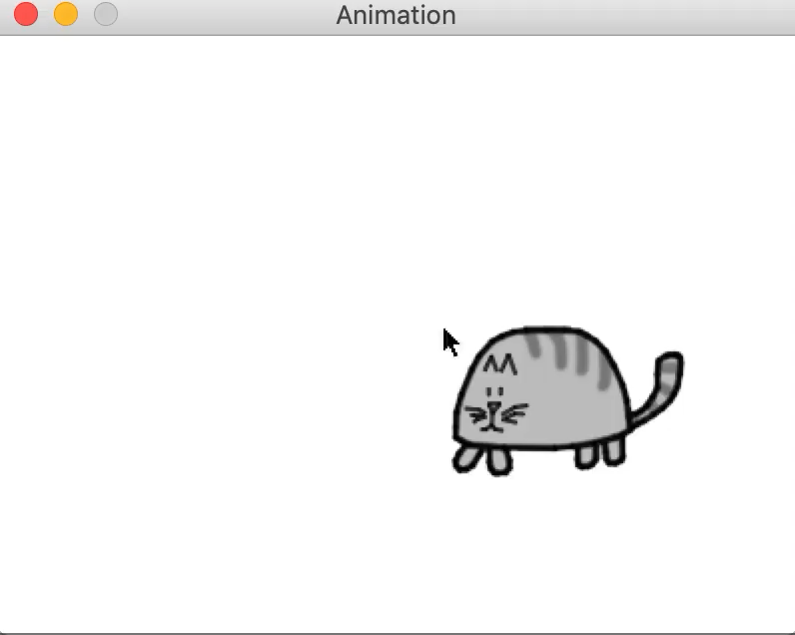
What Can We Do With This?
The code on the last slide makes the cat from catanimation.py follow our mouse around on the screen! Like this:
Notes:
Note from Chuck. If you are using these materials, you can remove the UM logo and replace it with your own, but please retain the CC-BY logo on the first page as well as retain the entire last page.

Slide 10
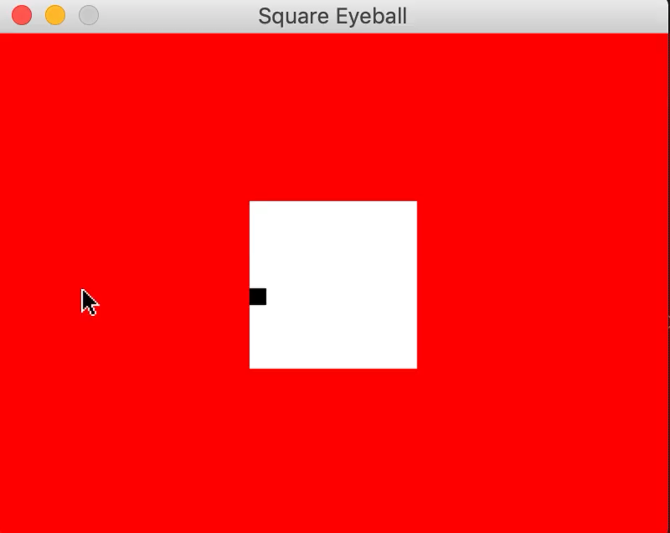
Now You Try
See if you can use two rectangles to create a “giant square eyeball” that follows your mouse around the screen, like this:
Notes:
Note from Chuck. If you are using these materials, you can remove the UM logo and replace it with your own, but please retain the CC-BY logo on the first page as well as retain the entire last page.

Slide 11
Making A Real Game
Notes:
Note from Chuck. If you are using these materials, you can remove the UM logo and replace it with your own, but please retain the CC-BY logo on the first page as well as retain the entire last page.

Slide 12
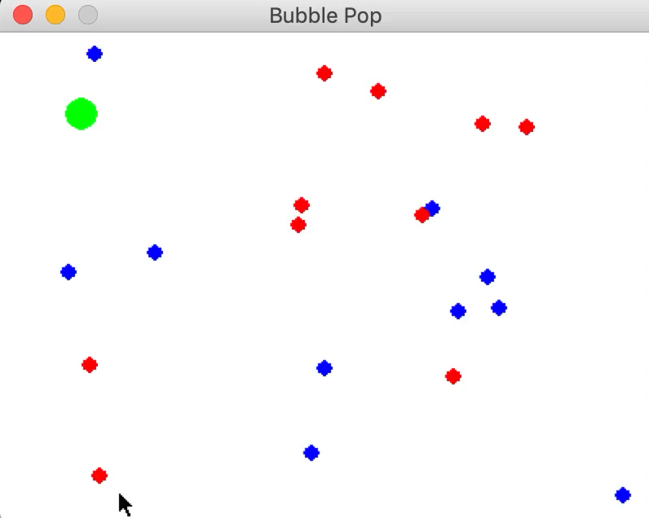
Bubble Pop – A Simple Game
We will try to make some changes to the game of “Bubble Pop”, which looks like this:
Don’t worry! I have given you some “starter code” in bubbles.py
Notes:
Note from Chuck. If you are using these materials, you can remove the UM logo and replace it with your own, but please retain the CC-BY logo on the first page as well as retain the entire last page.

Slide 13
Taking It To The Next Level
We don’t have to stop here! You can enhance your programs even more by adding sounds. Maybe the program can play a popping sound whenever we touch a bubble? Maybe there can be some music?
Maybe we can show the user their “score”? The possibilities are endless.
And remember, you can keep learning on your own. Everything you need to know about PyGame is here: https://www.pygame.org/
Notes:
Note from Chuck. If you are using these materials, you can remove the UM logo and replace it with your own, but please retain the CC-BY logo on the first page as well as retain the entire last page.

Slide 14
That’s it! Check your homework ^_^
Notes:
Note from Chuck. If you are using these materials, you can remove the UM logo and replace it with your own, but please retain the CC-BY logo on the first page as well as retain the entire last page.

Slide 15
Acknowledgements / Contributions
These slides are Copyright 2010- Charles R. Severance (www.dr-chuck.com) of the University of Michigan School of Information and made available under a Creative Commons Attribution 4.0 License. Please maintain this last slide in all copies of the document to comply with the attribution requirements of the license. If you make a change, feel free to add your name and organization to the list of contributors on this page as you republish the materials.
Initial Development: Charles Severance, University of Michigan School of Information
This deck uses the style and formatting of Charles R. Severance’s slides, but some of the content and code is borrowed from the wonderful book Making Games with Python & Pygame by Al Sweigart. Like Charles Severance and Al Sweigart, I license these slides and all associated content under a CC license.

