Slide 1

Hacking and Sharing
Class 9
Making Games With Python and PyGame
https://inventwithpython.com/pygame/

Slide 2
Hacking
Notes:
Note from Chuck. If you are using these materials, you can remove the UM logo and replace it with your own, but please retain the CC-BY logo on the first page as well as retain the entire last page.

Slide 3
What Is Hacking?
If you search Google or Baidu, they will tell you that “hacking” means breaking into other people’s computers to steal things or break things.
When people think of “hackers” now, this is what they think of. This is not really what a hacker is.
A hacker is somebody who really enjoys taking things apart to learn how they work. A hacker is someone who can make a machine (like a computer) do more than what it was designed to do. A hacker likes to break things down, build things up, and make things better.
Notes:
Note from Chuck. If you are using these materials, you can remove the UM logo and replace it with your own, but please retain the CC-BY logo on the first page as well as retain the entire last page.

Slide 4
What Is Hacking?
VS
Regular People
Hackers
What is it for?
How do I use it?
How can I learn just enough to make it work?
What can it do?
How does it work?
How can I learn enough to change the way it works?
Notes:
Note from Chuck. If you are using these materials, you can remove the UM logo and replace it with your own, but please retain the CC-BY logo on the first page as well as retain the entire last page.

Slide 5
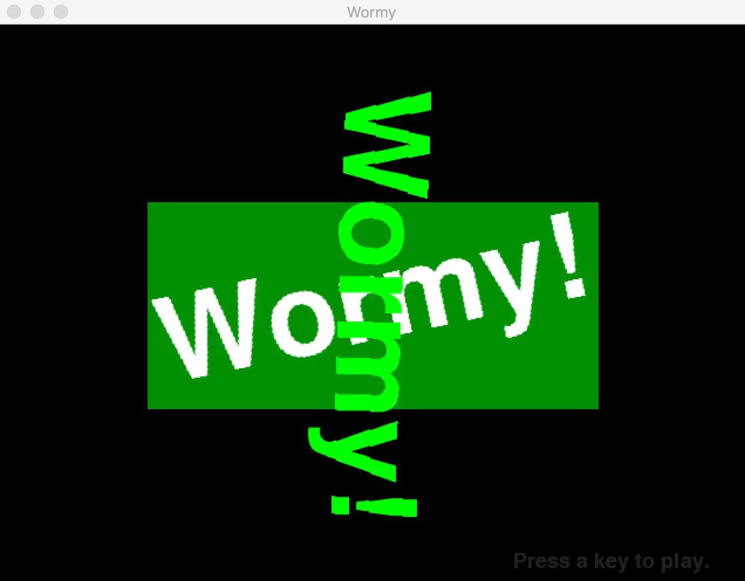
Hacking is Playing
Hacking is about having fun and stretching limits. Let’s try an example!
This is the game “wormy.py”. I have given you the code already.
Notes:
Note from Chuck. If you are using these materials, you can remove the UM logo and replace it with your own, but please retain the CC-BY logo on the first page as well as retain the entire last page.

Slide 6
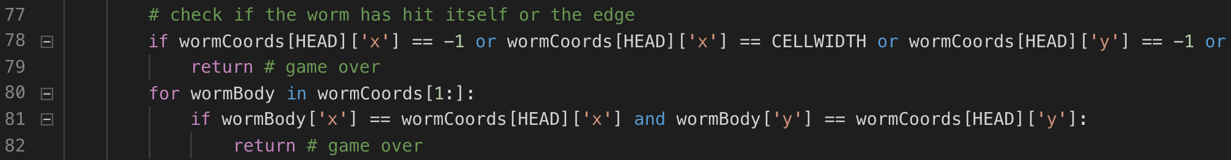
A Quick Example
Let’s take a quick look over the wormy.py code…ah! This looks interesting:
It looks like this code checks to see if the worm has touched the edge of the screen,
then exits the program (“Game Over”) if we are touching.
What if we just let the worm keep going? How could we do that?
Notes:
Note from Chuck. If you are using these materials, you can remove the UM logo and replace it with your own, but please retain the CC-BY logo on the first page as well as retain the entire last page.

Slide 7
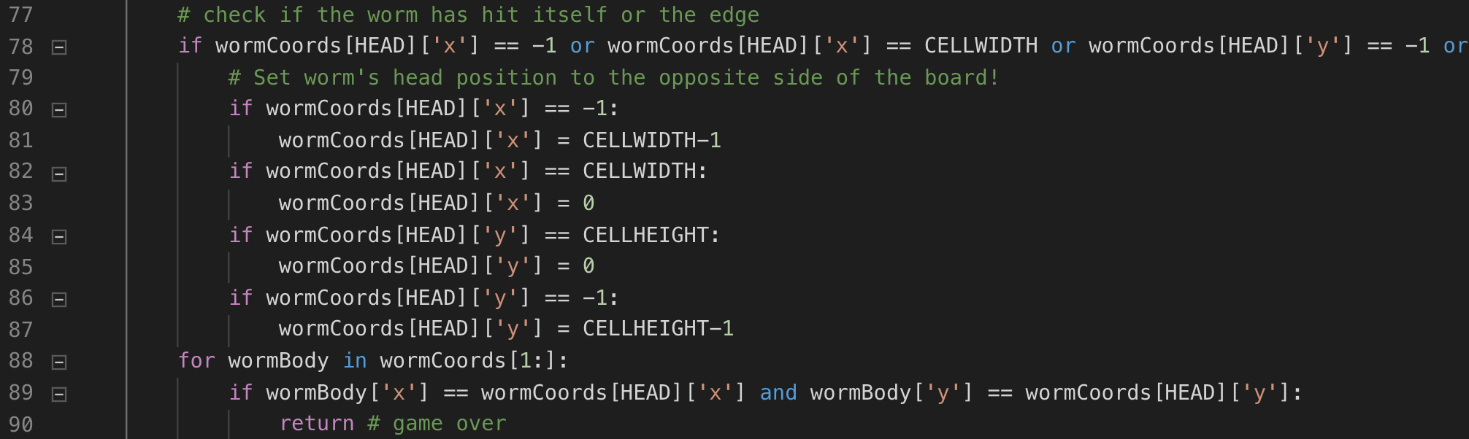
A Quick Example
Let’s change the code to look like this…
What do you think will happen?
Notes:
Note from Chuck. If you are using these materials, you can remove the UM logo and replace it with your own, but please retain the CC-BY logo on the first page as well as retain the entire last page.

Slide 8
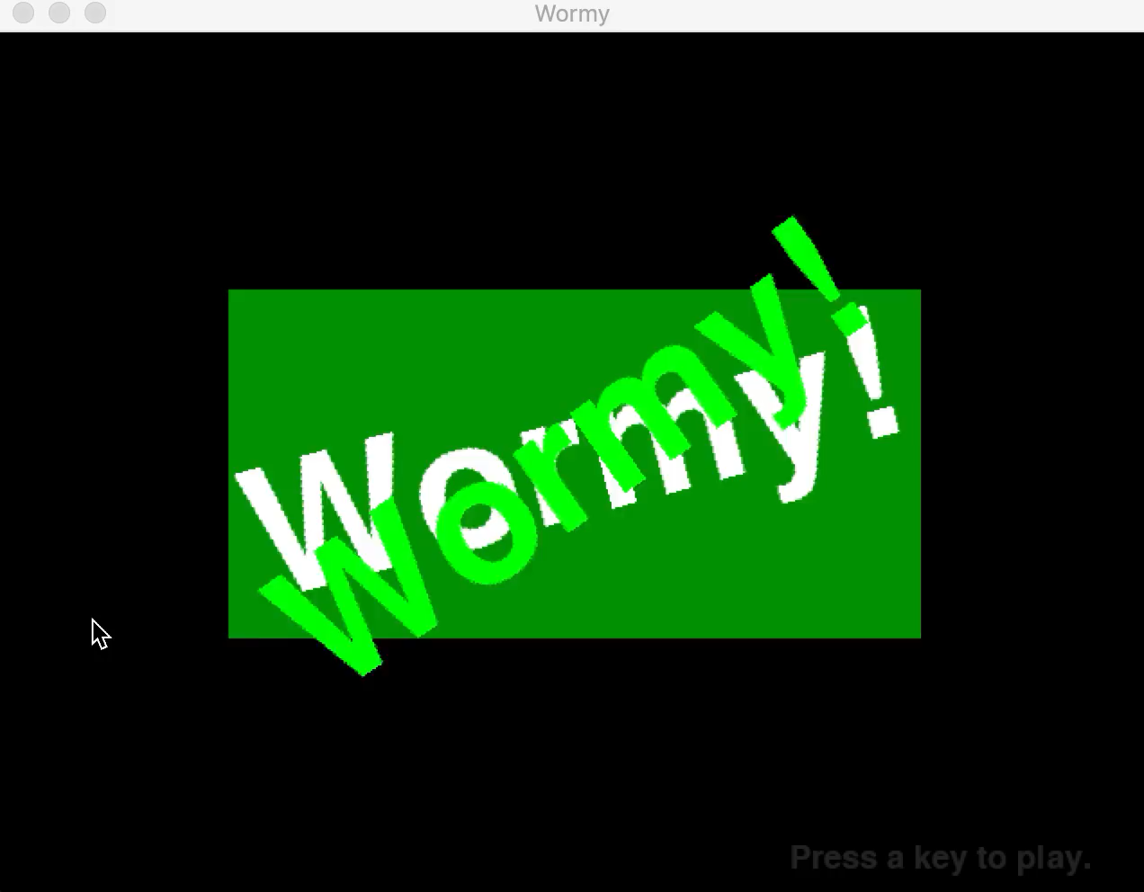
A Quick Example
Neat, right?
Notes:
Note from Chuck. If you are using these materials, you can remove the UM logo and replace it with your own, but please retain the CC-BY logo on the first page as well as retain the entire last page.

Slide 9
A Quick Competition
What else can you make wormy.py do? Try changing some of the variables like “FPS”. Or change the colors. Or maybe change the code so that the worm “bounces” off the walls and changes direction. Anything!
Notes:
Note from Chuck. If you are using these materials, you can remove the UM logo and replace it with your own, but please retain the CC-BY logo on the first page as well as retain the entire last page.

Slide 10
The Rules
You can ask me for help 3 times
You can ask each other for help as many times as you want
You can use the Internet to search for help
You can look at other people’s code from the Internet
Have Fun!
Notes:
Note from Chuck. If you are using these materials, you can remove the UM logo and replace it with your own, but please retain the CC-BY logo on the first page as well as retain the entire last page.

Slide 11
Sharing
Notes:
Note from Chuck. If you are using these materials, you can remove the UM logo and replace it with your own, but please retain the CC-BY logo on the first page as well as retain the entire last page.

Slide 12
Sharing
To share your app, you need to make sure the other person has Python3 and PyGame installed.
This means you need to teach them how to install and use Python! Use this as a good time to teach your friends to code! The steps are:
1 – Go to python.org to download and install the latest Python 3
2 – From the command line, type “python3 –m pip install pygame”
3 – Teach your friends how to run “python3 mygame.py” to run games!
You can also show them how to install Visual Studio Code so they can change your game!
Notes:
Note from Chuck. If you are using these materials, you can remove the UM logo and replace it with your own, but please retain the CC-BY logo on the first page as well as retain the entire last page.

Slide 13
THE END
That’s it! I hope you had fun. ^_^
https://inventwithpython.com/pygame/
Keep Learning Here!
Notes:
Note from Chuck. If you are using these materials, you can remove the UM logo and replace it with your own, but please retain the CC-BY logo on the first page as well as retain the entire last page.

Slide 14
Acknowledgements / Contributions
These slides are Copyright 2010- Charles R. Severance (www.dr-chuck.com) of the University of Michigan School of Information and made available under a Creative Commons Attribution 4.0 License. Please maintain this last slide in all copies of the document to comply with the attribution requirements of the license. If you make a change, feel free to add your name and organization to the list of contributors on this page as you republish the materials.
Initial Development: Charles Severance, University of Michigan School of Information
This deck uses the style and formatting of Charles R. Severance’s slides, but some of the content and code is borrowed from the wonderful book Making Games with Python & Pygame by Al Sweigart. Like Charles Severance and Al Sweigart, I license these slides and all associated content under a CC license. These modifications were made by Jeremy Pedersen.

