Slide 1

Functions and PyGame
Class 6
Making Games With Python and PyGame
https://inventwithpython.com/pygame/
Notes:
Note from Chuck. If you are using these materials, you can remove the UM logo and replace it with your own, but please retain the CC-BY logo on the first page as well as retain the entire last page.

Slide 2
Functions
Notes:
Note from Chuck. If you are using these materials, you can remove the UM logo and replace it with your own, but please retain the CC-BY logo on the first page as well as retain the entire last page.

Slide 3
Python Functions
There are two kinds of functions in Python.
- Built-in functions that are provided as part of Python - print(), input(), type(), float(), int() ...
- Functions that we make ourselves and then use

Slide 4
Function Definition
In Python a function is some reusable code that takes arguments(s) as input, does some computation, and then returns a result or results
We define a function using the def reserved word
We call/invoke the function by using the function name, parentheses, and arguments in an expression

Slide 5
Max Function
A function is some stored code that we use. A function takes some input and produces an output.
>>> big = max('Hello world')
>>> print(big)
w
max()
function
'Hello world'
(a string)
'w'
(a string)

Slide 6
Max Function
A function is some stored code that we use. A function takes some input and produces an output.
>>> big = max('Hello world')
>>> print(big)
w
def max(inp):
blah
blah
for x in inp:
blah
blah
'Hello world'
(a string)
'w'
(a string)

Slide 7
Functions of Our Own…

Slide 8
print("I'm a lumberjack, and I'm okay.")
print('I sleep all night and I work all day.')
print_lyrics():
x = 5
print('Hello')
def print_lyrics():
print("I'm a lumberjack, and I'm okay.")
print('I sleep all night and I work all day.')
print('Yo')
x = x + 2
print(x)
Hello
Yo
7

Slide 9
Definitions and Uses
Once we have defined a function, we can call (or invoke) it as many times as we like
This is the store and reuse pattern

Slide 10
x = 5
print('Hello')
def print_lyrics():
print("I'm a lumberjack, and I'm okay.")
print('I sleep all night and I work all day.')
print('Yo')
print_lyrics()
x = x + 2
print(x)
Hello
Yo
I'm a lumberjack, and I'm okay.
I sleep all night and I work all day.
7

Slide 11
Arguments, Parameters, and Return Values

Slide 12
Arguments
An argument is a value we pass into the function as its input when we call the function
We use arguments so we can direct the function to do different kinds of work when we call it at different times
We put the arguments in parentheses after the name of the function
big = max('Hello world')
Argument

Slide 13
Parameters
>>> def greet(lang):
... if lang == 'es':
... print('Hola')
... elif lang == 'fr':
... print('Bonjour')
... else:
... print('Hello')
...
>>> greet('en')
Hello
>>> greet('es')
Hola
>>> greet('fr')
Bonjour
>>>
A parameter is a variable which we use in the function definition. It is a “handle” that allows the code in the function to access the arguments for a particular function invocation.

Slide 14
Return Values
Often a function will take its arguments, do some computation, and return a value to be used as the value of the function call in the calling expression. The return keyword is used for this.
def greet():
return "Hello"
print(greet(), "Glenn")
print(greet(), "Sally")
Hello Glenn
Hello Sally

Slide 15
Code Break!
Write your own function called inputNumber. The function should ask the user to input a number. If the user does not enter a number, the code should repeat and ask them again and again until they finally enter a number. The code should look something like this:
def inputNumber(question):
# Your code here
return number

Slide 16
Code Break!
Write a program which uses your inputNumber function:
age = inputNumber(“Enter your age: ”)
print(“In 100 years you will be”, age+100)
When the program runs, something like this should happen:
Enter your age: banana
Sorry, banana is not a number
Enter your age: 25
In 100 years you will be 125

Slide 17
To function or not to function...
Organize your code into “paragraphs” - capture a complete thought and “name it”
Don’t repeat yourself - make it work once and then reuse it
If something gets too long or complex, break it up into logical chunks and put those chunks in functions
Make a library of common stuff that you do over and over - perhaps share this with your friends...

Slide 18
Let’s Make A Game!

Slide 19
Installing PyGame
Writing games is complicated. We will need to use functions written by other people to help us. In Python, a group of functions is called a module. We need to install a module called “pygame” to help us write games.
You can install new modules into Python using “pip”. See the next slide to learn how.

Slide 20
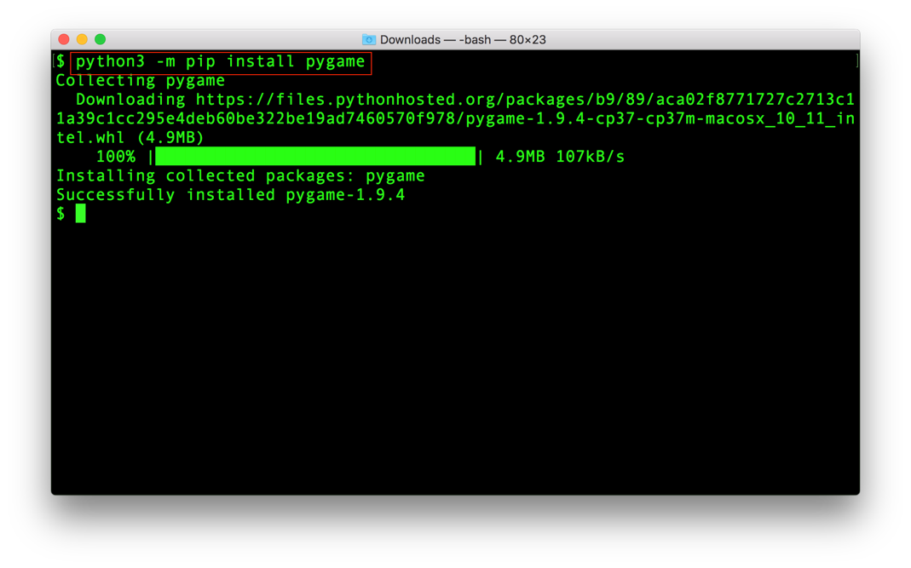
Installing PyGame

Slide 21
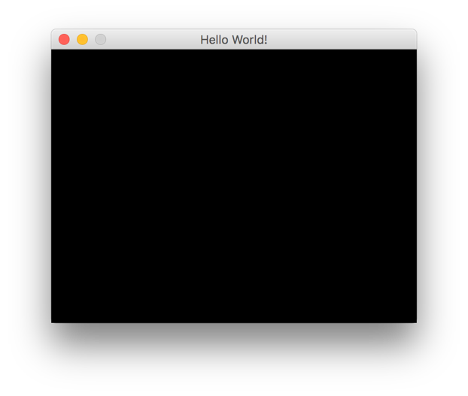
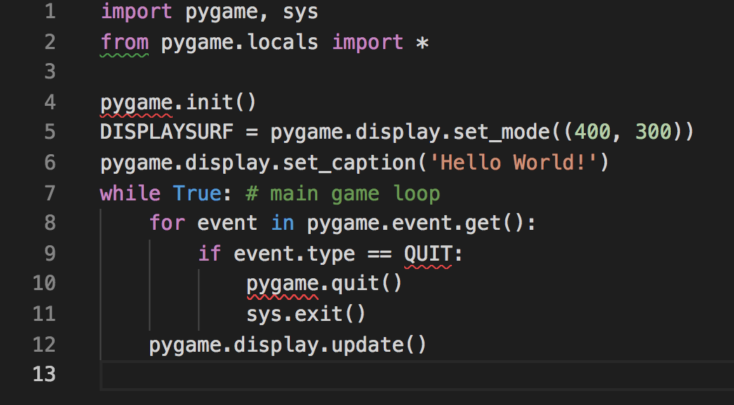
Writing Our First Game
Open up VS Code and then download and open the file “blankgame.py. You should see some code that looks like this:
When you run this code. You should see a little window open, like this one. This is the start of your first game!

Slide 22
So What Does This Code Do?

Slide 23
The Screen

Slide 24
Understanding The Screen
Our PyGame program has a line of code that says “set_mode((400, 300)). What does it mean?
The computer screen is made up of tiny boxes called “pixels”. The (400,300) tells the computer how many pixels wide and tall our window should be. We asked for a window 400 pixels wide and 300 pixels tall!
When we start drawing things inside our game window, we will do it by telling the computer which pixel or group of pixels we want to draw to.
X-axis
Y-axis
(200, 150)

Slide 25
Understanding The Screen
Our PyGame program has a line of code that says “set_mode((400, 300)). What does it mean?
The computer screen is made up of tiny boxes called “pixels”. The (400,300) tells the computer how many pixels wide and tall our window should be. We asked for a window 400 pixels wide and 300 pixels tall!
When we start drawing things inside our game window, we will do it by telling the computer which pixel or group of pixels we want to draw to.
X-axis
(0, 0)
Y-axis
(200, 150)

Slide 26
Understanding The Screen
Our PyGame program has a line of code that says “set_mode((400, 300)). What does it mean?
The computer screen is made up of tiny boxes called “pixels”. The (400,300) tells the computer how many pixels wide and tall our window should be. We asked for a window 400 pixels wide and 300 pixels tall!
When we start drawing things inside our game window, we will do it by telling the computer which pixel or group of pixels we want to draw to.
X-axis
(0, 0)
(400, 0)
Y-axis
(200, 150)

Slide 27
Understanding The Screen
Our PyGame program has a line of code that says “set_mode((400, 300)). What does it mean?
The computer screen is made up of tiny boxes called “pixels”. The (400,300) tells the computer how many pixels wide and tall our window should be. We asked for a window 400 pixels wide and 300 pixels tall!
When we start drawing things inside our game window, we will do it by telling the computer which pixel or group of pixels we want to draw to.
X-axis
(0, 0)
(400, 0)
Y-axis
(200, 150)
(0, 300)

Slide 28
Understanding The Screen
Our PyGame program has a line of code that says “set_mode((400, 300)). What does it mean?
The computer screen is made up of tiny boxes called “pixels”. The (400,300) tells the computer how many pixels wide and tall our window should be. We asked for a window 400 pixels wide and 300 pixels tall!
When we start drawing things inside our game window, we will do it by telling the computer which pixel or group of pixels we want to draw to.
X-axis
(0, 0)
(400, 0)
Y-axis
(200, 150)
(0, 300)
(400, 300)

Slide 29
So What?
X-axis
Later, when we draw things on the screen, we will do it by using these “pixel addresses”.
For instance, I might want to draw a green rectangle that starts at (200, 150) and ends at (400,300)…what would that look like?
(0, 0)
(400, 0)
Y-axis
(200, 150)
(0, 300)
(400, 300)

Slide 30
So What?
X-axis
Later, when we draw things on the screen, we will do it by using these “pixel addresses”.
For instance, I might want to draw a green rectangle that starts at (200, 150) and ends at (400,300)…what would that look like?
(0, 0)
(400, 0)
Y-axis
(200, 150)
(0, 300)
(400, 300)

Slide 31
Colors

Slide 32
Learning About Color
On the computer, colors are represented using the three primary colors: red, green, and blue. All the colors you see on your computer screen are made by mixing these three colors together. In PyGame, numbers from 0 to 255 represent how much of each color you need to mix to get the color you want. Like this:
RED = (255, 0, 0)
GREEN = (0, 255, 0)
BLUE = (0, 0, 255)
PURPLE = (128, 0, 128)
SILVER = (192, 192, 192)
How would I make black? What about white?

Slide 33
Learning About Color
On the computer, colors are represented using the three primary colors: red, green, and blue. All the colors you see on your computer screen are made by mixing these three colors together. In PyGame, numbers from 0 to 255 represent how much of each color you need to mix to get the color you want. Like this:
RED = (255, 0, 0)
GREEN = (0, 255, 0)
BLUE = (0, 0, 255)
PURPLE = (128, 0, 128)
SILVER = (192, 192, 192)
How would I make black? What about white?
BLACK = (0, 0, 0)
WHITE = (255, 255, 255)

Slide 34
A Good Use For Dictionaries
Let’s imagine that I am making my own game. I want to use lots of different colors to make the game look cool. Will I have to make a different variable for each one? No! We can use a dictionary!
my_colors = {
“red”: (255, 0, 0)
“green”: (0, 255, 0)
“blue”: (0, 0, 255)
“silver”: (192, 192, 192)
}
Later when I want to use a color in my program, I can simply write something like “my_colors[“silver”]” which is much easier to remember than (192, 192, 192)!

Slide 35
Another Way…
PyGame also has a special type of “object” called a “Color” object. We haven’t talked about Objects yet, but just remember for now you can also make a color like this:
RED = pygame.Color(255, 0, 0)
Inside your games, pygame.Color(255, 0, 0) is the same thing as (255, 0, 0) when you use “==“:
>>> pygame.Color(255, 0, 0) == (255, 0, 0)
True
That’s all you need to know for now. ☺

Slide 36
Drawing Shapes

Slide 37
Making Shapes
PyGame gives us several “shape primitives” (basic shapes) to work with. These can help us draw things like squares, rectangles, and circles on the screen.
For each shape, we have to tell the computer:
Where the shape starts and stops (using pixel addresses or pixel width and height)
What color the shape should be
What ”surface” the shape should be drawn on (we just have one in our programs so far…we saved it in a variable called DISPLAYSURF)
Here is a red rectangle that covers the top half of our 400x300 pixel screen:
pygame.draw.rect(DISPLAYSURF, RED, (0, 0, 400, 150))

Slide 38
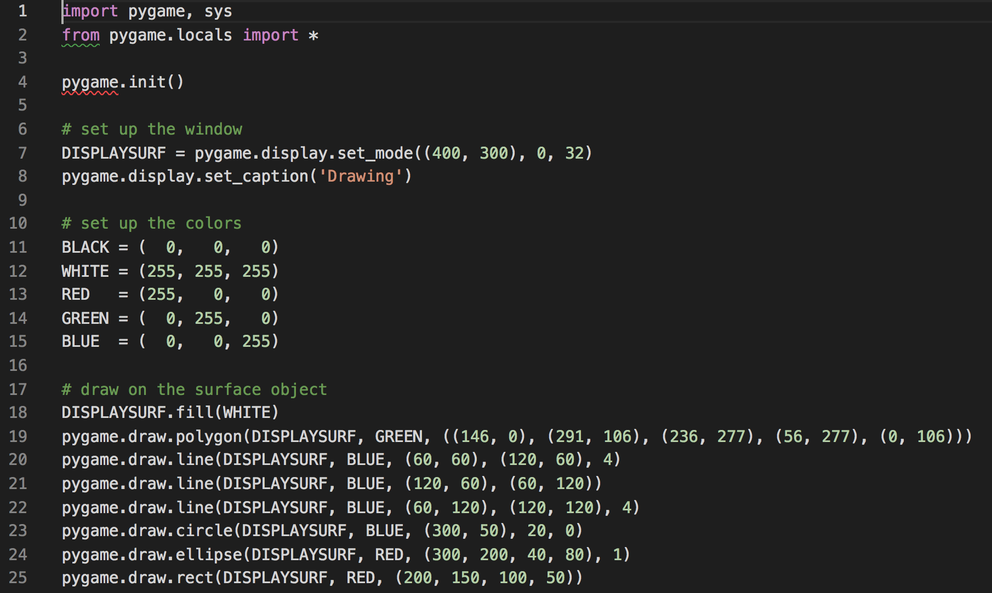
Try It Yourself
I have given you a program called “drawing.py” which I borrowed from this website: https://inventwithpython.com/pygame/
The code looks like this…try running it on your computer!

Slide 39
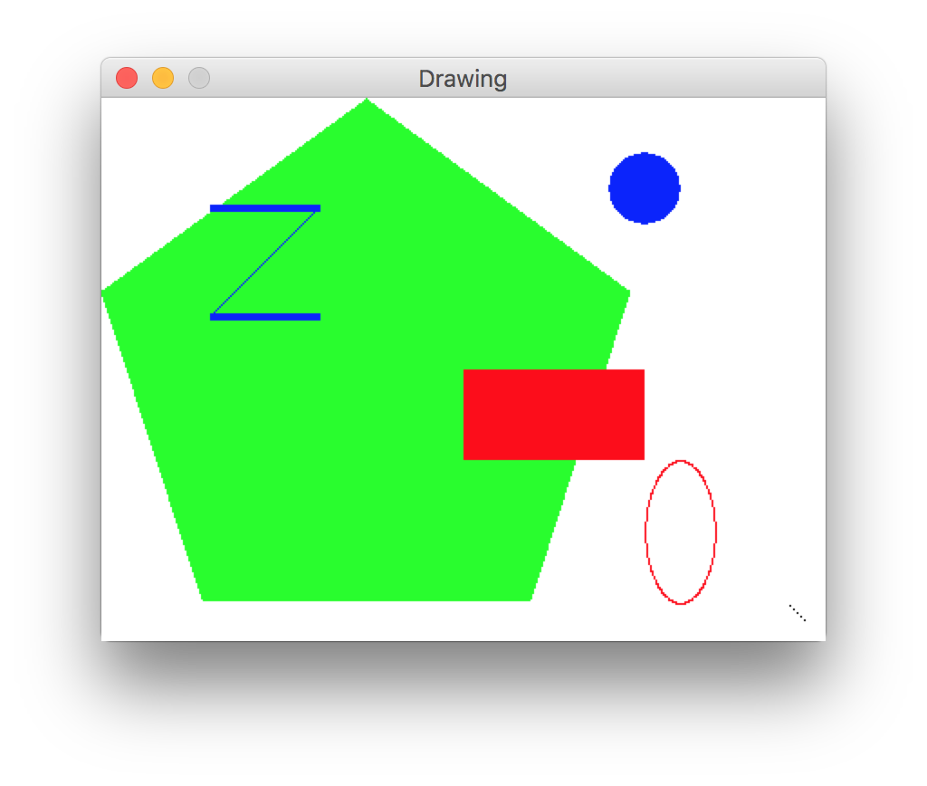
Try It Yourself
You should get a drawing like this one.

Slide 40
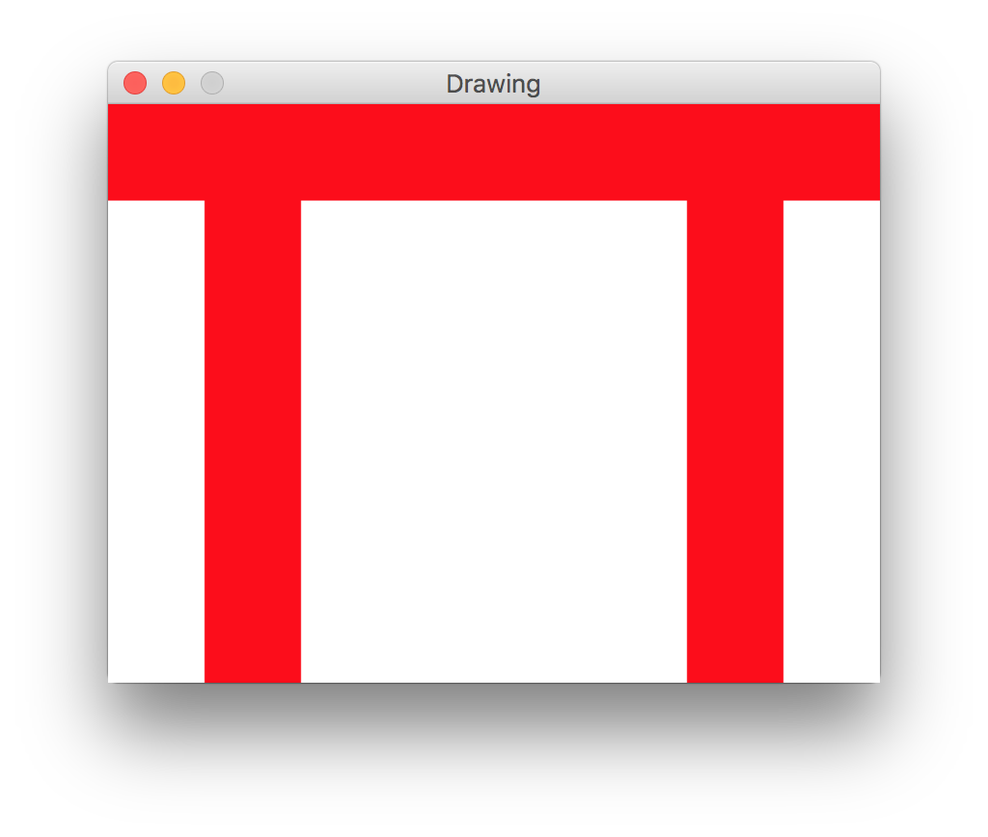
Code Break!
Use three rectangles to draw the “Pi” symbol, like this…

Slide 41
That’s it! Please take a look at your homework

Slide 42
Acknowledgements / Contributions
These slides are Copyright 2010- Charles R. Severance (www.dr-chuck.com) of the University of Michigan School of Information and made available under a Creative Commons Attribution 4.0 License. Please maintain this last slide in all copies of the document to comply with the attribution requirements of the license. If you make a change, feel free to add your name and organization to the list of contributors on this page as you republish the materials.
Initial Development: Charles Severance, University of Michigan School of Information
This deck uses the style and formatting of Charles R. Severance’s slides, but some of the content and code is borrowed from the wonderful book Making Games with Python & Pygame by Al Sweigart. Like Charles Severance and Al Sweigart, I license these slides and all associated content under a CC license.

