Slide 1

Welcome To Class!
Class 1 – Why Program?

Slide 2
About Me
My name is Jeremy
I work at Alibaba Cloud (阿里云)
I am 30 years old
I like programming a lot!

Slide 3
…And You?

Slide 4

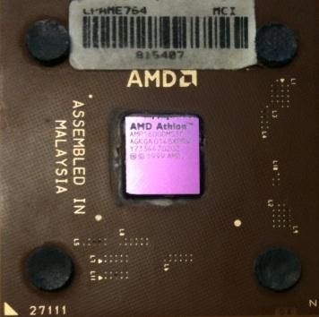
What Is A Computer?
A computer is a special machine that can follow instructions
What makes computers different from other kinds of machines?
What
Next?

Slide 5
Talking To The Computer
Computers cannot understand English or Chinese, so how do we talk to them? By using a programming language!
????????
Can you do my homework?

Slide 6
Why Be A Programmer?
To get some job done
- Finish your math homework
To make something for other people to use
- Write a game for your friends to play
- Make an APP and sell it for $$$!
Once you can program, YOU get to decide what the computer can do!

Slide 7
What Is Code? Software? A Program?
A sequence of stored instructions
- Like a piece of your brain inside the computer
- You solve a problem, translate the answer into computer code, and then in the future the computer can solve the problem for you (and maybe for other people too)
A piece of creative art – programs can be beautiful and powerful if they are written well

Slide 8
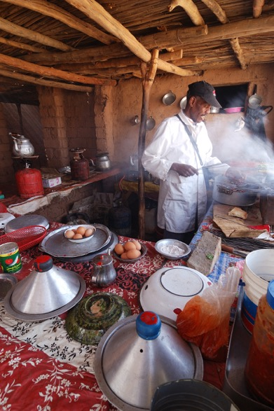
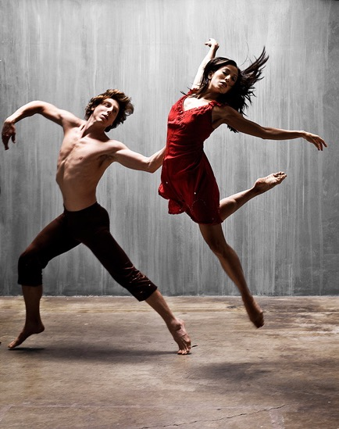
Programs For Humans
...and...
Barry Goyette from San Luis Obispo, USA - https://www.flickr.com/photos/93765931@N00/2147032210
Rosino - Flickr
Agdz, Morocco [2009]

Slide 9
Python

Slide 10
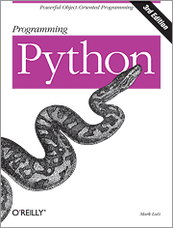
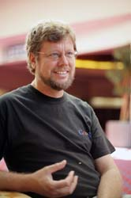

Python is a computer language. People who can write Python (or any other programming language) are called programmers. Learning to program is just like learning Chinese or English: it takes a long time to get it right, but the results are worth it!

Slide 11
Early Learner: Making Mistakes
We need to learn the Python language so we can communicate our instructions to Python. In the beginning, we will make a lot of mistakes, like a baby!
When you make a mistake, the computer says “syntax error” – this means the computer doesn’t know what you want it to do.
Whenever you see a “syntax error”, just remember that the computer isn’t trying to make you mad…it really just can’t understand what you want!

Slide 12
Talking To Python

Slide 13
$ python3
Python 3.5.1 (v3.5.1:37a07cee5969, Dec 5 2015, 21:12:44) [GCC 4.2.1 (Apple Inc. build 5666) (dot 3)] on darwinType "help", "copyright", "credits" or "license" for more information.
>>>
What next?

Slide 14
$ python3
Python 3.5.1 (v3.5.1:37a07cee5969, Dec 5 2015, 21:12:44) [GCC 4.2.1 (Apple Inc. build 5666) (dot 3)] on darwinType "help", "copyright", "credits" or "license" for more information.
>>> x = 1
>>> print(x)
1
>>> x = x + 1
>>> print(x)
2
>>> exit()
Try this out yourself!

Slide 15
So…What Can We Say?

Slide 16
Elements Of Python
Vocabulary / Words - Variables, Constants
Sentence structure - Expressions
Story structure – Conditionals, Loops, Functions

Slide 17
name = input('Enter file:')
handle = open(name)
counts = dict()
for line in handle:
words = line.split()
for word in words:
counts[word] = counts.get(word,0) + 1
bigcount = None
bigword = None
for word,count in counts.items():
if bigcount is None or count > bigcount:
bigword = word
bigcount = count
print(bigword, bigcount)
A short “story” about how to count words in a file in Python
python words.py
Enter file: words.txt
to 16

Slide 18
Sentences Or Lines
x = 2
x = x + 2
print(x)
Assignment statement
Assignment with expression
Print statement
Variable
Operator
Constant
Function

Slide 19
Different Ways To Talk To Python

Slide 20
Interactive Versus Script
Interactive
- You type directly to Python one line at a time and it responds
Script
- You enter many statements (lines) into a file and tell Python to read the file line-by-line and execute (run) each statement

Slide 21
Program Steps Or Program Flow
Like a recipe or installation instructions, a program is a sequence of steps to be done in order (顺序).
Some steps are conditional - they may be skipped.
Sometimes a step or group of steps must be repeated.
Sometimes we store a set of steps to be used over and over in different places in our program (these are called functions)

Slide 22
Sequential Steps
x = 2
Program:
x = 2
print(x)
x = x + 2
print(x)
Output:
2
4
print(x)
x = x + 2
print(x)
When a program is running, it flows from one step to the next. As programmers, we set up “paths” for the program to follow.

Slide 23
Conditional Steps
x = 5
Yes
x < 10 ?
Program:
x = 5
if x < 10:
print('Smaller')
if x > 20:
print('Bigger')
print('Finis')
print('Smaller')
Output:
Smaller
Finis
No
Yes
x > 20 ?
No
print('Bigger')
print('Finis')

Slide 24
Repeated Steps
n = 5
No
Yes
Output:
5
4
3
2
1
Blastoff!
n > 0 ?
Program:
n = 5
while n > 0 :
print(n)
n = n – 1
print('Blastoff!')
print(n)
n = n -1
print('Blastoff')
Loops (repeated steps) have iteration variables that change each time through a loop.

Slide 25
name = input('Enter file:')
handle = open(name, 'r')
counts = dict()
for line in handle:
words = line.split()
for word in words:
counts[word] = counts.get(word,0) + 1
bigcount = None
bigword = None
for word,count in counts.items():
if bigcount is None or count > bigcount:
bigword = word
bigcount = count
print(bigword, bigcount)
Sequential
Repeated
Conditional

Slide 26
name = input('Enter file:')
handle = open(name, 'r')
counts = dict()
for line in handle:
words = line.split()
for word in words:
counts[word] = counts.get(word,0) + 1
bigcount = None
bigword = None
for word,count in counts.items():
if bigcount is None or count > bigcount:
bigword = word
bigcount = count
print(bigword, bigcount)
A short Python “Story” about how to count words in a file
A word used to read data from a user
A sentence about updating one of the many counts
A paragraph about how to find the largest item in a list

Slide 27
Summary
That’s it! Please take a look at your homework. ;)

Slide 28
Acknowledgements / Contributions
These slides are Copyright 2010- Charles R. Severance (www.dr-chuck.com) of the University of Michigan School of Information and made available under a Creative Commons Attribution 4.0 License. Please maintain this last slide in all copies of the document to comply with the attribution requirements of the license. If you make a change, feel free to add your name and organization to the list of contributors on this page as you republish the materials.
Initial Development: Charles Severance, University of Michigan School of Information
Slides condensed into an 8 deck series aimed at younger learners in China by Jeremy Pedersen.

