Slide 1

Lists and Dictionaries
Class 5

Slide 2
But First! A Quick Review…

Slide 3
Definite Loops
Happy New Year: Joseph Happy New Year: Glenn
Happy New Year: Sally
Done!
friends = ['Joseph', 'Glenn', 'Sally']
for friend in friends :
print('Happy New Year:', friend)
print('Done!')

Slide 4
Indefinite Loops
No
True ?
Yes
....
while True:
line = input('> ')
if line == 'done' :
break
print(line)
print('Done!')
break
...
print('Done')

Slide 5
Lists
Notes:
Note from Chuck. If you are using these materials, you can remove the UM logo and replace it with your own, but please retain the CC-BY logo on the first page as well as retain the acknowledgement page(s) at the end.

Slide 6
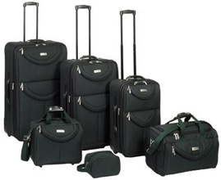
A List is a Kind of Collection
A collection allows us to put many values in a single “variable”
A collection is nice because we can carry many values around in one convenient package (variable).
friends = [ 'Joseph', 'Glenn', 'Sally' ]
bag = [ 'socks', 'shirt', 'perfume' ]

Slide 7
We Already Use Lists!
for i in [5, 4, 3, 2, 1] :
print(i)
print('Blastoff!')
5
4
3
2
1
Blastoff!

Slide 8
Lists and Definite Loops = Best Friends
friends = ['Joseph', 'Glenn', 'Sally']
for friend in friends :
print('Happy New Year:', friend)
print('Done!')
Happy New Year: Joseph
Happy New Year: Glenn
Happy New Year: Sally
Done!
z = ['Joseph', 'Glenn', 'Sally']
for x in z:
print('Happy New Year:', x)
print('Done!')

Slide 9
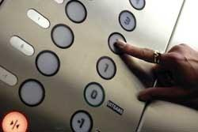
Looking Inside Lists
Just like strings, we can get at any single element in a list using an index specified in square brackets
>>> friends = [ 'Joseph', 'Glenn', 'Sally' ]
>>> print(friends[1])
Glenn
>>>
Joseph
Glenn
Sally
0
1
2

Slide 10
How Long is a List?
The len() function takes a list as a parameter and returns the number of elements in the list
Actually len() tells us the number of elements of any set or sequence (such as a string...)
>>> greet = 'Hello Bob'
>>> print(len(greet))
9
>>> x = [ 1, 2, 'joe', 99]
>>> print(len(x))
4
>>>

Slide 11
Using the range Function
The range function returns a list of numbers that range from zero to one less than the parameter
We can construct an index loop using for and an integer iterator
>>> print(range(4))
[0, 1, 2, 3]
>>> friends = ['Joseph', 'Glenn', 'Sally']
>>> print(len(friends))
3
>>> print(range(len(friends)))
[0, 1, 2]
>>>

Slide 12
A Tale of Two Loops...
>>> friends = ['Joseph', 'Glenn', 'Sally']
>>> print(len(friends))
3
>>> print(range(len(friends)))
[0, 1, 2]
>>>
friends = ['Joseph', 'Glenn', 'Sally']
for friend in friends :
print('Happy New Year:', friend)
for i in range(len(friends)) :
friend = friends[i]
print('Happy New Year:', friend)
Happy New Year: Joseph
Happy New Year: Glenn
Happy New Year: Sally

Slide 13
Concatenating Lists Using +
>>> a = [1, 2, 3]
>>> b = [4, 5, 6]
>>> c = a + b
>>> print(c)
[1, 2, 3, 4, 5, 6]
>>> print(a)
[1, 2, 3]
We can create a new list by adding two existing lists together

Slide 14
Lists Can Be Sliced Using :
>>> t = [9, 41, 12, 3, 74, 15]
>>> t[1:3]
[41,12]
>>> t[:4]
[9, 41, 12, 3]
>>> t[3:]
[3, 74, 15]
>>> t[:]
[9, 41, 12, 3, 74, 15]
Remember: Just like in strings, the second number is “up to but not including”

Slide 15
List Methods
>>> x = list()
>>> type(x)
<type 'list'>
>>> dir(x)
['append', 'count', 'extend', 'index', 'insert', 'pop', 'remove', 'reverse', 'sort']
>>>
http://docs.python.org/tutorial/datastructures.html

Slide 16
Building A List from Scratch
We can create an empty list and then add elements using the append method
The list stays in order and new elements are added at the end of the list
>>> stuff = list()
>>> stuff.append('book')
>>> stuff.append(99)
>>> print(stuff)
['book', 99]
>>> stuff.append('cookie')
>>> print(stuff)
['book', 99, 'cookie']

Slide 17
Is Something In A List?
Python provides two operators that let you check if an item is in a list
These are logical operators that return True or False
They do not change the list at all
>>> some = [1, 9, 21, 10, 16]
>>> 9 in some
True
>>> 15 in some
False
>>> 20 not in some
True
>>>

Slide 18
Lists Are In Order
A list can hold many items and keeps those items in order (顺序) until we do something to change the order
A list can be sorted (i.e., change its order)
The sort method means “sort yourself”
>>> friends = [ 'Joseph', 'Glenn', 'Sally' ]
>>> friends.sort()
>>> print(friends)
['Glenn', 'Joseph', 'Sally']
>>> print(friends[1])
Joseph
>>>

Slide 19
Built-in Functions and Lists
There are a number of functions built into Python that take lists as parameters
Remember the loops we built? These are much simpler.
>>> nums = [3, 41, 12, 9, 74, 15]
>>> print(len(nums))
6
>>> print(max(nums))
74
>>> print(min(nums))
3
>>> print(sum(nums))
154
>>> print(sum(nums)/len(nums))
25.6

Slide 20
Enter a number: 3
Enter a number: 9
Enter a number: 5
Enter a number: done
Average: 5.66666666667
total = 0
count = 0
while True :
inp = input('Enter a number: ')
if inp == 'done’:
break
value = float(inp)
total = total + value
count = count + 1
average = total / count
print('Average:', average)
numlist = list()
while True :
inp = input('Enter a number: ')
if inp == 'done' : break
value = float(inp)
numlist.append(value)
average = sum(numlist) / len(numlist)
print('Average:', average)

Slide 21
List Summary
Concept of a collection
Lists and definite loops
Indexing and lookup
List mutability
Functions: len, min, max, sum
Slicing lists
List methods: append, remove
Sorting lists
Splitting strings into lists of words
Using split to parse strings

Slide 22
Code Break
Write a short program that lets the user enter as many numbers as they want. When the user types “done”, the program should print out all the numbers the user entered in order from smallest to biggest, and it should print out the average of all the numbers. You should use these concepts in your program:
while loop
break
sum() function
len() function

Slide 23
Dictionaries

Slide 24

What is a Collection?
A collection is nice because we can put more than one value in it and carry them all around in one convenient package
We have a bunch of values in a single “variable”
We do this by having more than one place “in” the variable
We have ways of finding the different places in the variable

Slide 25
What is Not a “Collection”?
Most of our variables have one value in them - when we put a new value in the variable - the old value is overwritten
$ python
>>> x = 2
>>> x = 4
>>> print(x)
4

Slide 26
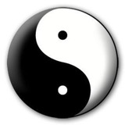


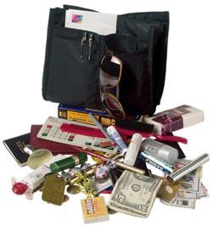
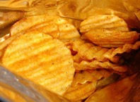
A Story of Two Collections..
List
- A linear collection of values that stay in order
Dictionary
- A “bag” of values, each with its own label

Slide 27
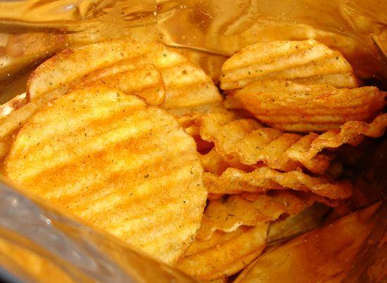
Dictionaries
tissue
calculator
perfume
money
candy
http://en.wikipedia.org/wiki/Associative_array

Slide 28
Dictionaries
>>> purse = dict()
>>> purse['money'] = 12
>>> purse['candy'] = 3
>>> purse['tissues'] = 75
>>> print(purse)
{'money': 12, 'tissues': 75, 'candy': 3}
>>> print(purse['candy'])
3
>>> purse['candy'] = purse['candy'] + 2
>>> print(purse)
{'money': 12, 'tissues': 75, 'candy': 5}
Lists index (locate) their entries based on the position in the list
Dictionaries are like bags - no order
So we index (locate) the things we put in the dictionary with a “lookup tag” (a “name”)

Slide 29
Comparing Lists And Dictionaries
Dictionaries are like lists except that they use keys (names) instead of numbers to look up values
>>> ddd = dict()
>>> ddd['age'] = 21
>>> ddd['course'] = 182
>>> print(ddd)
{'course': 182, 'age': 21}
>>> ddd['age'] = 23
>>> print(ddd)
{'course': 182, 'age': 23}
>>> lst = list()
>>> lst.append(21)
>>> lst.append(183)
>>> print(lst)
[21, 183]
>>> lst[0] = 23
>>> print(lst)
[23, 183]

Slide 30
>>> lst = list()
>>> lst.append(21)
>>> lst.append(183)
>>> print(lst)
[21, 183]
>>> lst[0] = 23
>>> print(lst)
[23, 183]
List
Key
Value
[0]
21
lst
[1]
183
>>> ddd = dict()
>>> ddd['age'] = 21
>>> ddd['course'] = 182
>>> print(ddd)
{'course': 182, 'age': 21}
>>> ddd['age'] = 23
>>> print(ddd)
{'course': 182, 'age': 23}
Dictionary
Key
Value
['course']
182
ddd
['age']
21

Slide 31
Dictionary Literals (Constants)
Dictionary literals use curly braces and have a list of key : value pairs
You can make an empty dictionary using empty curly braces
>>> jjj = { 'chuck' : 1 , 'fred' : 42, 'jan': 100}
>>> print(jjj)
{'jan': 100, 'chuck': 1, 'fred': 42}
>>> ooo = { }
>>> print(ooo)
{}
>>>

Slide 32
Most Common Name?
marquard
cwen
cwen
zhen
zhen
marquard
csev
csev
zhen
marquard
zhen
csev
zhen

Slide 33
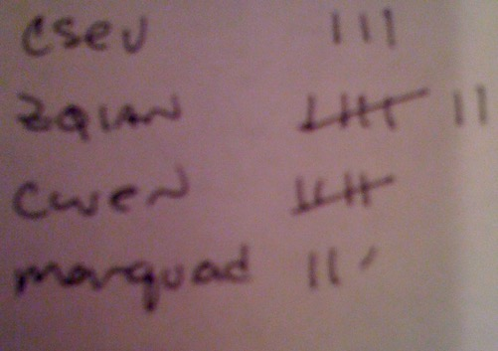
Most Common Name?
marquard
cwen
cwen
zhen
zhen
marquard
csev
csev
zhen
marquard
zhen
csev
zhen

Slide 34
Counting with a Dictionary
One common use of dictionaries is counting how often we “see” something
Key
Value
>>> ccc = dict()
>>> ccc['csev'] = 1
>>> ccc['cwen'] = 1
>>> print(ccc)
{'csev': 1, 'cwen': 1}
>>> ccc['cwen'] = ccc['cwen'] + 1
>>> print(ccc)
{'csev': 1, 'cwen': 2}

Slide 35
Dictionary Tracebacks (Errors)
It is an error to reference a key which is not in the dictionary
We can use the in operator to see if a key is in the dictionary
>>> ccc = dict()
>>> print(ccc['csev'])
Traceback (most recent call last):
File "<stdin>", line 1, in <module>
KeyError: 'csev'
>>> 'csev' in ccc
False

Slide 36
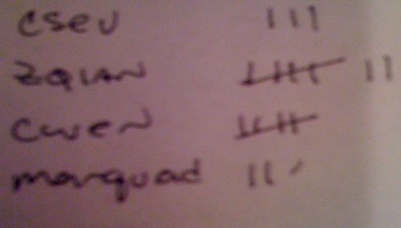
When We See A New Name
When we encounter a new name, we need to add a new entry in the dictionary and if this the second or later time we have seen the name, we simply add one to the count in the dictionary under that name
counts = dict()
names = ['csev', 'cwen', 'csev', 'zqian', 'cwen']
for name in names :
if name not in counts:
counts[name] = 1
else :
counts[name] = counts[name] + 1
print(counts)
{'csev': 2, 'zqian': 1, 'cwen': 2}

Slide 37
The get Method For Dictionaries
The pattern of checking to see if a key is already in a dictionary and assuming a default value if the key is not there is so common that there is a method called get() that does this for us
if name in counts:
x = counts[name]
else :
x = 0
x = counts.get(name, 0)
Default value if key does not exist (and no Traceback).
{'csev': 2, 'zqian': 1, 'cwen': 2}

Slide 38
Simplified Counting With get()
We can use get() and provide a default value of zero when the key is not yet in the dictionary - and then just add one
counts = dict()
names = ['csev', 'cwen', 'csev', 'zqian', 'cwen']
for name in names :
counts[name] = counts.get(name, 0) + 1
print(counts)
{'csev': 2, 'zqian': 1, 'cwen': 2}
Default

Slide 39
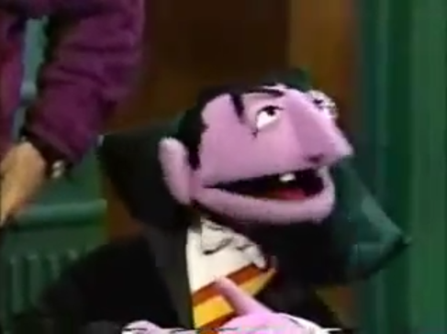
Simplified Counting With get()
counts = dict()
names = ['csev', 'cwen', 'csev', 'zqian', 'cwen']
for name in names :
counts[name] = counts.get(name, 0) + 1
print(counts)
http://www.youtube.com/watch?v=EHJ9uYx5L58

Slide 40
Definite Loops And Dictionaries
Even though dictionaries are not stored in order, we can write a for loop that goes through all the entries in a dictionary - actually it goes through all of the keys in the dictionary and looks up the values
>>> counts = { 'chuck' : 1 , 'fred' : 42, 'jan': 100}
>>> for key in counts:
... print(key, counts[key])
...
jan 100
chuck 1
fred 42
>>>

Slide 41
Retrieving Lists of Keys and Values
>>> jjj = { 'chuck' : 1 , 'fred' : 42, 'jan': 100}
>>> print(list(jjj))
['jan', 'chuck', 'fred']
>>> print(jjj.keys())
['jan', 'chuck', 'fred']
>>> print(jjj.values())
[100, 1, 42]
>>> print(jjj.items())
[('jan', 100), ('chuck', 1), ('fred', 42)]
>>>
You can get a list of keys, values, or items (both) from a dictionary

Slide 42
Code Break
Write a program which can count all the words in this list. Your program should then print out how many times each word appeared in the list:
x = ['the', 'clown', 'got', 'in', 'the', 'car', 'and', 'drove', 'the', 'car', 'down', 'the', 'road', 'to', 'the', 'house', 'and', 'then', 'got', 'out', 'of', 'the', 'car’]

Slide 43
That’s It!
Take a look at your homework and submit before next class. ☺

Slide 44
Acknowledgements / Contributions
These slides are Copyright 2010- Charles R. Severance (www.dr-chuck.com) of the University of Michigan School of Information and made available under a Creative Commons Attribution 4.0 License. Please maintain this last slide in all copies of the document to comply with the attribution requirements of the license. If you make a change, feel free to add your name and organization to the list of contributors on this page as you republish the materials.
Initial Development: Charles Severance, University of Michigan School of Information
Slides condensed into an 8 deck series aimed at younger learners in China by Jeremy Pedersen.

