Slide 1

Welcome To Class!
Class 1 – Why Program?
Based On Slides From the class “Python for Everybody”
www.py4e.com

Slide 2
About Me
My name is Jeremy
I work at Alibaba Cloud (阿里云)
I am 28 years old
I like programming a lot!

Slide 3
And You?

Slide 4

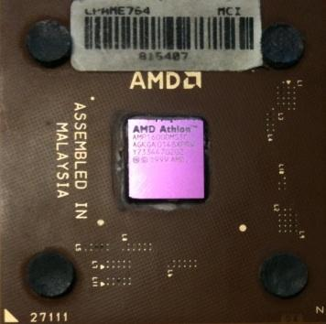
What is a Computer?
A computer is a special machine that can follow instructions
What makes computers different from other kinds of machines?
What
Next?

Slide 5
Talking to the Computer
Computers cannot understand English or Chinese, so how do we talk to them? By using a programming language!
????????
Can you do my homework?

Slide 6
Users vs. Programmers
Users are people who can use the software on a computer, but cannot make their own new software
Programmers are the people who can write new software for the computer to run: they tell the computer what to do!
Once you can program, YOU get to decide what the computer should do

Slide 7
Why be a Programmer?
To get some job done
  - Finish our math homework
To make something for other people to use
  - Write a game for your friends to play
  - Make a studying APP and sell it for $$$!

Slide 8
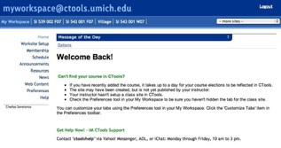
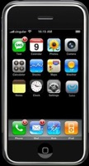

User
Computer
Hardware + Software
Programmer
As a programmer, it is your job to understand the computer’s hardware and software well enough to do make it do what you want. This can be a very challenging task and may take years to master. Because it is hard, people pay a lot of money for good programmers. Colleges and Universities want them as students (and teachers), too!

Slide 9
What is Code? Software? A Program?
A sequence of stored instructions
  - Like a piece of our brain inside the computer
  - We solve a problem, translate the answer into computer code, and then in the future the computer can solve the problem for us (and maybe for other people too)
  A piece of creative art – Programs can be beautiful and powerful if they are written well

Slide 10
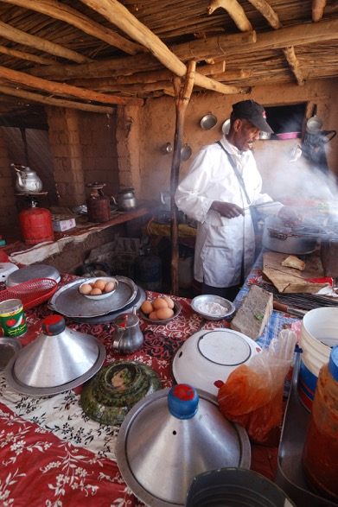
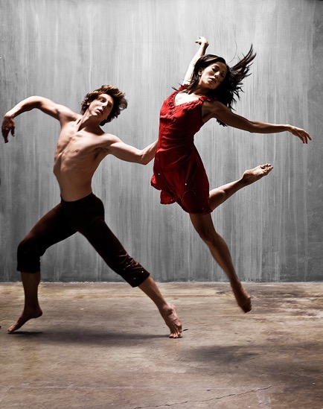
Programs for Humans
...and...
Barry Goyette from San Luis Obispo, USA - https://www.flickr.com/photos/93765931@N00/2147032210
Rosino - Flickr
Agdz, Morocco [2009]

Slide 11
Hardware Architecture
(What is Inside the Computer?)

Slide 12
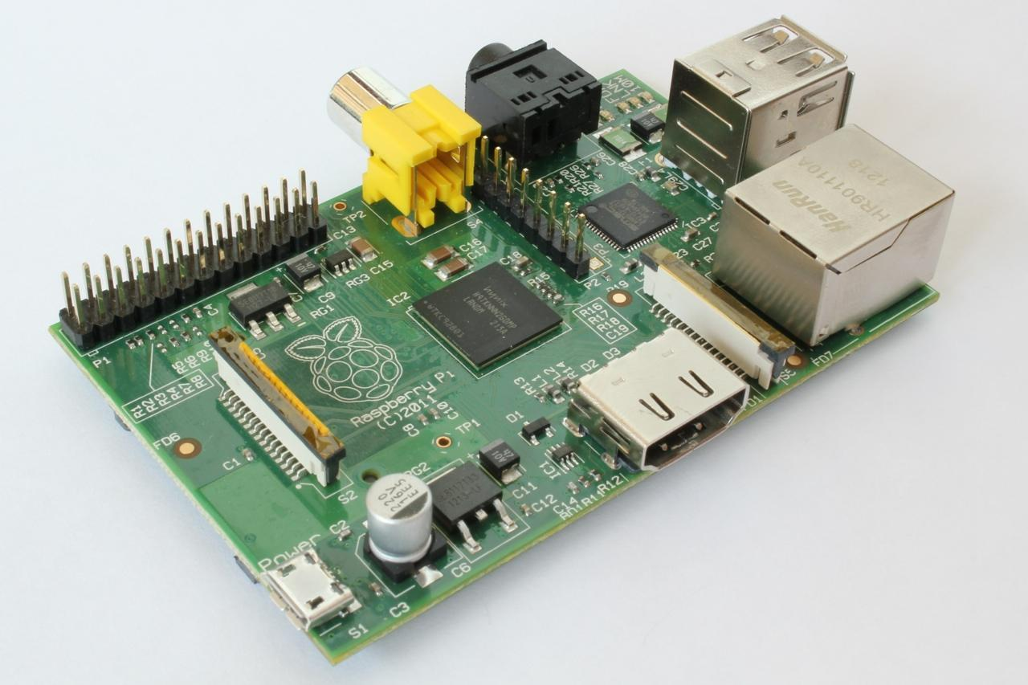
http://upload.wikimedia.org/wikipedia/commons/3/3d/RaspberryPi.jpg

Slide 13
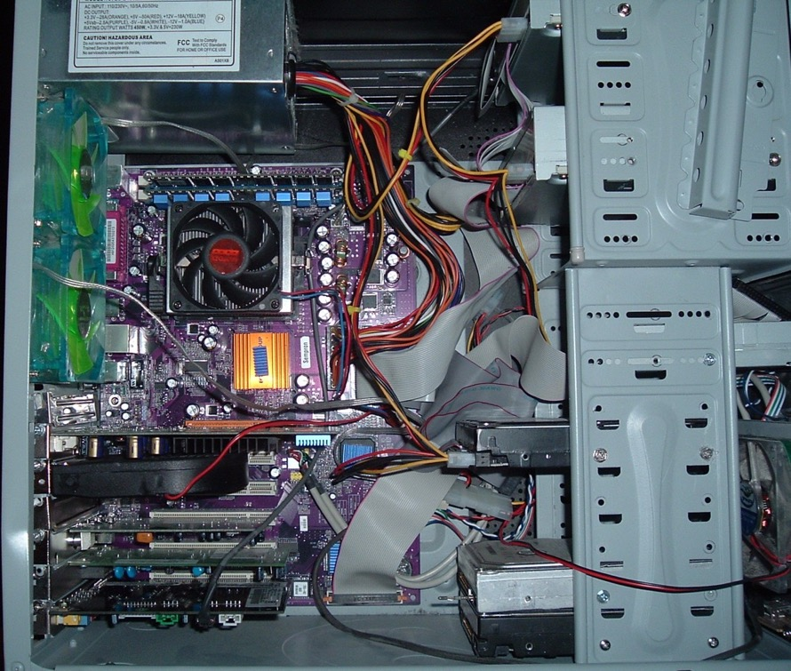
https://upload.wikimedia.org/wikipedia/commons/b/b5/Inside_armadnigenerals_computer.jpg
ArmadniGeneral at the English language Wikipedia [GFDL (http://www.gnu.org/copyleft/fdl.html) or CC-BY-SA-3.0 (http://creativecommons.org/licenses/by-sa/3.0/)]

Slide 14
Software
What
Next?
Generic
Computer
Input
and Output
Devices
Central
Processing
Unit
Secondary
Memory
Main
Memory

Slide 15
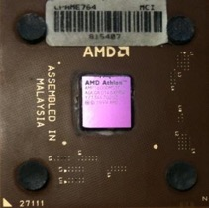
Definitions
Central Processing Unit: Runs the Program - The CPU is
always wondering “what to do next”. Not the brains
exactly - very dumb but very very fast
Input Devices: Keyboard, Mouse, Touch Screen, ???
Output Devices: Screen, Speakers, Printer, ???
Main Memory: Fast, small, and temporary (often called RAM)
Secondary Memory: Big, slow, permanent (hard drive or sometimes just “disk”)
What
Next?

Slide 16
Generic
Computer
Software
What
Next?
Input
and Output
Devices
Central
Processing
Unit
Secondary
Memory
if x < 3: print
Main
Memory

Slide 17
Generic
Computer
Software
What
Next?
Input
and Output
Devices
Central
Processing
Unit
Secondary
Memory
01001001
00111001
Main
Memory
Machine
Language

Slide 18
Python as a Language

Slide 19
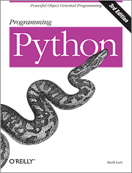
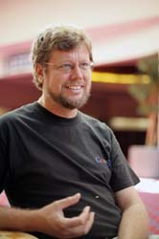
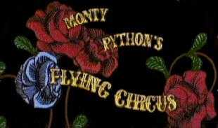
Python is a computer language. People who can write Python (or any other programming language) are called programmers. Learning to program is just like learning Chinese or English: it takes a long time to get it right, but the results are worth it!

Slide 20
Early Learner: Syntax Errors
We need to learn the Python language so we can communicate our instructions to Python. In the beginning we will make lots of mistakes and speak gibberish like small children.
When you make a mistake, the computer does not think you are “cute”. It says “syntax error” - given that it knows the language and you are just learning it. It seems like Python is cruel and unfeeling.
You must remember that you are intelligent and can learn. The computer is simple and very fast, but cannot learn. So it is easier for you to learn Python than for the computer to learn English...

Slide 21
Talking to Python

Slide 22
$ python3
Python 3.5.1 (v3.5.1:37a07cee5969, Dec 5 2015, 21:12:44) [GCC 4.2.1 (Apple Inc. build 5666) (dot 3)] on darwinType "help", "copyright", "credits" or "license" for more information.
>>>
What next?

Slide 23
$ python3
Python 3.5.1 (v3.5.1:37a07cee5969, Dec 5 2015, 21:12:44) [GCC 4.2.1 (Apple Inc. build 5666) (dot 3)] on darwinType "help", "copyright", "credits" or "license" for more information.
>>> x = 1
>>> print(x)
1
>>> x = x + 1
>>> print(x)
2
>>> exit()
This is a good test to make sure that you have Python correctly installed. Note that quit() also works to end the interactive session.

Slide 24
What Do We Say?

Slide 25
Elements of Python
Vocabulary / Words - Variables and Reserved words (Chapter 2)
Sentence structure - valid syntax patterns (Chapters 3-5)
Story structure - constructing a program for a purpose

Slide 26
name = input('Enter file:')
handle = open(name)
counts = dict()
for line in handle:
words = line.split()
for word in words:
counts[word] = counts.get(word,0) + 1
bigcount = None
bigword = None
for word,count in counts.items():
if bigcount is None or count > bigcount:
bigword = word
bigcount = count
print(bigword, bigcount)
A short “story” about how to count words in a file in Python
python words.py
Enter file: words.txt
to 16

Slide 27
Reserved Words
You cannot use reserved words as variable names / identifiers
False class return is finally
None if for lambda continue
True def from while nonlocal
and del global not with
as elif try or yield
assert else import pass
break except in raise

Slide 28
Sentences or Lines
x = 2
x = x + 2
print(x)
Assignment statement
Assignment with expression
Print statement
Variable
Operator
Constant
Function

Slide 29
Programming Paragraphs

Slide 30
Python Scripts
Interactive Python is good for experiments and programs of 3-4 lines long.
Most programs are much longer, so we type them into a file and tell Python to run the commands in the file.
In a sense, we are “giving Python a script”.
As a convention, we add “.py” as the suffix on the end of these files to indicate they contain Python.

Slide 31
Interactive versus Script
Interactive
  - You type directly to Python one line at a time and it responds
Script
  - You enter many statements (lines) into a file and tell Python to read the file line-by-line and execute (run) each statement

Slide 32
Program Steps or Program Flow
Like a recipe or installation instructions, a program is a sequence of steps to be done in order.
Some steps are conditional - they may be skipped.
Sometimes a step or group of steps is to be repeated.
Sometimes we store a set of steps to be used over and over as needed several places throughout the program (these are called functions and we will get to them later)

Slide 33
Sequential Steps
x = 2
Program:
x = 2
print(x)
x = x + 2
print(x)
Output:
2
4
print(x)
x = x + 2
print(x)
When a program is running, it flows from one step to the next. As programmers, we set up “paths” for the program to follow.

Slide 34
Conditional Steps
x = 5
Yes
x < 10 ?
Program:
x = 5
if x < 10:
print('Smaller')
if x > 20:
print('Bigger')
print('Finis')
print('Smaller')
Output:
Smaller
Finis
No
Yes
x > 20 ?
No
print('Bigger')
print('Finis')

Slide 35
Repeated Steps
n = 5
No
Yes
Output:
5
4
3
2
1
Blastoff!
n > 0 ?
Program:
n = 5
while n > 0 :
print(n)
n = n – 1
print('Blastoff!')
print(n)
n = n -1
print('Blastoff')
Loops (repeated steps) have iteration variables that change each time through a loop.

Slide 36
name = input('Enter file:')
handle = open(name, 'r')
counts = dict()
for line in handle:
words = line.split()
for word in words:
counts[word] = counts.get(word,0) + 1
bigcount = None
bigword = None
for word,count in counts.items():
if bigcount is None or count > bigcount:
bigword = word
bigcount = count
print(bigword, bigcount)
Sequential
Repeated
Conditional

Slide 37
name = input('Enter file:')
handle = open(name, 'r')
counts = dict()
for line in handle:
words = line.split()
for word in words:
counts[word] = counts.get(word,0) + 1
bigcount = None
bigword = None
for word,count in counts.items():
if bigcount is None or count > bigcount:
bigword = word
bigcount = count
print(bigword, bigcount)
A short Python “Story” about how to count words in a file
A word used to read data from a user
A sentence about updating one of the many counts
A paragraph about how to find the largest item in a list

Slide 38
Summary
That’s it! Please take a look at the quiz I have assigned to you. ;)

Slide 39
Acknowledgements / Contributions
These slides are Copyright 2010- Charles R. Severance (www.dr-chuck.com) of the University of Michigan School of Information and made available under a Creative Commons Attribution 4.0 License. Please maintain this last slide in all copies of the document to comply with the attribution requirements of the license. If you make a change, feel free to add your name and organization to the list of contributors on this page as you republish the materials.
Initial Development: Charles Severance, University of Michigan School of Information
Slides condensed into an 8 deck series aimed at younger learners in China by Jeremy Pedersen.

