Slide 1

Animation, Text, and Sound
Class 6
Making Games With Python and PyGame
https://inventwithpython.com/pygame/

Slide 2
Making Transparent Shapes
Notes:
Note from Chuck. If you are using these materials, you can remove the UM logo and replace it with your own, but please retain the CC-BY logo on the first page as well as retain the entire last page.

Slide 3
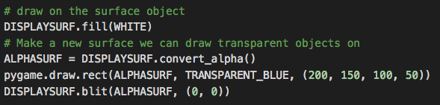
Transparency (Alpha)
In PyGame, you can draw shapes that are “see through” by setting the alpha value when setting the shape’s color. Code to draw a 50% see-through blue rectangle on the screen would look like this:
Notes:
Note from Chuck. If you are using these materials, you can remove the UM logo and replace it with your own, but please retain the CC-BY logo on the first page as well as retain the entire last page.

Slide 4
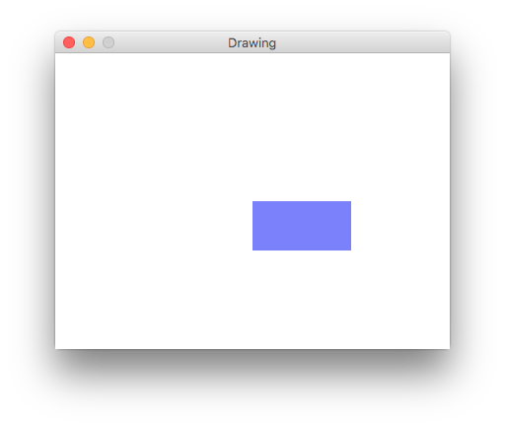
Transparency (Alpha)
And the result would look like this…
Notes:
Note from Chuck. If you are using these materials, you can remove the UM logo and replace it with your own, but please retain the CC-BY logo on the first page as well as retain the entire last page.

Slide 5
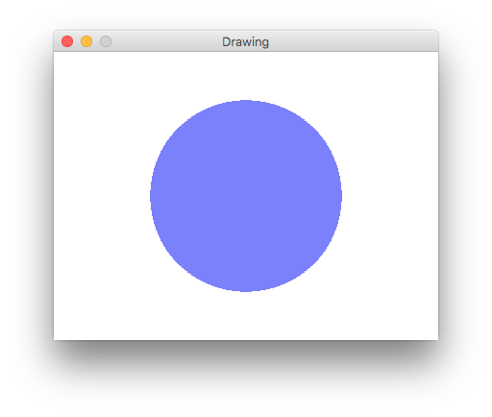
Now You Try…
Make a 50% transparent blue circle, like this one:
Notes:
Note from Chuck. If you are using these materials, you can remove the UM logo and replace it with your own, but please retain the CC-BY logo on the first page as well as retain the entire last page.

Slide 6
Drawing To A Single Pixel

Slide 7
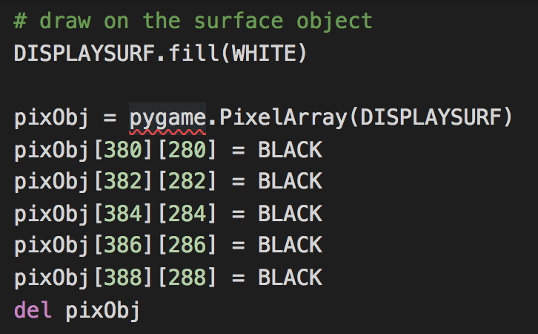
Drawing To A Single Pixel
You can create a “pixel object” so you can change individual pixels on the screen. You must remember to delete your pixel object when you are done, or you won’t be able to draw any more shapes. An example:
Notes:
Note from Chuck. If you are using these materials, you can remove the UM logo and replace it with your own, but please retain the CC-BY logo on the first page as well as retain the entire last page.

Slide 8
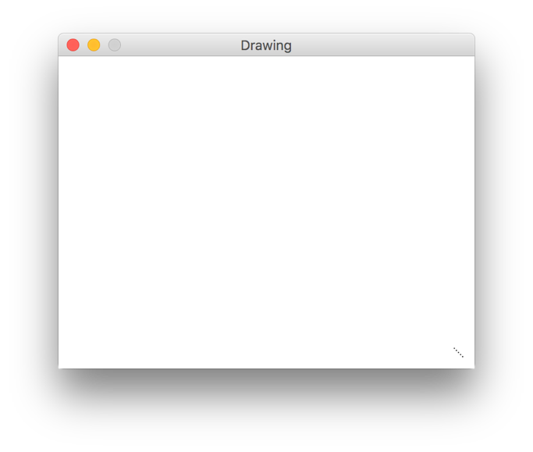

Drawing To A Single Pixel
The result looks like this:
Notes:
Note from Chuck. If you are using these materials, you can remove the UM logo and replace it with your own, but please retain the CC-BY logo on the first page as well as retain the entire last page.

Slide 9
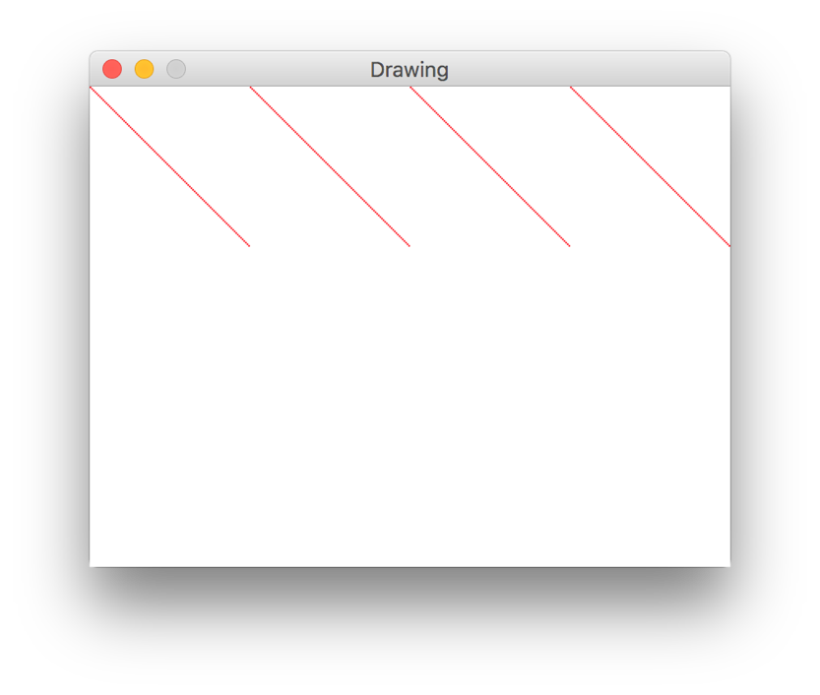
Now You Try…
Try using a “for” loop and the “%” operator to make a 100-pixel high pattern like this one:
Notes:
Note from Chuck. If you are using these materials, you can remove the UM logo and replace it with your own, but please retain the CC-BY logo on the first page as well as retain the entire last page.

Slide 10
Loading Images

Slide 11
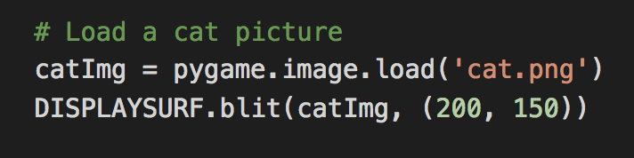
Loading Images
Remember the “blit()” function we used to draw transparent shapes? We can also load images from a file and use “blit()” to draw them on the screen. Like this!
This will only work if cat.png is in the same directory as our program! Be careful. ☺

Slide 12
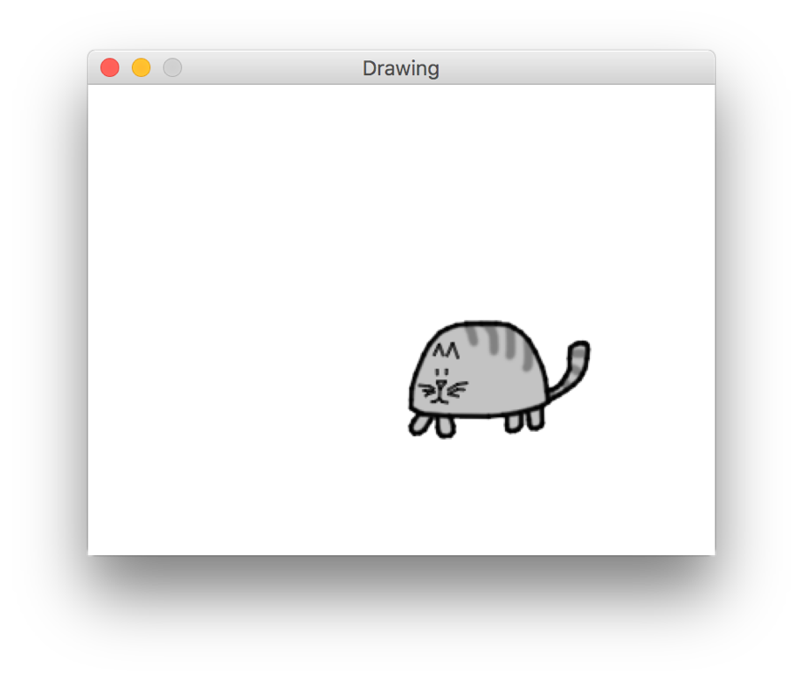
Loading Images
The result will look something like this:

Slide 13
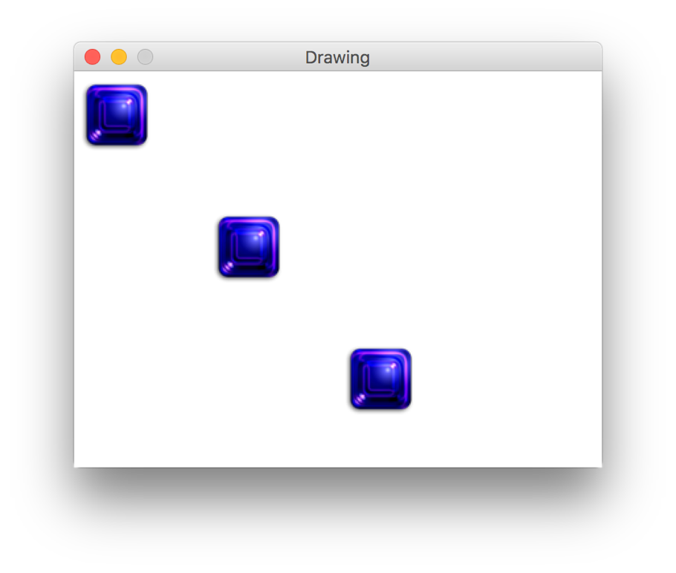
Now You Try
Using the image file I gave you, draw this:

Slide 14
Making Animation

Slide 15
Making Animation
What if we drew our cat on the screen, then erased the picture and drew the cat in another place on the screen? If you do this very quickly, and you only move the cat a little bit, then you get something like this…

Slide 16
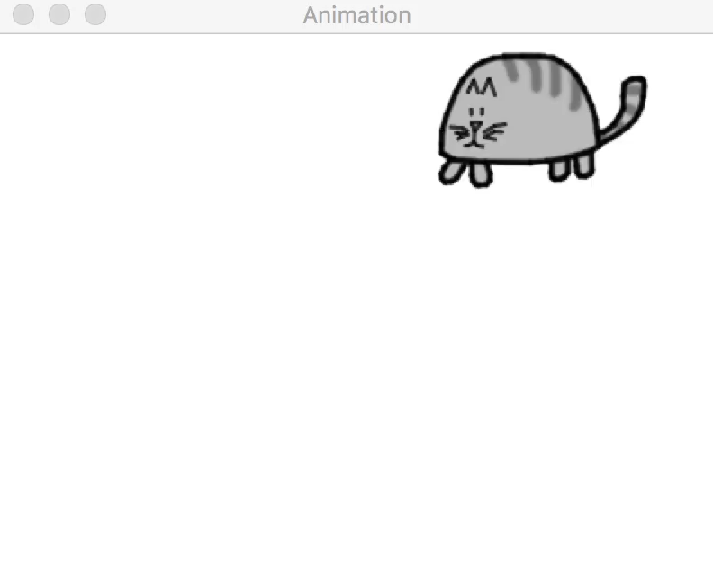

Slide 17
Making Animation
This is how movies and computer games work! They just draw regular pictures on the screen, then change them a little bit and re-draw them…again and again and again, very quickly!
This makes it look to us like things are “moving”. Really the computer is just showing us a sequence of pictures very fast.
Look at the code in catanimation.py… Can you understand it? How are we moving the cat? Let’s look at some of the important parts…

Slide 18
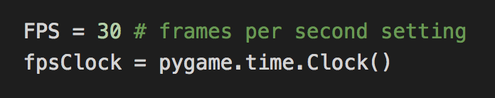
Making Animation
These two lines tell the computer how often we want to draw a new picture on the screen.
Not every computer is the same speed. If we don’t tell the computer how many ”frames per second” (FPS) we want to draw on the screen, then faster computers and slower computers will run our animation at different speeds! We will use pygame.time.Clock() to control the speed.

Slide 19
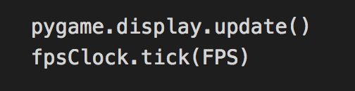
Making Animation
Every time we update the screen, we need to remind PyGame to slow down a little bit by calling fpsClock.tick(FPS). This makes sure we don’t draw more than 30 pictures to the screen each second.
Try changing FPS at the top of the program…what happens?

Slide 20
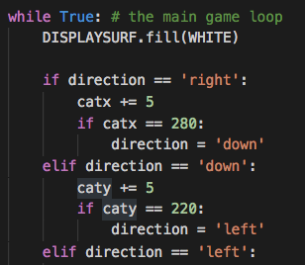
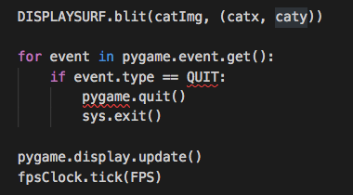
Making Animation
Inside of catanimation.py we fill the screen with white every time we complete the while loop, then we change the cat’s position and redraw it on the screen. Why do we do this? What will this look like when we run?
.
.
.

Slide 21
Brain Teaser
What would happen if we did NOT fill the screen with white every time we ran the loop?

Slide 22
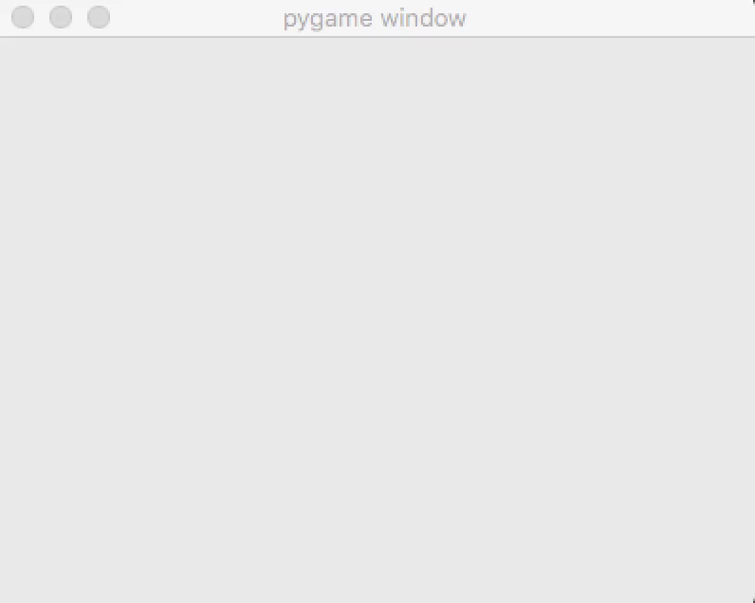
Did you guess correctly? ☺

Slide 23
Now You Try
Can you make the cat go in the other direction?

Slide 24
Making Text

Slide 25
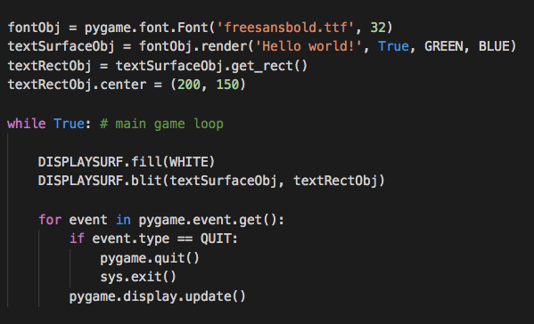
Making Text
So far we have learned how to draw shapes, load pictures, and even change individual pixels. But what if we want to write text? We could try to use the line function but writing even simple sentences would be a lot of work and would look very ugly! Instead, we can use some helpful functions built into PyGame.

Slide 26
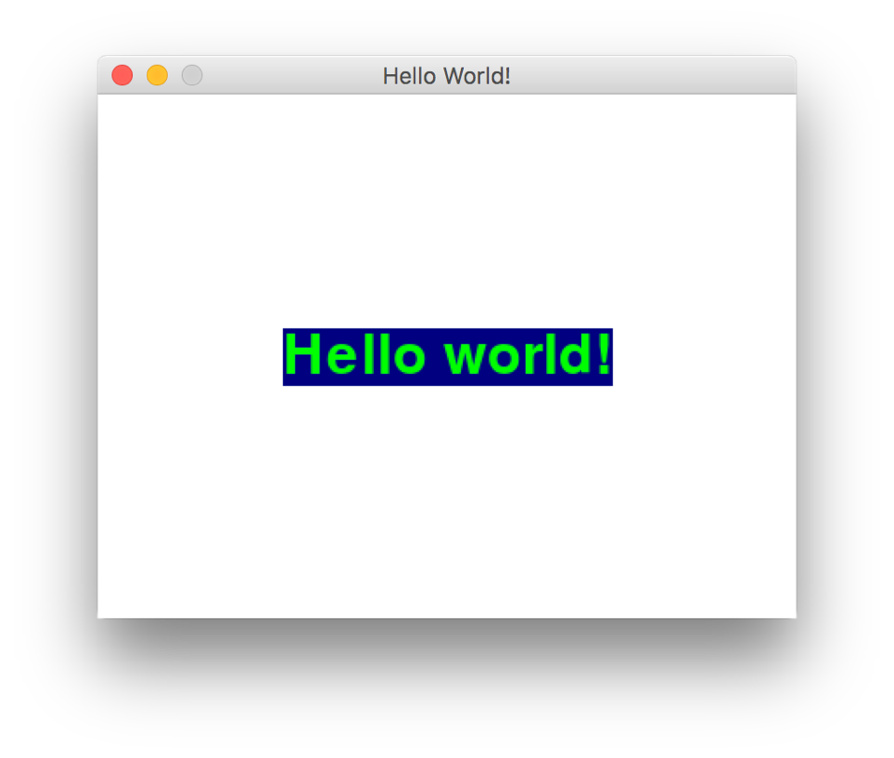
Making Text
What does the result look like?

Slide 27

Making Text
So how did we get that result?
Create a “font object” and set the size (32) and style (freesansbold.ttf)
Convert our “text surface object” into a rect (rectangle) object
Our text
Text color
Background color
Set our text’s position (X, Y) on the screen
Use “anti-aliasing”?

Slide 28
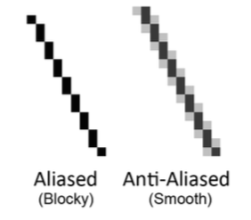
A Quick Note on “Anti-Aliasing”
Anti-Aliasing is a technique to make lines on the computer screen look smoother. Diagonal lines (lines that are not straight) can sometimes look “blocky” because their edges are sharp (the computer screen is made of little rectangles called “pixels” so drawing a smooth line is hard!). Anti-Aliasing adds “shading” (extra, light-colored pixels) around lines to make them look better.

Slide 29
Now You Try
Write a message on the screen and show it to me in class. ^_^

Slide 30
Adding Sound

Slide 31

How Do We Play A Sound?
You can create a sound object and use its .play() method to play it one time:
This is a great way to make your game more interactive! You can play a sound when a player does something in the game. We will talk about how to do that later. ☺

Slide 32

How Do We Play Background Music?
Background music works a little differently:
Repeat forever
(a number like “2” would
Make the sound file play 2 time)
Position in the file (in seconds) to start playing from. So “10” would start playing 10 seconds into the file (this can help us skip the beginning of a music file if we don’t need it)

Slide 33
Now You Try
Add some of your own sounds or music to your program. You can use mp3 files, WAV files, or even MIDI files (for background music). Let me hear it! ^_^

Slide 34
That’s it! Please take a look at your homework and the quiz

Slide 35
Acknowledgements / Contributions
These slides are Copyright 2010- Charles R. Severance (www.dr-chuck.com) of the University of Michigan School of Information and made available under a Creative Commons Attribution 4.0 License. Please maintain this last slide in all copies of the document to comply with the attribution requirements of the license. If you make a change, feel free to add your name and organization to the list of contributors on this page as you republish the materials.
Initial Development: Charles Severance, University of Michigan School of Information
This deck uses the style and formatting of Charles R. Severance’s slides, but some of the content and code is borrowed from the wonderful book Making Games with Python & Pygame by Al Sweigart. Like Charles Severance and Al Sweigart, I license these slides and all associated content under a CC license.

