Slide 1

UNSCRIPTED SEO PODCAST
Grant Simmons
Entity SEO, LLMs &
the Future of Search Visibility
Fiat Growth · @simmonet · linkedin.com/in/simmonet

Slide 2
About Grant Simmons
Developer & marketer since the 1980s — SEO practitioner since the mid-1990s
Built a pre-YouTube video sharing website and learned to rank it
7+ years at Homes.com: VP of Search → VP of Performance Marketing (CoStar acquisition)
Led recovery from a 60% organic traffic loss caused by Google Panda
Creator of Query Drift & AppSlicer — Google Search Console analysis tools
US Ambassador for Waikay (LLM visibility tracking) and Inlinks (entity SEO)
Currently: Head of SEO & GEO at Fiat Growth (FinTech agency, San Francisco)

Slide 3
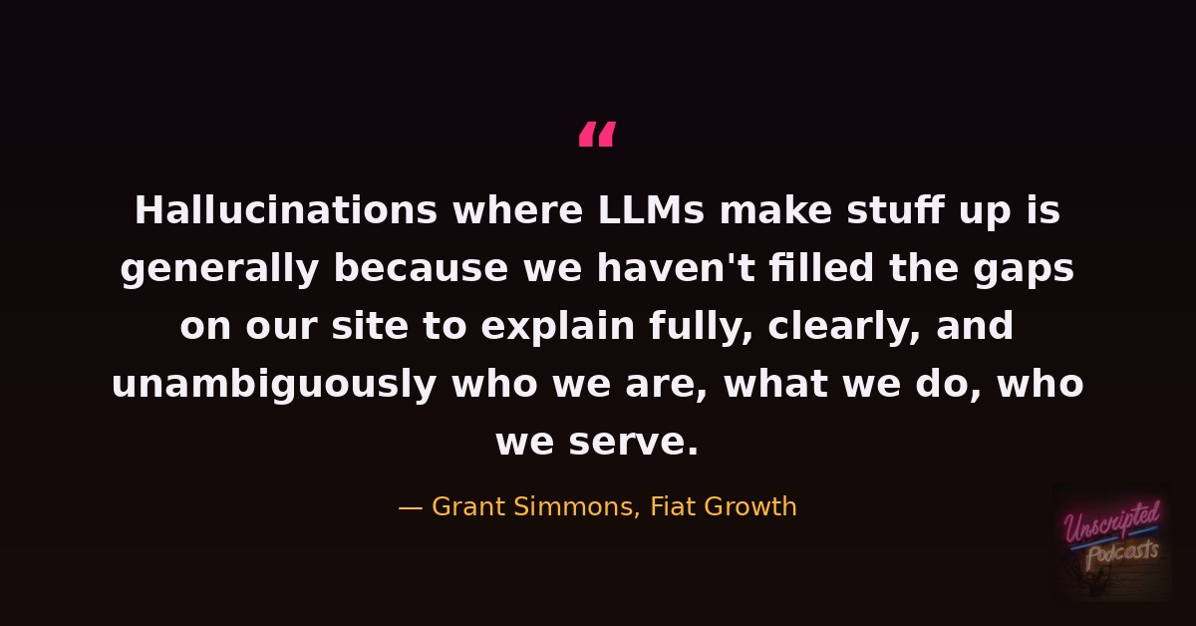

Slide 4
Entity SEO — Grant's Core Framework
The Framework
Key Tools
One entity per page — tight topical focus
Connect pages to known graph sources (Wikipedia, schema catalogs)
Detect query drift — outlier topics that deserve their own page
Disambiguation entities support the main entity within a page
Treat Google & LLMs like small children: explain who you are, unambiguously
querydrift.com — entity-level page analysis against GSC data
EntityMap.org — emerging spec for a 'meaning layer' on key pages
waikay.io — track & improve LLM search visibility
inlinks.com — entity SEO optimization platform
appslicer.com — GSC query data tools & AI Overview impact estimator

Slide 5
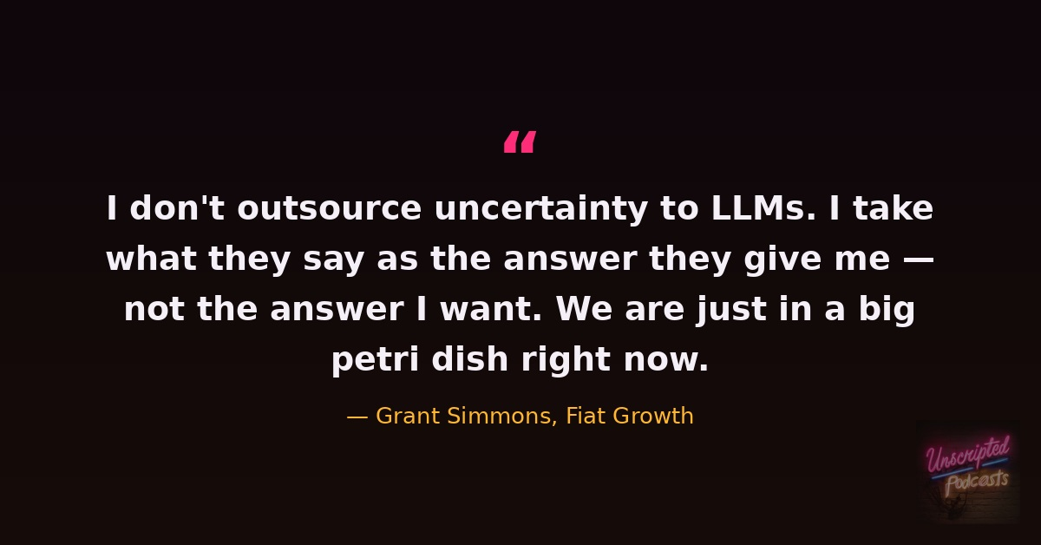

Slide 6
Schema Markup — Still Worth Doing
For Rich Results
For Ontology
For LLMs
Unambiguously good for rich results — broad consensus across the SEO community.
Google uses schema for ontology categorization. Grounded LLMs inherit that categorization.
RAG in LLMs is largely a wrapper for Google results today. What helps Google helps the LLM layer. Low lift — why not?
"If FAQ Schema has gone away, does that mean you shouldn't use it? I would still — it's a very low lift." — Grant Simmons

Slide 7
Beta Culture & Google's Opacity
What Google Won't Say
The Beta Testing Problem
Click engagement signals (~30% of ranking per antitrust docs) denied for a decade
Paths to satisfaction: consistent dwell + navigation paths Google can see via Chrome
Google doesn't fully know its own algorithm — outcomes beat listening to spokespeople
Test and validate for 15+ years beats any official statement
Most new LLM SEO tools are shite — creators know it, shipping for feedback
SEOs accept subpar LLM answers rather than working for right ones
"We are beta testing the beta testers" — Grant Simmons
Don't outsource uncertainty: treat LLM output as the answer given, not the answer wanted

Slide 8
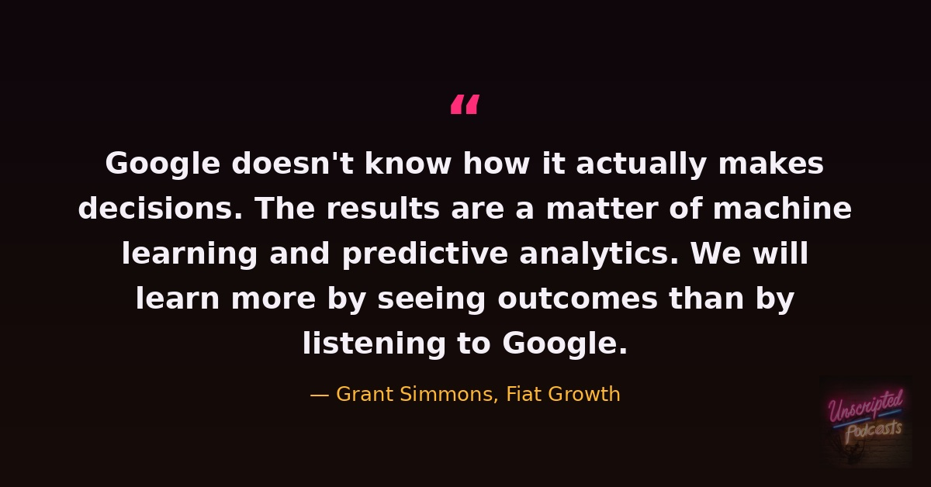

Slide 9
The Reporting Gap & Grant's Tools
Query Drift · querydrift.com
Entity-level page analysis vs. GSC data — detects topical sprawl
AppSlicer · appslicer.com
AI Overview impact estimator — YoY CTR, position & query count analysis
SEO Attribution
Predictive tool: 'these updates make these changes' — clarifying SEO value
OrganicRI · organicri.com
First-party pixel + log file analysis to replace not-provided guesswork
"Degapinator"
Jeremy's concept: triangulate Ahrefs + GA4 + GSC to map likely query clicks

Slide 10
Key Takeaways
01
GEO is great SEO. Fill the gaps — explain who you are, unambiguously, on your own site first.
04
Test and validate. We will learn more by seeing outcomes than by listening to Google.
02
Entity SEO: one entity per page, connected to known graph sources, with query drift analysis.
05
LLM optimization needs additional budget for citable source link-building — not the same $2k/mo.
03
Schema is still worth doing at mid-surface depth — it grounds Google's ontology categorization.
06
Reporting is the biggest unresolved agency problem. Insights ≠ KPI-connected narratives.

Slide 11
LISTEN NOW
Grant Simmons
on Entity SEO, LLMs &
Search Visibility
Where to Find Grant
LINKEDIN
linkedin.com/in/simmonet
Unscripted SEO Podcast
unscriptedseo.com
TWITTER/X
@simmonet
“SEO has been very good to me. If one person gets one good thing out of this interview today, it’s all about giving back.
TOOLS
appslicer.com · querydrift.com
DAY JOB
fiatgrowth.com
ENTITY
waikay.io · inlinks.com

