Slide 1

The American Problem
Dying to be free

Slide 2
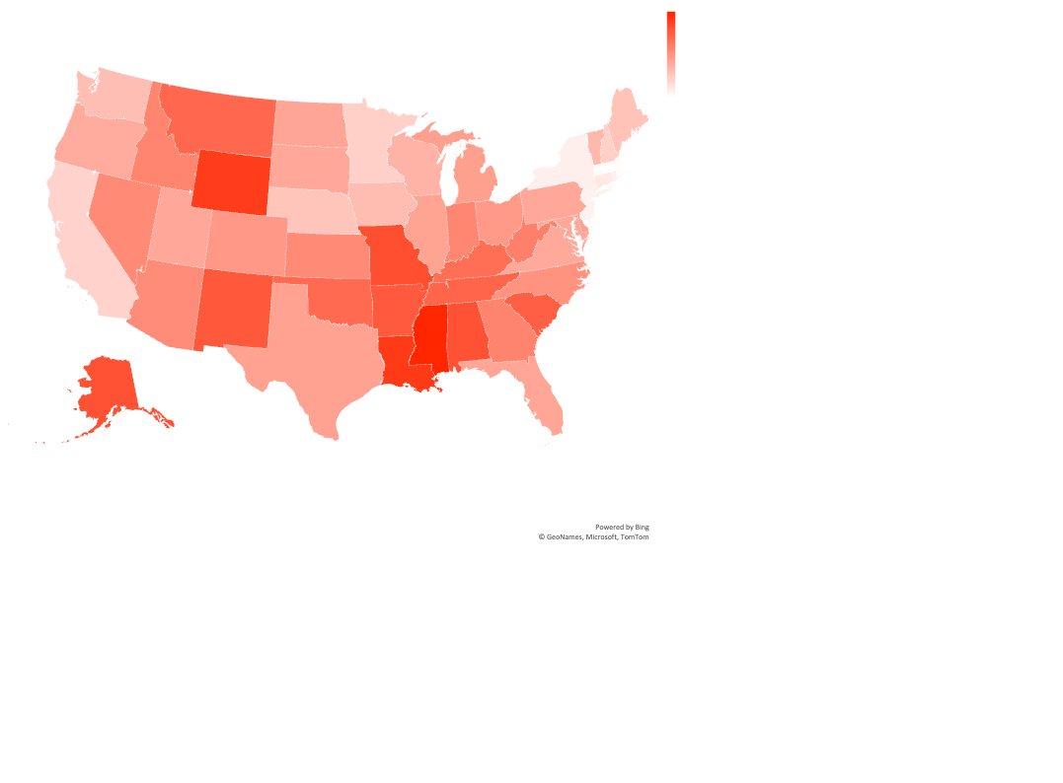
How Many Deaths Are Caused by Guns?
It’s often said “the only way to stop a bad guy with a gun is a good guy with a gun,” but is it? What factors affect deaths caused by firearms?

Slide 3
Do More Guns Lead to More Violent Crime?

Slide 4
Do Guns Reduce Violence?
Clearly, more guns do not reduce violent crime.
What about deaths? Surely fewer people overall die when they have more access to guns for protection.

Slide 5
Do More Guns Lead to More Deaths?

Slide 6
Do Guns Reduce Gun Deaths?
Increased access to guns is very clearly associated with more deaths caused by guns.
We know some of these deaths are self-inflicted, but how would suicide rates be affected if there were fewer guns?

Slide 7
Do More Guns Lead to More Suicides?

Slide 8
Maybe It’s Not Just the Guns?
Increased access to guns is extremely correlated with higher suicide rates.
Could other factors affect violent crime and firearm deaths? What about “tough on crime” policies or poverty?

Slide 9
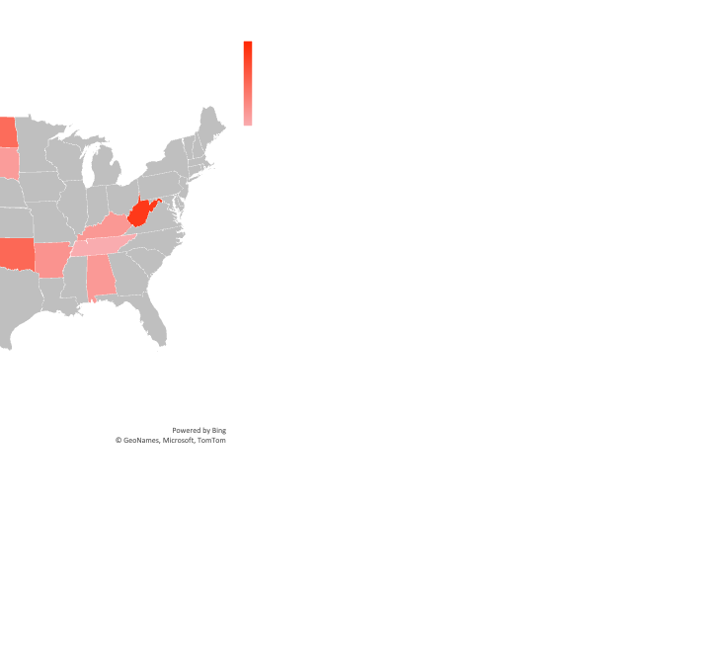
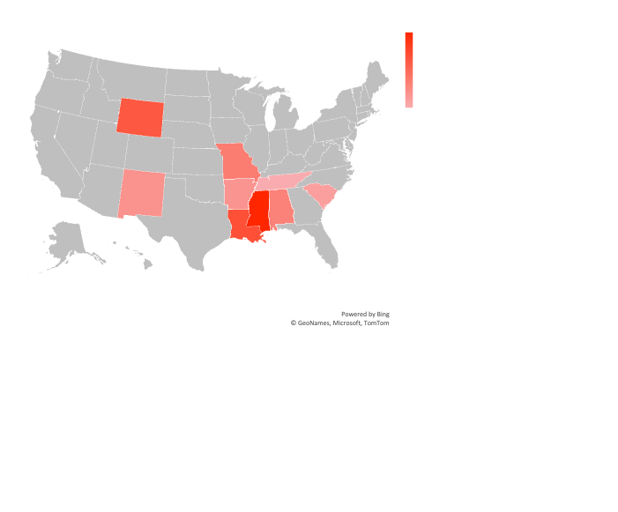
The Republican Party Considers Itself “Tough on Crime”
There are 4 common states in these categories:
Alabama, Arkansas, Tennessee, & Wyoming

Slide 10
Does the Number of Police in a State Affect Violent Crime or Firearm Deaths?
Nope.

Slide 11
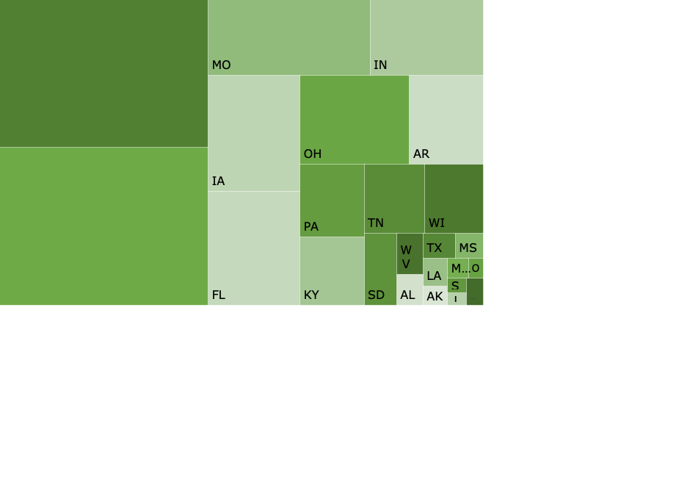
Money Donated to US Senators from the NRA
The larger the square, the more money that state’s senators have received throughout their careers.

Slide 12
Firearm Ownership > Correlation with Firearm Deaths Than Poverty
“r” measures how closely two factors are related. The closer r is to an absolute value of 1, the closer the relationship. Positive numbers show the factors increase or decrease together.

Slide 13
The Problem
If every proposed solution is met with “shall not be infringed” what can be done to reduce the main factor associated with firearm deaths – access to firearms? Could it really be a paperwork problem?

Slide 14
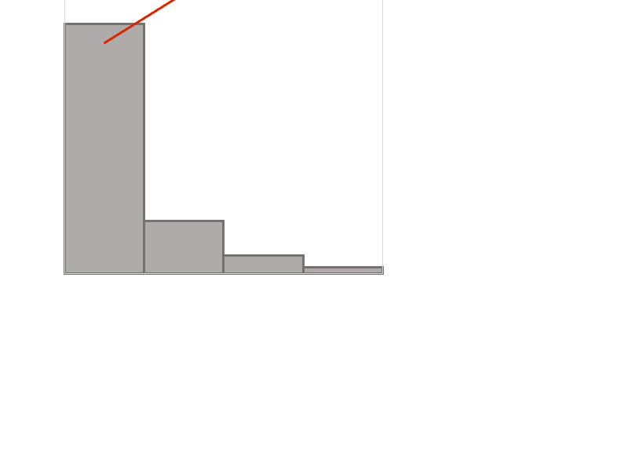
Does Registering Assault Weapons Affect Firearm Deaths?
1 = broad registration state laws
2 = selective registration state laws
3 = state law doesn’t prohibit or require registration
4 = registration prohibited by state law
% of firearm deaths overall
There’s a 92% decrease in deaths caused by firearms when assault weapon registration is required

Slide 15
Required Reporting of Lost or Stolen Firearms
There’s a 20% decrease in the average violent crime rate between states that do not require reporting lost or stolen firearms and those that do require reporting and a 42% decrease in the average rate of firearm deaths.

Slide 16
Increased access to firearms makes us less safe. Even if the gun doesn’t cause violence, its presence inherently makes it more deadly. There are multiple solutions that could be effective, but have political liabilities which make passing them improbable. One solution, though, doesn’t infringe on anyone’s rights and is shown to dramatically decrease firearm deaths – simply reporting them lost or stolen.

