Slide 1

Node.js
a platform built on Chrome's JavaScript runtime for easily building fast, scalable network applications
by: Jeremy Rambo

Slide 2
disclaimer
i’m still learning
always trust a ginger

Slide 3
paradigm shift
i/o

Slide 4
threads
pros
cons
thread per client request
share process resources
execute independently
execute concurrently
great for algorithms and long running processes*
difficult to work with
memory heavy
default > 512KB
config > -Xss
thread limits
Notes:
* these are processes exclusive of i/o operations

Slide 5
web server
promise to make a point here… ☺
serve static content
pages, script, styles, images, etc…
serve dynamic content
we can get into the semantics of a stateless time machine at some other juncture
serve lots of stuff to lots of people – i/o

Slide 6
non-blocking i/o model
single thread always
everything runs in parallel, except your code

Slide 7
non-blocking i/o model
pros
cons
efficient
scales really well
requires no interlocking for shared resources
single thread always
fun – nerd cred
different programming approach, can be confusing
not good for algorithms and long running processes*
not for seti@home

Slide 8
thread server flow
client
server
app
a
( 10 sec. )
b
c
server | app pre | db | app post | total
0 | 1 | 10 | 1 | 12
0 | 1 | 10 | 1 | 12
12 | 1 | 10 | 1 | 24
a
b
c

Slide 9
non-blocking i/o flow
client
server
app
a
event loop
( 10 sec. )
b
c
server | app pre | db | app post | total
0 | 1 | 10 | 1 | 12
1 | 1 | 10 | 1 | 13
2 | 1 | 10 | 1 | 14
a
b
c

Slide 10

case study at paypal
how paypal migrated their account overview page

Slide 11
development
team java
team node
started january 2013
5 engineers
completed in june
5 core server
started march 2013
2 engineers
completed in june
single core server
node app built almost twice as fast with half the team
node app had 33% fewer lines of code
node app had 40% fewer files

Slide 12
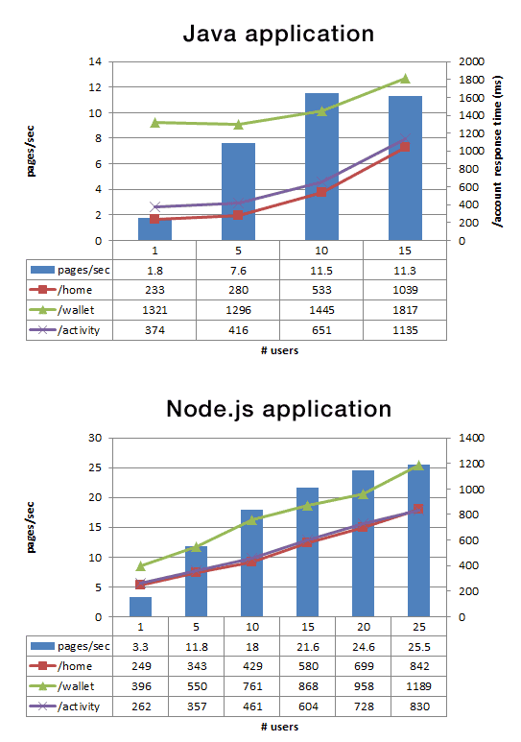
performance
team java
team node
java application
node application
pages / sec
pages / sec
response time (ms)
response time (ms)
Notes:
Double the requests per second vs. the Java application. This is even more interesting because our initial performance results were using a single core for the node.js application compared to five cores in Java. We expect to increase this divide further.
35% decrease in the average response time for the same page. This resulted in the pages being served 200ms faster— something users will definitely notice.

Slide 13
Node.js
a lightweight and efficient event-driven, non-blocking I/O model runtime

Slide 14

node what?
not “no js” but Node.js
does not run in a browser, it is not a client
Node.js is a runtime container, like Apache or WAS
Node.js is a binary that executes JavaScript
can be a server or any other task
web analogy
JavaScript is to Node.js as a Servlet is to Apache or WAS

Slide 15
getting started
https://olex-secure.openlogic.com/packages/node-js
or search “Node” in OLEX
download and install the package applicable for your system
open a terminal (console)
type: node --version
verify you see: v0.10.20

Slide 16
javascript rocks
node isn’t always a server
example “javascript rocks!”
~ alpha.js
console.log(“javascript rocks!”);
>> node alpha
javascript rocks!
Notes:
----- Meeting Notes (1/30/14 08:34) -----
change

Slide 17
modules
require( {module} )
built in function that resolves a dependent module
module.exports
the default object created by the Node module system
can add to or re-assign
module.exports = function(){}
module.exports.doSomething = function(){}
implicit “exports” available as alias shorthand

Slide 18
modules in action
~ beta.js
module.exports = {
js : "javascript rocks!"
};
~ alpha.js
var beta = require( "./beta" );
console.log( beta.js );
>> node alpha
javascript rocks!
Notes:
here is a good time to demonstrate how to append to exports vs. replacing the default object.

Slide 19
package.json
package.json
allows you to “package” a module within your project
specify the main script
specify dependencies and their respective versions
expose only what you want to expose
so much more, a great topic for another brown bag
acts similarly to maven

Slide 20
package.json in action
~ /beta/package.json
{
"name" : "javascript rock content module",
"main" : "gamma.js"
}
~ /beta/gamma.js
module.exports = {
js : "javascript rocks!"
};
~ alpha.js
var beta = require( "./beta" );
console.log( beta.js );
>> node alpha
javascript rocks!
Notes:
here is a good time to demonstrate how to append to exports vs. replacing the default object.

Slide 21
node package manager
node package manager (npm)
public respository that packages, manages and installs node modules
npm install {module}
installs modules into node_module directory
npm install pg
installs the postgres node module
npm install express
installs the express node module
npm publish {module folder/tarball}

Slide 22
core modules
net
console
events
file system
OS
HTTP
timers
crypto
UDP
process
utilities
TLS / SSL

Slide 23
global objects
objects that are available without require
__dirname
exports
global
console
__filename
module
setTimeout

Slide 24
require resolve order
how does require( {module} ) work?
if {module} is core module, load core module
if {module} begins with ‘./’, ‘/’, or ‘../’
load as file relative to current path
load as directory relative to current path
attempt to load package.json
attempt to load index.js
load {module} from node_modules
attempt to load in reverse from current path
walk up the tree and check each node_module directory

Slide 25
Node.js Web Server
HTTP is a first class protocol in Node. Node's HTTP library has grown out of the author's experiences developing and working with web servers.

Slide 26
creating a server
~ server.js
var http = require("http");
http.createServer(function (request, response) {
response.writeHead(200, {"Content-Type": "text/plain"});
response.write( "javascript rocks!" );
response.end();
}).listen(8080);
console.log( "Server running at http://127.0.0.1:8080/" );

Slide 27
creating a server
you can leverage all your modules
~ server.js
var http = require( "http" ),
beta = require( "./beta" );
http.createServer(function (request, response) {
response.writeHead(200, {"Content-Type": "text/plain"});
response.write( beta.js );
response.end();
}).listen(8080);
console.log( "Server running at http://127.0.0.1:8080/" );

Slide 28
taking it a step further
simple static web server
leverage callbacks to promote non-blocking i/o behaviors
leverage globals

Slide 29
serving a page
~ server.js
var http = require( "http" ),
fs = require( "fs" );
http.createServer(function (request, response) {
var url = __dirname + "/public" + (request.url === "/" ? "/index.html" : request.url );
fs.exists( url, function( exists ){
if( exists ){
response.writeHead( 200, {"Content-Type": "text/html"} );
var stream = fs.createReadStream(url);
stream.pipe( response );
stream.on( "end", function(){
response.end();
});
}else{
response.writeHead( 404 );
response.end();
}
});
}).listen(8080);
console.log( "Server running at http://127.0.0.1:8080/" );

Slide 30
final thoughts

Slide 31
awesome modules
express
minimal and flexible framework for building single and multi-page apps
pg | mysql
powerful database connectors ( think JDBC )
socket.io | faye
great web socket & pub/sub implementations
passport
amazing authentication module for both oauth and basic
mustache
powerful server and client side logic-less template engine
moment
date library that should honestly be part of the javascript spec.

Slide 32
rambo’s thoughts
node isn’t a replacement for everything
node can make an absolutely awesome REST server
node can be extremely powerful for the SPA paradigm
node is just fun
when your server starts in about 4ms, you get a lot of time back in your day

Slide 33
?

