Slide 1
Pure CSS
SWE 632 Tech Talk
Jeremy Ryan & Ryan Ammons

Slide 2







Overview
URL: https://purecss.io
Developed at Yahoo!
Open source: Yahoo! Inc. BSD license
Minimal footprint CSS framework
~4KB minified & gzipped
Mobile-first
No JavaScript needed
GitHub popularity
> 18,000 stars
> 2,000 forks

Slide 3
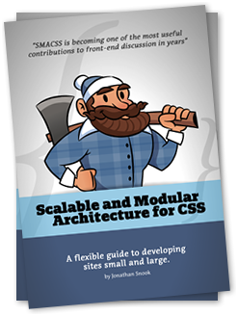
SMACSS
Scalable and Modular Architecture for CSS
Uses Categories of Rules:
Base Rules
Layout Rules
Module Rules
State Rules
Theme Rules
Pure Base Rules: Normalize.css – CSS reset
Pure Layout Rules: Grid, fixed and responsive
Pure Module Rules: Forms, Buttons, Tables, Menus
https://smacss.com

Slide 4
Naming Convention
Class name format: <framework>-<module>(-<specialization>)
All classes prefixed with pure-*
Followed by module name: pure-table, pure-button
Specializations: pure-table-bordered, pure-button-primary
Include both module class and specialization class
Examples:
Bordered Table: <table class=“pure-table pure-table-bordered”>
Primary Button: <a class=“pure-button pure-button-primary”>
Horiz. Menu: <ul class=“pure-menu pure-menu-horizontal”>

Slide 5
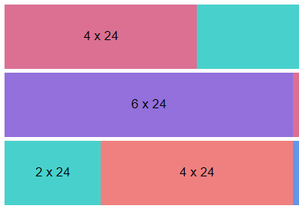
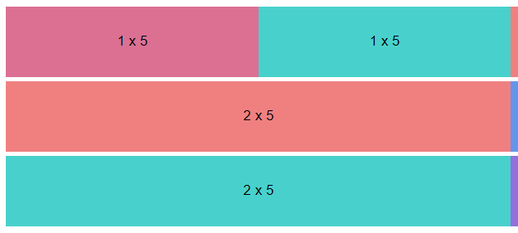
Grids
Classes: pure-g, pure-u-*
5ths-based and 24ths-based grids
Units are fractions (1/3s, 1/5s, etc.)
Responsive, mobile-first
Default media queries:
Small: pure-u-sm-* ≥ 568px
Medium: pure-u-md-* ≥ 768px
Large: pure-u-lg-* ≥ 1024px
Extra Large: pure-u-xl-* ≥ 1280px
Customizable media queries

Slide 6

Forms
Default: form.pure-form
Stacked: form.pure-form.pure-form-stacked
Aligned: form.pure-form.pure-form-aligned,
pure-control-group
Grouped inputs: fieldset.pure-group
Sized inputs: input.pure-input-*
Required: add required attribute
Disabled: add disabled attribute
Read-only: add readonly attribute

Slide 7
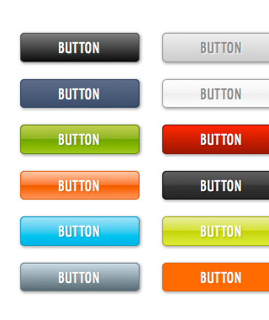
Buttons
Default: a.pure-button, button.pure-button
Disabled: .pure-button.pure-button-disabled
Active: .pure-button.pure-button-active
Primary: .pure-button.pure-button-primary
Grouped: div.pure-button-group

Slide 8
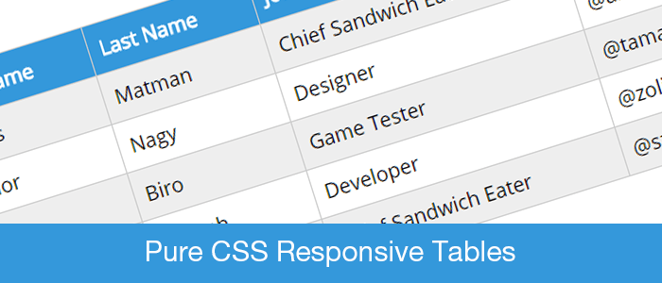
Tables
Default: table.pure-table
Bordered: table.pure-table.pure-table-bordered
Horiz. borders: table.pure-table.pure-table-horizontal
Striped: table.pure-table.pure-table-striped

Slide 9
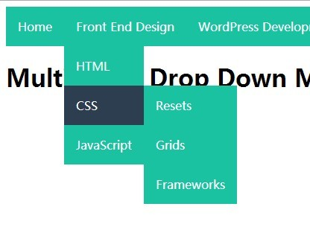
Menus
Vertical (default): pure-menu, pure-menu-heading,
ul.pure-menu-list, li.pure-menu-item
Horizontal: pure-menu-horizontal
Selected: pure-menu-selected
Disabled: pure-menu-disabled
Dropdowns: ul.pure-menu-list,
li.pure-menu-item
Submenus: li.pure-menu-has-children,
ul.pure-menu-children
Scrollable (horiz. & vert.): pure-menu-scrollable

Slide 10
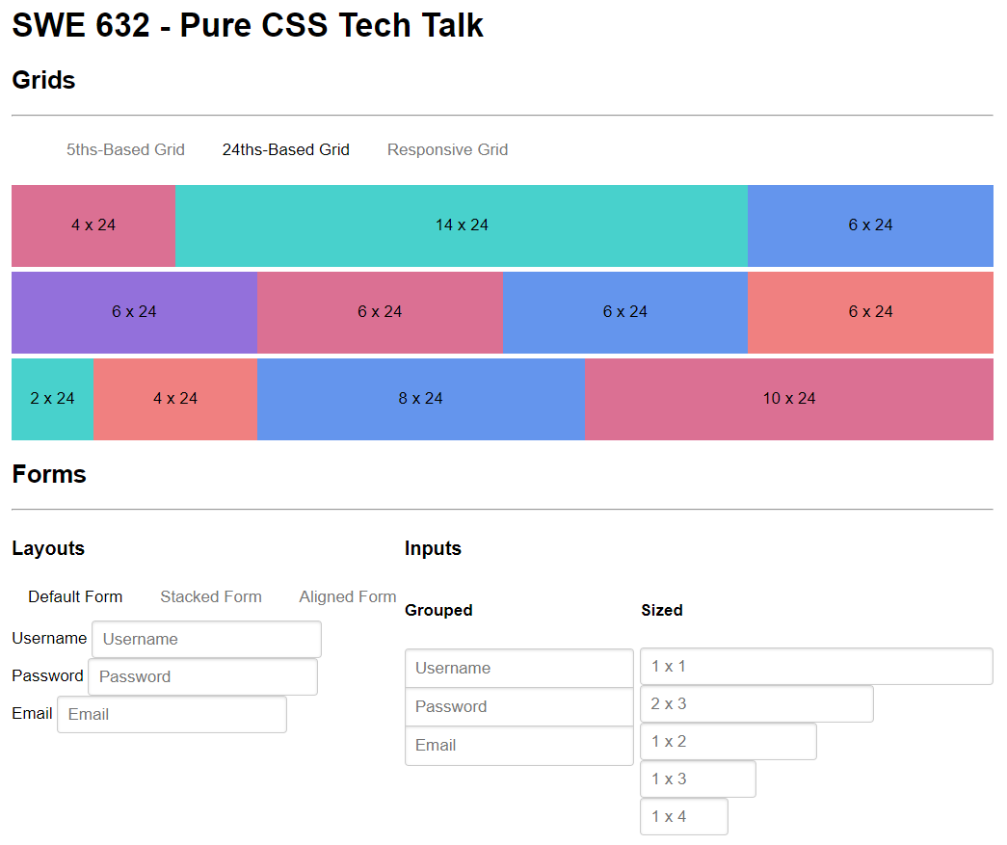
Demo
http://ammonsdatasolutions.com/projects/swe_632_tech_talk

Slide 11

Pros and Cons
Pros:
Very small footprint
Cross-browser compatibility (Normalize.css)
Easily extended
Plays nice with other frameworks like Bootstrap
Installation via npm, bower, composure, or CDN
Cons:
Fewer features vs larger CSS frameworks (focuses on min. functional feature set)
Not suited for beginners (no ready-access to multitude of styles)
vs

Slide 12



Comparison to other CSS frameworks
Metric | PureCSS | Bootstrap | Foundation | Materialize
Size (no minif/gzip) | Small (~80KB) | Large (~300KB) | Extreme (> 500KB) | Very Large (> 300KB w/o fonts)
Complexity / Learning Curve | Low | Medium | Low-Medium | Low-Medium
Extendibility / Customizability | Extreme | Medium-High | Very high | Low
Support and Documentation | Simple, minimal | Extensive | Good | Good
Popularity | Medium (~18K GH stars) | Very high (~123K GH stars) | High (~30K GH stars) | High (~32K GH stars)
Feature set | Minimal: all req’d basics, no JS | Large | Very extensive | Extensive
*compiled by analyzing framework files, documentation, and GitHub statistics

Slide 13

Summary
Example layouts built with Pure: https://purecss.io/layouts
GitHub: https://github.com/pure-css/pure
Blog: http://blog.purecss.io
SMACSS info: https://smacss.com
QUESTIONS?

