Slide 1
Micro Greenhouse
Vadim Babiy
Daniel Bracamontes
Wesley Nguyen
Jeremy Shaw

Slide 2
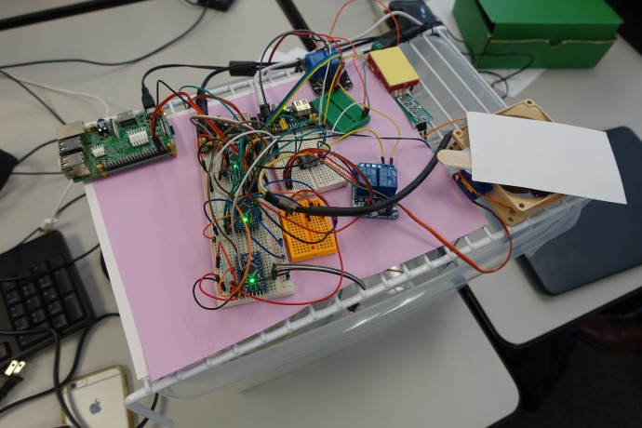
Upper Level Deck

Slide 3
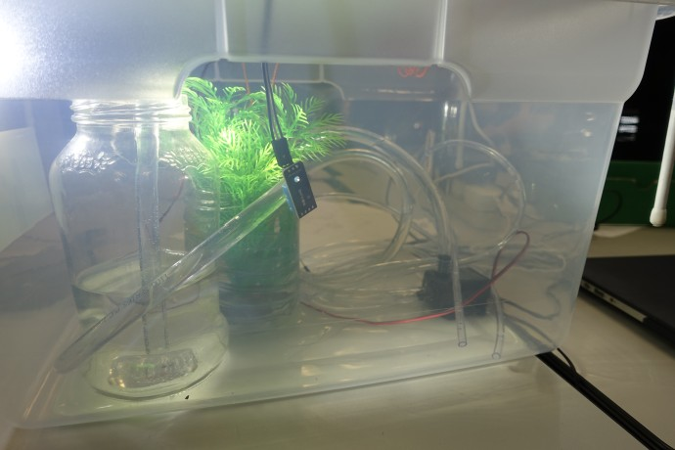
Lower Level Bin

Slide 4
Overview
WaterlevelSensor
WaterPumpRelay
Vadim
Jeremy
HeaterRelay
Light
Wesley
FanRelay
FanPWM
Vent Servo
Daniel
HumiditySensor
LightLevelSensor
TemperatureSensor

Slide 5
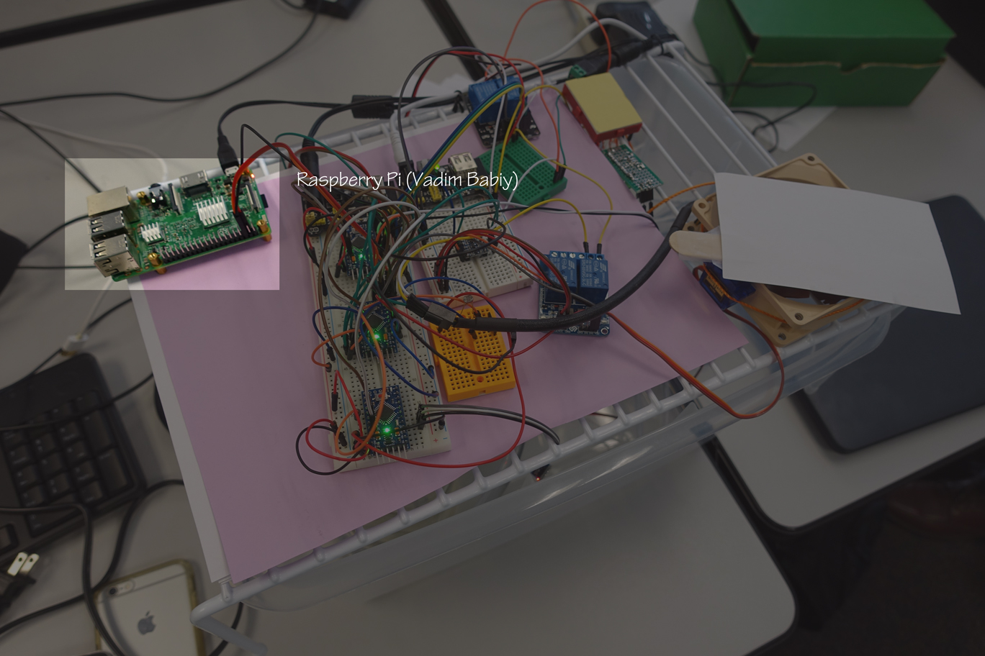
Vadim Babiy

Slide 6
Vadim
Vadim
Jeremy
- CLI to directly poll sensors and control peripheral devices
-Web server to give current sensor readouts
-acts as I2C master to drive the I2C bus
Wesley
Daniel

Slide 7
Aside: I2C
Vadim
Setup in a poll – respond format
Example:
  V: bus_write(address, request)
  J/W/D: onRequest(V, requestedData)
  V: int x = readNumber()
Jeremy
(11)
Wesley
(12)
Daniel
(13)

Slide 8
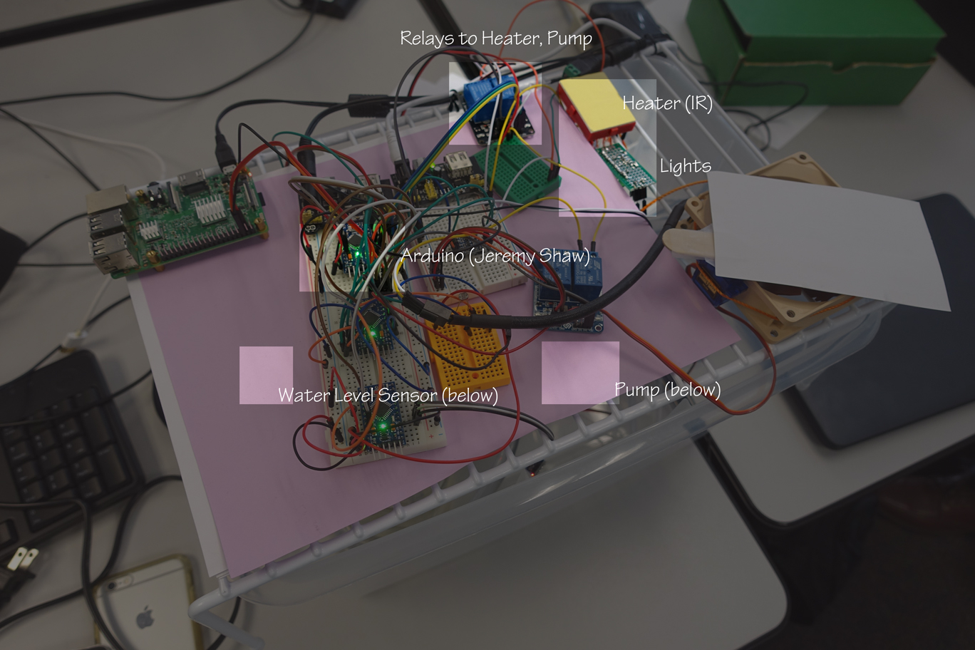
Jeremy Shaw

Slide 9
Jeremy (I2C address 11)
Sensors abstracted to be presented via i2c
Relays and light presented to i2c
WaterlevelSensor
WaterPumpRelay
Vadim
Jeremy
HeaterRelay
Light

Slide 10
Wesley Nguyen

Slide 11
Wesley (I2C address 12)
Presents Fan control (relay and PWM) to I2C
Vadim
Wesley
FanRelay
FanPWM
Vent Servo

Slide 12
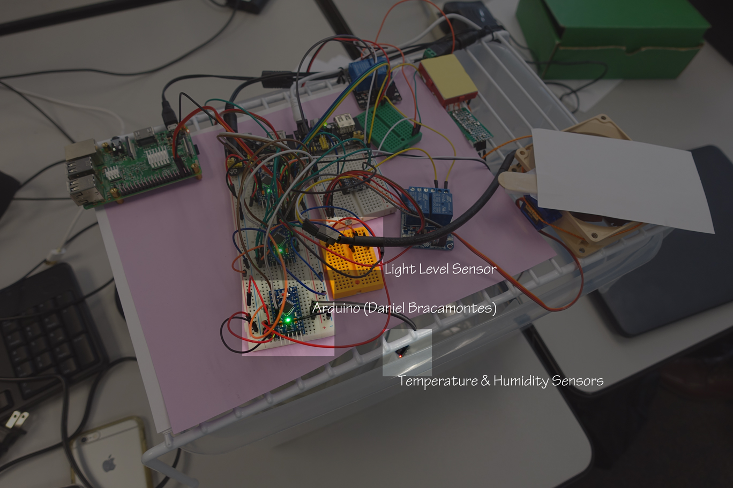
Daniel Bracamontes

Slide 13
Daniel (I2C address 13)
Presents Light level reading from ADC to I2C
Presents Humidity/Temp from DHT11 to I2C
  DHT11 has a maximum 1Hz refresh cycle, so the interstitial arduino automatically polls the DHT11 and stores the values locally to present to I2C master
Vadim
Daniel
HumiditySensor
LightLevelSensor
TemperatureSensor

Slide 14
Simplification
Only need one microcontroller with network interface
Reduce down to two relays:
  Heater
  Pump

Slide 15
Thanks!

