Slide 1
Choosing the Best Neighborhoods to Open a New Pizzeria
Data Science Capstone Project
1/2/2021

Slide 2
Where to open a new pizzeria?
Criteria for neighborhood:
High demand for pizza
Poor quality of existing venues
Use Foursquare data to identify suitable neighborhoods!

Slide 3
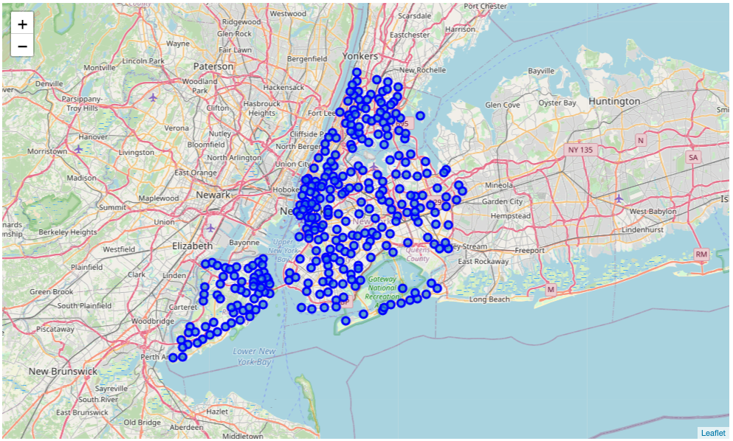
NYC neighborhoods

Slide 4
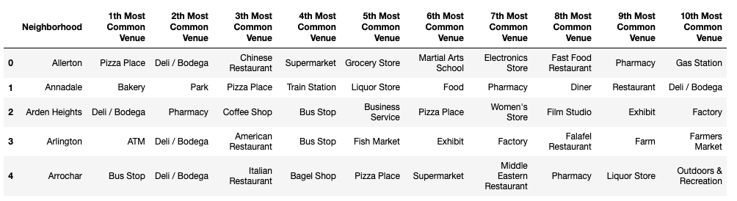
Most common venues per neighborhood

Slide 5
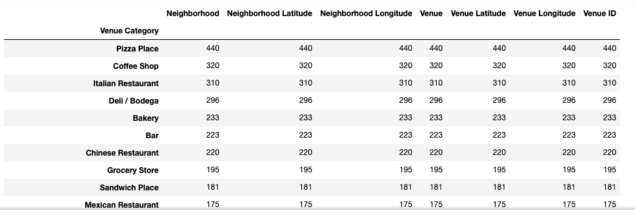
Most common venues citywide

Slide 6
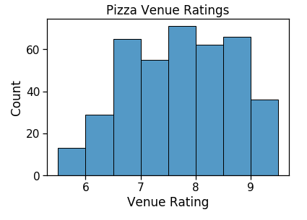
Distribution of pizza venue ratings

Slide 7
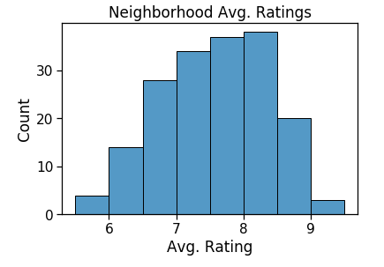
Distribution of neighborhood average ratings

Slide 8
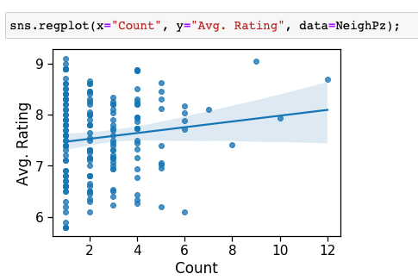
Relationship between quantity and quality

Slide 9
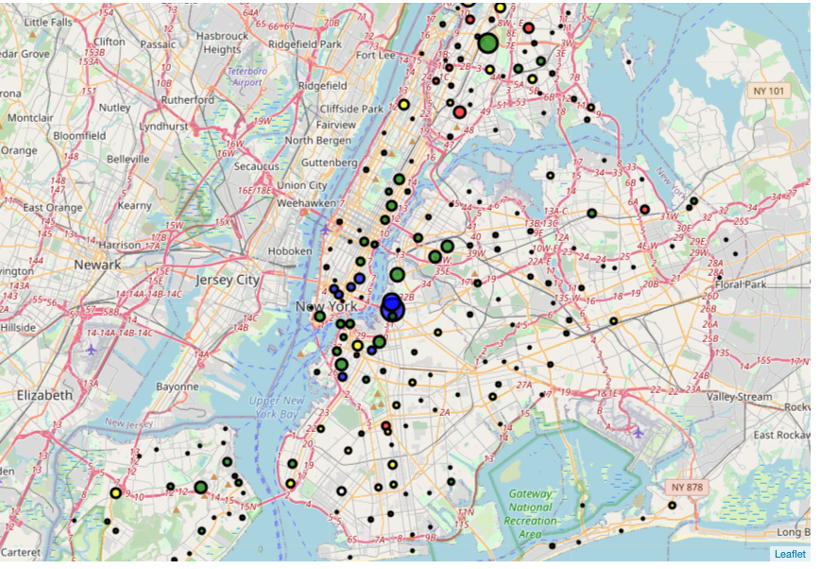
Map of venue quantity and quality

Slide 10
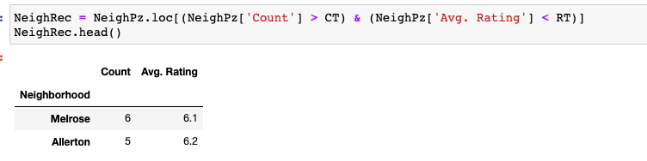
Results: Neighborhoods with high demand,
And high potential for disruption

Slide 11
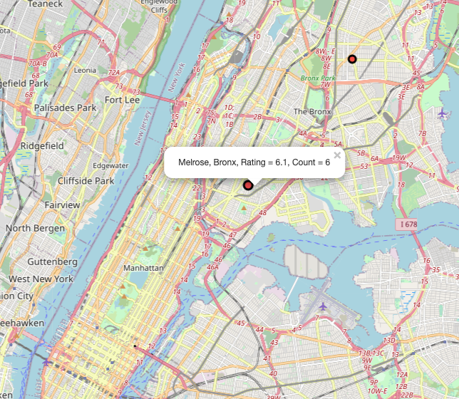
Results: Neighborhoods with high demand,
And high potential for disruption

