Slide 1






Recitation 1
Basic circuits
TA: Yuchen Sun ys1338@scarletmail.rutgers.edu

Slide 2
Across, through or of?
Get this straight and half the confusion disappears
Voltage V
Current I
Resistance R
A difference across two points.
Flow through one path.
A property of the component.
Meter in parallel.
Very high internal resistance.
Meter in series.
Very low internal resistance.
Measure the part on its own,
with the power off.
Voltage is always across something. Current is always through something.

Slide 3

Charge, current, voltage
Charge Q
coulombs (C). 1 C ≈ 6.24 × 10¹⁸ electrons
Long plate = +
Current I = Q / t
1 A = 1 C/s — charge past a point, per second
Voltage V = E / Q
1 V = 1 J/C — energy carried, per coulomb
A 9 V battery hands 9 joules to every coulomb that passes through it.

Slide 4
Two directions, one convention
Electron flow: − → +
What the electrons physically do inside the wire.
Conventional current: + → −
What every formula, every schematic, and this whole course uses.
Analyse with conventional current. Electron direction only matters when you explain the physics.

Slide 5
Voltage can exist with no current
I = 0
open circuit
A battery on the shelf still has its full voltage across the terminals.
Current needs a complete loop; voltage does not.

Slide 6
1
Problem
A current of 1.5 A flows through a wire for 3.0 seconds.
(a) How much charge passes through?
(b) How many electrons is that?

Slide 7
Problem 1 — answer
(a) Q = I t = 1.5 × 3.0 = 4.5 C
(b) n = Q / qe = 4.5 / 1.602 × 10⁻¹⁹ ≈ 2.8 × 10¹⁹ electrons
One coulomb is already ~6.24 × 10¹⁸ electrons — that is why we count in amps, not electrons.

Slide 8
Ohm's law
V = I × R I = V / R R = V / I
Current ∝ voltage
Current ∝ 1 / resistance
Double V → double I.
Double R → half I.

Slide 9
2
Problem
A 220 Ω resistor is connected across a 5.0 V supply.
(a) Find the current, in mA.
(b) Find the power dissipated, in mW.

Slide 10
Problem 2 — answer
(a) I = V / R = 5.0 / 220 = 0.0227 A = 22.7 mA
(b) P = V I = 5.0 × 0.0227 = 0.114 W = 114 mW
Convert prefixes before you substitute, and convert back at the end.

Slide 11
3
Problem
A lamp has a resistance of 240 Ω.
(a) Plugged into a US outlet at 120 V — current and power?
(b) Plugged into a UK outlet at 230 V — current and power?
(c) The voltage did not quite double. Why did the power nearly quadruple?

Slide 12
Problem 3 — answer
(a) I = 120 / 240 = 0.50 A P = 60 W
(b) I = 230 / 240 = 0.958 A P ≈ 220 W
(c) R is fixed, so P = V² / R — power follows the square of voltage:
(230 / 120)² ≈ 3.7
This is why a 120 V appliance in a 230 V outlet does not run 'a bit hot' — it fails.

Slide 13
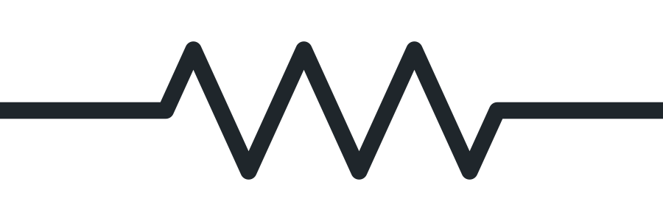
Resistance
R = ρ L / A
where ρ is resistivity (Ω·m), an intrinsic property of the material, L is length (m), and A is cross-sectional area (m²).
Longer wire (L) → more resistance.
Thicker wire (A) → less resistance. Double the diameter and R drops to one quarter, not one half.
ρ depends on the material; temperature changes it too.

Slide 14
Power
P = E / t, and E = VQ, and I = Q / t
P = V I = I² R = V² / R
Every component has rated limits
Before you use a part, check the voltage across it, the current through it, and the power it dissipates against the rating.

Slide 15
4
Problem
You have a 100 Ω resistor rated at ¼ W.
(a) What is the maximum voltage you may apply? What current is that?
(b) A classmate connects it straight across a 9 V battery. What power does it dissipate, and by what factor is the rating exceeded?

Slide 16
Problem 4 — answer
(a) Vmax = √(P R) = √(0.25 × 100) = 5.0 V, I = 50 mA
(b) P = V² / R = 81 / 100 = 0.81 W → 3.2 × the ¼ W rating
The resistor overheats, discolours, and fails.
Nothing in Ohm's law forbids this. Only the power rating does.

Slide 17
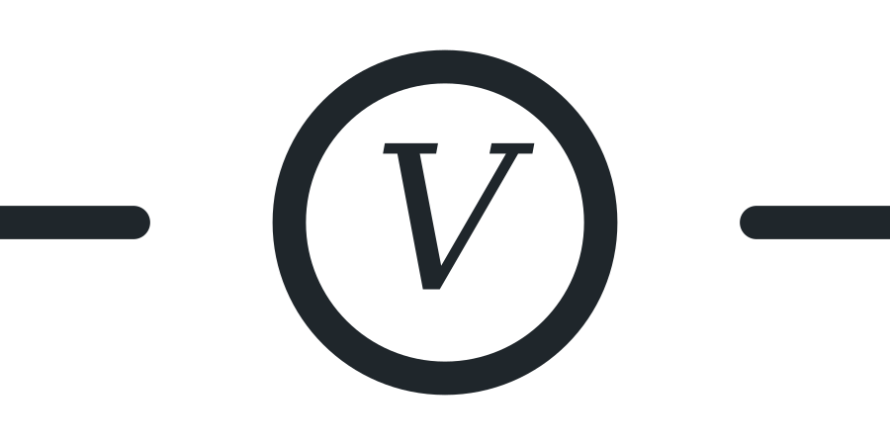
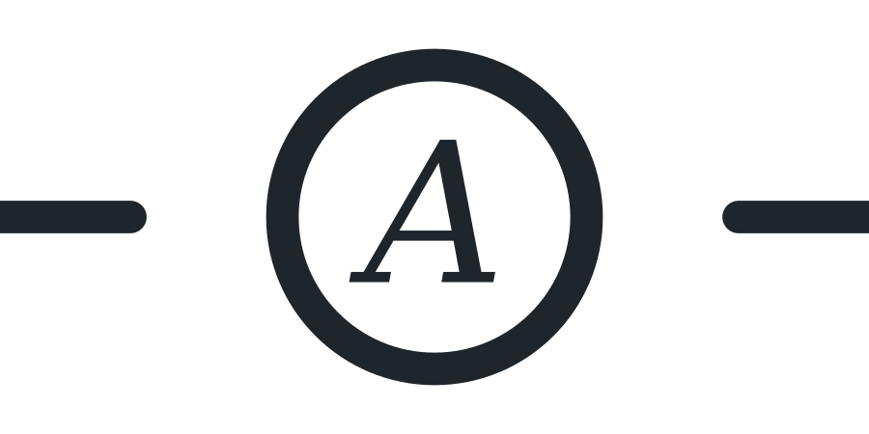
Voltmeter and ammeter
Voltmeter
Ammeter
Connect in parallel, across the two points.
Connect in series, in the path you are measuring.
R ≈ 10 MΩ, so almost no current is diverted into the meter.
R ≈ 0, so the meter barely reduces the current it reads.
Both are built to be as invisible to the circuit as possible.

Slide 18
5
Problem
A 6.0 V battery drives one 100 Ω resistor. The battery's internal resistance is 0.5 Ω.
(a) Connected correctly — what do the two meters read?
(b) The voltmeter (10 MΩ) is put in series by mistake. What is the current now, and what does it display?
(c) The ammeter (R ≈ 0) is put in parallel across the battery. What current flows?

Slide 19
Problem 5 — answer
(a) I ≈ 60 mA, voltmeter reads ≈ 6.0 V
(b) I ≈ 0.6 µA — the resistor drops 60 µV, so the meter shows ≈ 6 V:
the supply voltage, not the component's. The circuit has stopped working.
(c) I = 6.0 / 0.5 = 12 A — a short circuit. The meter's fuse blows.
A short circuit is not 'no current'. It is uncontrolled current, limited only by the source and wiring.

Slide 20
Batteries: series and parallel
Series
Parallel
End to end. Voltages add, respecting polarity.
Side by side. Voltage stays the same.
1.5 V + 1.5 V = 3 V
Capacity (mAh) unchanged.
Capacity adds.
Same voltage, chemistry, and charge state only.

Slide 21
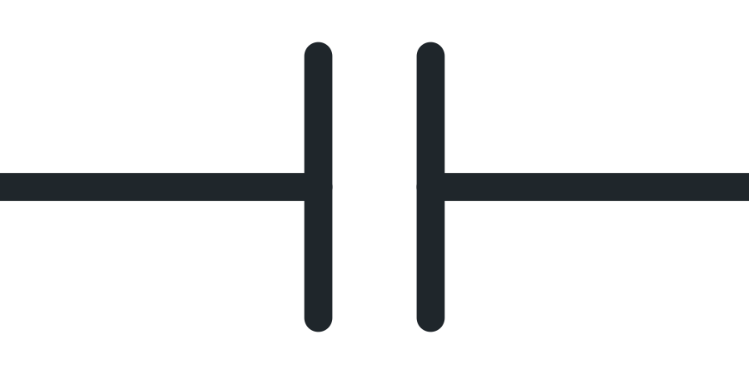
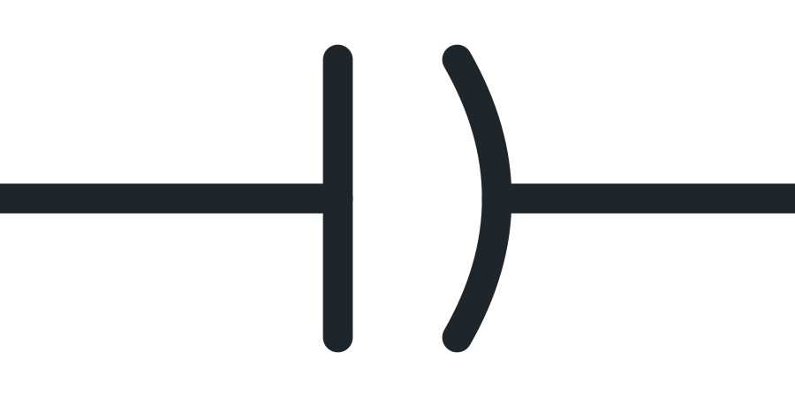
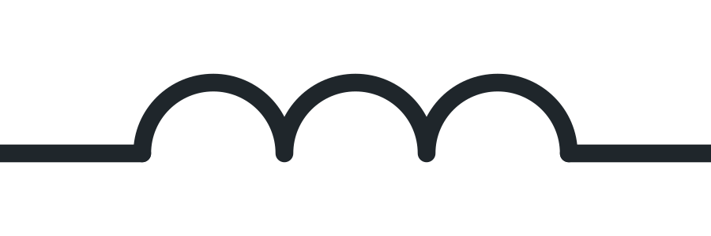


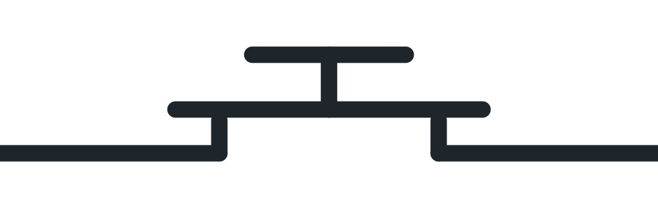
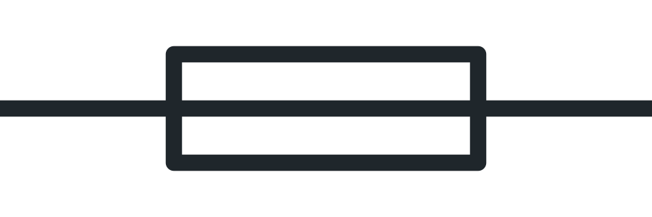

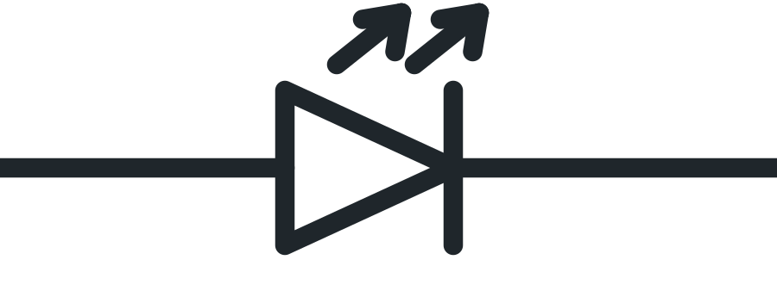

The parts you will meet
Learn the symbol, not just the name
Capacitor
Polarized cap
Inductor
SPST
SPDT
Pushbutton
Fuse
Diode
LED
Zener

Slide 22
Capacitor
Equal and opposite charge on two plates
Q = C V
non-polarized polarized
U = ½ C V²
Polarized (electrolytic): has a + and a − terminal, and fails if connected backward.
Non-polarized (ceramic): goes in either way.

Slide 23
6
Problem
A 100 µF capacitor is charged to 12 V.
(a) How much charge is stored?
(b) How much energy is stored?
(c) A power supply holds a 1000 µF capacitor at 400 V. How much energy is that?

Slide 24
Problem 6 — answer
(a) Q = C V = 100 × 10⁻⁶ × 12 = 1.2 mC
(b) U = ½ C V² = 7.2 mJ
(c) U = ½ × 1000 × 10⁻⁶ × 400² = 80 J
80 J still sitting there long after the supply is unplugged — enough to injure or kill.

Slide 25
Inductor, switches, fuse
Inductor
Stores energy in a magnetic field: E = ½ L I². Resists changes in current.
SPST / SPDT
Single throw makes or breaks one path; double throw picks one of two.
Fuse
A deliberate weak link, always in series. Melts above its rated current.
A capacitor resists changes in voltage; an inductor resists changes in current.

Slide 26
The diode family
Same triangle-and-bar; the differences are small and deliberate
Diode
Conducts one way, blocks the other. Rectifies AC to DC, and protects against reverse current.
LED
A diode built to emit light. Two outward arrows are the only change to the symbol.
Zener
Conducts in reverse above its breakdown voltage. Regulates voltage instead of rectifying.

Slide 27
7
Problem
Drive a red LED from a 5.0 V supply. Forward drop 2.0 V, target current 15 mA.
(a) How much voltage must the resistor drop?
(b) What resistance do you need?
(c) Nearest standard value is 220 Ω — what is the actual current?
(d) Resistor power? Is ¼ W enough?
(e) What happens with no resistor at all?

Slide 28
Problem 7 — answer
(a) 5.0 − 2.0 = 3.0 V
(b) R = 3.0 / 0.015 = 200 Ω
(c) I = 3.0 / 220 = 13.6 mA — close enough; LEDs are not fussy.
(d) P = I² R = 41 mW — comfortably under ¼ W. Yes.
(e) The LED's forward resistance is tiny, so current is limited only by
the supply and wiring. It burns out, usually instantly.

