Slide 1
Recitation 2
Notes:
Welcome back. Today has two halves: finishing the circuit material, then starting Boolean algebra.

Slide 2

We need to reset the VLab password to access VLab using these instructions
https://ecs.rutgers.edu

Slide 3
Where we are going
Part 1 — Circuits
Part 2 — Boolean algebra
Ground and the 0 V reference
Resistors in parallel
Series, KVL, the voltage divider
KCL and the current divider
A worked example, checked three ways
The breadboard
From switches to 0 and 1
Axioms, theorems, duality
Precedence: NOT, AND, OR
Truth tables and DeMorgan
Simplifying by algebra
NAND as a universal gate
Notes:
Roadmap: 40 minutes of circuits, then 35 of Boolean algebra, 5 to wrap up.

Slide 4
Part 1
Circuits with more than one component
Notes:
We finish the circuit half first, then switch to logic.

Slide 5
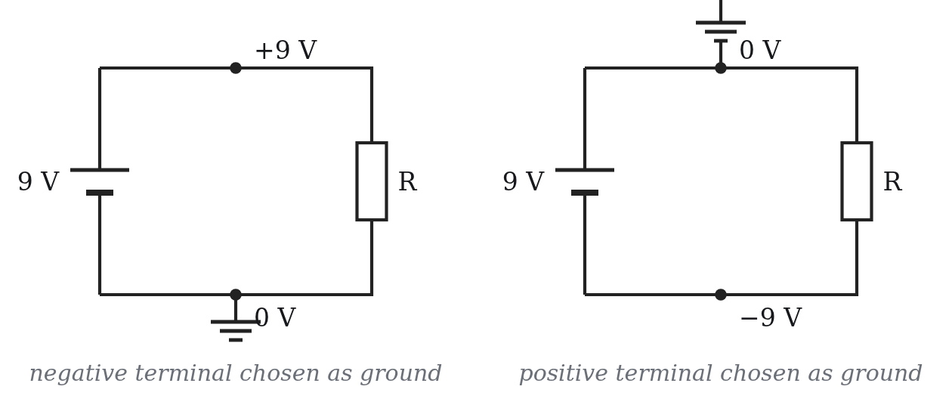
1
Ground and the 0 V reference
Voltage is a difference. “The voltage at node A” means nothing until you say relative to what.
Circuit ground = the one node you declare to be 0 V
The choice is free: currents and every voltage across a component are unchanged
Same ground symbol at several points = the same node, with no wire drawn
V+ − V− = 9 V either way
same circuit, two choices of reference — the 9 V difference never moves
Notes:
Voltage is a difference. Ground is the node we declare to be zero. Choosing it changes labels, not physics.

Slide 6
1
Circuit ground is not Earth ground
Circuit ground
Earth ground
A chosen reference node
Exists only on paper and in your analysis
Lets you stop drawing long return wires
A physical connection to the building
There for safety, not for analysis
A ground symbol does not by itself mean this
Ask in the lab: is this symbol telling me where zero is, or where the safety path is?
Notes:
Circuit ground is a bookkeeping choice. Earth ground is a physical safety connection. The symbol does not promise Earth.

Slide 7
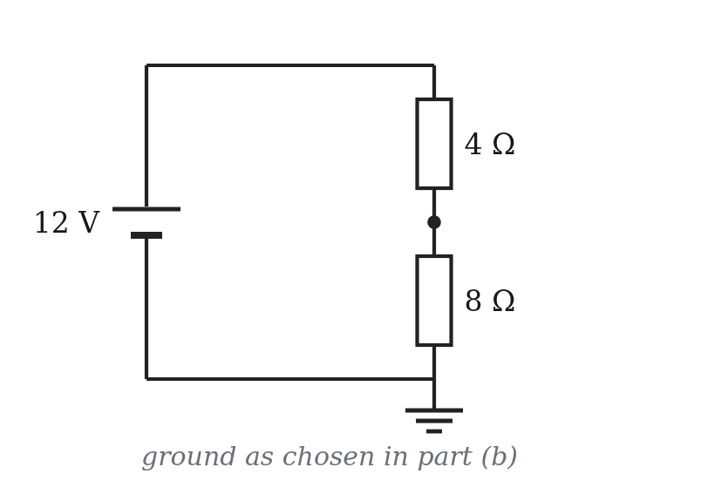
1
Problem 1
12 V source, 4 Ω on top, 8 Ω below.
Find the current and the voltage across each resistor
Bottom node = 0 V: what are the middle and top potentials?
Middle node = 0 V instead: what are the top and bottom?
Which numbers changed — and which physical quantities did not?
Notes:
Two minutes on this. The point of (d) is that nothing physical changed.

Slide 8
1
Problem 1 — answers
(a)
Req = 12 Ω, I = 1 A; drops are 4 V and 8 V
(b)
bottom 0 V → middle 8 V, top 12 V
(c)
middle 0 V → top +4 V, bottom −8 V
(d)
only the labels moved: I is still 1 A, the drops are still 4 V and 8 V
A negative node potential just means the node sits below the one you called zero.
Notes:
Answers. Emphasise that a negative node potential is ordinary.

Slide 9
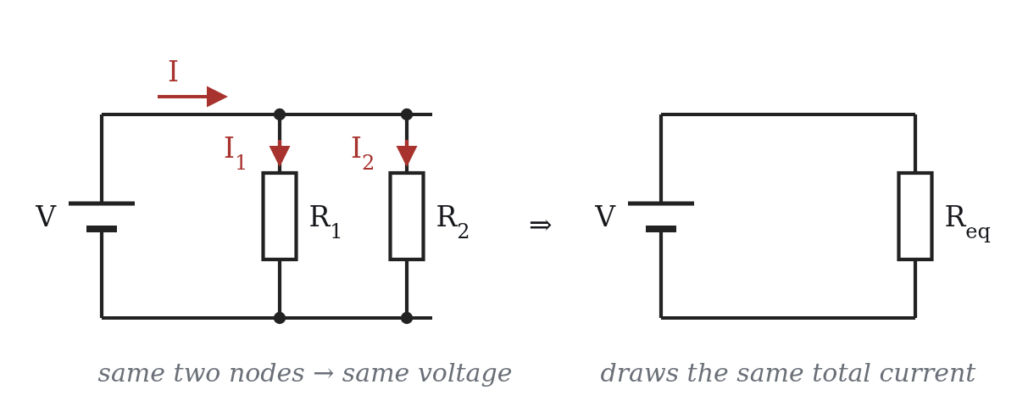
2
Resistors in parallel
Both ends on the same pair of nodes
So both see the same V
Each takes V/R, and the currents add
I = V/R1 + V/R2 = V (1/R1 + 1/R2)
1/Req = 1/R1 + 1/R2 + ... + 1/Rn
two resistors: Req = R1R2 / (R1 + R2)
Notes:
Parallel: same two nodes, same voltage. Derive the reciprocal rule on the board with the figure up.

Slide 10
2
Three things to memorise
1
n equal resistors
n in parallel give R / n
2
always smaller
Req is smaller than the smallest resistor in the group
3
the small one wins
a small R beside a much larger one ≈ the small one alone
Careful: the reciprocals add, not the resistances. Forgetting to invert at the end is the classic slip.
Notes:
These three let them sanity-check an answer in one second.

Slide 11
2
Problem 2
(a) 6 Ω ∥ 3 Ω
2 Ω
(b) three 3 Ω in parallel
1 Ω
(c) 100 Ω ∥ 1 Ω
0.990 Ω — essentially the 1 Ω alone
(d) 12 Ω ∥ ? = 4 Ω
6 Ω
(d) 1/4 − 1/12 = 1/6. Check (c) against rule 3: the answer had to be just under 1 Ω.
Notes:
Let them do all four, then read the answers across.

Slide 12
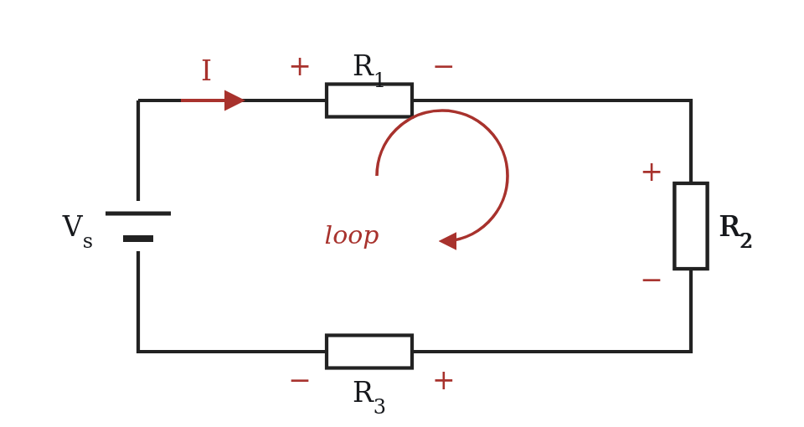
3
Kirchhoff’s voltage law
Around any closed loop, the algebraic sum of the voltages is zero.
∑ Vk = 0
Carry one coulomb around the loop and back
What it gains it must give up
Vs − V1 − V2 − V3 = 0 for the loop shown
pick a direction first — clockwise or counter-clockwise, both work
Notes:
KVL is conservation of energy around a loop.

Slide 13
3
The sign rule, and resistors in series
− into +
voltage rise
write + V
In series
Vs = IR1 + IR2 + IR3
Req = R1 + R2 + R3
+ into −
voltage drop
write − V
Either direction gives the same answer — what must not change is the rule you apply as you cross each part.
Same current everywhere; the voltage is what divides.
Notes:
Sign rule, then the series result. Make them say the rule out loud once.

Slide 14
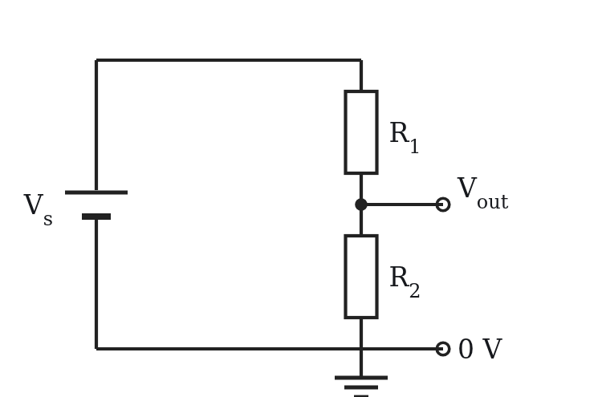
3
The voltage divider
Vout = Vs · R2 / (R1 + R2)
The same I flows through both, so Vout = I·R2
The fraction is just R2’s share of the total resistance
Equal resistors must give half of Vs
Vout can never exceed Vs
Careful: this assumes nothing draws current from the middle node. Hang a load there and the ratio changes.
Notes:
Read the formula off the figure: R2's share of the total resistance.

Slide 15
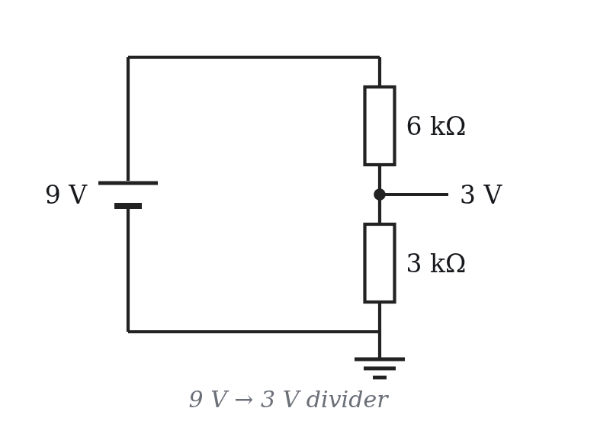
3
Problem 3
9 V across 1 kΩ + 2 kΩ + 3 kΩ: find I → 1.5 mA
Drops: 1.5 V, 3.0 V, 4.5 V — they sum to 9 V
Divider check on the 2 kΩ: 9 · 2k/6k = 3.0 V
Design 9 V → 3 V with I ≤ 1 mA
Ratio: R2/(R1+R2) = 1/3, so R1 = 2R2.
Current: total ≥ 9 kΩ.
→ 6 kΩ and 3 kΩ (or any larger 2:1 pair).
Notes:
Part (d) is a design question, not a plug-in. Ratio first, then the current budget.

Slide 16
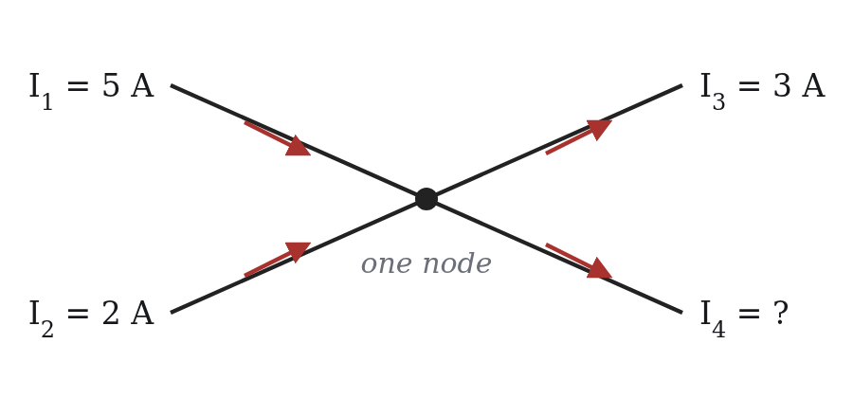
4
Kirchhoff’s current law
Charge is conserved and does not pile up at a junction, so at every node the currents entering equal the currents leaving.
∑ Iin = ∑ Iout
Written with signs, the algebraic sum at a node is zero — but then you must commit to one direction as positive and keep it.
Notes:
KCL: charge does not pile up at a node.

Slide 17
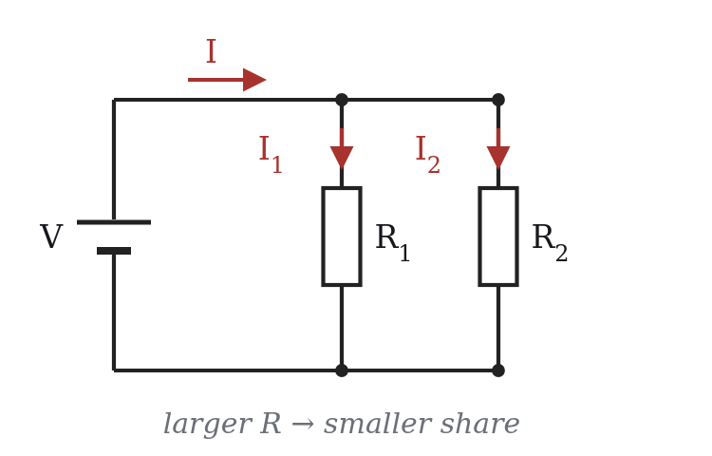
4
The current divider
I1 = I · R2 / (R1 + R2)
Both branches see the same V
I1 = V/R1, I2 = V/R2, and they add to I
Eliminate V and you get the formula
The numerator is the OTHER resistor. Current prefers the easier path, so the bigger resistance takes the smaller share.
Notes:
Current divider — stress that the numerator is the other resistor.

Slide 18
4
Problem 4
5 A and 2 A flow in; 3 A flows out along a third wire.
(a)
(b)
In = 7 A, out so far = 3 A,
so the fourth wire carries
4 A leaving the node.
5 + 2 + 3 + I4 = 0 adds four currents as if they all flowed the same way.
Take “in” as positive:
5 + 2 − 3 + I4 = 0 → I4 = −4 A, i.e. 4 A leaving.
Notes:
Quick one. The sign-convention mistake in (b) is the teaching point.

Slide 19
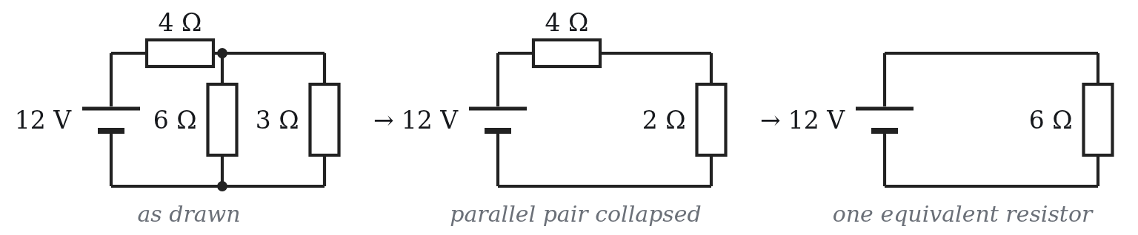
5
Worked example — collapse
12 V, a 4 Ω in series with 6 Ω ∥ 3 Ω.
6 ∥ 3 = (6 · 3)/9 = 2 Ω
Req = 4 + 2 = 6 Ω
I = 12 / 6 = 2 A
Notes:
Worked example. Collapse from the far end back to the source.

Slide 20
5
Worked example
4 Ω
all 2 A flows through it → drops 2·4 = 8 V
the pair
12 − 8 = 4 V, across both branches
6 Ω
4 / 6 = 0.667 A (divider: 2·3/9 = 0.667 A)
3 Ω
4 / 3 = 1.333 A smaller R, larger current
Power: 2² · 4 = 16 W 4²/6 = 2.67 W 4²/3 = 5.33 W
Notes:
Now expand outward: series drop first, then what is left across the pair.

Slide 21
5
Then check three ways
KCL
0.667 + 1.333 = 2 A
branch currents add to the total
KVL
12 − 8 − 4 = 0
drops cancel the source around the loop
Power
16 + 2.67 + 5.33 = 24 W
equals 12 V × 2 A from the source
Two of the three are nearly free once you have the numbers — and together they catch almost every arithmetic error.
Notes:
Three checks, every time. Two of them are free.

Slide 22

5
Problem 5
24 V, an 8 Ω in series with 6 Ω ∥ 12 Ω.
Req and the total current
Voltage across the 8 Ω and across the pair
Branch currents — by Ohm’s law and by the divider
Power in each resistor, then all three checks
Req = 12 Ω, I = 2 A
16 V and 8 V
1.333 A and 0.667 A
32 + 10.67 + 5.33 = 48 W ✓
Notes:
Same method, new numbers. Give them five minutes.

Slide 23
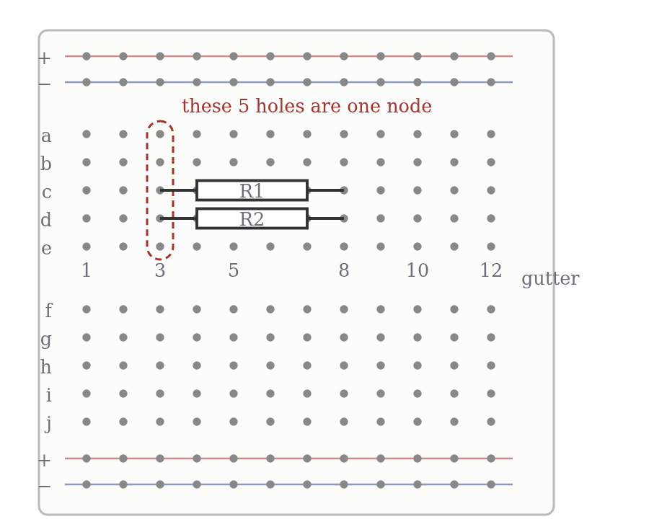
6
The breadboard
In the main area, each strip of five holes is one node
The long rails are one node each — but connected to nothing until you wire them
The gutter separates the halves; holes facing each other are not connected
Two failure modes eat most of your debugging time:
• both legs of one part in the same five-hole group — you shorted it out
• assuming the rails are live when no wire runs to them
Notes:
Breadboard: nothing on the plastic tells you what is connected.

Slide 24
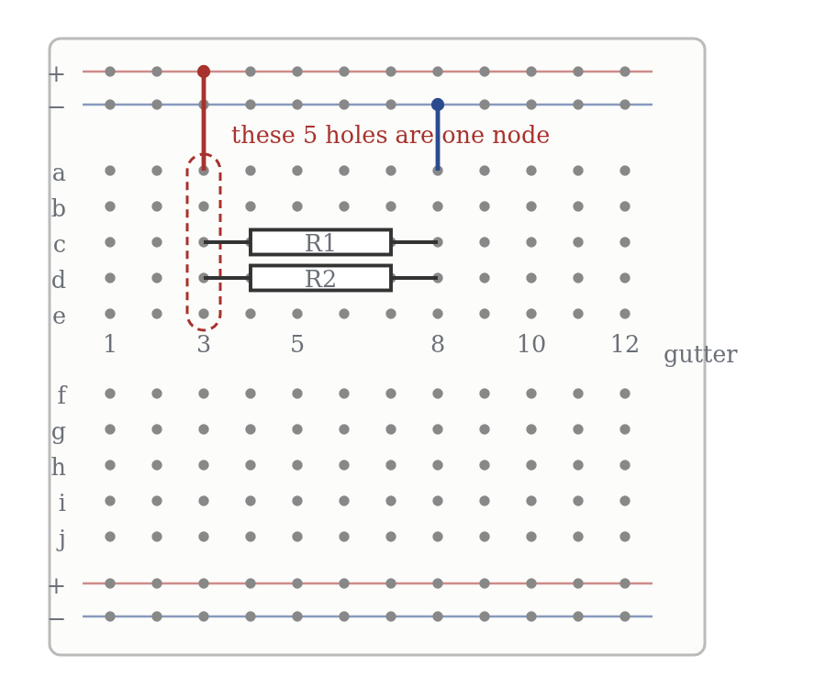
6
Problem 6 — answers
(a)
Parallel — both legs share the column-3 node and the column-8 node. Different rows are irrelevant.
(b)
No — a8 and f8 are in opposite halves, split by the gutter.
(c)
A short across that resistor: b6 and e6 are the same node.
(d)
+ rail into column 3, column 8 out to the − rail — and wire the rails to the supply.
Notes:
Answers to problem 6 — argue from nodes, not from the picture.

Slide 25
Part 2
From switches to Boolean algebra
Notes:
Bridge slide: two switches make AND and OR.

Slide 26
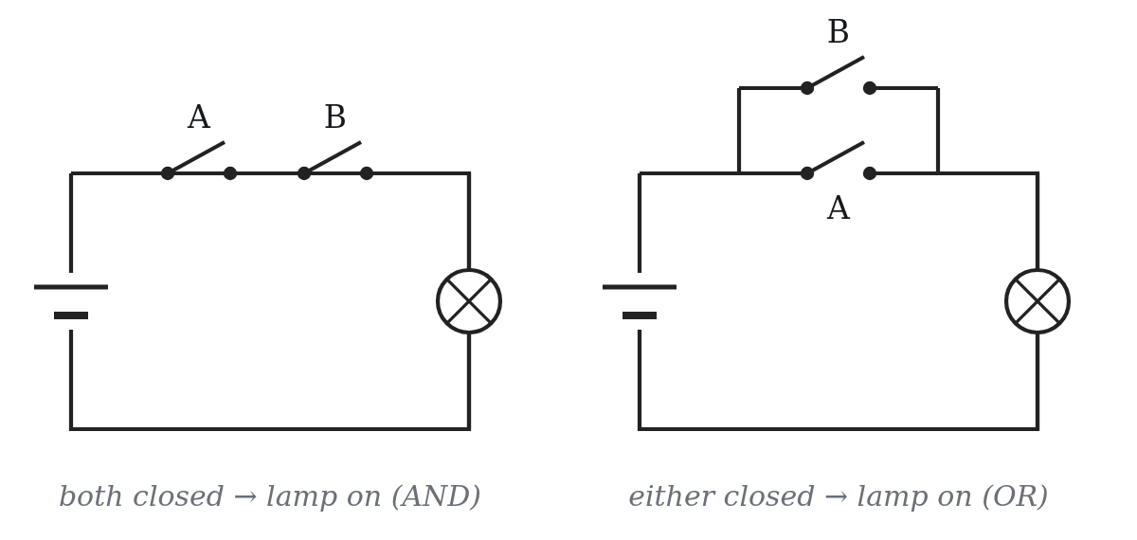
7
Two switches, two functions
Write 1 for closed and 0 for open, 1 for lamp on and 0 for off — and the two circuits become two truth tables.
A
B
AND
OR
0
0
0
0
0
1
0
1
1
0
0
1
1
1
1
1
The wires have not gone anywhere — we have simply stopped writing volts and amps, because only two states matter.
Notes:
Series switches = AND, parallel = OR. Then stop drawing lamps.

Slide 27
8
Axioms and single-variable theorems
On these slides x′ means NOT x (the handout uses an overbar).
Axioms
Single-variable theorems
1a 0 · 0 = 0
1b 1 + 1 = 1
5a x · 0 = 0
5b x + 1 = 1
2a 1 · 1 = 1
2b 0 + 0 = 0
6a x · 1 = x
6b x + 0 = x
3a 0 · 1 = 0
3b 1 + 0 = 1
7a x · x = x
7b x + x = x
4a x = 0 → x′ = 1
4b x = 1 → x′ = 0
8a x · x′ = 0
8b x + x′ = 1
9 (x′)′ = x
Notes:
Axioms and single-variable theorems. On slides a prime means NOT.

Slide 28
8
The named theorems, and duality
10
x·y = y·x
Commutative
Duality
11
x(yz) = (xy)z
Associative
Swap every · with +
and every 0 with 1,
and a true identity becomes another true identity.
That is why they come in a / b pairs — learn one of each.
12
x(y+z) = xy + xz
Distributive
13
x + xy = x
Absorption
14
xy + xy′ = x
Combining
15
(x·y)′ = x′ + y′
DeMorgan
16
x + x′y = x + y
17
xy + yz + x′z = xy + x′z
Consensus
Each line above has a dual (the b version) not shown — write two of them yourself.
Notes:
The named theorems, and duality — the list is half as long as it looks.

Slide 29
8
Problem 7 — name the theorem you used
(a) x(x + y)
= x (13b, absorption)
(b) x + x′y
= x + y (16a)
(c) dual of x(y+z) = xy + xz
x + yz = (x+y)(x+z) (12b)
(d) xy + xy′ + x′y
= x + y (14a then 16a)
12b has no counterpart in ordinary arithmetic — addition does not distribute over multiplication for numbers.
Notes:
Quick drills with the tables in front of them. Name the theorem each time.

Slide 30
9
Precedence: NOT, AND, OR
NOT › AND › OR — when in doubt, write the parentheses
x + yz means x + (yz)
x′y means (x′)y, not (xy)′
The bar is its own grouping symbol: everything under one bar is complemented together
Problem 8
Is x + yz = (x+y)z ?
No. Take x = 1, y = 0, z = 0:
left = 1, right = 0.
Notes:
Precedence. Get them to find the counterexample themselves.

Slide 31
10
Truth tables and DeMorgan
x
y
x·y
(x·y)′
x′
y′
x′+y′
In words
0
0
0
1
1
1
1
The complement of a product is the sum of the complements — and vice versa.
An AND with an inverted output is an OR with inverted inputs.
0
1
0
1
1
0
1
1
0
0
1
0
1
1
1
1
1
0
0
0
0
The last two columns agree in every row — that is the proof.
Exhaustive but exponential: n variables need 2ⁿ rows — 8 rows at three variables, 64 at six. That is the motivation for the algebra.
Notes:
DeMorgan by truth table, then the practical reading: pushing bubbles.

Slide 32
11
How to simplify
1
Multiply out first
xx′ then vanishes (8a) and y + y′ collapses to 1 (8b)
2
Factor
use the distributive law to expose exactly those pairs
3
Duplicate a term
x + x = x used backwards — one term can pair with two neighbours
4
Reduce both sides
to prove an identity, meet in the middle rather than transform one side
Notes:
Four tactics. The third one is the one they never think of.

Slide 33
11
Problem 10
(x1 + x3)(x1′ + x3′) = x1·x3′ + x1′·x3
LHS = (x1+x3)x1′ + (x1+x3)x3′ (12a)
= x1x1′ + x3x1′ + x1x3′ + x3x3′
= 0 + x3x1′ + x1x3′ + 0 (8a)
= x1x3′ + x1′x3 (6b)
This is XOR — true exactly when the two inputs differ.
Notes:
Problem 10. Expand, then kill the contradictory terms.

Slide 34
11
Problem 11 — meet in the middle
LHS
RHS
x1x3′ + x2′x3′ + x1x3 + x2′x3
= x1(x3′+x3) + x2′(x3′+x3) (12a)
= x1(1) + x2′(1) (8b)
= x1 + x2′ (6a)
x1′x2′ + x1x2 + x1x2′
= x1′x2′ + x1(x2+x2′) (12a)
= x1′x2′ + x1 (8b, 6a)
= x1 + x2′ (16a)
Both sides land on x1 + x2′, so the identity holds.
Notes:
Problem 11. Reduce both sides; call out the theorem numbers.

Slide 35
11
Problem 12 — the trick worth remembering
f(x1, x2) = x1x2 + x1′x2′ + x1′x2
duplicate the last term (7b): f = x1x2 + x1′x2 + x1′x2′ + x1′x2
factor each pair: (x1 + x1′)x2 + x1′(x2′ + x2) (12a)
each bracket is 1 (8b): f = x2 + x1′ (6a)
A term plus itself is itself — so you may copy a term as often as you like, and let each copy pair with a different neighbour.
Notes:
Problem 12 — the duplication trick. Nobody finds this without being told once.

Slide 36
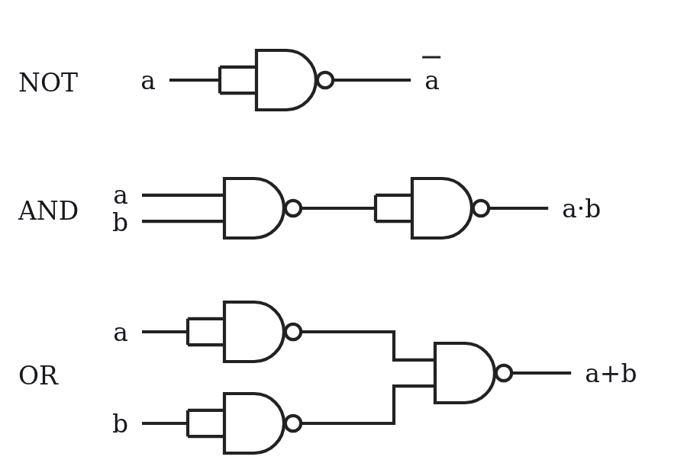
12
NAND is a universal gate
Any function can be written as a sum of products — which needs only NOT, AND and OR.
NOT: tie the two inputs together
AND: a NAND, then that inverter
OR: invert both inputs, then NAND — DeMorgan read backwards
In CMOS the NAND is cheaper and faster than the AND — so “universal” is a manufacturing fact, not just a theorem.
Notes:
NAND is universal — that is why it is the workhorse gate in CMOS.

Slide 37
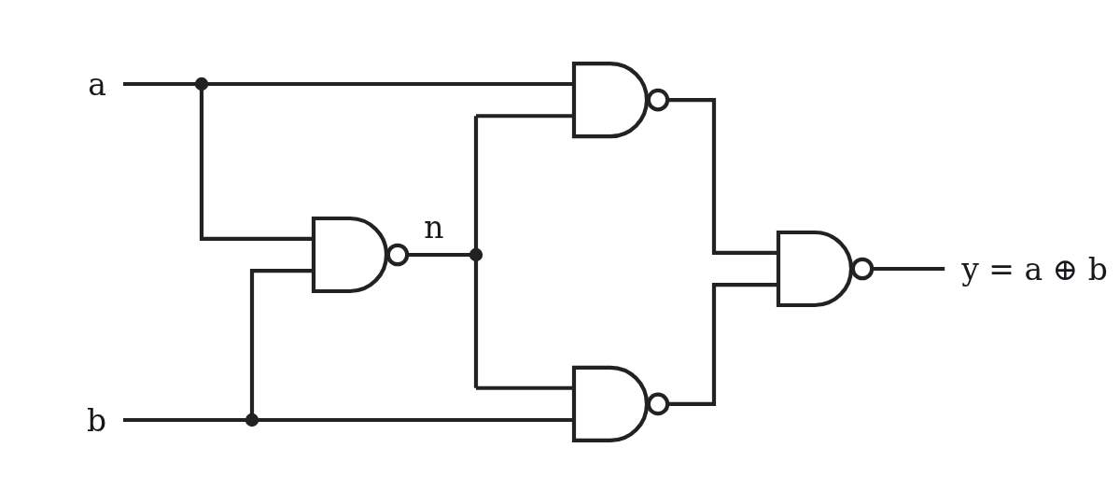
12
Problem 13 — XOR from four NANDs
Start from a·b′ + a′·b and apply DeMorgan.
With n = (a·b)′, the output is
[(a·n)′ · (b·n)′]′
NOR is universal too: NOT = NOR with tied inputs, OR = NOR then that inverter, AND = invert both inputs then NOR.
Notes:
Problem 13 — XOR from four NANDs. Let them try before showing it.

