Slide 1
RECITATION 3
Boolean algebra
and logic gates
Notes:
Today is all Boolean algebra, and we have eighty minutes. We start from two switch circuits, get to the six gates, go through the theorems, and finish by designing circuits from truth tables and converting them to NAND or NOR. The handout follows the same order. Each section ends with a problem, and we work through seven of them, with the answers on the slide right after each problem. Problem 8 stays in the handout for you to do on your own.

Slide 2
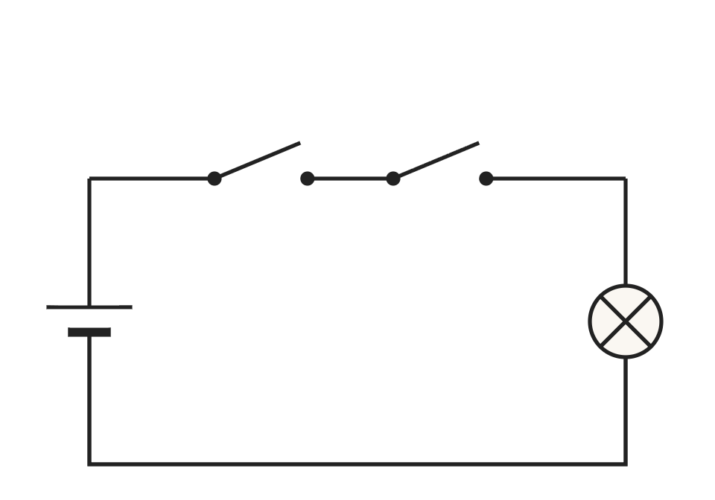
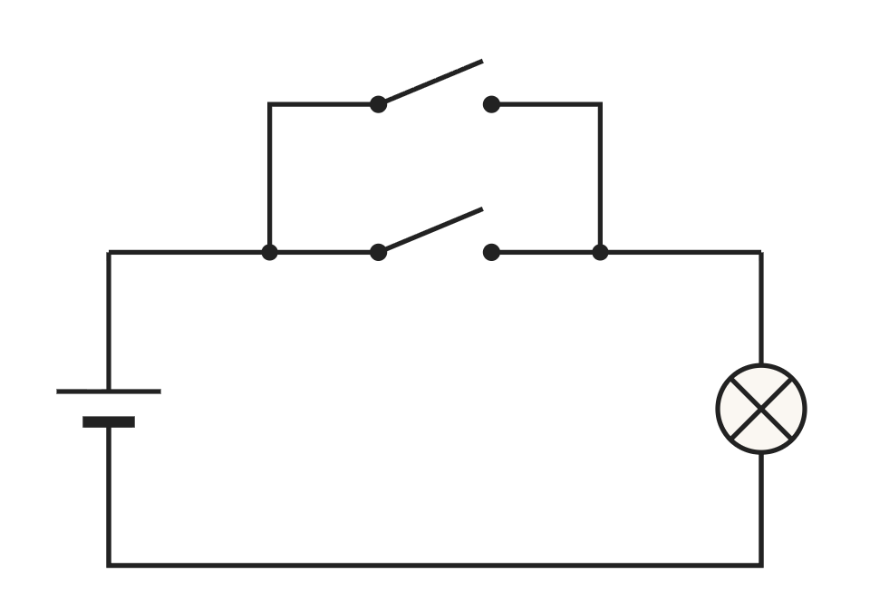
1 · FROM SWITCHES TO GATES
Two switches, one lamp, and the table they give
B
A
B
A | B | series lamp | parallel lamp
0 | 0 | 0 | 0
0 | 1 | 0 | 1
1 | 0 | 0 | 1
1 | 1 | 1 | 1
A
series: both closed
parallel: either closed
Closed switch = 1, open = 0. Lamp on = 1, off = 0.
The series column is 1 only when both inputs are 1, which is AND. The parallel column is 1 when at least one input is 1, which is OR.
Recitation 3 · Boolean algebra and logic gates
2
Notes:
Here are two circuits built from the same two switches and one lamp. In the series circuit the current has only one path, so the lamp lights only when both A and B are closed. In the parallel circuit there are two paths, so the lamp lights when either switch is closed. Now write 1 for a closed switch and 0 for an open one, 1 for the lamp on and 0 for off, and list all four combinations. Take one row: A = 0, B = 1 means A is open and B is closed, so the series lamp is off and the parallel lamp is on. Now read whole columns. The series column is 1 only in the last row, where both inputs are 1: that is AND. The parallel column is 1 whenever at least one input is 1: that is OR. Nothing physical changed. We only stopped writing voltages and currents, because a digital circuit cares about just two states. Everything today is algebra on these two symbols.

Slide 3
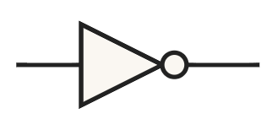
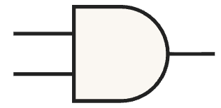
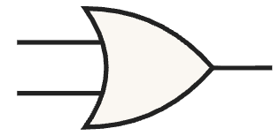
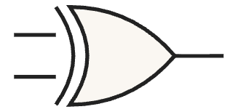
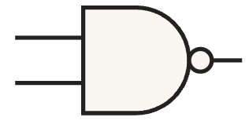
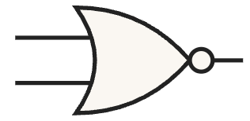
1 · FROM SWITCHES TO GATES
The six gates, and their truth tables
GATE
SYMBOL
ALGEBRA
OUTPUT IS 1 WHEN
ROWS 00 01 10 11
NOT
A′
the input is 0
1 1 0 0
AND
AB
both inputs are 1
0 0 0 1
OR
A + B
at least one input is 1
0 1 1 1
XOR
A ⊕ B
the inputs differ
0 1 1 0
NAND
(AB)′
the inputs are not both 1
1 1 1 0
NOR
(A + B)′
both inputs are 0
1 0 0 0
Recitation 3 · Boolean algebra and logic gates
3
Notes:
These are the six gates from lecture. The fourth column says each gate in words, and the last column is its truth table written on one line: the output for A B equal to 0 0, then 0 1, then 1 0, then 1 1. Read the last column down the list. NOT only uses A, so it gives 1 1 0 0 and ignores B. AND is 0 0 0 1: only the last case, where both inputs are 1. OR is 0 1 1 1: everything except the first case. XOR is 0 1 1 0: the two middle cases, where the inputs differ. The last two are the first two inverted. NAND is 1 1 1 0, the AND row with every bit flipped, and NOR is 1 0 0 0, the OR row flipped. So four of the six gates come from AND and OR by inverting the output.

Slide 4

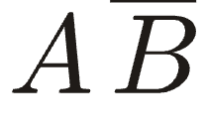

1 · FROM SWITCHES TO GATES
Bar or prime: the same NOT
BAR (HANDOUT)
PRIME (SLIDES)
MEANS
A′
NOT A
A′B′
NOT A, times NOT B: 1 on one row
(AB)′
NOT (A times B): NAND, 1 on three rows
Careful: two short bars and one long bar are different functions. Try A = 1, B = 0: A′B′ = 0 but (AB)′ = 1.
Order of operations without parentheses: NOT, then AND, then OR. So x + yz means x + (yz), and in x′y the prime covers only x.
Recitation 3 · Boolean algebra and logic gates
4
Notes:
The handout and the textbook write NOT as a bar over the letter. These slides use a prime, which is also what the LOGIC boxes on the course pages accept. Both mean the same thing. With the prime, complementing a group needs parentheses, (AB) prime; the bar groups by itself, and everything under one bar is complemented together. Here is the trap. Two short bars and one long bar are different functions. Take A = 1, B = 0. Two short bars give 0 times 1, which is 0. One long bar gives NOT of 0, which is 1. Where a bar breaks is part of the expression; copy one bar wrong and you have a different function. Without parentheses, NOT goes first, then AND, then OR, NAO for short. So x + yz means x + (yz), and in x′y the prime applies only to x. When in doubt, write the parentheses; an extra pair never costs a point.

Slide 5
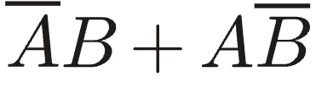
1 · FROM SWITCHES TO GATES
Problem 1: notation and precedence
a. Write
with primes. Which gate from the table is it?
b. Insert all the implied parentheses in x′y + z.
c. Are x + yz and (x + y)z the same function? If not, give values that tell them apart.
d. Are x′·y′ and (x·y)′ the same? Try a few rows.
Recitation 3 · Boolean algebra and logic gates
5
Notes:
Problem 1 is about the notation from this section. Part a switches from bars to primes, parts b and c are about the order of operations, and part d is the bar trap we just saw.

Slide 6
1 · FROM SWITCHES TO GATES
Problem 1: answers
a. A′B + AB′. It is XOR: 1 exactly when A and B differ.
b. ((x′)·y) + z
c. Not the same. x = 1, y = 0, z = 0 gives 1 for the first and 0 for the second.
d. Not the same. x = 1, y = 0 gives x′·y′ = 0 but (xy)′ = 1. DeMorgan: (xy)′ = x′ + y′.
Recitation 3 · Boolean algebra and logic gates
6
Notes:
(a) With primes this is A′B + AB′. It is 1 when A is 0 and B is 1, or when A is 1 and B is 0, so exactly when the inputs differ: that is XOR. (b) NOT first, then AND, then OR: ((x′)·y) + z. (c) They are not the same. Take x = 1, y = 0, z = 0: the first gives 1 and the second gives 0. To show that two functions differ, one row is enough; to show they are equal, every row has to agree. (d) Not the same either. At x = 1, y = 0, x′·y′ is 0 but (xy)′ is 1. The correct expansion is DeMorgan, which comes in section 4: (xy)′ = x′ + y′.

Slide 7
2 · TRUTH TABLES
One column per sub-expression
Example from lecture: A + BC + A′C′
A | B | C | BC | A′C′ | output
0 | 0 | 0 | 0 | 1 | 1
0 | 0 | 1 | 0 | 0 | 0
0 | 1 | 0 | 0 | 1 | 1
0 | 1 | 1 | 1 | 0 | 1
1 | 0 | 0 | 0 | 0 | 1
1 | 0 | 1 | 0 | 0 | 1
1 | 1 | 0 | 0 | 0 | 1
1 | 1 | 1 | 1 | 0 | 1
1. BC
1 only when B = C = 1: rows 011 and 111.
2. A′C′
1 only when A = C = 0: rows 000 and 010.
3. OR the three columns
Any 1 in a row makes the output 1.
List the rows in binary counting order, 000 up to 111, so none is skipped: n inputs give 2ⁿ rows.
Shortcuts: an OR is 1 as soon as one term is 1, so every row with A = 1 is 1 here. An AND is 0 as soon as one factor is 0.
Recitation 3 · Boolean algebra and logic gates
7
Notes:
With n inputs there are 2 to the n rows, because each input can be 0 or 1, and every extra input doubles the count. Always list the rows in binary counting order, so no row is skipped or repeated. For three inputs the columns follow a pattern: A is four 0s then four 1s, B alternates in pairs, and C alternates every row. To evaluate an expression, give each sub-expression its own column. Take A + BC + A′C′ from lecture. BC is 1 only when B and C are both 1: rows 011 and 111. A′C′ is 1 only when A and C are both 0: rows 000 and 010. Then OR the three columns: the output is 1 wherever A, BC or A′C′ is 1. Two shortcuts save time. In an OR, one term at 1 is enough, so every row with A = 1 is 1 without looking at B or C. In an AND, one factor at 0 is enough. Fill in what the shortcuts give you, then evaluate only the rows that are left. A truth table can prove any identity: compute both sides and compare the columns. It always works, but the rows double with every input, and six inputs already mean 64 rows. That is why we need the algebra in the next section.

Slide 8
2 · TRUTH TABLES
Problem 2: truth tables
Fill in the output column for every input combination.
a. F = AB + B′C′
b. G = (A + B)(A′ + C)
c. How many rows do you need to check a three-variable identity? A six-variable one?
Recitation 3 · Boolean algebra and logic gates
8
Notes:
Problem 2 practises truth tables: two expressions to fill in, and a question about how many rows an identity check needs.

Slide 9
2 · TRUTH TABLES
Problem 2: answers
a. F = AB + B′C′
b. G = (A + B)(A′ + C)
A | B | C | AB | B′C′ | F
0 | 0 | 0 | 0 | 1 | 1
0 | 0 | 1 | 0 | 0 | 0
0 | 1 | 0 | 0 | 0 | 0
0 | 1 | 1 | 0 | 0 | 0
1 | 0 | 0 | 0 | 1 | 1
1 | 0 | 1 | 0 | 0 | 0
1 | 1 | 0 | 1 | 0 | 1
1 | 1 | 1 | 1 | 0 | 1
A | B | C | A + B | A′ + C | G
0 | 0 | 0 | 0 | 1 | 0
0 | 0 | 1 | 0 | 1 | 0
0 | 1 | 0 | 1 | 1 | 1
0 | 1 | 1 | 1 | 1 | 1
1 | 0 | 0 | 1 | 0 | 0
1 | 0 | 1 | 1 | 1 | 1
1 | 1 | 0 | 1 | 0 | 0
1 | 1 | 1 | 1 | 1 | 1
c. 8 rows for a three-variable identity, 64 rows for a six-variable one.
Recitation 3 · Boolean algebra and logic gates
9
Notes:
(a) Here are the two sub-expression columns. AB is 1 on rows 110 and 111. B′C′ is 1 where B and C are both 0, rows 000 and 100. OR them, and F reads 1 0 0 0 1 0 1 1 down the table. This is the in-class table from lecture. (b) A + B is 0 on rows 000 and 001, so G is 0 on those two rows whatever the second factor does. A′ + C is 0 when A is 1 and C is 0, rows 100 and 110. Multiply the two columns and G reads 0 0 1 1 0 1 0 1. (c) A three-variable identity needs 8 rows, and a six-variable one needs 64.

Slide 10
3 · AXIOMS AND THEOREMS
Axioms and single-variable theorems
Axioms
Single-variable theorems
 | AND | OR
1 | 0·0 = 0 | 1 + 1 = 1
2 | 1·1 = 1 | 0 + 0 = 0
3 | 0·1 = 1·0 = 0 | 1 + 0 = 0 + 1 = 1
4 | if x = 0, x′ = 1 | if x = 1, x′ = 0
 | a (AND) | b (OR)
5 | x·0 = 0 | x + 1 = 1
6 | x·1 = x | x + 0 = x
7 | x·x = x | x + x = x
8 | x·x′ = 0 | x + x′ = 1
9 | (x′)′ = x
Recitation 3 · Boolean algebra and logic gates
10
Notes:
Boolean algebra is built like Euclidean geometry: a few axioms, and everything else is derived from them. Boole published it as pure mathematics in the 1840s and 1850s, and it met switching circuits only in Claude Shannon’s 1938 master’s thesis. The axioms just restate the AND and OR truth tables. The single-variable theorems are easier to remember as wiring, which is the next slide.

Slide 11
3 · AXIOMS AND THEOREMS
Single-variable theorems as wiring
AND, one input at 1
AND, one input at 0
The other input passes through. 6a: x·1 = x
The output is stuck at 0. 5a: x·0 = 0
OR, one input at 1
OR, one input at 0
The output is stuck at 1. 5b: x + 1 = 1
The other input passes through. 6b: x + 0 = x
A signal and its own complement into one gate give a constant (8a, 8b). On the bench: tie a spare AND input to 1 and a spare OR input to 0, and never leave an input floating.
XOR identities: A ⊕ 0 = A, A ⊕ 1 = A′, A ⊕ A = 0, A ⊕ A′ = 1. The second one makes an XOR a controlled inverter.
Recitation 3 · Boolean algebra and logic gates
11
Notes:
Read theorems 5 to 8 as wiring. An AND gate with one input tied to 1 passes the other input straight through; that is 6a. Tie that input to 0 and the output is stuck at 0; that is 5a. OR is the mirror image: a 1 sticks the output at 1, and a 0 passes the other input through. A signal together with its own complement always gives a constant. This is also the rule for the lab: tie a spare AND input to 1 and a spare OR input to 0. Never leave an input floating; a floating input has no defined level, and the circuit will work only some of the time. The textbook table has no XOR, but lecture gave these four identities, and each one follows from the definition A ⊕ B = A′B + AB′. The useful one is A ⊕ 1 = A′. Treat one input as a control: when it is 1, the gate inverts the other input; when it is 0, the input passes through. So an XOR is an inverter you can switch on and off.

Slide 12
3 · AXIOMS AND THEOREMS
Two- and three-variable theorems
 | a | b | name
10 | x·y = y·x | x + y = y + x | commutative
11 | x(yz) = (xy)z | x + (y + z) = (x + y) + z | associative
12 | x(y + z) = xy + xz | x + yz = (x + y)(x + z) | distributive
13 | x + xy = x | x(x + y) = x | absorption
14 | xy + xy′ = x | (x + y)(x + y′) = x | combining
15 | (xy)′ = x′ + y′ | (x + y)′ = x′y′ | DeMorgan
16 | x + x′y = x + y | x(x′ + y) = xy
17 | xy + yz + x′z = xy + x′z | (x + y)(y + z)(x′ + z) = (x + y)(x′ + z) | consensus
Duality: swap · with +, and 0 with 1, and any identity becomes the other half of its pair. So the table is half as long as it looks.
Recitation 3 · Boolean algebra and logic gates
12
Notes:
These are the two- and three-variable theorems, for reference during the problems. The ones you will use most are 14a and 16a, and DeMorgan, number 15, gets its own section next. Every theorem comes in an a and a b version. Swap AND with OR, and 0 with 1, and a true identity becomes another true identity, called its dual. So you only need to learn half the table.

Slide 13
3 · AXIOMS AND THEOREMS
Problem 3: using the theorems
Name the theorem you use at each step.
a. Simplify x(x + y).
b. Simplify x + x′y.
c. Write the dual of x(y + z) = xy + xz and find it in the table.
d. Simplify xy + xy′ + x′y.
e. Starting from A ⊕ B = A′B + AB′, prove A ⊕ 1 = A′ and A ⊕ A′ = 1.
Recitation 3 · Boolean algebra and logic gates
13
Notes:
Problem 3 uses the theorem tables. The rule for this problem is that every step names the theorem it uses.

Slide 14
3 · AXIOMS AND THEOREMS
Problem 3: answers
a. x(x + y) = x by 13b (absorption).
b. x + x′y = x + y by 16a.
c. x + yz = (x + y)(x + z), which is 12b.
d. xy + xy′ = x by 14a, then x + x′y = x + y by 16a.
e. A ⊕ 1 = A′·1 + A·0 = A′ by 4b, 6a, 5a, 6b. A ⊕ A′ = A′·A′ + A·A = A′ + A = 1 by 9, 7a, 8b.
Recitation 3 · Boolean algebra and logic gates
14
Notes:
(a) x(x + y) = x directly by absorption, 13b; or expand to xx + xy = x + xy by 7a, then use 13a. (b) x + x′y = x + y by 16a. (c) The dual of the distributive law is x + yz = (x + y)(x + z), which is 12b. (d) 14a merges xy + xy′ into x, leaving x + x′y, which is x + y by 16a. (e) Substitute into the XOR definition. A ⊕ 1 = A′·1 + A·1′; the prime of 1 is 0 by 4b, so this is A′·1 + A·0, which is A′ by 6a, 5a and 6b. For the second, A ⊕ A′ = A′·A′ + A·A using 9; that is A′ + A by 7a, and 1 by 8b.

Slide 15
4 · DEMORGAN’S THEOREM
DeMorgan’s theorem
x | y | xy | (xy)′ | x′ | y′ | x′ + y′
0 | 0 | 0 | 1 | 1 | 1 | 1
0 | 1 | 0 | 1 | 1 | 0 | 1
1 | 0 | 0 | 1 | 0 | 1 | 1
1 | 1 | 1 | 0 | 0 | 0 | 0
15a
(xy)′ = x′ + y′
15b
(x + y)′ = x′y′
The last two columns agree on every row.
Any number of variables: (ABC)′ = A′ + B′ + C′. Nested: start with the outermost complement.
Careful: split the complement and swap the operator at the same time. (AB)′ = A′ + B′, never A′B′. Check A = 1, B = 0: the first two are 1, the last is 0.
Recitation 3 · Boolean algebra and logic gates
15
Notes:
This section matters most today. Here is 15a proved with a truth table. Look at the last two columns, (xy)′ and x′ + y′: they agree on every row, so the identity holds. In one sentence: the complement of a product is the sum of the complements, and the complement of a sum is the product of the complements. It works for any number of variables, and with nested complements you start from the outermost one and work inward. This is the most common algebra mistake in this course. When you split a complement, the operator must swap at the same time. Check with A = 1, B = 0: (AB)′ is 1 and A′ + B′ is 1, but A′B′ is 0. Splitting the complement without swapping the operator gives a different function.

Slide 16
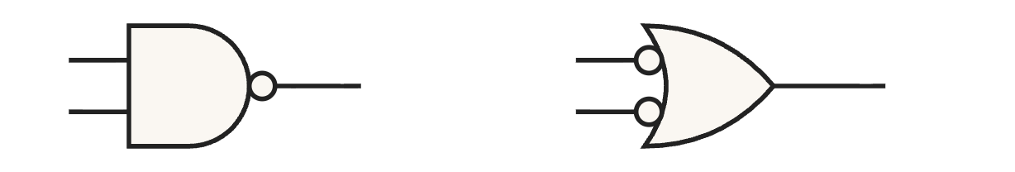
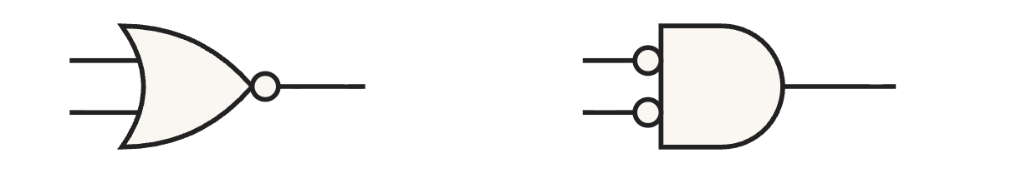
4 · DEMORGAN’S THEOREM
DeMorgan in circuits: moving bubbles
A bubble is the small circle on a gate symbol
It marks a complement at that terminal. NAND and NOR carry it on the output; a bubble drawn on an input means that input is inverted before it enters the gate.
A
≡
A
A
≡
A
B
B
B
B
NAND = OR with inverted inputs
NOR = AND with inverted inputs
The rule
Move bubbles across a gate: AND and OR swap, and every terminal flips. A bubble appears where there was none and disappears where there was one.
Recitation 3 · Boolean algebra and logic gates
16
Notes:
First, what a bubble is. It is the small circle drawn on a gate symbol, and it marks a complement at that terminal. NAND and NOR carry it on the output, which is why they are AND and OR with the output inverted. A bubble drawn on an input means that input is inverted before it enters the gate, so it does the same job as an inverter in front of the gate. In a circuit, DeMorgan means a bubble can move through a gate. Push the output bubble of a NAND back onto its two inputs, and the AND shape becomes an OR shape: a NAND is an OR with inverted inputs. The same move shows that a NOR is an AND with inverted inputs. The general rule: moving bubbles across a gate swaps AND and OR, and flips every terminal, so a bubble appears where there was none and disappears where there was one. Section 7 uses exactly this rule to convert whole circuits.

Slide 17
4 · DEMORGAN’S THEOREM
Problem 4: DeMorgan
a. Prove 15b, (x + y)′ = x′y′: build the truth table for both sides and compare the two columns.
b. Rewrite ((A + B′)C)′ so that no complement covers more than one letter. Name the theorem at each step.
c. Draw an AND gate with an inverter on each input, and write what it computes. Which single gate from section 1 has that truth table? Do the same for an OR gate with an inverter on each input.
d. Start from F = AB + B′C′. Use DeMorgan twice to write the complement F′ as a product of two sums.
Recitation 3 · Boolean algebra and logic gates
17
Notes:
Problem 4 practises DeMorgan in algebra and in gates. Part a is the truth table proof of 15b. Part b asks you to keep splitting the complement until no bar covers more than one letter, naming the theorem at each step. Part c goes to the circuit: draw an AND gate with an inverter on each input, write down the expression it computes, and find the single gate with the same truth table. Then the same for an OR gate. Part d is one complement, done with DeMorgan twice, and the answer should be two sums multiplied together.

Slide 18
4 · DEMORGAN’S THEOREM
Problem 4: answers
a. The last two columns agree, so 15b holds.
x | y | x + y | (x + y)′ | x′ | y′ | x′y′
0 | 0 | 0 | 1 | 1 | 1 | 1
0 | 1 | 1 | 0 | 1 | 0 | 0
1 | 0 | 1 | 0 | 0 | 1 | 0
1 | 1 | 1 | 0 | 0 | 0 | 0
b. ((A + B′)C)′ = (A + B′)′ + C′ by 15a, = A′·(B′)′ + C′ by 15b, = A′B + C′ by 9.
c. The AND gives A′B′, which is (A + B)′ by 15b: a NOR. The OR gives A′ + B′, which is (AB)′ by 15a: a NAND.
d. F′ = (AB + B′C′)′ = (AB)′·(B′C′)′ by 15b, = (A′ + B′)(B + C) by 15a and 9.
Recitation 3 · Boolean algebra and logic gates
18
Notes:
(a) The table has one column for each side. (x + y)′ reads 1, 0, 0, 0, and so does x′y′, so the two sides agree on every row and 15b holds. (b) Start at the outermost complement, which covers a product, so 15a turns it into a sum: ((A + B′)C)′ = (A + B′)′ + C′. The first part still has a complement over a sum, so 15b turns it into a product: A′·(B′)′. Finally (B′)′ is B by theorem 9, and the answer is A′B + C′. (c) With an inverter on each input, the AND gate computes A′B′. By 15b that equals (A + B)′, which is the NOR truth table. The OR gate with inverted inputs computes A′ + B′, which by 15a equals (AB)′: the NAND truth table. These are the two equivalences in the bubble figure. (d) The complement covers a sum of two products, so 15b splits it into a product of two complements: (AB)′·(B′C′)′. Then 15a opens each one: (AB)′ = A′ + B′, and (B′C′)′ = (B′)′ + (C′)′ = B + C by theorem 9. So F′ = (A′ + B′)(B + C), a product of two sums, which is where section 6 begins.

Slide 19
5 · ALGEBRAIC SIMPLIFICATION
Simplifying: four moves, two workhorse theorems
Move | Example
Multiply out | x(x′ + y) = xx′ + xy = xy (8a)
Factor | xy + xy′ = x(y + y′) = x (8b)
Duplicate a term | x + x = x, used backwards (Problem 5d)
Prove both sides | reduce each side to the same expression
Goal: fewer terms and fewer literals, so fewer gates and gate inputs.
14a: xy + xy′ = x
16a: x + x′y = x + y
Two terms differ only in one variable, plain in one and primed in the other. That variable disappears.
The x′ in the second term is redundant: whenever it matters, x already covers the case.
Recitation 3 · Boolean algebra and logic gates
19
Notes:
Minimising means fewer terms and fewer literals, so fewer gates and fewer gate inputs. Simplifying by algebra is a search, not a recipe, but these four moves cover most cases. Multiply out, so that terms like xx′ vanish. Factor, to expose pairs like y + y′ that collapse to 1. The third move is the one people never think of: x + x = x read backwards. You can write a term twice so it can combine with two different neighbours; we use it in Problem 5d. And to prove an identity, reduce each side separately to the same expression. Learn to recognise these two by shape. 14a: two terms identical except for one variable, plain in one and primed in the other; merge them and that variable disappears. 16a: if x is already a term, the x′ condition in another term is redundant, because whenever it matters, x already covers the case.

Slide 20
5 · ALGEBRAIC SIMPLIFICATION
Problem 5: proofs and minimisation
a. Prove (x₁ + x₃)(x₁′ + x₃′) = x₁x₃′ + x₁′x₃.
b. What familiar two-input function is this?
c. Prove by reducing each side: x₁x₃′ + x₂′x₃′ + x₁x₃ + x₂′x₃ = x₁′x₂′ + x₁x₂ + x₁x₂′
d. Minimise f = x₁x₂ + x₁′x₂′ + x₁′x₂ and check with a truth table.
Recitation 3 · Boolean algebra and logic gates
20
Notes:
Problem 5 uses the four moves: an identity proved by multiplying out, one proved by reducing both sides, and a minimisation.

Slide 21
5 · ALGEBRAIC SIMPLIFICATION
Problem 5: answers
a. Expand with 12a; x₁x₁′ and x₃x₃′ are 0, leaving x₁x₃′ + x₁′x₃.
b. XOR.
c. Both sides reduce to x₁ + x₂′. Left: pair the terms and factor (8b, 6a). Right: x₁x₂ + x₁x₂′ = x₁, then 16a.
d. f = x₂ + x₁′, by 14a then 16a (or duplicate x₁′x₂ with 7b). It is 0 only at x₁ = 1, x₂ = 0.
Recitation 3 · Boolean algebra and logic gates
21
Notes:
(a) Expand with 12a into four terms: x₁x₁′ + x₃x₁′ + x₁x₃′ + x₃x₃′. The first and last are 0 by 8a, leaving x₁x₃′ + x₁′x₃. (b) That is XOR: true exactly when the two inputs differ. (c) This one shows the reduce-both-sides move. On the left, pair the terms: x₁(x₃′ + x₃) + x₂′(x₃′ + x₃); each bracket is 1, so the left side is x₁ + x₂′. On the right, x₁x₂ + x₁x₂′ = x₁, and x₁ + x₁′x₂′ = x₁ + x₂′ by 16a. Both sides equal x₁ + x₂′. (d) Two routes give the same answer. With 14a, x₁x₂ + x₁′x₂ = x₂, and then 16a turns x₂ + x₂′x₁′ into x₂ + x₁′. Or duplicate x₁′x₂ by 7b and pair it with each neighbour. Either way, f is 0 only at x₁ = 1, x₂ = 0, which matches the truth table.

Slide 22
6 · SOP AND POS
From a truth table to an expression
So far: expression → table. Design goes the other way: table → expression → circuit.
SOP: sum of products
POS: product of sums
One product per row where the output is 1. A variable is plain if it is 1 in that row, primed if it is 0. OR the products.
One sum per row where the output is 0. A variable is plain if it is 0 in that row, primed if it is 1. AND the sums.
Recitation 3 · Boolean algebra and logic gates
22
Notes:
Until now we went from an expression to its truth table. Design runs the other way: we know what the output must be for every input, and we need an expression, and then a circuit. Every function can be written straight from its table in two standard forms. Sum of products: for each row where the output is 1, write the product that is 1 on that row and nowhere else, then OR the products. Each product switches on for exactly one row, so the sum is 1 on exactly the 1-rows. Product of sums is the mirror image: it is built from the 0-rows, with the literal rule reversed.

Slide 23
6 · SOP AND POS
One table, two expressions
A | B | F | SOP term | POS term
0 | 0 | 1 | A′B′
0 | 1 | 0 |  | A + B′
1 | 0 | 0 |  | A′ + B
1 | 1 | 1 | AB
SOP
F = A′B′ + AB: ANDs feeding an OR
POS
F = (A + B′)(A′ + B): ORs feeding an AND
Same function (XNOR: 1 when the inputs are equal), two different circuits.
Careful: the literal rules for the two forms are opposite. Plug each term back into its own row: a product must give 1 there, a sum must give 0.
Recitation 3 · Boolean algebra and logic gates
23
Notes:
Here is the table from lecture. The 1-rows are 00 and 11, so the SOP is A′B′ + AB. The 0-rows are 01 and 10, so the POS is (A + B′)(A′ + B). Both describe XNOR, which is 1 when the inputs are equal. They are two different circuits for the same function: SOP is ANDs feeding an OR, POS is ORs feeding an AND. The literal rules for SOP and POS are opposite, and they are easy to mix up. The fix is a habit: plug each term back into its own row. A product term must come out 1 on its row: on row 00, A′B′ is 1 times 1. A sum term must come out 0 on its row: on row 01, A + B′ is 0 plus 0. A note on lecture slides 21 and 24: the formulas there do not match the schematics. The schematics are AB + B′C and (A + B)(B′ + C), and both printed formulas reduce to just B. Go by the schematics; section 7 uses AB + B′C. A note on lecture slide 34: it writes this SOP with one long bar over AB. It should be a separate complement on each letter. One bar over AB is NAND, which is 1 on three rows.

Slide 24
6 · SOP AND POS
Inverse logic: write the shorter list
ABC | 000 | 001 | 010 | 011 | 100 | 101 | 110 | 111
F | 1 | 0 | 1 | 1 | 1 | 0 | 1 | 1
POS: two 0s, two terms
Or through the complement
F = (A + B + C′)(A′ + B + C′) = B + C′ by 14b
F′ = A′B′C + AB′C = B′C, so F = B + C′
Check: F is 0 only when B = 0 and C = 1, exactly rows 001 and 101.
Recitation 3 · Boolean algebra and logic gates
24
Notes:
SOP needs one term per 1, and POS one term per 0, so write whichever list is shorter. This table from lecture has six 1s and only two 0s. The POS has two terms, (A + B + C′)(A′ + B + C′), and they differ only in A, so 14b collapses them to B + C′. Another way is through the complement: F′ is 1 on the two 0-rows, so F′ = A′B′C + AB′C = B′C, and DeMorgan gives F = B + C′. Check against the table: F is 0 only when B is 0 and C is 1, exactly rows 001 and 101. The LOGIC box on lecture slide 35 shows a formula that does not match this table; the correct answer is B + C′.

Slide 25
6 · SOP AND POS
Problem 6: SOP and POS
a. For XOR (0 1 1 0 on rows 00, 01, 10, 11), write the SOP and the POS. Which gates does the SOP need?
b. Write the full SOP of F = AB + B′C′ from your table in Problem 2a, one product per 1, and simplify it back.
c. A three-input function is 0 only on rows 011 and 111. Use inverse logic and simplify. Which single gate is it?
Recitation 3 · Boolean algebra and logic gates
25
Notes:
Problem 6 practises SOP and POS: XOR in both forms, a full SOP simplified back, and one function where inverse logic is the quick route.

Slide 26
6 · SOP AND POS
Problem 6: answers
a. SOP A′B + AB′, POS (A + B)(A′ + B′). The SOP needs two inverters, two ANDs and one OR.
b. A′B′C′ + AB′C′ + ABC′ + ABC. Merge each pair with 14a: B′C′ + AB.
c. F′ = A′BC + ABC = BC, so F = (BC)′ = B′ + C′: one NAND of B and C.
Recitation 3 · Boolean algebra and logic gates
26
Notes:
(a) For XOR the 1-rows are 01 and 10, so the SOP is A′B + AB′. The 0-rows are 00 and 11, so the POS is (A + B)(A′ + B′). The SOP needs two inverters, two ANDs and one OR. These two expressions are exactly the two sides of Problem 5a. (b) The 1-rows are 000, 100, 110 and 111, giving four products. The first pair differs only in A, so 14a merges it into B′C′; the second pair differs only in C and merges into AB. We are back at AB + B′C′. The full SOP is easy to write but long; simplifying shrinks the circuit a lot. (c) There are only two 0s, so use the complement: F′ = A′BC + ABC = BC, and F = (BC)′ = B′ + C′. That is a single NAND of B and C; A does not matter.

Slide 27
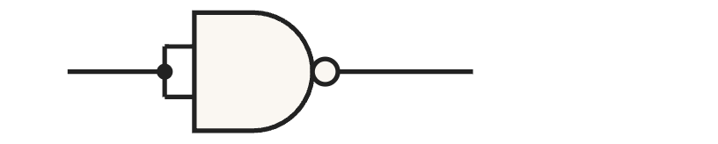
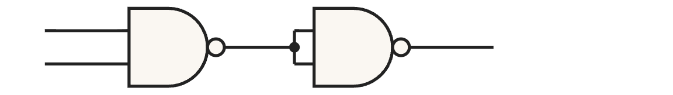
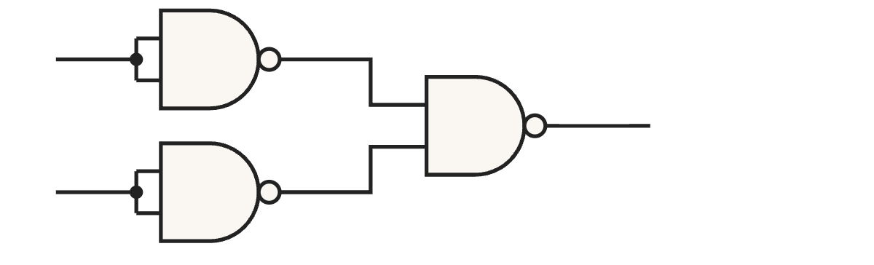
7 · NAND AND NOR
Each basic gate, as a formula and as NANDs
NOT
a
a′
(a·a)′ = a′
tie both inputs to a: a·a = a by 7a, so the NAND gives a′
AND
a
a·b
((ab)′·(ab)′)′ = ((ab)′)′ = ab
b
first NAND gives (ab)′; the second one inverts it back, by 7a and 9
a
a + b
(a′·b′)′ = a + b
OR
b
invert a and b with tied NANDs, then NAND them: 15a and 9 give a + b
A sum of products needs only NOT, AND and OR, and all three are here, so NANDs alone can build any circuit. One 74LS00 chip holds four of them.
Recitation 3 · Boolean algebra and logic gates
27
Notes:
Three pictures, three formulas, one gate type. Top row: take one NAND and tie its two inputs together, so both inputs see a. Since a·a = a by 7a, the gate computes (a·a)′, which is a′. That is an inverter. Middle row: the first NAND gives (ab)′, and the second NAND, with its inputs tied, inverts that again. By 9 the two complements cancel, so the output is ab: a plain AND. Bottom row: invert a and b first, each with a tied NAND, then NAND the two results. That is (a′·b′)′, and 15a with 9 turns it into a + b: an OR. This is DeMorgan read backwards. Why this matters: every function can be written as a sum of products, which needs only NOT, AND and OR. All three are on this slide, built from NANDs, so NANDs alone can build any circuit. And the chip you use in the lab, the 74LS00, holds four of them.

Slide 28
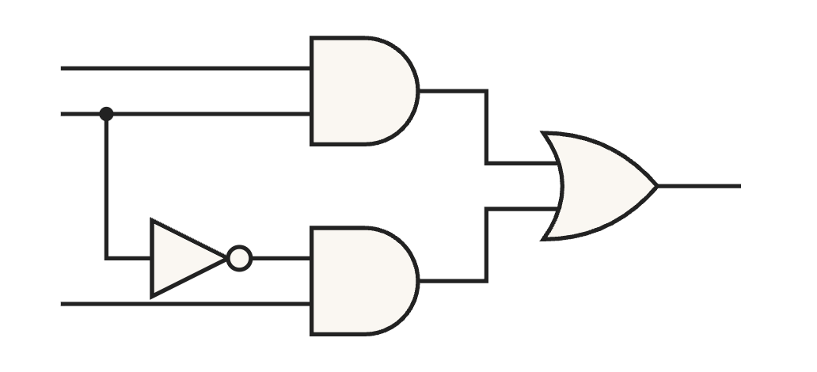
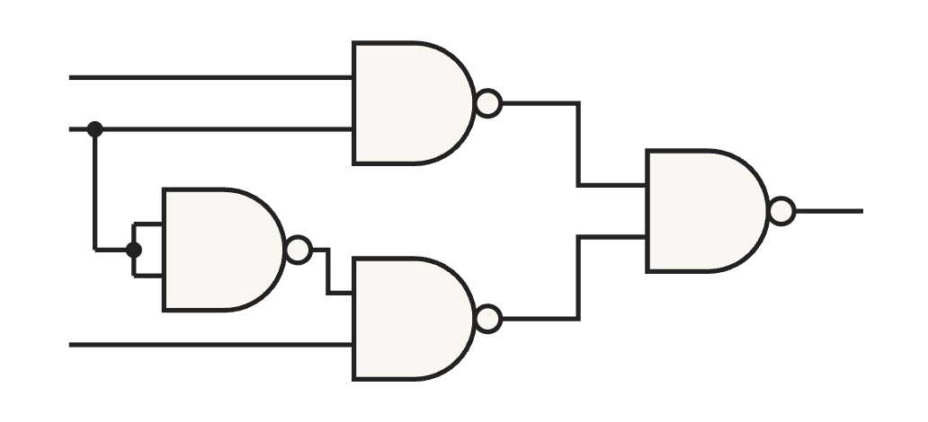
7 · NAND AND NOR
From the formula to a NAND circuit
A
B
F
1
Start from the function: F = AB + B′C.
2
Complement it twice. By 9 that changes nothing: F = ((AB + B′C)′)′.
C
3
The inner complement sits over a sum, so 15b splits it into a product: (AB + B′C)′ = (AB)′·(B′C)′.
the AND-OR circuit
4
Put it back: F = ((AB)′·(B′C)′)′.
A
B
5
Now read the three complements as gates: (AB)′ is a NAND of A and B, (B′C)′ is a NAND of B′ and C, and the outer one is a NAND of those two outputs.
F
C
the same formula, all NANDs
Recitation 3 · Boolean algebra and logic gates
28
Notes:
This is the same conversion done on the formula instead of the picture. Start with F = AB + B′C. Step two: complement the whole thing twice. Theorem 9 says two complements cancel, so the function is untouched: F = ((AB + B′C)′)′. Step three: look at the inner complement. It sits over a sum, so 15b turns it into a product of complements: (AB + B′C)′ = (AB)′·(B′C)′. Putting that back gives F = ((AB)′·(B′C)′)′. Step five is the whole point: every complement in that formula is one NAND. (AB)′ is a NAND with inputs A and B. (B′C)′ is a NAND with inputs B′ and C. The outer complement of the product of those two is a third NAND fed by the first two. Three NANDs, plus one more with tied inputs to make B′, and the picture on the right is exactly that formula.

Slide 29
7 · NAND AND NOR
The recipe, and the same trick for POS
The recipe
Those two steps, complement twice and split with DeMorgan, always land in the same place: in a two-level AND-OR circuit, replace every gate with a NAND and leave the wiring alone.
Product of sums, the same way
(A + B)(B′ + C) = (((A + B)(B′ + C))′)′ = ((A + B)′ + (B′ + C)′)′ by 9 and 15a. Every complement is a NOR, so an OR-AND circuit becomes all NORs.
Count the gates
For AB + B′C: two NANDs for the products, one for the sum, and one with its inputs tied to make B′. Four 2-input NANDs, which is one 74LS00 chip.
Careful: every input of the OR has to come from an AND. A single letter going straight in, like C in AB + C, has no gate to invert it, so it enters the last NAND already inverted: AB + C = ((AB)′·C′)′.
Recitation 3 · Boolean algebra and logic gates
29
Notes:
Those two steps, complement twice and then split with DeMorgan, always end the same way, so you do not have to redo the algebra every time. The recipe is: in a two-level AND-OR circuit, replace every gate with a NAND and leave the wiring alone. A product of sums works the same way. Complement (A + B)(B′ + C) twice, and 15a splits the inner complement of a product into a sum of complements: ((A + B)′ + (B′ + C)′)′. Now every complement is over a sum, and a complemented sum is a NOR, so an OR-AND circuit becomes all NORs. Counting gates for AB + B′C: two NANDs for the two products, one NAND for the sum, and one more with its inputs tied to make B′. Four 2-input NANDs, so the whole circuit fits in one 74LS00. One thing to watch. The recipe assumes every input of the OR comes from an AND. If a single letter goes straight into the OR, like C in AB + C, there is no first-level gate to invert it. Run the same two steps and you get AB + C = ((AB)′·C′)′: C has to enter the last NAND already inverted.

Slide 30
7 · NAND AND NOR
Problem 7: NAND and NOR
a. Build XOR from NAND gates only. Four are enough. (Hint: start from ab′ + a′b and apply DeMorgan.)
b. Show that NOR is universal: build NOT, OR and AND from NOR gates.
c. Convert F = (A + B)(B′ + C) to NOR gates only. How many 2-input NORs?
Recitation 3 · Boolean algebra and logic gates
30
Notes:
Problem 7 builds on this section: XOR from NAND gates, NOR as a universal gate, and a POS circuit converted to NOR-NOR. Part a is the hardest problem today; the key is the output of the first gate, which I will call n.

Slide 31
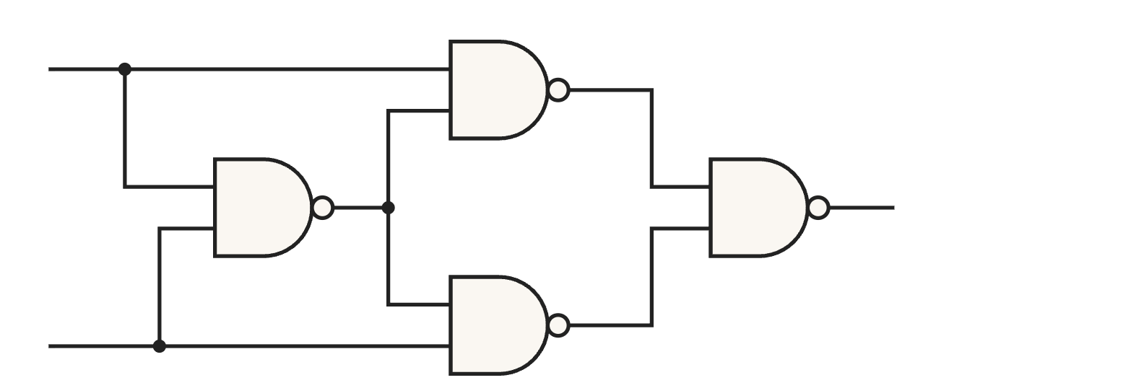
7 · NAND AND NOR
Problem 7: answer (a), XOR from four NANDs
1
Name the first gate’s output: n = (ab)′.
a
2
The next two gates give (an)′ and (bn)′; the last one combines them: F = ((an)′·(bn)′)′.
n
y = a ⊕ b
3
By 15a and 9 the outer complement opens up: F = an + bn.
4
By 15a, n = (ab)′ = a′ + b′. So an = a(a′ + b′) = aa′ + ab′ = ab′ by 12a, 8a and 6b.
b
5
The same way, bn = b(a′ + b′) = a′b.
6
So F = ab′ + a′b, which is 1 exactly when a and b differ: XOR.
Recitation 3 · Boolean algebra and logic gates
31
Notes:
Work it gate by gate. Call the first gate’s output n, so n = (ab)′. The second gate takes a and n, the third takes b and n, and the fourth combines those two, which gives F = ((an)′·(bn)′)′. Open the outer complement with 15a and 9: the complement of a product is the sum of the complements, and the double complements cancel, so F = an + bn. Now substitute n. By 15a, n = a′ + b′. Then an = a(a′ + b′), which multiplies out to aa′ + ab′; the first term is 0 by 8a, so an = ab′. In the same way bn = a′b. Adding them gives F = ab′ + a′b, which is 1 when a is 1 and b is 0, or a is 0 and b is 1: exactly when the inputs differ. That is XOR, built from four NANDs.

Slide 32
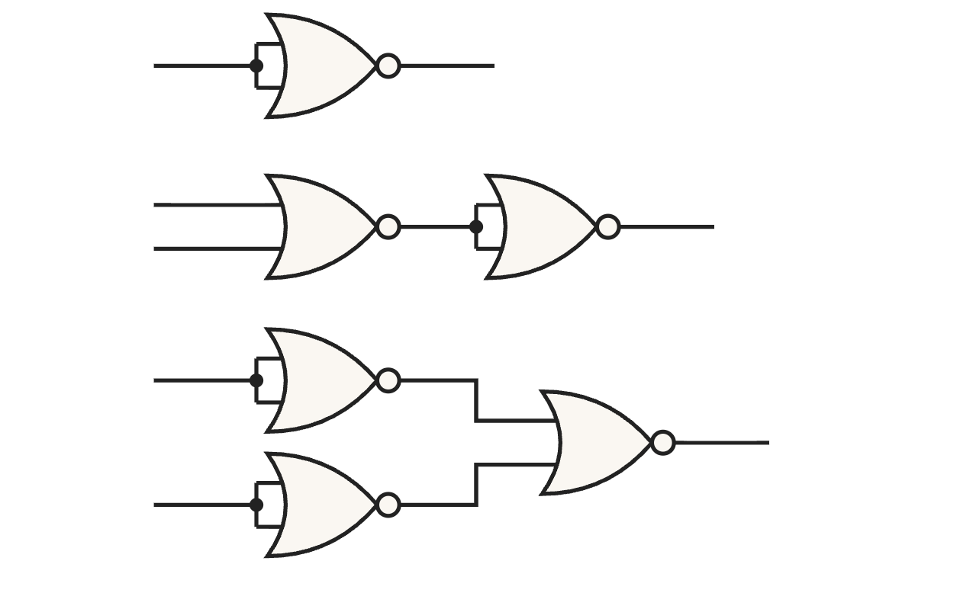
7 · NAND AND NOR
Problem 7: answers (b) and (c)
NOT
a
a′
OR
a
a + b
b
NOT: tie the inputs. (a + a)′ = a′ by 7b.
b
OR: a NOR, then that inverter. ((a + b)′)′ = a + b by 9.
a
AND: invert both inputs, then NOR. (a′ + b′)′ = ab by 15b and 9.
AND
a·b
b
c
F = (A + B)(B′ + C) = (((A + B)(B′ + C))′)′ by 9, = ((A + B)′ + (B′ + C)′)′ by 15a.
Each complement of a sum is a NOR: one for A + B, one for B′ + C, and the outer one combines them. With a fourth NOR (inputs tied) for B′, that is four 2-input NORs, one 74LS02.
Recitation 3 · Boolean algebra and logic gates
32
Notes:
Part b mirrors what we did with NAND. Tie the inputs of a NOR and you get (a + a)′, which is a′ by 7b: an inverter. A NOR followed by that inverter is an OR, because the second complement cancels the first. And inverting both inputs before a NOR gives (a′ + b′)′, which is ab by 15b and 9: an AND. Part c is the POS version of the trick from this section. Complement F twice, which changes nothing by 9. The inner complement sits over a product, so 15a splits it into a sum: F = ((A + B)′ + (B′ + C)′)′. Now read the complements as gates. Each complement of a sum is a NOR, so (A + B)′ is one NOR, (B′ + C)′ is another, and the outer complement of their sum is a third NOR fed by the first two. Add a fourth NOR with its inputs tied to make B′, and the whole circuit is four 2-input NORs: one 74LS02 chip.

Slide 33
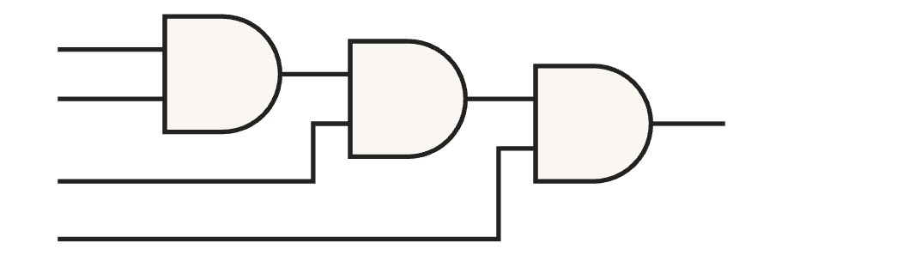
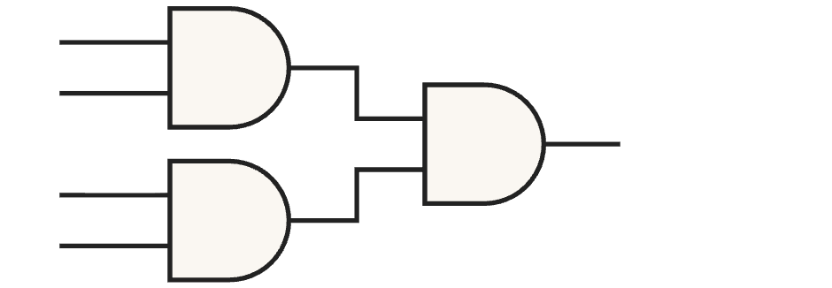
8 · GATES WITH MORE INPUTS
More inputs, written as formulas
Chaining is just regrouping
Gates and delay
A + B + C = (A + B) + C by 11b, and ABCD = ((AB)C)D = (AB)(CD) by 11a. Every grouping is the same function, so you may combine the inputs two at a time in any order.
Either way it takes n − 1 two-input gates. In the tree every input sits two gates from the output; in the chain the first inputs sit three gates away.
A
A
B
ABCD
B
ABCD
C
C
D
D
chain: ((AB)C)D
tree: (AB)(CD)
Careful: a NAND does not regroup. Chaining two of them gives ((AB)′·C)′ = AB + C′ by 15a and 9, while a 3-input NAND is (ABC)′ = A′ + B′ + C′. For three inputs write (ABC)′ = ((AB)C)′: an AND first, then a NAND.
Recitation 3 · Boolean algebra and logic gates
33
Notes:
Same idea here: start from the formula. A 3-input OR is A + B + C, and 11b says that is (A + B) + C. The grouping does not change the function, so you can wire two 2-input ORs in a chain. For four inputs, 11a gives ABCD = ((AB)C)D, and also (AB)(CD). Those two groupings are the two pictures. ((AB)C)D is the chain and (AB)(CD) is the tree. Both use three gates, which is n − 1, but in the tree every input is two gates away from the output, while in the chain A and B are three gates away. Same cost, less delay. NAND is the exception, and the formula shows why. Chain two NANDs and you get ((AB)′·C)′. Apply 15a and 9: it is AB + C′. A real 3-input NAND is (ABC)′, which by 15a is A′ + B′ + C′. Those are different functions. The fix is in the formula too: write (ABC)′ as ((AB)C)′. The bracket is an ordinary AND of the first two inputs, and the outer complement is one NAND with that result and C. So it is an AND followed by a NAND, not two NANDs.

Slide 34
8 · GATES WITH MORE INPUTS
What to take away
1
Split a complement and the operator swaps: (AB)′ = A′ + B′.
2
SOP: one product per 1. POS: one sum per 0. Write the shorter list.
3
Check every term on its own row.
4
Two-level SOP becomes NAND-NAND by replacing every gate.
5
NAND and NOR do not chain the way AND and OR do.
Recitation 3 · Boolean algebra and logic gates
34
Notes:
Five things to take away from today. Splitting a complement swaps the operator. SOP takes one product per 1 and POS one sum per 0, so write the shorter list. Check every term on its own row. A two-level SOP becomes NAND-NAND by replacing every gate. And NAND and NOR do not chain the way AND and OR do. All eight problems and their full solutions are in the handout, Problem 8 included, so you have the worked steps to go back to.

