Slide 1

What’s New in
Autodesk® Revit® Building 9 & 9.1

Slide 2
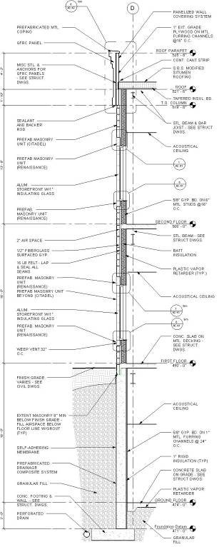
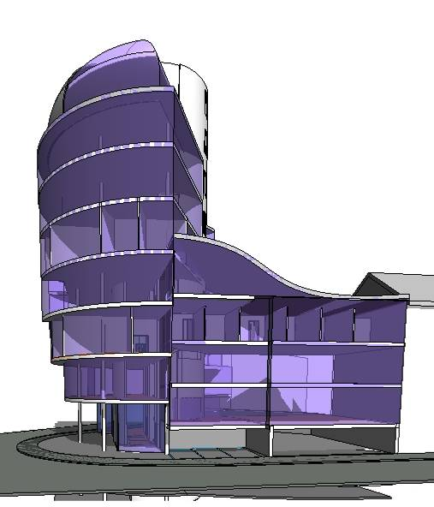

Feature Focus
Autodesk Revit Building 9.1
  Openness & Conceptual Design
    SketchUp Import
    Coordination Monitor
    IFC Export…
  Construction Documentation
    Detailing
    Keynoting
    Material Take Off…
  Design Insight & Analysis
    Rooms
    Sun Studies
    gbXML..

Slide 3
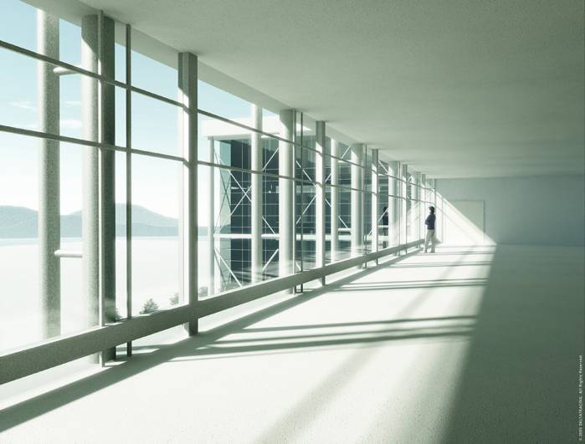
Works the Way You Think
Notes:
Autodesk Revit Building works the way you do, supporting collaboration and your design and decision-making process.
With Revit Building the design and documentation of the building is done concurrently instead of serially, in collaboration with your team, so that decisions can be made with confidence and in a timely manner and waste and rework can be avoided. Design thinking is captured at the point of creation and embedded in the documentation as the work proceeds. All deliverables for the design team—schedules, color-filled diagrams, drawings—are created dynamically while the design work is being done. When a change is made, all the consequences of that change are automatically coordinated throughout the project. All of this allows the design team to work more naturally and effectively.
Revit Building supports better decision making through in-process design visualization, timely cost estimating, and in-process analysis. You will have more timely and better information to support decisions on project design, scope, schedule, and budget
Revit Building works holistically, in terms of the entire building rather than individual sections and floor plans, giving you the most complete understanding of the project.
The document sets are more complete and easier to understand.

Slide 4
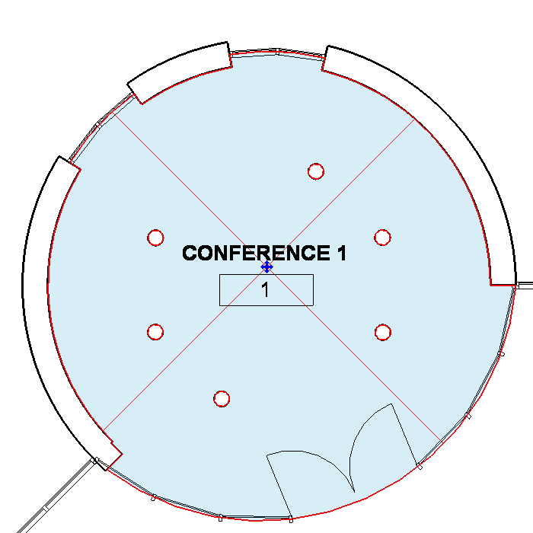
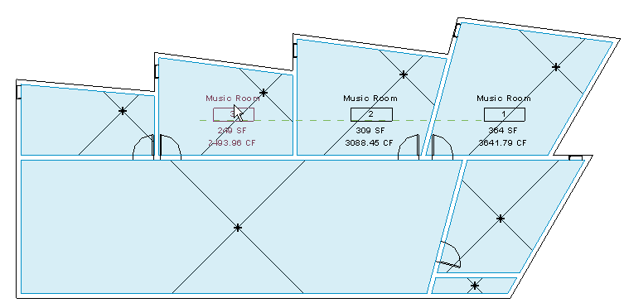
Rooms
Design Insight & Analysis
Room Object
  Visual Representation of Rooms
  Consistent Object/Annotation Behavior
    Properties stored in Room Objects
    Properties are reported by Tag
  ‘Show Room’ functionality in schedules
  Select and Tag Rooms in Section and Elevation
  Room Volumes
  New Room Bounding Objects
    Columns
    In-place Families
    Curtain Systems
  Rooms with Location
    Split Levels
    Multi Story Rooms
Notes:
Visual Representation of Rooms – The Room In-Fill –
The Room In-fill clearly identifies the room and its boundaries to the user
allows the user to view all defined rooms at once whether tagged or not
Untagged rooms can be selected and deleted from plans rather than only in a schedule
Consistent Object/Annotation Behavior
Properties are stored in the Rooms Object
Properties are accessible through the room object (without annotation)
room properties can be accessed and viewed or changed on any plan where a room is represented.
The annotations reports information about the room object
Show functionality in schedules – In a schedule, click show in the options bar to open a graphical view of the room
Tag in Section and Elevation – because rooms have height, now they can be drawn and tagged in Section and elevation
Room Bounding Objects - Columns, In Place Families, Curtain Systems. Columns are room bounding or not room bounding at the instance level and this setting can be controlled at the point of insertion
Room Volumes – because rooms have height, Revit can generate volumes which is vital to architects during analysis, space planning, etc. But also vital to Mechanical and Electrical Engineers who need room volumes in order to analyze Heating/Cooling Load information, Air Flow calculations, Lighting Calculations, etc.
Rooms with location – Multi-Level Rooms are easily handled
KEEP IN MIND THAT prior to Revit 9 Rooms were:
Created via annotations (annotations and tags are largely used interchangeably) – Users Place a Room Tag in order to store information about a given space.
All Information stored in annotation – Room Name, Floor Finish, Area, Perimeter, etc., is all stored in the room tag.
This is inconsistent for an annotation in Revit.
Further,
No ceiling height property – Rooms, as they existed in 8.1 had no ceiling height property so Revit Building could not generate Room Volumes
Room Bounding Elements – A room could tell if it was enclosed, so it could generate perimeter and area. However, if there was an object in the room that needed to be subtracted from the area (for instance, a column), Revit Building could not detect the object.
Not graphically visible – When looking at a plan, users could not identify a room unless it was tagged. Further, Tags only exist in a view that they are placed.
Did not understand location – A room tag did not understand its location, so multi-level rooms could cause double counting problems
Extra Management – because rooms and room tags didn’t function like typical objects and annotations in Revit, users had to develop other ways to manage them. For example, in order to change any property of a room, the view with the Room Tag had to be found OR users would place another Room Tag and then edit the Room Properties and then delete the room tag?!

Slide 5
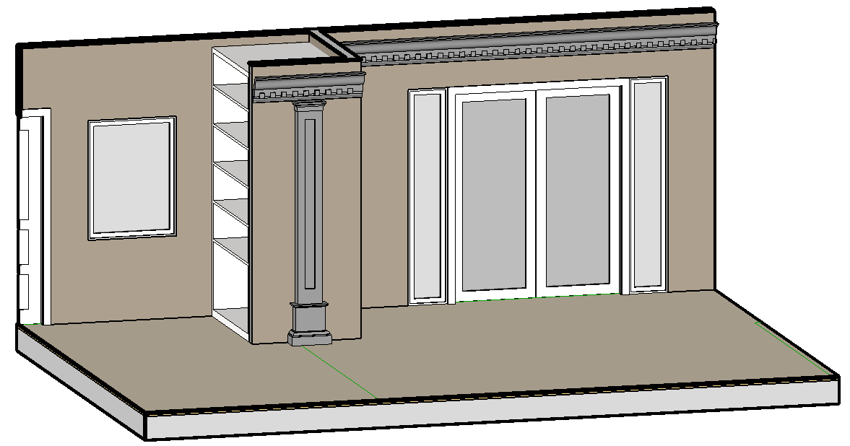
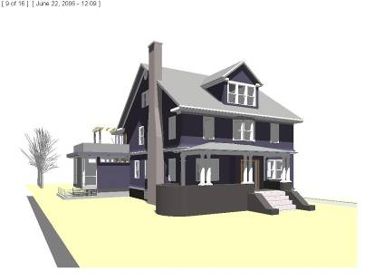
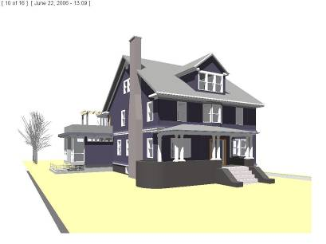
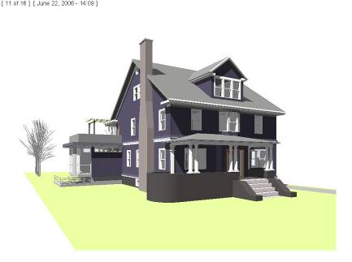
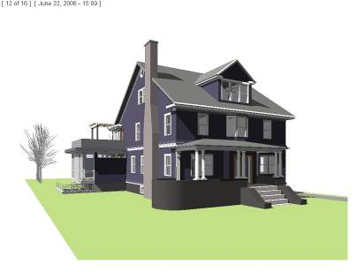
Modeling Enhancements
Openness & Conceptual Design
Sun Studies
Modeling Sweeps
3D 2-Pick Families
Rehost Elements
Columns – Top & Bottom
Attachment
Notes:
Sun Studies – Generate an AVI to perform Sun Studies
Control
Time Range
One Day
Multi Day
Location
City
Coordinate
Frame Rate (as determined by time interval)
Display Mode (Hidden Line, Shading w/ Edges, etc.)
Output Size
Modeling Sweeps
(8.1) Spline could be in path OR profile
(9) Spline can be in path AND profile
2 Pick 3D Families
2 Picks (Start & End) create a 3D family
Because it’s a family, it’s inherently more intelligent
Works in all view types
Rehost Families – Move elements from one host to another without having to delete and replace
For example, moving a skylight from one side of roof to another
Columns have a Top & Bottom Attachment
Subsequently, they remain attached when the ceiling or floor moves.

Slide 6
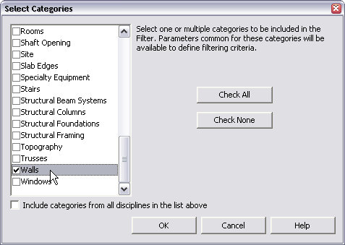
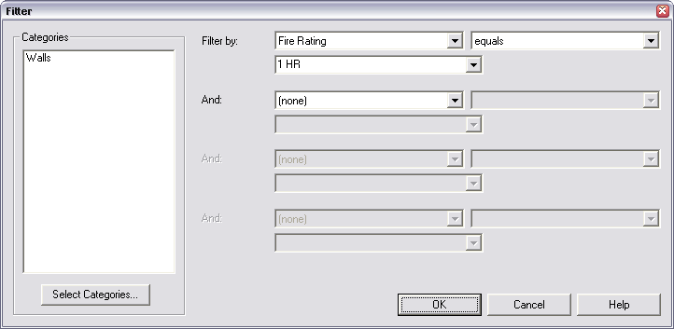
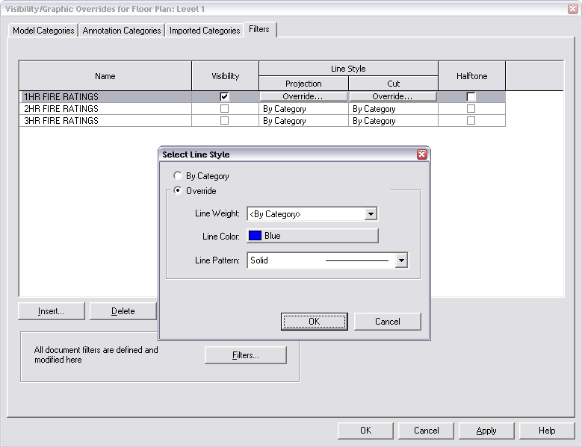
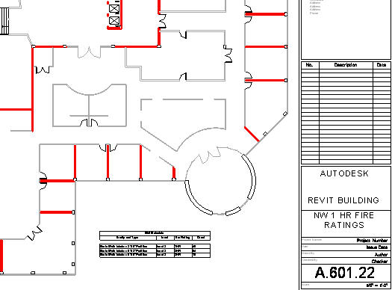
User Defined Filters
Construction Documentation
Notes:
Graphical method of calling out components that share like characteristics
For example, turn all 1HR Fire Rated walls Red

Slide 7
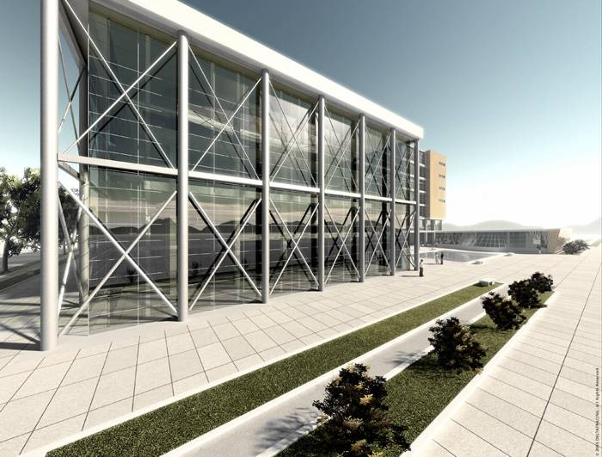
Better Coordination & Quality
Notes:
Autodesk Revit Building helps make error-free documents a reality, minimizing coordination mistakes and improving quality. It helps eliminate rework, manual coordination, and other sources of human error.
Because coordination is fully supported by the system, you are free to make your documents as complete as possible. In the past, architects have had to be careful that information was shown in one place and one place only in the documents so that if it changed it only had to be changed in one location, reducing the risk that the documents would have conflicting information. This made documents difficult to use for builders and other team members, who often had to search for where a particular piece of casework, for example, was called out. Now that casework can be keyed on both the plan and the interior elevation, if it changes, the software will coordinate the change in both places.
Documents are more complete, clearer, and of higher quality. And of course, better-coordinated documents lead to smoother construction.

Slide 8
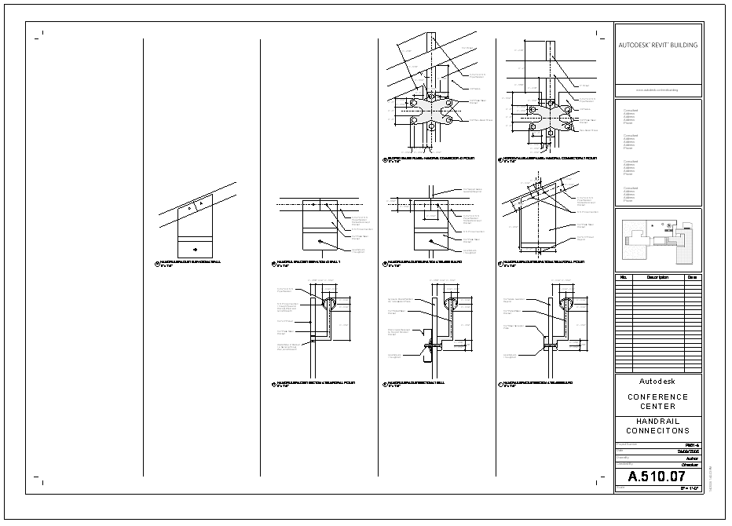

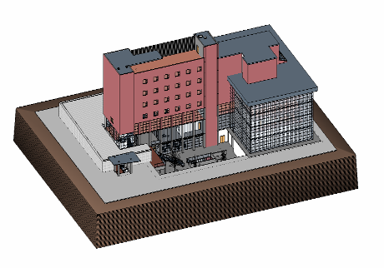
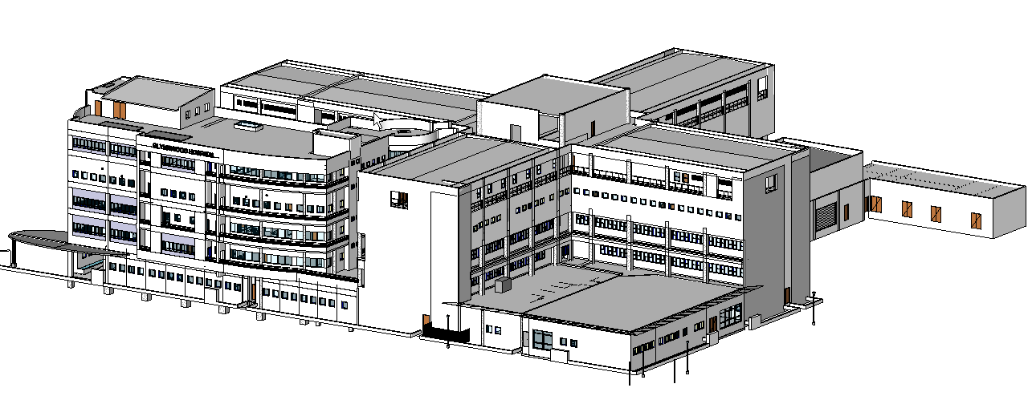
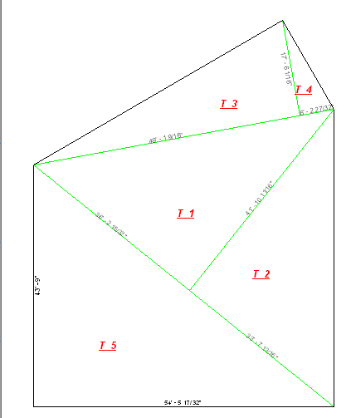
Detailing
Construction Documentation
Detail Library
Save & Re-use Views
  Drafting Views
  Sheets
  Schedules
2D 2-Pick Components
Display Obscured Elements
Dimensioning non-orthogonal walls
Free and attached Tag Leaders
Room & Area Reports
  Calculation by Triangulation
Notes:
Detail Library - Large Detail component library that meet the CSI method of organization
Save and Reuse Drafting Views, Schedules, and Sheets
Drafting Views
that contain model geometry – the model geometry is also saved and reloaded
New Drafting Views are created
Schedule
formatting transfers – not the schedule data itself
New Schedules are created
Sheets
Drafting Views and Schedules that are on the sheet transfer
Layout is also maintained
Detail Obscured Elements
Display both detail or model elements
2D 2-Pick Components
Purpose – Detailing
2 Clicks – Start & End
They are families
Room & Area Reports
Calculation by Triangulation - room and area reports offer a new (much clearer and cleaner!!) method of calculation

Slide 9
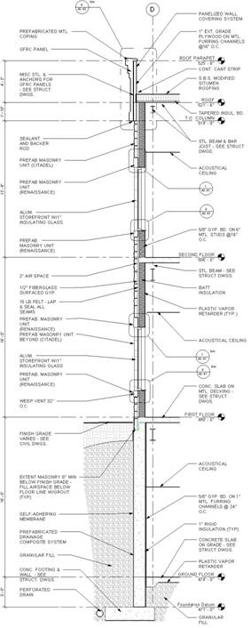
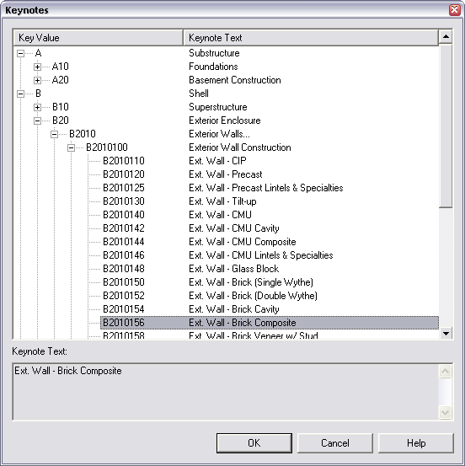
Keynoting
Construction Documentation
Keynotes
  Element
  Material
  User
External Source
  .TXT File
Keynote Legends
  Sheet
  Project
Notes:
Keynotes
External Tab delimited TXT File
Can be managed by Excel & exported to Tab delimited File
If lost (for instance, if there is a Network Outage) the element/material holds its last value
TXT File format
Key Value Keynote Text Parent
… … …
A hierarchy can be created
The Keynote
By
Element (e.g., wall)
Material (e.g., Gypsum wallboard)
User Defined (e.g., Verify in Field)
And By
Key Value
Keynote text
Is attached to the component (if the component is deleted, then the keynote is deleted)
Looks to component properties or material properties for a value first, and then to the TXT file
Keynote Legend
Automatically create keynote legend that shows all keynotes on a given sheet OR project wide

Slide 10
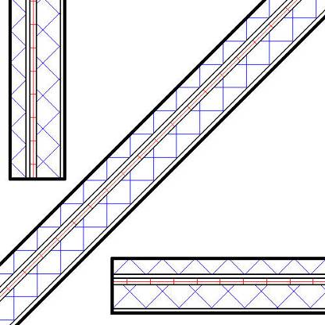
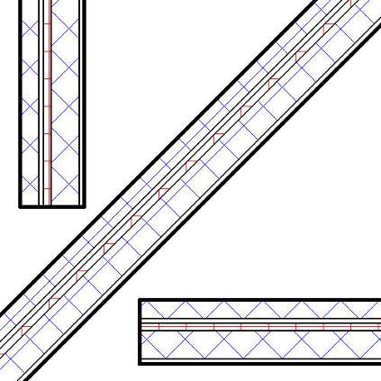
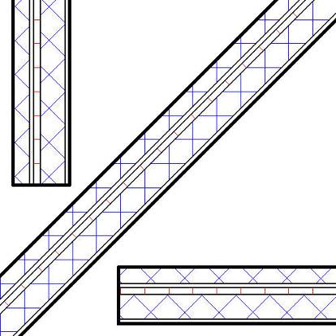
Graphical Output
Construction Documentation
Hosts
  Core Layer Cleanup control
  Control Visibility of Cut Pattern
  Control Visibility of Cut Lines
  Control Cut Pattern Orientation
Notes:
Core Layer Cleanup
Control Visibility of Cut Pattern in Hosts – on/off
Control Visibility of Cut Lines
Default
Use Function
Use Common Edge Style
No Edge
Control Cut Pattern Orientation
Orient to View
Align w/ Element
Keep Readable

Slide 11
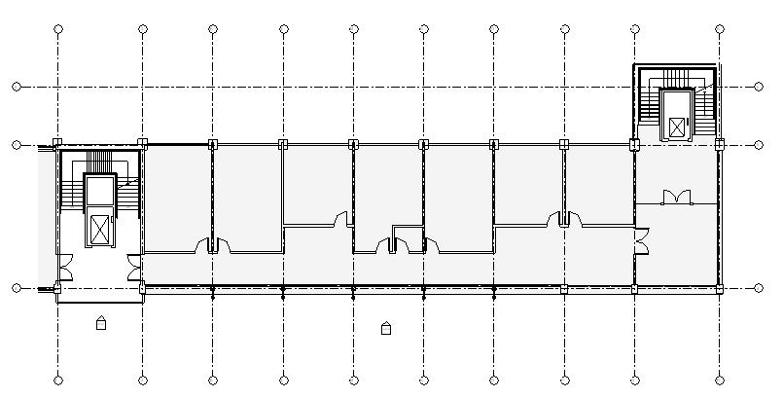
Graphical Output
Construction Documentation
Walls
  Joins of 3+ Walls
  Crossing Walls Cleanup
Notes:
Joins of 3+ Walls – intersections of 3 or more walls join correctly
Crossing Walls clean up & close a room
No Join needed – walls (and core layers) automatically clean up when crossed
Walls also automatically enclose a room

Slide 12
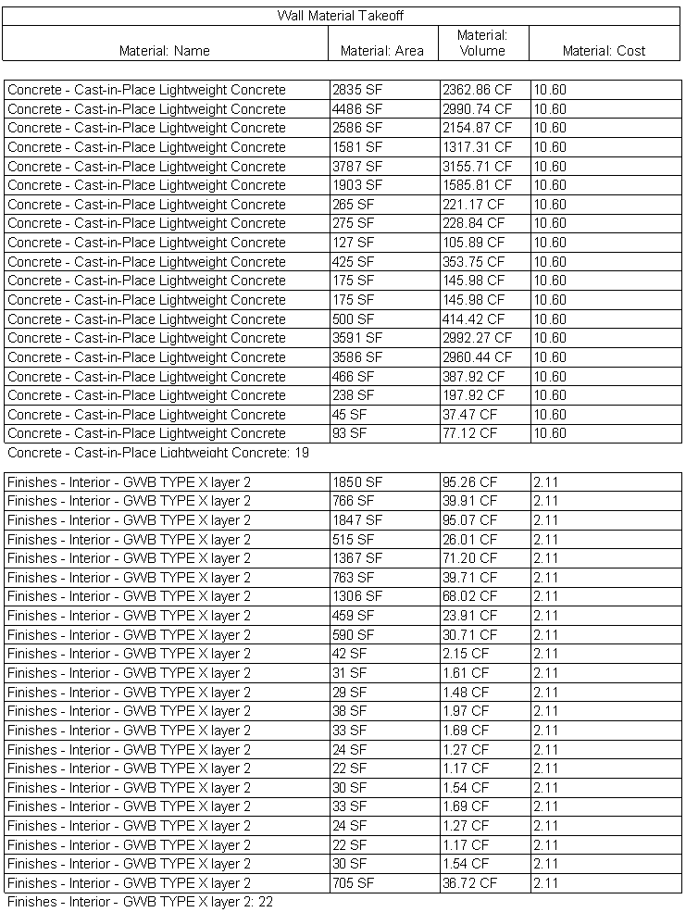
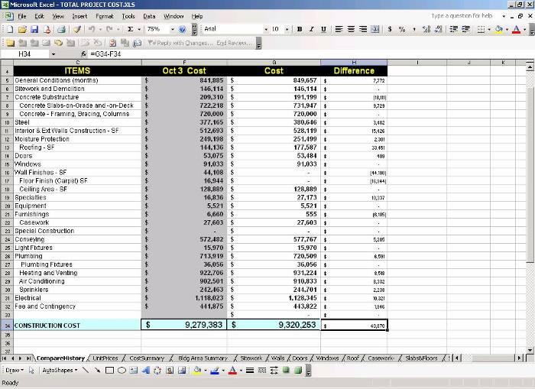
Materials
Openness & Conceptual Design
Material Takeoff
Material Keynotes
ODBC
API
Notes:
ODBC
Material Quantities are exportable for cost estimation via ODBC
API
Material are exposed via the API
Keynoting
Materials are open for keynoting
Material Takeoffs
Use Material information to create Material TakeOffs like
Area
Volume
Keynote
Cost
as well as identification data like
URL
Model Number
Manufacturer

Slide 13
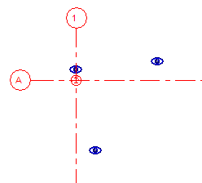
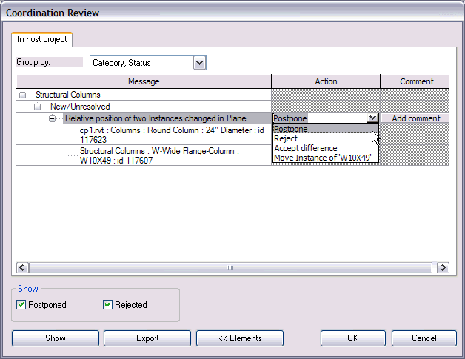
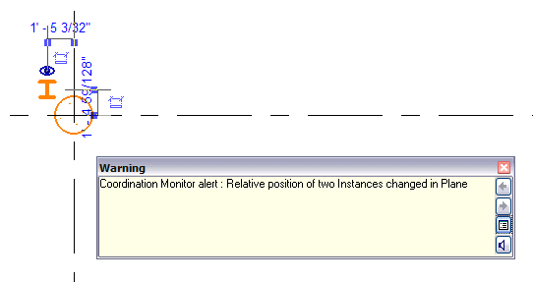
Coordination
Openness & Conceptual Design
Coordination Monitor
  Columns
  Grids
  Levels
  Walls
  Slabs
Compatibility
  Autodesk® Revit® Structure 4
  Autodesk® Revit® Systems

Slide 14
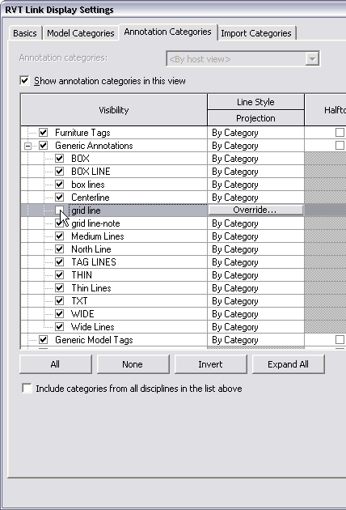
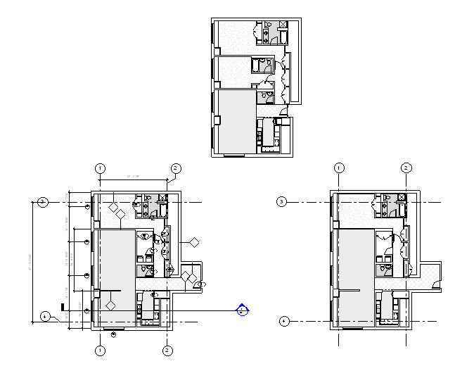
Coordination
Openness & Conceptual Design
Linked File Enhancements
  Display & Control Annotations
  View Properties
  Display Design Options
  Object Styles
  Linked Model Visibility
  View DWG™
Notes:
Display Design Options - You now can choose to display different design options from the Link (8.1 always shows primary option)
View Properties - You have full control of all Categories and subcats of all model things from Link (in 8.1 you only had on/off vis of full category)
Display & Control Annotations - Display of annotations from Link - and full control of them (in 8.1 no annotations came in at all)
Object Styles - Ability to display Link with same object styles as host file- so link can look at model and annotation settings (materials, colors, weights, etc.) and display the same as native things (8.1 link always uses these settings from the link only
Linked Model Visibility - If you have more than 1 instance of the same link you can control them all (so they all look the same in a view) or override them individually to display differently in the same view. (use case...presentation drawing of a campus with many of same building, - each could display different plans in the same drawing...or each could display different annotations)
View DWG - DWG Links and Imports now display in the host, and you have control of all categories and sub-cats (in 8.1 they did not display)

Slide 15
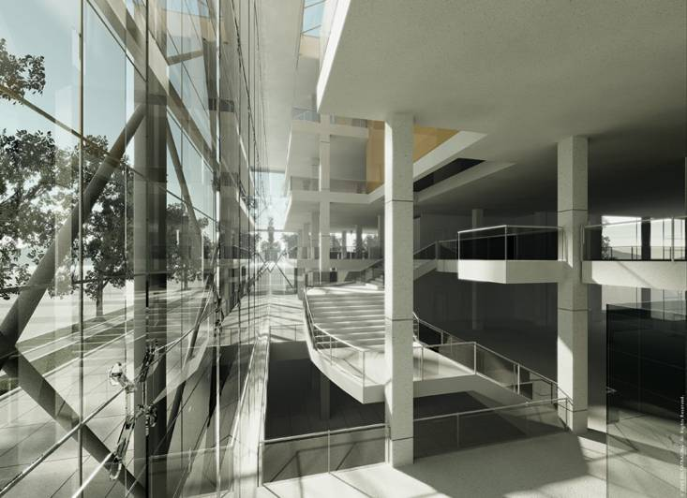
Better for Your Business
Notes:
Revit Building can help improve your business and help you make more money.
You will experience orders-of-magnitude reduction in production time from schematic design through construction documents
Better documents mean you will have fewer problems and less time spent in construction phase
It improves design collaboration within office; all members of project team can use the same software and work on the same information. It allows exploration and changes to the project at any time in the design or documentation process without encumbering the design team with laborious re-coordination tasks. It also returns more time for design and solving high-value architectural problems to the design team by minimizing coordination time and manual checking. Changes are instantly reflected in all drawings so changes can be understood immediately.
And using Revit Building, the design team gets more work done with fewer people. A smaller design team improves collaboration.
And you will find more opportunities to perform additional services based on the building information model (for example integration with estimating, move management, renovation phasing analysis)...for more fee. You can offer better quality and more complete services, keeping your best clients from looking around for better or different services.

Slide 16
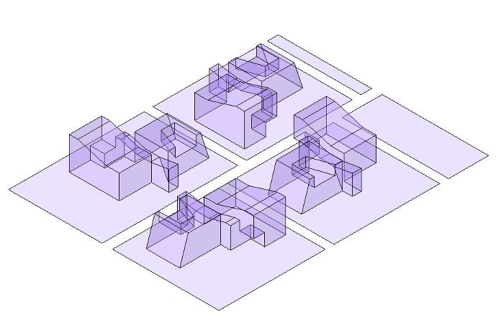
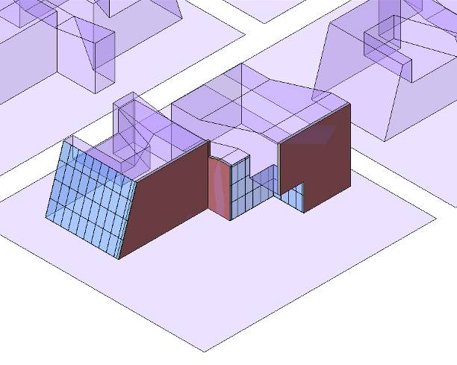
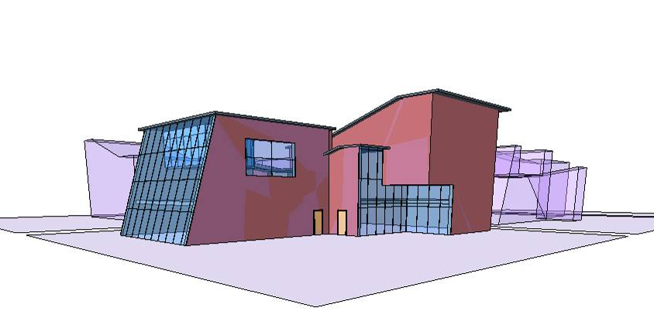
Import/Export
Construction Documentation
gbXML
IFC Import
DWG 2007
SKP
PNG
Notes:
GBXML - the Export gbXML now supports “true” room volumes, calculated from the “new” 3D-rooms. The “true” room volume is computed from the elements that bound the space/room. The most enhancements and work has really been done on the “new” rooms, the gbXML only takes advantage of it. The major improvement for gbXML has been to be able to output basically everything that is sloping and to be able to handle multi-level spaces/rooms.
The former support for Export of room volume via gbXML was limited to estimating a room’s volume based upon information about the level above and the calculated average wall height. This method was inaccurate and insufficient for the calculation of the volume of rooms where the floors and ceilings were not parallel or planar and in rooms with sloped walls. Common exterior wall conditions represented by curtain systems and in-place walls were not currently room bounding and couldn’t be calculated. Also, in Revit Building 9.1, Building Location and Type of Building Parameters are exported in the GBXML information.
The Autodesk® Revit® Building 9 software provides Industry Foundation Classes (IFC) export and import based on the latest International Alliance for Interoperability (IAI) IFC 2x2 data exchange standard. Export of Industry Foundation Classes (IFC) data from Revit Building received full certification by the International Alliance for Interoperability (IAI) in November of 2005 for the IFC2x2 Code Checking View that expands the IFC Coordination View to additionally support architectural code checking. Submittal for Stage 1 and Stage 2 (final) certification of IFC import is currently planned within the next year.
DWG
DWG 2007
Exporting Wall, floor, etc., cut patterns onto their own layers
Export Grid/Level lines and Grid/Level head on different layers
Option to make all DWG entities BYLAYER
Merge collinear lines when exporting to DWG
DWG linetypes exported by Revit Building conform to standard LTSCALE and PSLTSCALE
Cleanup export Options dialogue Box
Import CAD Formats
Set DWG Units on Export
SKP – Revit Building now has a direct import of native SketchUp files
Import & Export PNG Image File Format

Slide 17
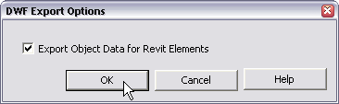
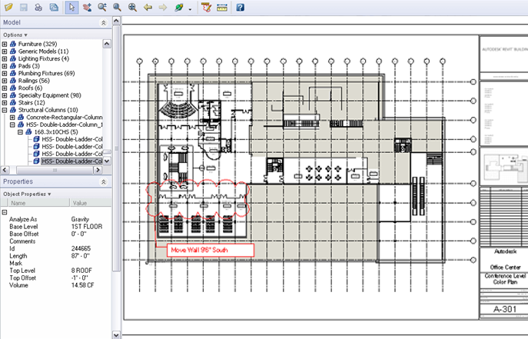

DWF
Openness & Conceptual Design
2D DWF™
  Element Properties included in export
  Rooms and Areas included in export
Notes:
2D DWF
Element Properties included in export
Rooms and Areas included in export

Slide 18
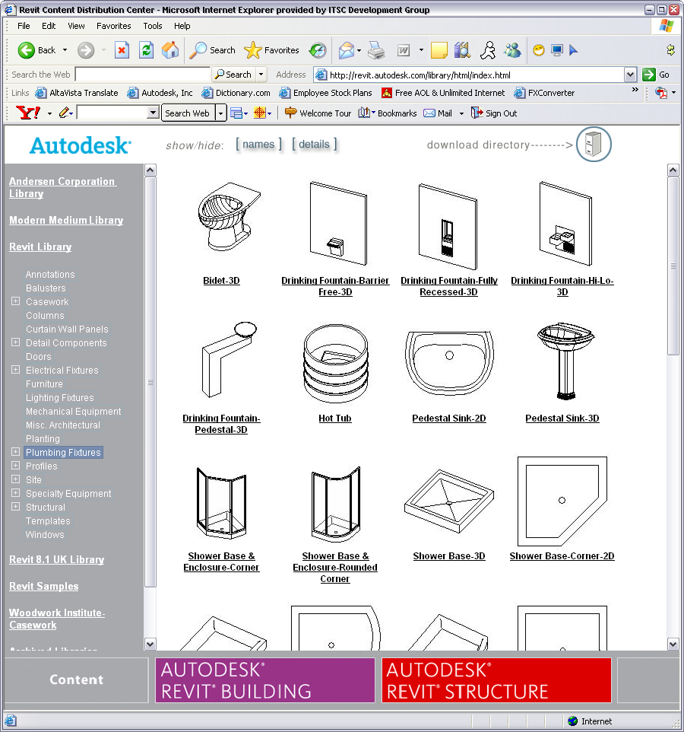
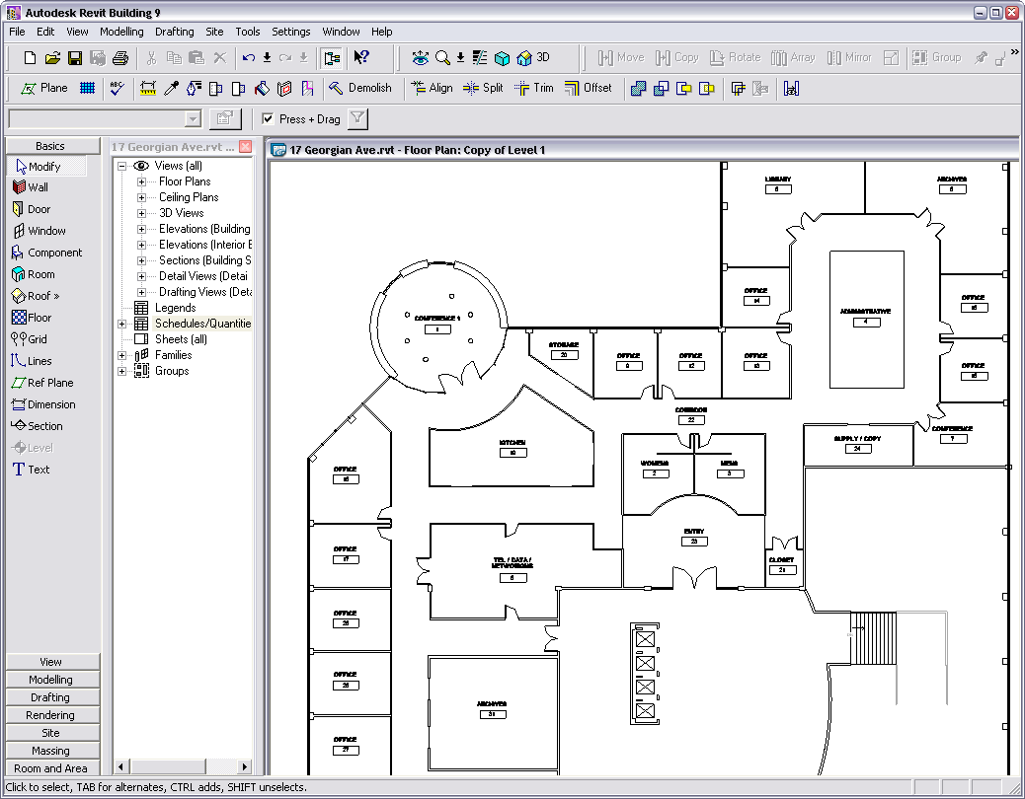
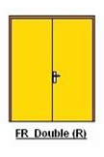
Platform
Autodesk Revit Building
i-drop®
Notes:
Revit Building 9+ can leverage the i-drop functionality from i-drop enabled web sites

Slide 19
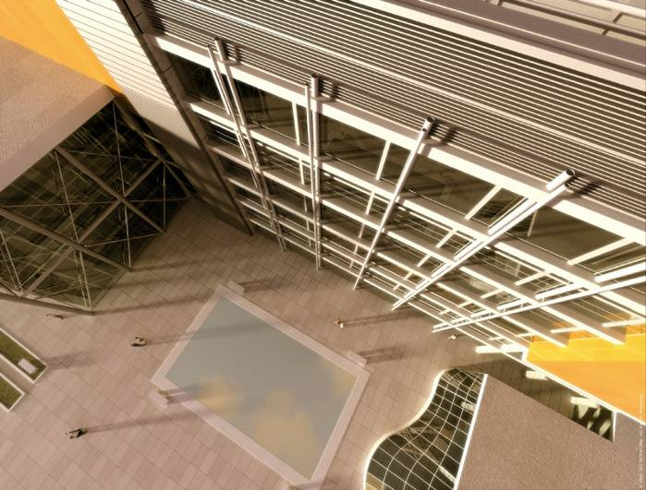
Competitive Advantages

Slide 20
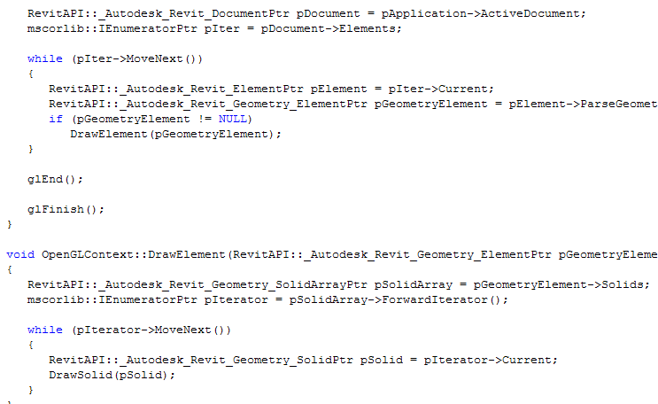
Revit Building API
Openness and Conceptual Design
Available to All Users
.NET based API
  API based on .NET 2.0 Framework (MS DevStudio 2005)
  Program in C, C++, VB, C#
API enables you to:
  Access Elements
  Query & Change properties
  Extract geometry
  Generate Dimensions
  Create Views & Sheets
  Create Rooms & Room Tags
  Place Views on Sheets
  Create all Family Based Elements
  Access to Fill and Color Info
  Create Walls, Slabs, Grids, & Levels
  Create Openings, Model Lines, & Reference Planes
  Support through ADN (Autodesk Developers Network)
Notes:
Must be written in MS Dev Studio 2005 – Released in November of ’05. The Revit API is not backwards compatible with MS DevStudio 2003

Slide 21

Autodesk, DWF, DWG, i-drop, and Revit are registered trademarks or trademarks of Autodesk, Inc., in the USA and/or other countries. All other brand names, product names, or trademarks belong to their respective holders. Autodesk reserves the right to alter product offerings and specifications at any time without notice, and is not responsible for typographical or graphical errors that may appear in this document.
© 2006 Autodesk, Inc. All rights reserved.

