Slide 1

Getting into the Flow: Understanding Connectors in Revit MEP Content
Martin Schmid, P.E.
MEP Customer Success Engineer

Slide 2
Goals
Understand how…
  spaces compute airflows.
  pipes and ducts propagate flow.
  connectors in Family definitions facilitate flow propagation
** Not a class on ‘physical’ geometry / content creation!

Slide 3


Supply Air Direction

Slide 4


Return / Exhaust Air Direction

Slide 5
Creating Duct Systems
IN
OUT
OUT
OUT
IN
IN
Air Terminals / Equipment Connectors:
Supply Air systems contain families with Supply Air
Return Air systems contain families with Return Air
Exhaust Air systems contain families with Exhaust Air
Mechanical Equipment for a system must have connector type:
Supply Air for a Supply Air System
Return Air for a Return Air System
Exhaust Air for a Exhaust Air System
Difference between Return air and Exhaust air?
Some ASHRAE duct fitting coefficients.

Slide 6
What about other air systems?
Consider the direction of airflow:
A system named “Relief Air” works like a Air system type.
A system named “Outside Air” works like a Air system type.
Return or Exhaust
Supply

Slide 7
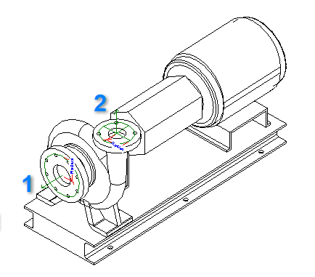
Pump Connector Example
Poor
 | 1 | 2
Flow | 400 gpm | 400 gpm
Flow Configuration | Calculated | Calculated
Flow Direction | Bidirectional | Bidirectional
System Type | Hydronic Return | Hydronic Supply
Connector Description
Better
 | 1 | 2
Flow | <Flow> | <Flow>
Flow Configuration | Calculated | Calculated
Flow Direction | In | Out
System Type | Global | Global
Connector Description | Inlet | Outlet

Slide 8
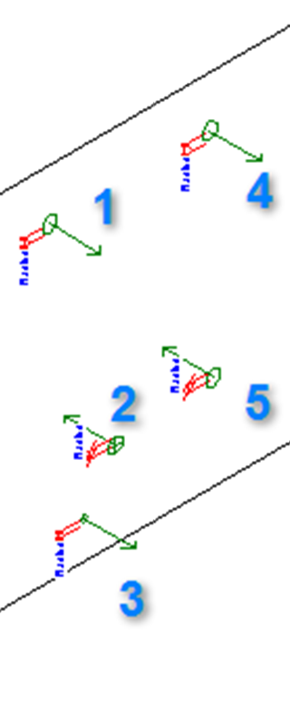
AHU Coil Connector Example
Poor
 | 1 | 2 | 3 | 4 | 5
Flow | 0 | 0 | 0 | 0 | 0
Flow Configuration | Calculated | Calculated | Calculated | Calculated | Calculated
Flow Direction | Bidirectional | Bidirectional | Bidirectional | Bidirectional | Bidirectional
System Type | Hydronic Return | Other | Other | Other | Other
Connector Description
Better
 | 1 | 2 | 3 | 4 | 5
Flow | <CHWFlow> | <CHWFlow> | <CDFlow> | <HWFlow> | <HWFlow>
Flow Configuration | Preset | Preset | Preset | Preset | Preset
Flow Direction | Out | In | Out | Out | In
System Type | Hydronic Return | Hydronic Supply | Other | Hydronic Return | Hydronic Supply
Connector Description | CHWR | CHWS | CD | HWR | HWS

Slide 9



