Slide 1
Autodesk Exchange for Autodesk® Revit®
Preparing Apps for the Store:
Guidelines
Notes:
I will now talk about the guidelines for preparing your app for publication to the exchange store.

Slide 2
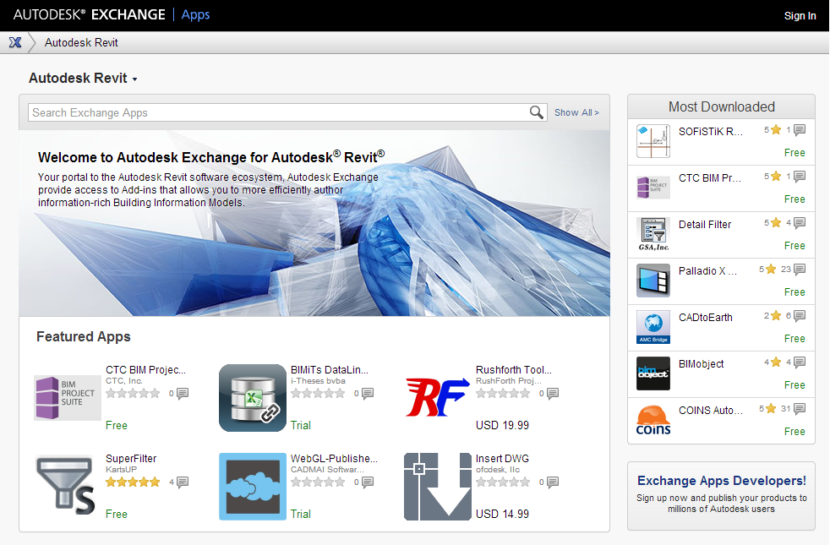
Publishing Workflow Overview
6. Update bundle or upload the msi for final publishing
1. App
7. Go live on the store
.bundle Guidelines
3. Initial submission
Publisher (developer)
Autodesk
2. Publish-ing Info.
4. Packaging/testing
Icons, help files,
contact, etc.
5. Send updated bundle or msi for testing
Notes:
Here is an overview of all the steps necessary to publish your app:
First the app needs to be prepared based on certain guidelines
Next, publishing information needs to be gathered, organized and prepared.
The app is then submitted to the store along with the publishing information
Autodesk then creates the help file template and installer for your app.
This installer is then sent to you for verification and testing. One of the things we would like you to do during verification is to complete the help documentation for your app based on the HTML Help file template we provide to you.
Once you approve that the installer and app are behaving as desired, Autodesk goes ahead and publishes the app to the store.
There are two main pieces that you, as a developer will be working on: One is an app itself, and the other is publishing information. This includes providing icons used in the store page and help summary displayed during the install process. I will now explain the guidelines to satisfy for your app.

Slide 3
Guidelines
Ribbon buttons
Contextual (F1) help
Install locations
“Bundle” structure
Notes:
The guidelines can be categorized as follows: (read the PPT)

Slide 4
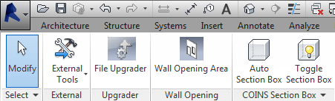
Ribbon Buttons
Need to have Ribbon Button (not under external tools)
Add-ins tab (by default)
Custom tabs (optional)
Autodesk Icon Guidelines.pdf under Revit SDK
Autodesk WikiHelp > Revit > Developers > Appendices > API User Interface Guidelines > Ribbon Guidelines http://wikihelp.autodesk.com/Revit/enu/2014/Help/ 3665-Developers/0170-Appendic170/0206-API_User206/0215-Ribbon_G215
Notes:
Here are the guidelines for the ribbon button:
Your application should have a ribbon button
Your application cannot be placed under “External Tools” button
Your App ribbon button is placed in the Add-ins tab by default
Optionally, if you application includes many functions and requires many spaces under one tab, you may choose to use custom tab.
The app ribbon button needs to follow the Autodesk Icon guidelines under the Revit SDK and Ribbon guidelines available on the wiki help.

Slide 5
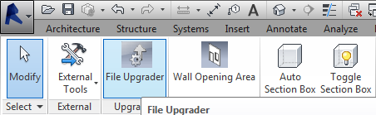
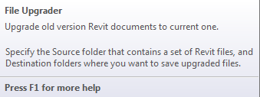
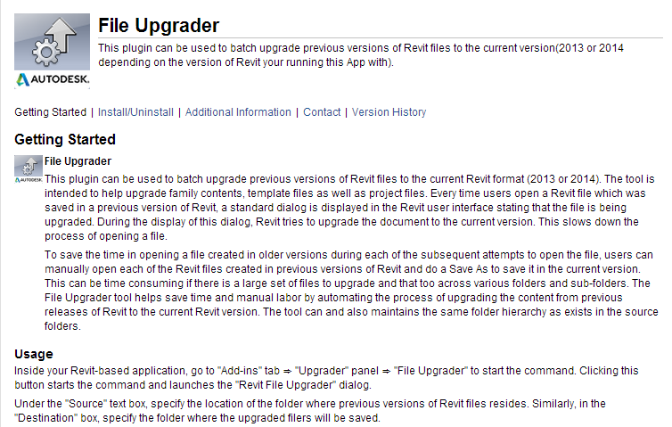
Contextual (F1) Help
RibbonItem. SetContextualHelp()
Link to:
External URL
Local help file
Autodesk help file
Notes:
We also ask you to add contextual help on your button. You can use the setContextualHelp method to link to an external help page, or a local help file, or Autodesk help documentation

Slide 6
Install Locations
All User (Default)
%ProgramData%\Autodesk\ApplicationPlugins\<myApp>.bundle
Per User
%AppData%\Autodesk\ApplicationPlugins\<myApp>.bundle
All User location
Fixed location. Shares with other Autodesk products
A folder containing your application
Per User location
Notes:
Here are the guidelines for the install location for your app.
App store Apps can be installed under two main sub-folders.
If it is to be installed for all users on the machine, it will be installed under %ProgramData% subfolder. This will be default location.
If the App is to be installed only for one user on the machine, it will be installed under %AppData% subfolder.
Under AppData or ProgramData, all app store apps should be placed under Autodesk/ApplicationPlugins subfolder.

Slide 7

Bundle Folder Structure (1) Typical Single App
Contain Installer and run-time info.^{*1} To be completed upon submission
<myApp>.bundle
PackageContents.xml
Contents
<myApp>.dll
<myApp>.addin
Resources
myIconImage.png
myHelp.html
<any other supporting files/folders>
Organize and place necessary files under .bundle
*1) Revit supports the store location or PackageContents.xml since the release 2014
Notes:
Now I will talk about the folder structure for your app.
First and foremost, we require that all your application files be contained in a folder with the name “YourAppName.bundle”.
Under the bundle folder, there will be a file called PackageContents.xml. The PackageContents.xml file is an application configuration file that contains installer and application runtime information. PackageContents.xml is created by Autodesk on initial submission of your app. The content of the PackageContents.xml file is filled out based on your app and information you provide about your app.
Under the bundle folder, we recommend that you place your application files under the Contents folder and support files under the Resources folder under the contents folder.

Slide 8
Bundle Folder Structure (2) App Supporting Multiple Versions
<myApp>.bundle
PackageContents.xml
Contents
2014
<myApp>.dll
<myApp>.addin
20xx
<myApp>.dll
<myApp>.addin
Resources
myIconImage.png
myHelp.html
<any other supporting files and folders>
Organize and place necessary files under .bundle
Notes:
If you have multiple versions of your app for different versions of Revit, all the versions need to be placed under the same bundle folder.
We recommend that you create version specific folders under the contents folder and place your application files under the version specific folders.

Slide 9
PackageContents.xml
Generated by the Autodesk installer tool after the initial submission of an app (populated from submission information. No need for publisher to provide as such)
Contains installer information
Revit 2014 (and above) will read this file and pick up the location of .addin manifest
Important: keep it in your bundle once it is generated after the initial submission
Notes:
Now, about the PackageContents.XML file. If you are submitting your app for the first time to the exchange store, we will generate the PackageContents.xml for you.
It contains information including installer related information and the path to the add-in manifest of your Revit application.
We require that you keep the Package contents.xml file in your bundle folder when you submit updates or newer versions of your app.

Slide 10
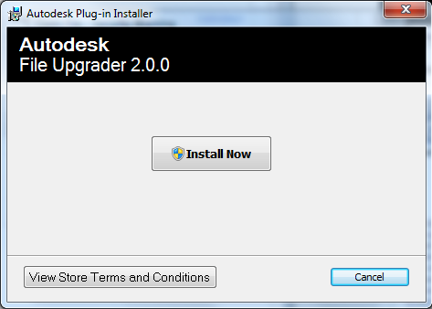

PackageContents.xml Populated by Installer Tool
<?xml version="1.0" encoding="utf-8"?>
<ApplicationPackage SchemaVersion="1.0"
AutodeskProduct="Revit"
ProductType="Application"
Name="File Upgrader"
AppVersion="2.0.0"
Description="ADN Plugin of the Month: File Upgrader"
Author="Saikat Bhattacharya"
Icon="./Contents/2014/Resources/FileUpgrader_Thumbnail.png"
OnlineDocumentation="http://labs.autodesk.com/utilities/ADN_Plugins"
HelpFile="./Contents/2014/Resources/ADNFileUpgraderHelp.htm"
ProductCode="{F23B85C8-D5DE-45B9-977E-D860120D27B1}"
UpgradeCode="{5D9F89AD-3CC0-4769-B90D-60BFB4EE90DB}"
FriendlyVersion="2.0.0"
SupportedLocales="Enu"
AppNameSpace="appstore.exchange.autodesk.com">
<CompanyDetails Name="Autodesk"
Url="http://labs.autodesk.com/utilities/ADN_Plugins"
Email="adn.apps@autodesk.com"
Phone=" " />
<RuntimeRequirements OS="Win32|Win64"
Platform="Revit|Revit Architecture|Revit Structure|Revit MEP"
SeriesMin="R2014"
SeriesMax="R2014" />
<Components Description="2014 parts">
<RuntimeRequirements OS="Win32|Win64"
Platform="Revit|Revit Architecture|Revit Structure|Revit MEP"
SeriesMin="R2014"
SeriesMax="R2014" />
<ComponentEntry AppName="FileUpgrader"
Version="2.0.0"
ModuleName="./Contents/2014/ADNPlugin-FileUpgrader.addin"
AppDescription="FileUpgrader" />
</Components>
</ApplicationPackage>
Installer information
Summary of components (optional)
Revit run-time info
Location of addin manifest
Notes:
This shows how a typical PackageContents.xml file looks like. As I mentioned previously, the information in this file is completed by Autodesk from your submission information. However, understanding how it works might be helpful for truobleshoorting while testing your apps.
PackageContents.xml includes two kinds information: installer information and run-time information.
Under Components, you will notice a tag called ComponentEntry which contains a property called ModuleName. This property represents the path to the add-in manifest file. You will notice that the path is a relative path

Slide 11
Revit App Auto Load Flow
Revit goes through the common install folder and parse for Revit apps for the appropriate environments (RuntimeRequirements)
Revit picks up the location of addin manifest (ModuleName)
Read .addin manifest and load the app.
<?xml version="1.0" encoding="utf-8"?>
<ApplicationPackage>
<Components Description="2014 parts">
<RuntimeRequirements OS="Win32|Win64"
Platform="Revit|Revit Architecture|Revit Structure|Revit MEP"
SeriesMin="R2014"
SeriesMax="R2014" />
<ComponentEntry AppName="FileUpgrader"
Version="2.0.0"
ModuleName="./Contents/2014/ADNPlugin-FileUpgrader.addin"
AppDescription="FileUpgrader" />
</Components>
</ApplicationPackage>
Minimum PackageContents.xml to load to Revit.
Use for testing purposes
Notes:
You might now wonder how revit uses the install paths and bundle structure.
Revit first looks under the programdata and appdata standard install locations for the bundle folders.
It then parses the PackageContents.xml file for each of the bundles and checks if they are Revit apps.
It then reads the path to the addin manifest file and loads the app using the manifest file.

Slide 12
Addin Manifest
Use the relative path to your dll
By default, Revit will load addins without restarting Revit. If you want to change this behavior, add the flag: ^{*1}
<?xml version="1.0" encoding="utf-8" standalone="no"?>
<RevitAddIns>
<AddIn Type="Application">
<Name>File Upgrader</Name>
<Assembly>.\ADNPlugin-FileUpgrader.dll</Assembly>
<ClientId>BEA80927-9044-4c31-AAE1-48AB3527AAAA</ClientId>
<FullClassName>ADNPlugin.Revit.FileUpgrader.Ribbon</FullClassName>
<VendorId>ADNP</VendorId>
<VendorDescription>Autodesk, www.autodesk.com</VendorDescription>
</AddIn>
</RevitAddIns>
Relative path to your dll
<AllowLoadIntoExistingSession>false</AllowLoadIntoExistingSession>
*1) Revit supports in-session loading since the release 2014. Earlier releases require restarting Revit.
Notes:
As an experienced Revit developer, you should be familiar with the addin manifest file.
A typical addin manifest file for an exchange store app looks like this
You will observe that the path to the application DLL is a relative path
Starting with Revit 2014, Revit will load an app without restart as soon as a new addin manifest file is detected by it.
If you do not want this behavior, you can explicitly set the tag called AllowLoadIntoExistingSession to false.

Slide 13
Preparing Apps for the Store: Guidelines
Ribbon buttons
Contextual (F1) help
Install locations
“Bundle” structure
Next: App Submission Processes
Notes:
This concludes the guidelines section of this presentation for the exchange store apps.

Slide 14
Notes:
This is the end of the presentation. Thank you for watching it patiently.

