Slide 1
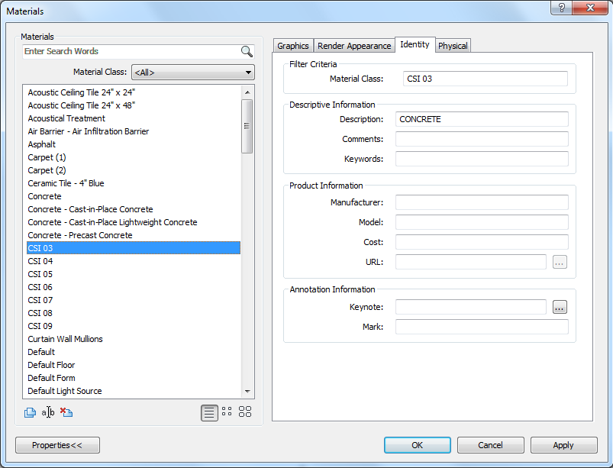
<Material Class>
STEP1. Set up basic materials within the project file to duplicate with ‘Material Class’
Note: Material Class name should follow this format :’CSI XX’

Slide 2
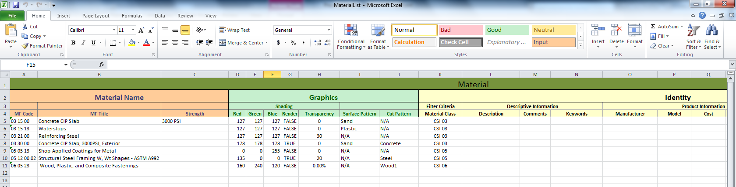
STEP2. Check all the material information in right format.
In C:\RevitAPI\MaterialList.xlsx
Note1: Graphics section doesn’t allow to leave empty space. It should be filled with ‘0’ or N/A.
Note2: Material Class values should be equivalent to basic material class that will be used for duplicate.

Slide 3
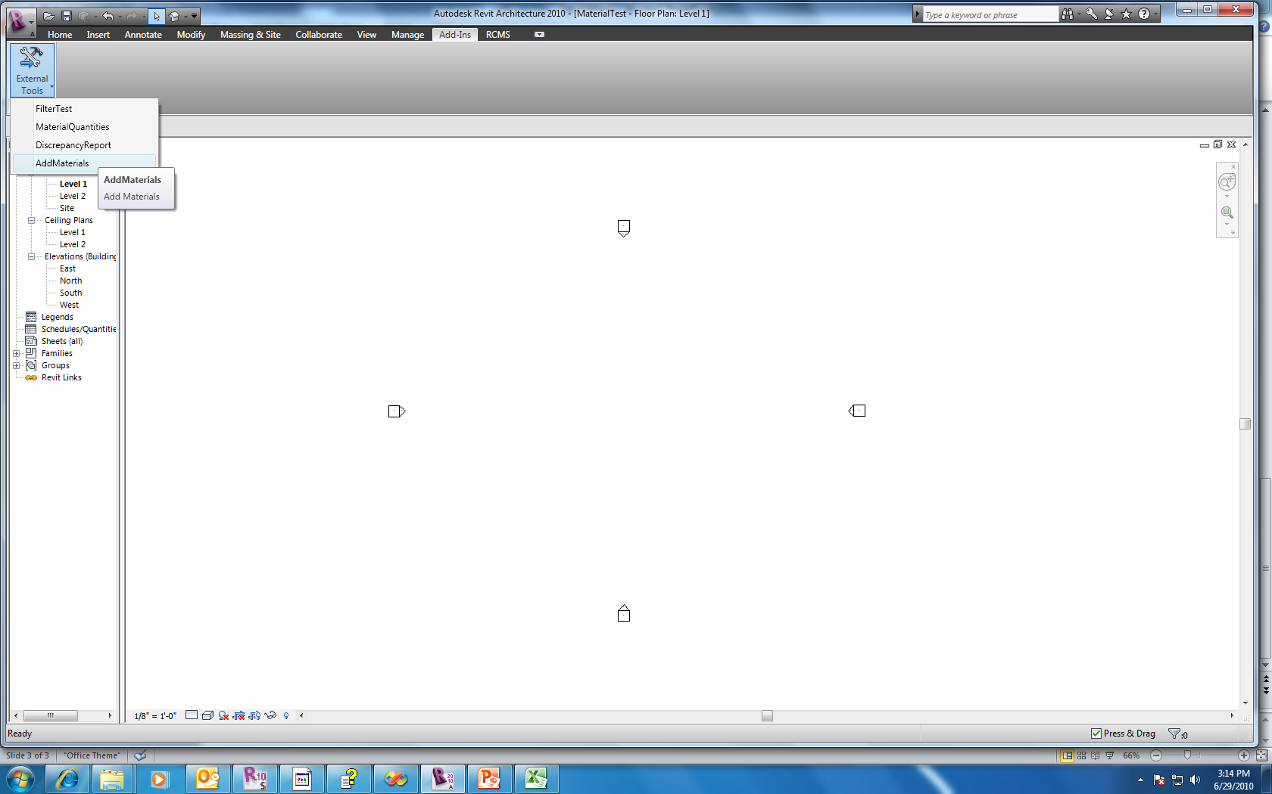
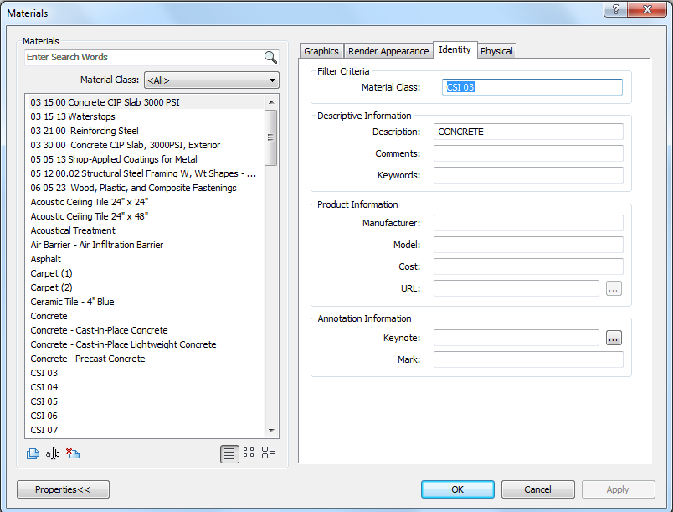
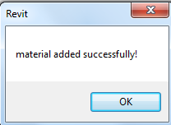
STEP3. See if all the materials added successfully.

