Slide 1
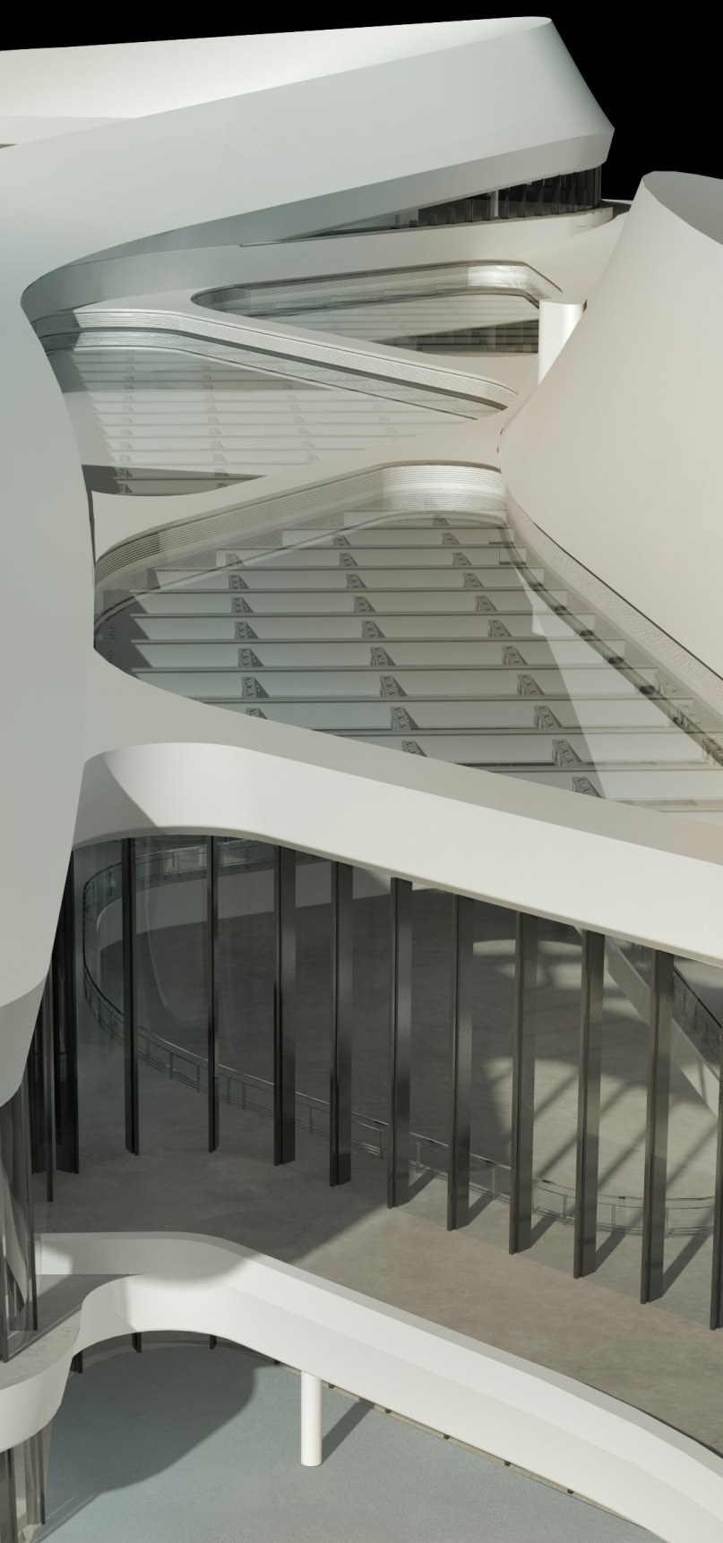
Revit 2012 WikiHelp
Mary Roy AEC User Assistance Architect
Patty Gale Revit Lead Technical Writer
Image courtesy of CCDI Group
Notes:
Social media has forever changed the way we interact with our environment.
People want to find information quickly and no longer accept slow searches or walls of text.

Slide 2
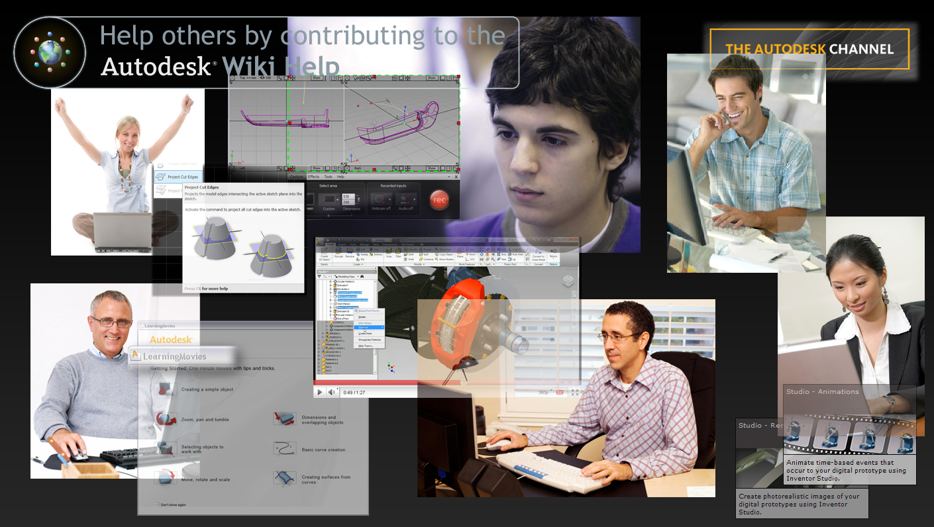
WikiHelp is where you get the best help ever.
Customers and Autodesk partner for learning
to collect and share knowledge from around the globe and make learning relevant, dynamic, and responsive.
Notes:
The learning experience isn’t just about delivering existing help content in a different way, or embracing new media alone.
It’s a new way of thinking – a partnership between Autodesk staff, partners, and customers to form a true learning community.
Autodesk provides the core content to provide the initial, successful, and engaging learning experience.
All users can add a meaningful tag or expand on this content, leveraging their know-how about an application or their business processes. We gain the customer’s intuitive understanding of their business and how it applies to our applications. Users benefit because they can find content in their preferred search engines, such as YouTube or Google, and then email the url.
Our goal is to hear people say, “I don’t know how I got by without it!”

Slide 3
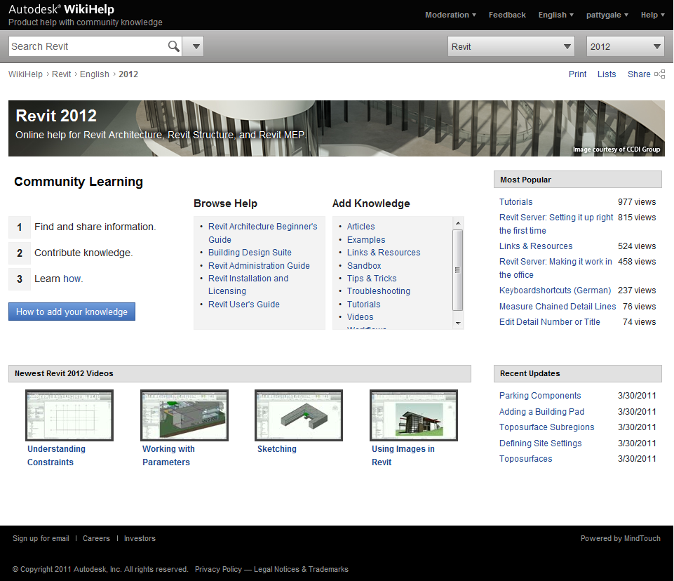
It’s more than help. It’s a learning community.
WikiHelp Benefits
Enables contributions
Improves access
Directly from Revit
From your favorite search engine
Allows dynamic updates
Supports peer-to-peer learning
Supports emailing links
Plus Full Offline Help
Included on the installation media
Supports companies with zero-Internet-access policies
Enables access to static help content when offline
Notes:
Why did we decide to deliver the help content on the Wiki?
We want to build a learning solution that leverages the knowledge of the entire community. The Wiki enables contributions from everyone and the content is dynamic.
Wiki content can also be found with web searches and then emailed.
The learning experience team will still provide the core content we always have, but the user contributions will enrich or correct the content.
By delivering the help content on the Wiki, we have the possibility of reducing the help footprint on the installation media by in future releases. This also allows us to deliver more video content without impacting the size of the delivered support system.
Currently, the installed help content is the full help. If an internet connection is detected, invoking help will call the appropriate area on the Wiki. If a user is working offline, invoking help calls the appropriate topic in the locally installed help.

Slide 4
Revit WikiHelp Landing Page
Contributions from the Revit community
One Wiki for Revit Architecture, Revit Structure, and Revit MEP
User assistance from Autodesk
What are people looking at the most?
Newest videos added to WikiHelp
What has been added/updated recently?
Notes:
5 minutes
Default
Easy it is to access different products.
Search, Rate. Tag, Watch, RSS

Slide 5
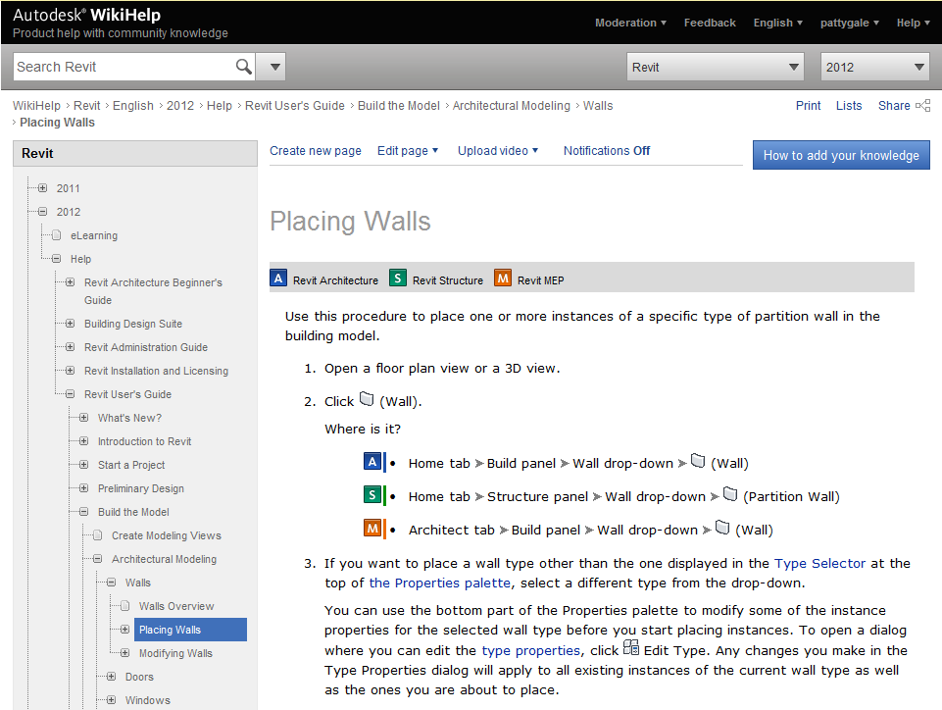
Sample Help Topic
When working in Revit, press F1 or click Help to display the relevant help topic.
Use the contents pane to navigate.
Icons identify product-specific information.

Slide 6
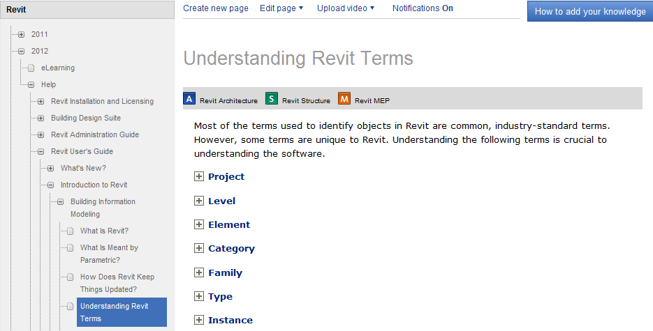
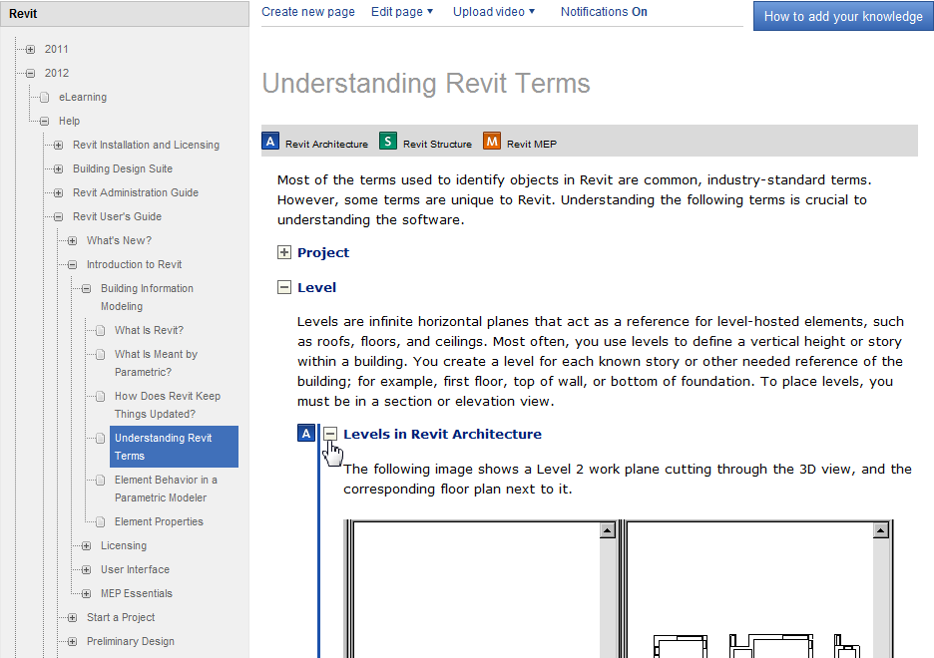
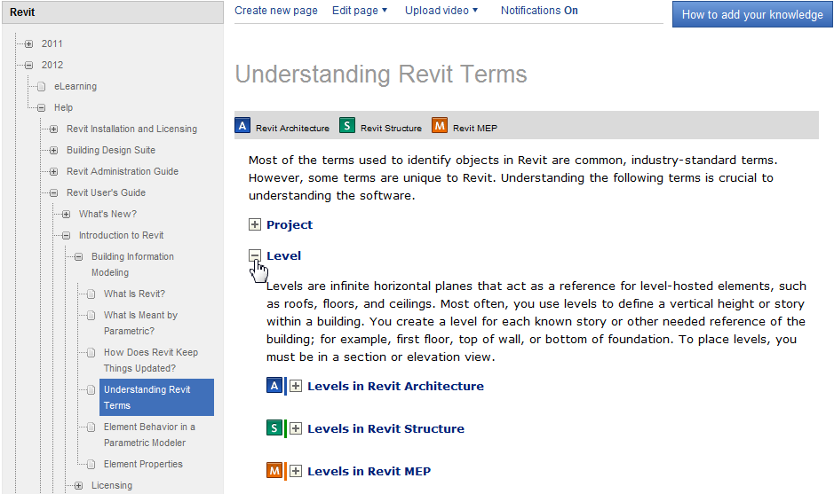
Layered information improves scanning.
Information is collapsed under subheadings to improve scanning and reduce scrolling.
Click the + to expand a subheading and view its content.
Product-specific images are also collapsed. Click the + to expand an image.

Slide 7
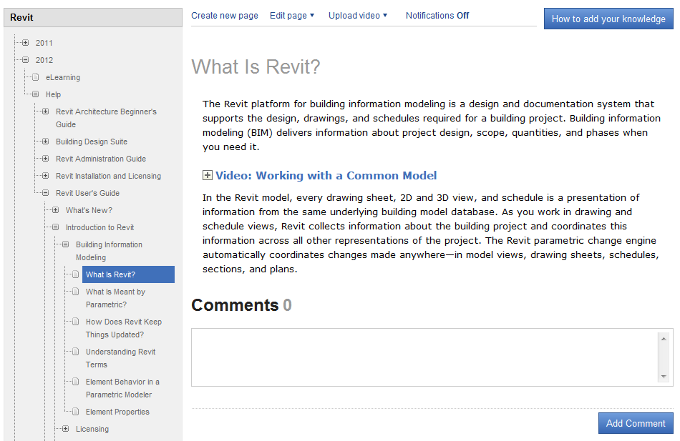
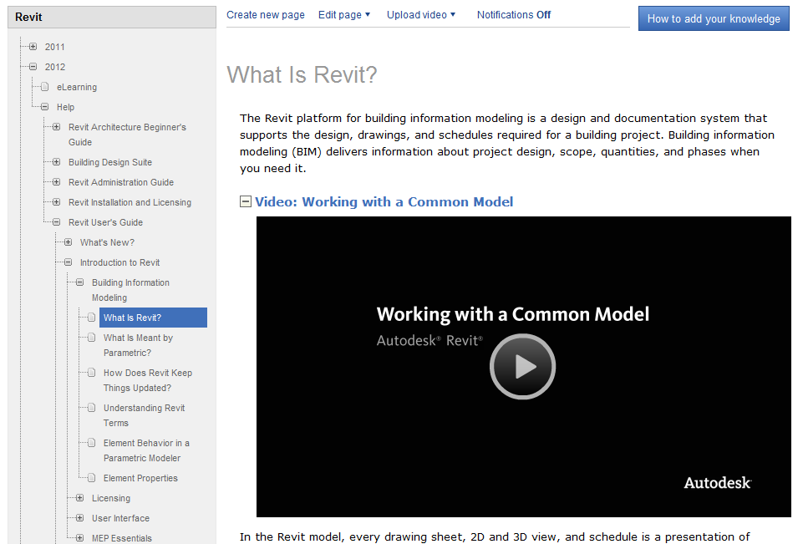
Embedded videos provide easy access.
Videos are embedded directly in relevant topics for easy access.
Click the + to expand the video player.

Slide 8
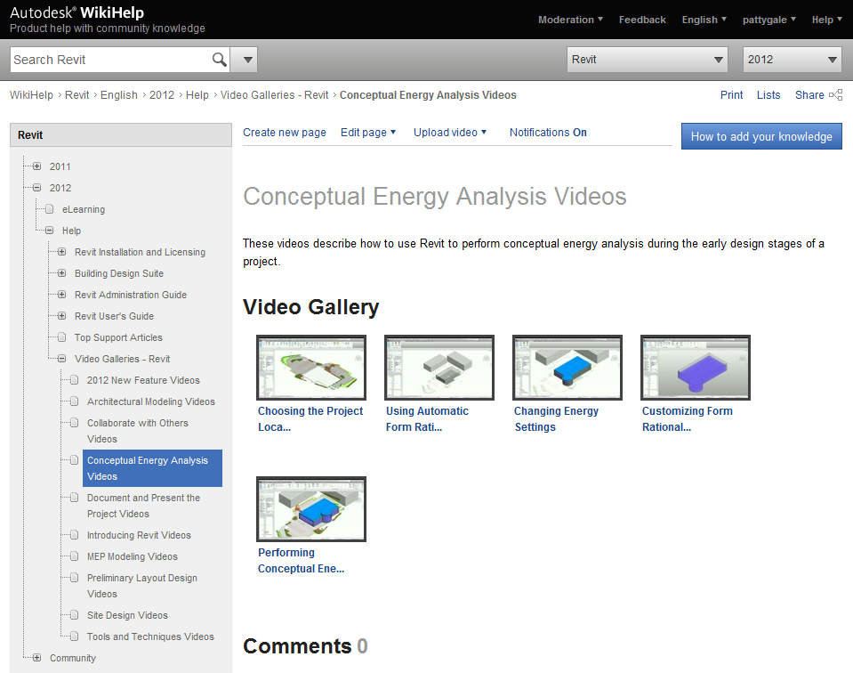
Video galleries show workflows and features.
Autodesk videos are typically 1-3 minutes long.
Features that require more coverage are presented in a series of related videos.
A video gallery presents a series of videos in a unified learning experience.

Slide 9
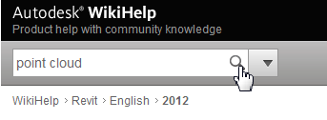
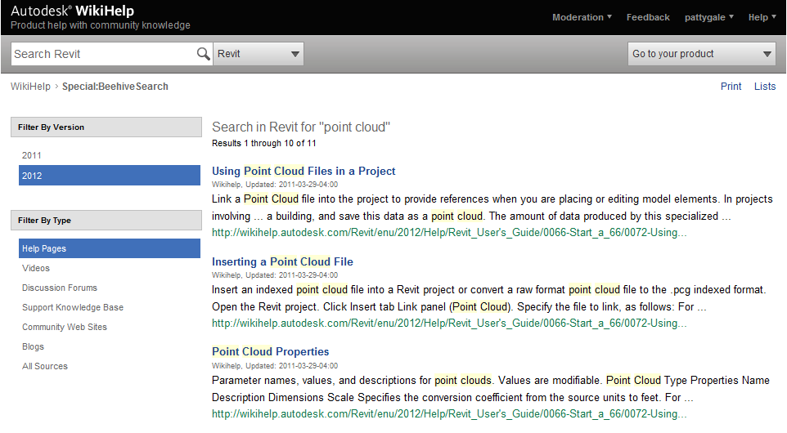
Search gives you access to many sources.
By default, search finds help pages for the current release.
Click a filter to find relevant information in other sources.

Slide 10
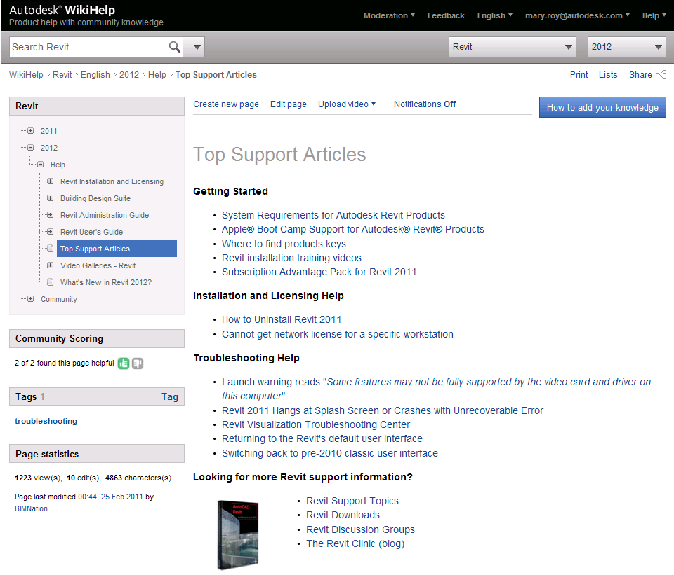
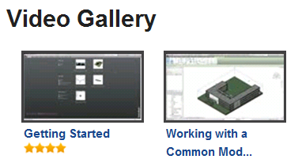
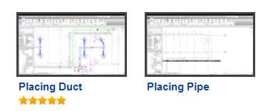
Get ENGAGED. Rate topics and videos.

Slide 11

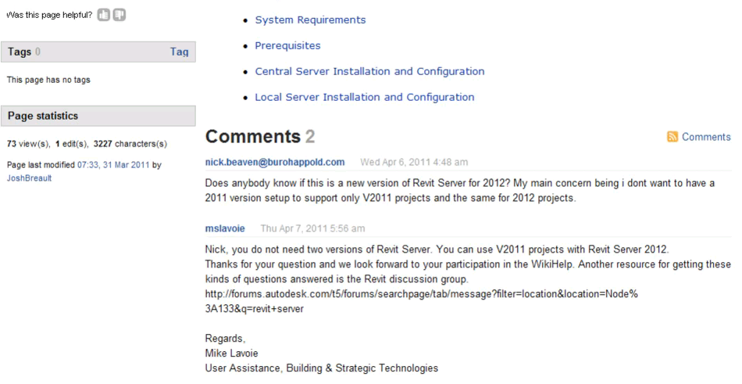
Get ENGAGED. Comment on what you read and view.
Here’s a tip when using this feature…
We also use this tool as follows…

Slide 12

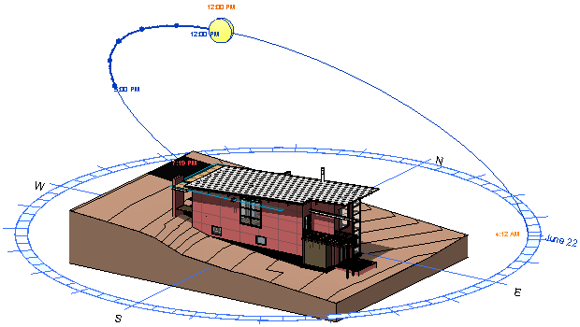
Get ENGAGED. Add your own know-how.
Here’s my workflow:
Import a CAD drawing.
Use it as an underlay.
Sketch new lines on top.
Here’s a video of how I use this tool to maximize my productivity:
Here’s what you can do with this tool:

Slide 13

Get ENGAGED. Make it better for everyone.
Contribute your know-how.
Email links.
Support peer-to-peer learning.
Build the Revit Community Be a part of it.

Slide 14
http://wikihelp.autodesk.com/Revit/enu/2012

Slide 15
Autodesk

