Slide 1

Autodesk AEC DevCamp 2012
Autodesk Revit Materials, Physical Properties and Compound Structure API Basics
Steven Mycynek Principal Engineer

Slide 2
Outline
Material Model History
Material Properties
Dealing with Units
Working with Materials
GbXML’s role in Revit
Family Thermal Properties
Layered Assemblies
Layered Assembly Thermal Properties
A few last enhancements

Slide 3
1) Material Model History

Slide 4

2) Material Properties

Slide 5
Materials Model History
Materials in 2011
Inheritance model
Materials in 2012
PropertySet model, Material subclasses obsolete
Materials in 2013
PropertySet plus Asset model, Material subclasses removed
Why the changes?
Extensibility for the future
Add another asset, not derive another subclass.
Better Element Filter support
AIRMax compatibility

Slide 6
2) Material Properties

Slide 7
Material Property Hierarchy
Material
PropertySetElement – generic parameter bag
StructuralAsset – discoverable props, new in 2013
PropertySetElement – generic parameter bag
ThermalAsset – discoverable props, new in 2013
API documentation
Material.ThermalAssetId
Material.StructuralAssetId

Slide 8
Asset types and properties
ThermalAsset
ThermalMaterialType
Solid
Liquid
Glass
Undefined
StructuralAsset
StructuralAssetClass
Undefined
Basic
Generic
Metal
Concrete
Wood
Liquid
Gas
Plastic
Not all properties in each asset apply to all types, e.g. “LiquidViscosity”
Watch out for InapplicableDataException.
See documentation for details.

Slide 9
MaterialClass property – new in 2013
A simple, top-level string property on Material
Useful for casual categorization
Already filled out for standard materials
Users asked for it with 2012.

Slide 10
3) Units

Slide 11
Working with Units
Who’s had confusion and frustration here ? ☺
Revit Internal Units
Unless documented otherwise…
Lengths in decimal feet
All other units in metric
Compound units can be tricky
Revit UI units – any number of common metric or imperial units
Document.ProjectUnit[].FormatOptions
Converting units
Helper method in ExporterIFCUtils
Code walkthrough – units sample
UnitUtility.cs

Slide 12
UnitUtility.cs sample code
Helper Methods in today’s sample code
SystemToDisplayUnits
A wrapper around an IFC API method
Double
XYZ
DisplayUnitsToSystem
Had to do a little extra math
FormatValue
Shows in both API/System units and current display units.

Slide 13
4) Working with Materials

Slide 14
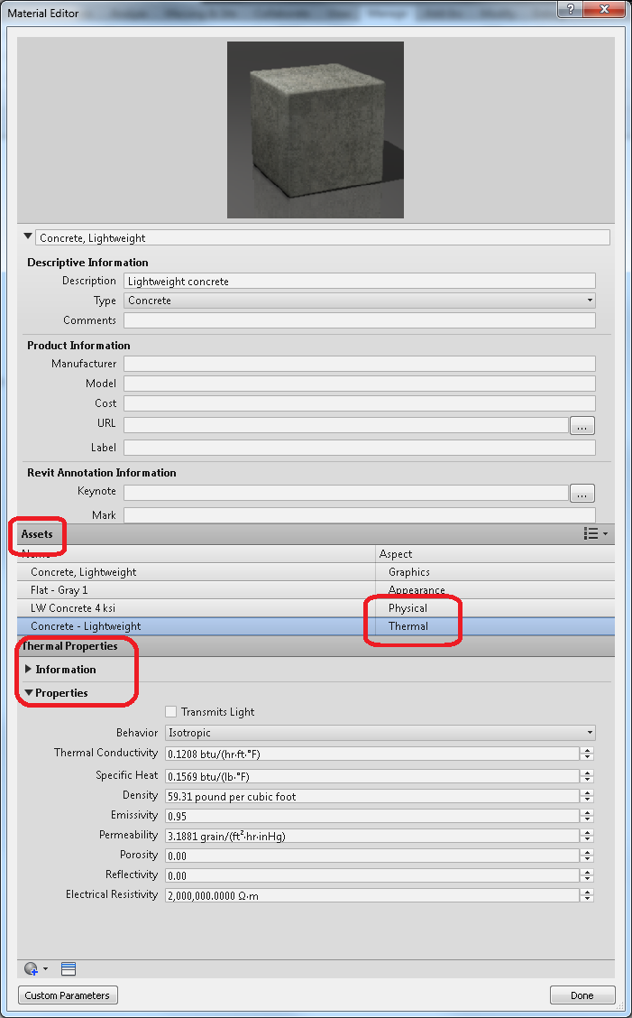
Materials UI

Slide 15
Creating a material – General Guidelines
Materials are complicated and have a lot of data
No longer just a texture map.
Have a plan when creating a new one
Do you want a totally new material?
Maybe a material very similar to an existing one?
What in particular is “new” about this new one?
Organize your code well

Slide 16
Creating a material
Creation though duplication
Duplicate the Material
Material.Duplicate()
Just the top-level items – a “shallow copy”
Duplicate Assets
ThermalAsset and StructuralAsset Copy() method
Setting with new data is somewhat optional
Duplicate PropertySetElements
PropertySetElement.Duplicate()
New elements to be saved in the Revit document
Set PropertySetElements to material
Combine everything from above into one DB.Material

Slide 17
Creating a material
Creation from scratch
Create a new material with Material.Create()
Create assets
ThermalAsset constructor
StructuralAsset constructor
Create PropertySetElements
PropertySetElement.Create
Requires assets from (2) as input
Set PropertySetElements to Material
Material.StructuralAssetId
Material.ThermalAssetId

Slide 18
Demo: Creating a material through duplication

Slide 19
Demo: Creating a new material from scratch

Slide 20
5) GBXML in Revit

Slide 21
GBXML
What is it?
Who uses it outside of Revit?
Where is it used in Revit?
Understanding the format

Slide 22
GBXML –What is it?
Open source energy data format
http://www.gbxml.org/currentschema.php

Slide 23
GBXML –Who uses it outside of Revit?
DOE-2 (doe2.com)
Green Building Studio (gbs.autodesk.com)
Bentley
Carmel Software
Trane
Carrier

Slide 24
GBXML –Where is it used in Revit?
Family thermal properties
Doors
Windows
Curtain Panels
Constructions Overrides
As an alternative to layer-calculated properties
Use a known agreed-on GBXML data set instead
General Export
Entire thermal model of building.

Slide 25
Understanding the GBXML format.
Constructions.xml -- It’s in your Revit.exe folder.
100% GBXML
A few key elements
Construction – a wall, door, ceiling, or other type
Material – a physical medium with thermal properties.
WindowType – a thermal description of a window

Slide 26
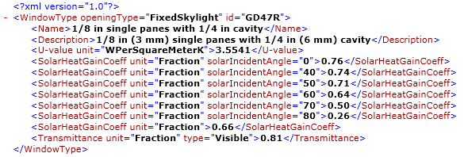
Constructions.xml - Windows
WindowType – a complete window assembly
Name and Id
U-value
SolarHeatGainCoefficient (only for an angle of 0)
Visual Light Transmittance

Slide 27
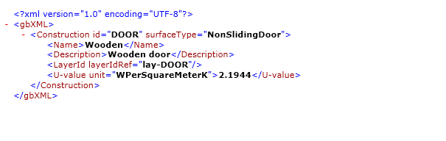
Constructions.xml - Doors
Construction– a complete window assembly
Name and Id
surfaceType =“NonSlidingDoor”
U-value

Slide 28
Where does contructions.xml end up in the API?
Stay tuned…

Slide 29
6) Family Thermal Properties

Slide 30
FamilyThermalProperties class
Class basics:
A thermal property class for families
No constructor
Static Find() method to get by Id*
All Properties are read-only
Get/Set method on FamilySymbol
What can you do?
Read thermal from families.
*Find thermal data in constructions.xml
Reassign thermal data from constructions.xml to families.

Slide 31
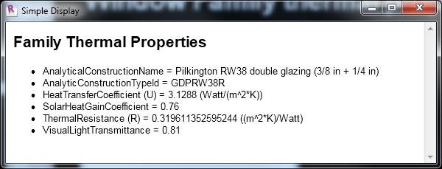
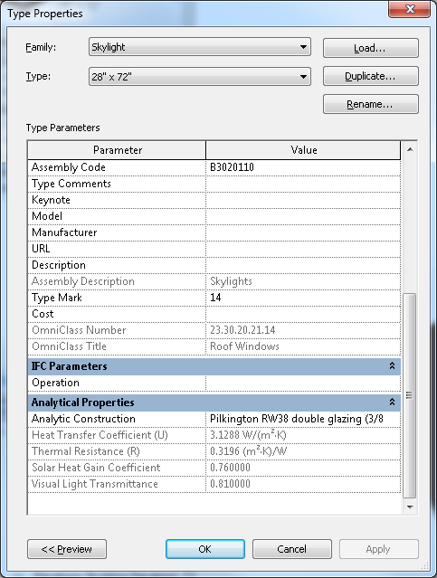
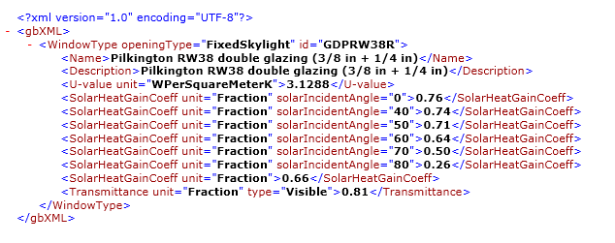
Window Family thermal properties – Exposed!

Slide 32
Demo – Family Thermal Properties
API Macro to view and set family thermal properties.

Slide 33
Not all thermal properties are GBXML based
Stay tuned…

Slide 34
7) Layered Assemblies

Slide 35
Layered Assemblies
What element types are layered?
WallType
FloorType
RoofType
CeilingType
BuildingPadType

Slide 36
A bit about the layers API
Much of the API for compound structure and layers is not new to 2013
Quick review of API
CompoundStructure
CompoundStructureLayer
WallType.Get/SetCompoundStructure()
CompoundStructure.SetLayers()

Slide 37
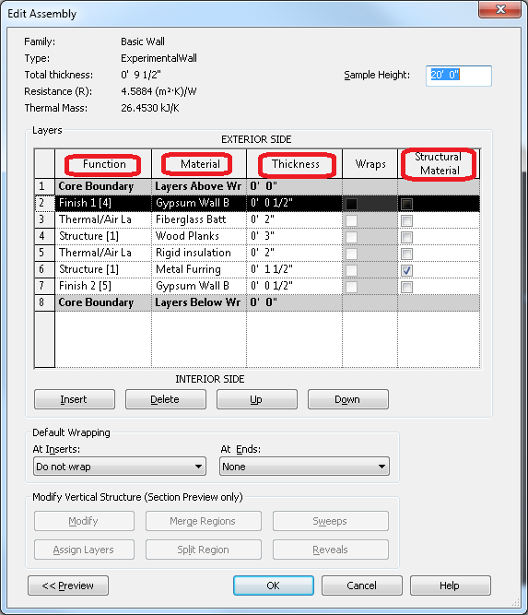
Wall Layers UI
Function
Material
Thickness
Structural?
New 2013

Slide 38
CompoundStructure class in detail
A property of HostObjAttributes
WallType
FloorType
CeilingType
…
Not an instance property.
Must be explicit set via SetCompoundStructure()
StructrualLayerIndex – new in 2013

Slide 39
CompoundStructureLayer class in detail
Most important properties
Width
MaterialId
Much more important now that materials have more analytical data.
Function
Insulation, membrane, etc…

Slide 40
8) Layered Assembly Thermal Properties

Slide 41
ThermalProperties class
Class basics
A thermal property class for layered assembly types
New in 2013
No constructor or class factory method
Some read-write properties, some read-only.
What can you do?
Read thermal data from layered assembly types.
Adjust certain properties.
Absorptance
Roughness
View driven properties
U-Value
R-Value
Thermal Mass

Slide 42
ThermalProperties - Driven
How are driven properties generated?
From the ThermalAsset data in the materials in the layers of the assembly.
Some older materials may not have thermal assets.
Adjust your layers and materials to see overall assembly properties change.

Slide 43
WallType property hierarchy
WallType
ThermalProperties
Writeable (Absorptance, Roughness)
Driven by CompoundStructure (ThermalMass, Resistance, HTC)
CompoundStructure
CompoundStructureLayer
Material
PropertySetElement
StructuralAsset
PropertySetElement
ThermalAsset
CompoundStructureLayer
…..

Slide 44
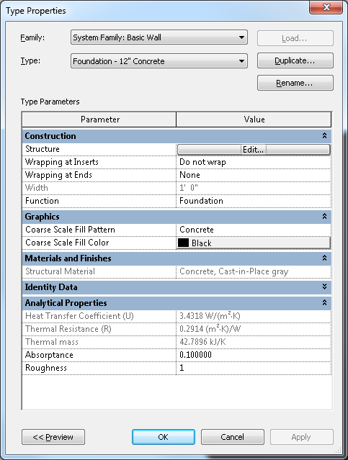
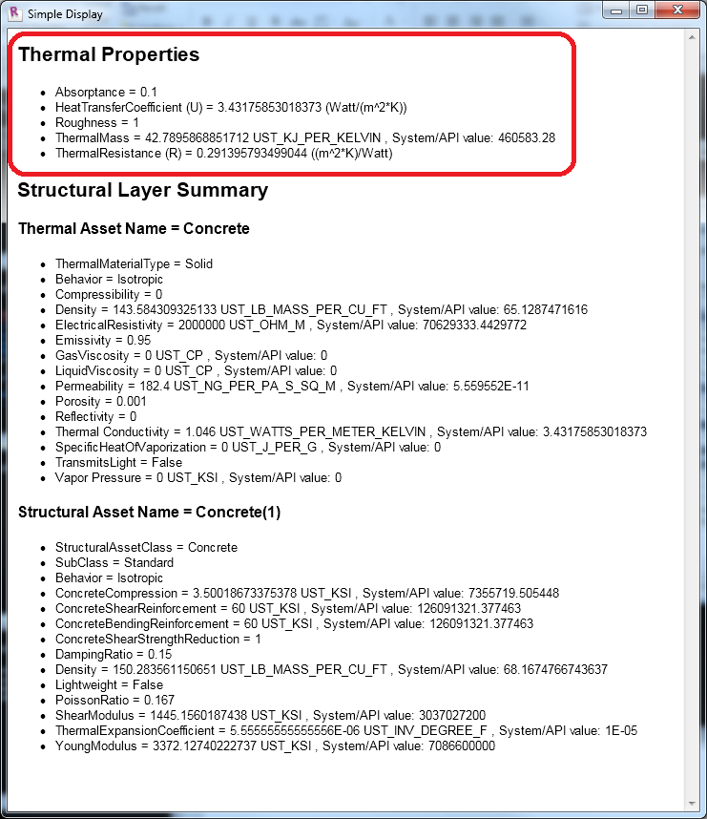
WallType thermal properties – Exposed!

Slide 45
How do driven thermal properties change?
The inherent thermal nature of a material.
The amount of that material.
We can adjust both in the UI or API and observe the projected thermal results.

Slide 46
Demo – layered assembly thermal properties

Slide 47
Demo: Change a layer material
Note the overall thermal properties of an assembly.
Change a material.
Note our two demo materials
Concrete_standard
Concrete_highConductivity
Note the result.

Slide 48
Demo: Increase a layer width
Note the overall thermal properties of a wall assembly.
Change a width.
Note the result.

Slide 49
Demo: Wall analysis
In the API, I can…
Query layer widths
Query with layers are insulation
Query overall R-Value
Edit a wall’s layer widths
Let’s put all of these together!

Slide 50
Demo: Wall analysis
Visualize how total R-Values change
…by adjusting small pieces of a design.
Reset the design to its original configuration when done.

Slide 51
Demo: Wall analysis
Select a sample wall
Make several trial adjustments insulation widths
Record and display results

Slide 52
9) A few last things

Slide 53
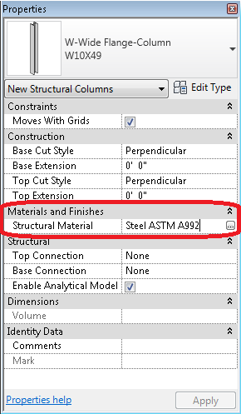
Structural Material Id
(FamilyInstance.StructuralMaterialId)

Slide 54
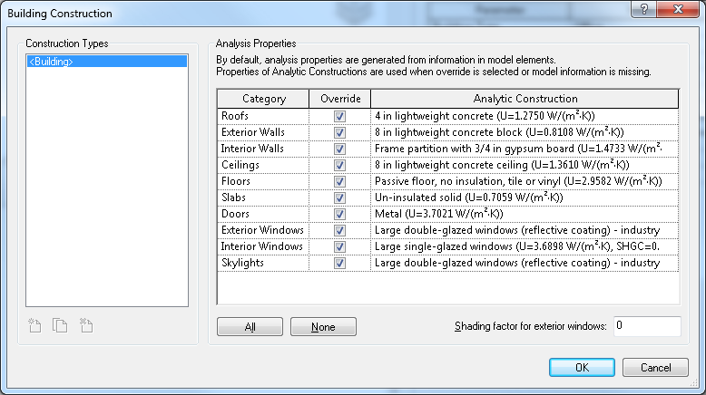
Construction overrides
Analyze->H&C Loads -> Building Construction
Demo

Slide 55
Thank you
steven.mycynek@autodesk.com

Slide 56

Autodesk, AutoCAD, Alias, Revit, Autodesk Inventor, Inventor, Maya, Mudbox, and 3ds Max are registered trademarks or trademarks of Autodesk, Inc., and/or its subsidiaries and/or affiliates in the USA and/or other countries. Academy Award and Oscar are registered trademarks of the Academy of Motion Picture Arts and Sciences. mental ray is a registered trademark of mental images GmbH licensed for use by Autodesk, Inc. All other brand names, product names, or trademarks belong to their respective holders. Autodesk reserves the right to alter product and services offerings, and specifications and pricing at any time without notice, and is not responsible for typographical or graphical errors that may appear in this document.
© 2012 Autodesk, Inc. All rights reserved.

