Slide 1
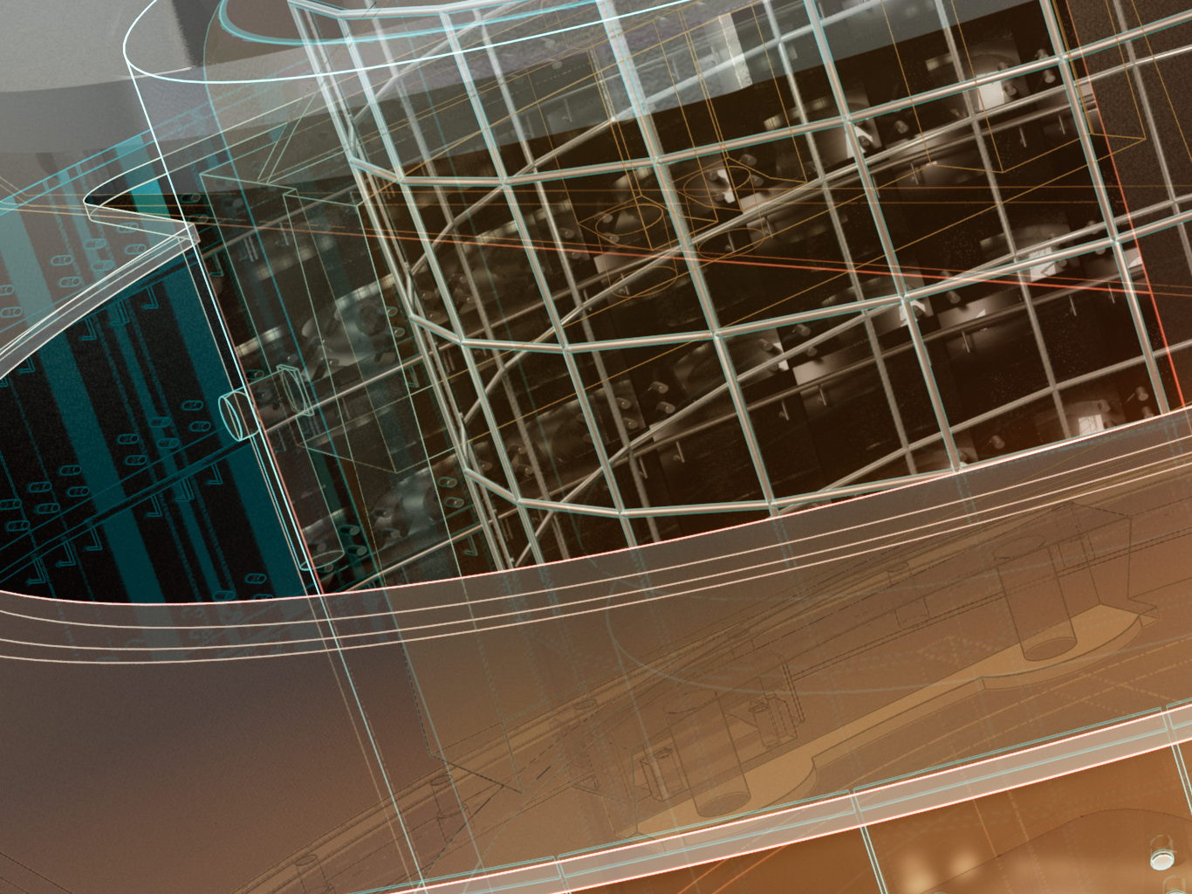
Autodesk AEC DevCamp 2012
Geometry API in Autodesk Revit® 2013
Scott Conover Software Development Manager, Revit API & Interoperability

Slide 2
About this course
Two sections
Geometry extraction fundamentals
Tools
For more details: developers guide wiki
Samples – provided as course material

Slide 3
Learning Objectives
At the end of this class, you will be able to:
Extract and analyze the geometry of existing Revit elements
Create and manipulate temporary curve and solid geometry
Find elements by 3D intersection
Find elements by ray projection and filtering
Apply an ExtrusionAnalyzer to geometry
Utilize parts to analyze geometry of HostObjects and their layers
Extract and analyze the boundary geometry of rooms and spaces
Analyze the geometry of point clouds

Slide 4
Geometry extraction in the Revit API

Slide 5
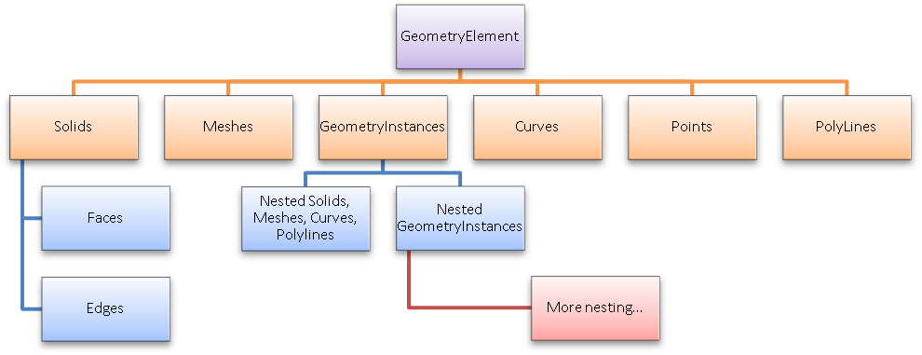
Geometry extraction
Element.Geometry
3D model elements
System family instances (walls, floors and roofs)
Family instances (doors, windows, furniture, or masses)
Returns GeometryElement containing:

Slide 6
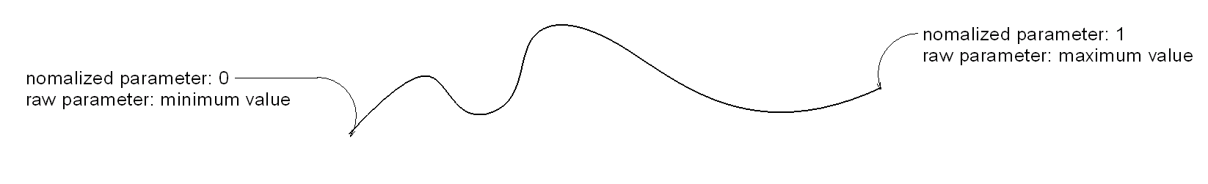
Curves
A path in 2 or 3 dimensions in the Revit model
May represent the element’s geometry (e.g. CurveElement)
May represent a single piece of the geometry of an element (e.g. centerline of a wall or duct)
Curves and collections of curves used as inputs in many places
Consult wiki for curve types, analysis and mathematical representations

Slide 7
CurveLoop
Specific chain of curves joined end-to-end
Used as an output for some element boundary properties
Used as input to several geometry and element creation routines
Can be closed or open loop
Create using:
CurveLoop.Create()
CurveLoop.CreateViaCopy()
CurveLoop.CreateViaThicken()

Slide 8
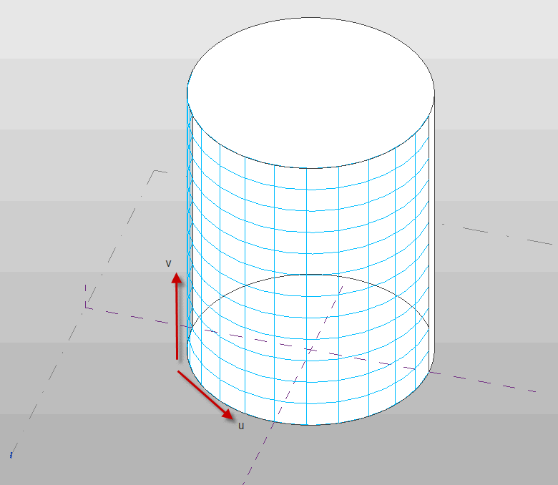
Solids, faces and edges
Solid
Collection of faces and edges
Typically full volumes
A shell (partially bounded volume) can be encountered
Sometimes Revit geometry has unused solids
Face
Mathematical function of “u” and “v” parameters in 3D space
Consult wiki for face types, analysis and mathematical representations
Edge
Boundary curve of one or 2 adjacent faces
Use parameters to analyze or convert to curve:
Edge.AsCurve()
Edge.AsCurveFollowingFace() functions.

Slide 9
Solid and face creation
GeometryElement.GetTransformed()
Copies an existing element geometry to a new location/orientation
GeometryCreationUtilities
Extrusion
Revolution
Sweep
Blend
SweptBlend
Uses for created solid
Display it (analysis visualization framework)
Analyze it (volume, area, centroid calculations)
Intersect it (element intersection filters)
Combine it (boolean operations)

Slide 10
Boolean operations
Combine input solids (add, subtract, intersect)
BooleanOperationsUtils class
ExecuteBooleanOperation()
Copies input solids
Produces new solid
Inputs can be Revit element solids or temporary geometry
ExecuteBooleanOperationModifyingOriginalSolid()
Modifies the first solid directly
First solid must be modifiable (not a Revit element’s geometry)

Slide 11
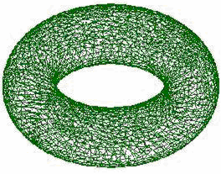
Meshes, polylines and points
Mesh
Collection of triangular boundaries
Forms a 3D shape
Imported geometry
Topography surfaces
Results of Face.Triangulate()
Polyline
Collection of line segments defined by a set of coordinate points
Imported geometry
Point
Represents a visible coordinate in 3D space
Mass family elements (ReferencePoint)

Slide 12
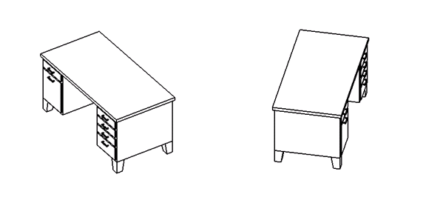
GeometryInstances
A set of geometry stored by Revit in a default configuration
Transformed into the proper location as a result of the properties of the element
Encountered in many Family instances (but not all)

Slide 13
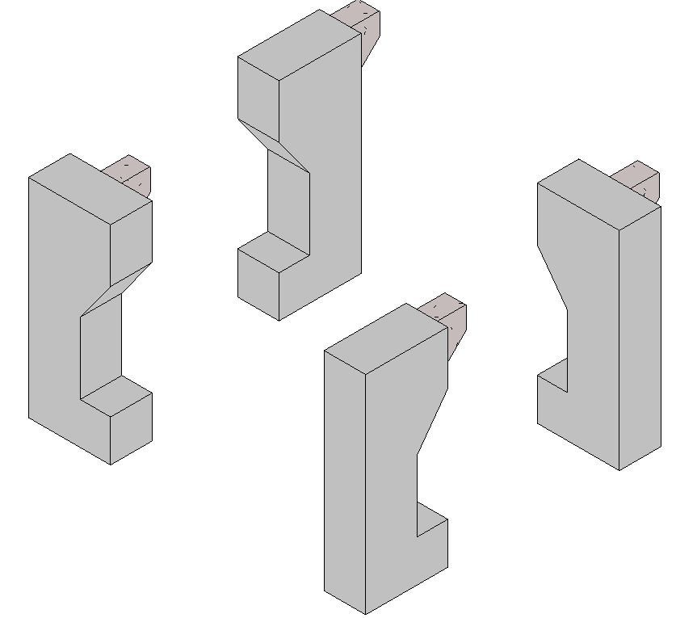
GeometryInstances
Different ways to parse
GetSymbolGeometry() (no transform) – returns Revit geometry of the symbol
Separate Transform property is also available
GetSymbolGeometry (Transform) or GetInstanceGeometry (with or without Transform) – returns copy of Revit geometry
For some cases (dimensioning, element referencing), use the Symbol Geometry to get a proper reference (and analyze the geometry via transform if needed)

Slide 14
Geometry tools in the Revit API

Slide 15
2012 geometry tools
Temporary solid geometry (already described)
Boolean operations (already described)
Element intersection filters
Extrusion analysis
Element.GetGeneratingElementIds
CompoundStructure & HostObject utilities
Parts
Room & space geometry
Energy analytical model
Point cloud analysis

Slide 16
2013 geometry API tools and changes
ReferenceIntersector
Split volumes
Solid tessellation
CylindricalHelix curve type
GeometryElement as IEnumerable<GeometryObject>
CurveLoop as IEnumerable<Curve>

Slide 17
Element intersection filters
ElementIntersectsElementFilter
Passes elements by 3D geometry intersection
Determined with same logic used by Revit for Interference Reports
Some combinations of elements will never pass this filter
Joined elements
Non-solid elements (rebar)
ElementIntersectsSolidFilter
Passes elements intersecting any solid
Solid obtained from anywhere including created from scratch or Boolean operation
Passing elements must have solid geometry

Slide 18
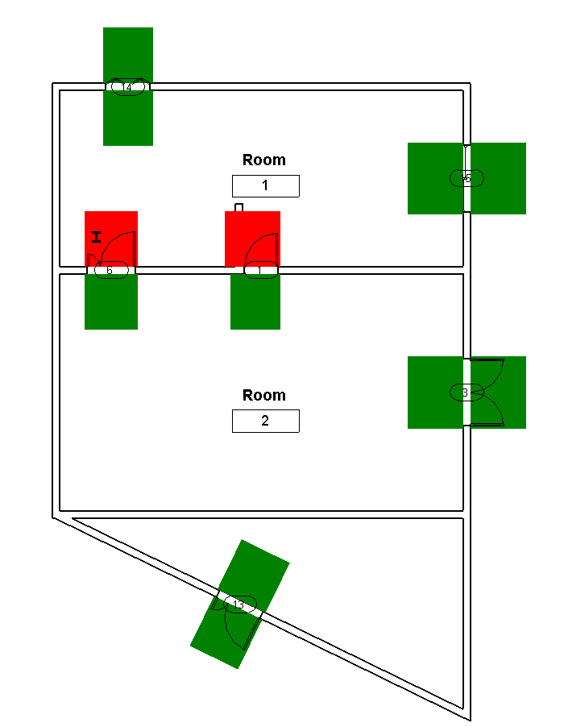
Element intersection filters
Using filters to check volume of access around doors
Create solids around volume
Highlight volumes with Analysis Visualization

Slide 19
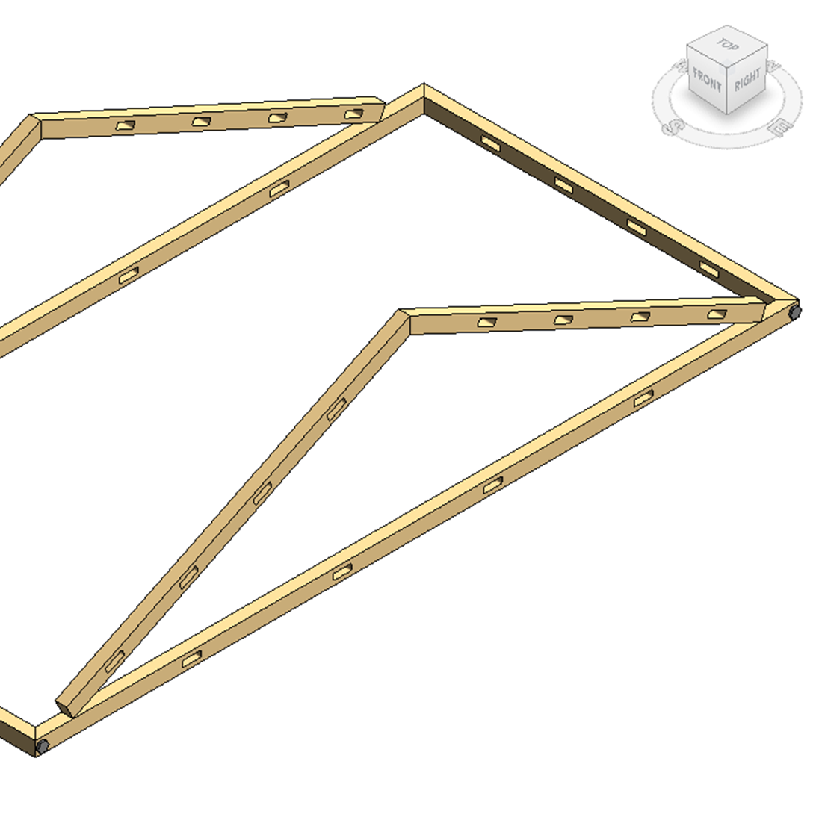
ReferenceIntersector (2013)
Ray-casts to find elements using a point and direction
Target: Element, Face, Edge, Mesh or Curve
ElementFilter or specific element
Find() or FindNearest()
Note issue with FindNearest() if no results will be found – fix in 2013 update release 1

Slide 20
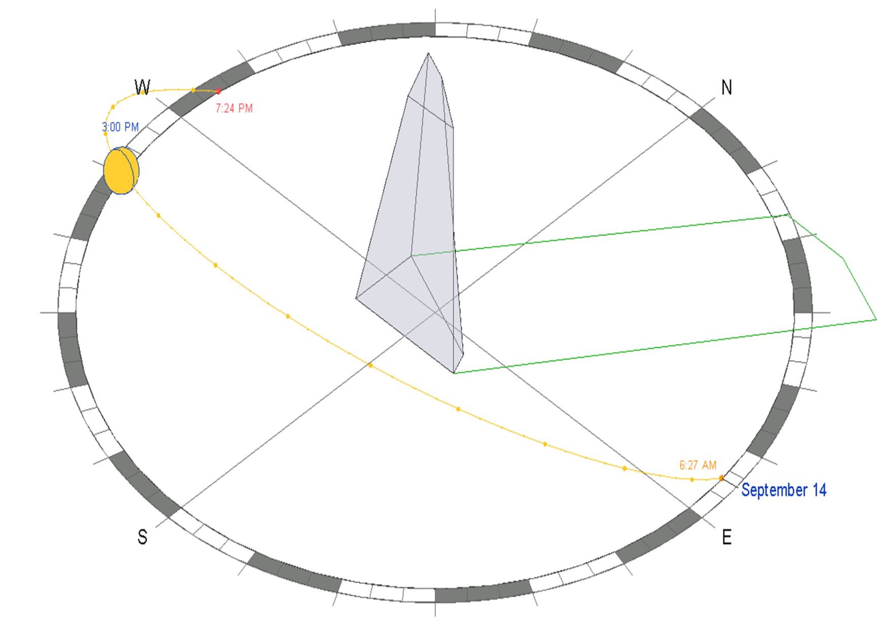
ExtrusionAnalyzer
“Fits” geometry into extruded profile
Inputs:
Solid geometry
Plane
Direction
Results:
Base profile
Face alignment
Example: Revit’s IFC exporter (available on Open Source)

Slide 21
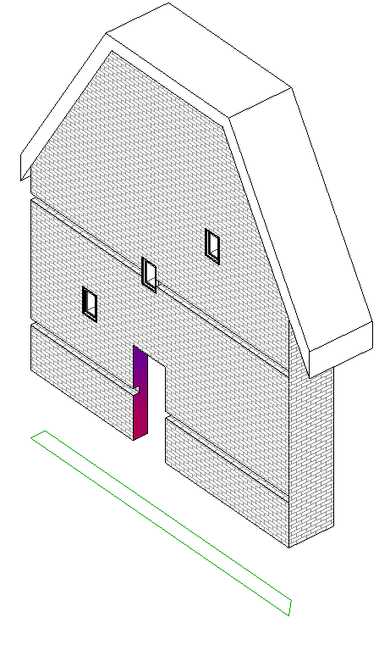
Element.GetGeneratingElementIds
Examines relationships among elements
Window and door cutting walls
Openings cutting hosts
Face splitting faces
Wall sweep or reveal traversing wall
Walls joining to other wall(s)
Elements extending to roof(s)
More than one id may be returned

Slide 22
CompoundStructure & HostObject utilities
HostObject
Walls, floors, ceilings and roofs
CompoundStructure
Read/write layers
Vertically compound layers
Offset to location lines (finish face, core boundaries)
Get layer widths
HostObjectUtils
GetSideFaces() – walls
GetTopFaces()/GetBottomFaces() – floors, roofs, ceilings

Slide 23
Parts
Construction modeling tool
Divide HostObject elements from the design intent model by layer
Further subdivisions possible
By layer
By grid
By sketched curve
Parts update with changes to their source elements
PartUtils
CreateParts()
DivideParts()
GetAssociatedParts()

Slide 24
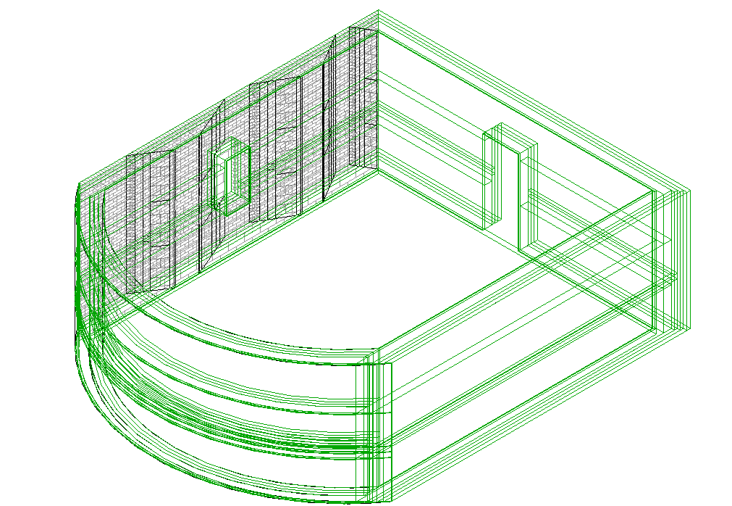
Parts as a geometric analysis tool
Easy access to the geometry of each of the layers of materials within a compound object
East access to split resultant geometry by grid or layer
Use temporary changes to extract information and then restore original model

Slide 25
Room & space geometry
SpatialElementGeometryCalculator
3D geometry volume of room or space
Relationships between the geometry and the boundary elements
2 options:
SpatialElementBoundaryLocation –finish faces or boundary element centerlines for calculation
StoredFreeBoundaryFaces – whether to include faces which don’t map directly to a boundary element
Results: SpatialElementGeometryResults
The Solid volume representing the geometry (GetGeometry() method)
The boundary face information (a collection SpatialElementBoundarySubfaces)

Slide 26
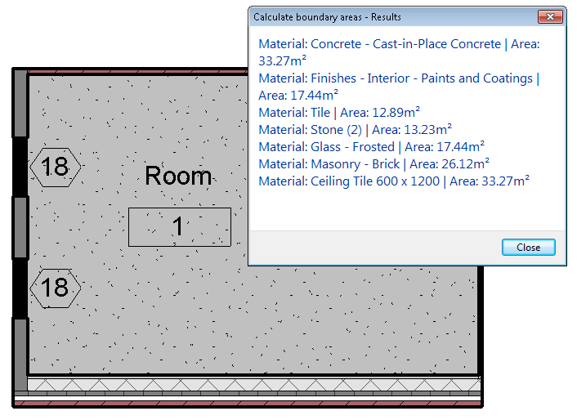
Room & space geometry
Subfaces
The face of the spatial element & the matching face of the boundary element
Subface type (bottom, top, or side)
Notes:
Use same calculator for multiple elements
Bottom faces (floors) never have boundary elements
Openings are not included
Geometry matches what Revit uses for boundary calculations

Slide 27
Energy analytical model
Export to gbXML/ Heating and Cooling Loads features
Analytical thermal model
Spaces, zones and surfaces
EnergyAnalysisDetailModel.Create()
Options
Level of computation (NotComputed, FirstLevelBoundaries, SecondLevelBoundaries, Final)
Whether mullions should be exported as shading surfaces
Whether shading surfaces will be included
Whether to simplify curtain systems
Same result as export to gbXML
Example: Revit’s IFC exporter (available on Open Source)

Slide 28
Point cloud analysis
Accessing Points in a Point Cloud
PointCloudInstance.GetPoints(PointCloudFilter filter, int numPoints)
Iterate the resulting points directly from the PointCollection return using the IEnumerable<CloudPoint> interface
Get a pointer to the point storage of the collection and access the points directly in memory in an unsafe interface (C# or C++/CLI)
Filters (PointCloudFilter)
Limit the volume which is searched when reading points
Govern the display of point clouds
A collection of planar boundaries
Checks if point is located on the “positive” side of each input plane
Volume formed by a combination of planes

Slide 29
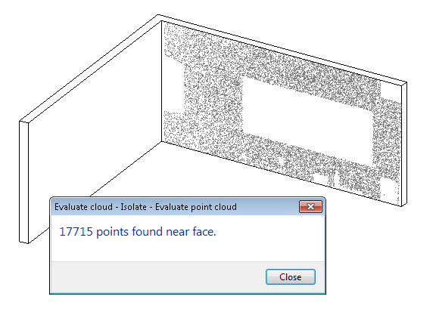
Point cloud analysis
Filters used to affect display
PointCloudInstance.SetSelectionFilter()
PointCloudInstance.FilterAction
None
Highlight
Isolate
Example: visual representation of how well a given element aligns with points in the point cloud

Slide 30
Conclusions

Slide 31
Learning Objectives
You have learned how to:
Extract and analyze the geometry of existing Revit elements
Create and manipulate temporary curve and solid geometry
Find elements by 3D intersection
Apply an ExtrusionAnalyzer to geometry
Utilize parts to analyze geometry of HostObjects and their layers
Extract and analyze the boundary geometry of rooms and spaces
Analyze the geometry of point clouds

Slide 32
Caveats
Keep edge cases in mind
Possible for users to model situations which don’t mesh well with the tools and might result in failure situations
Samples do not cover these situations are not handled robustly
Consider how robust solution should be: are there situations where it should or should not produce valid results?

Slide 33
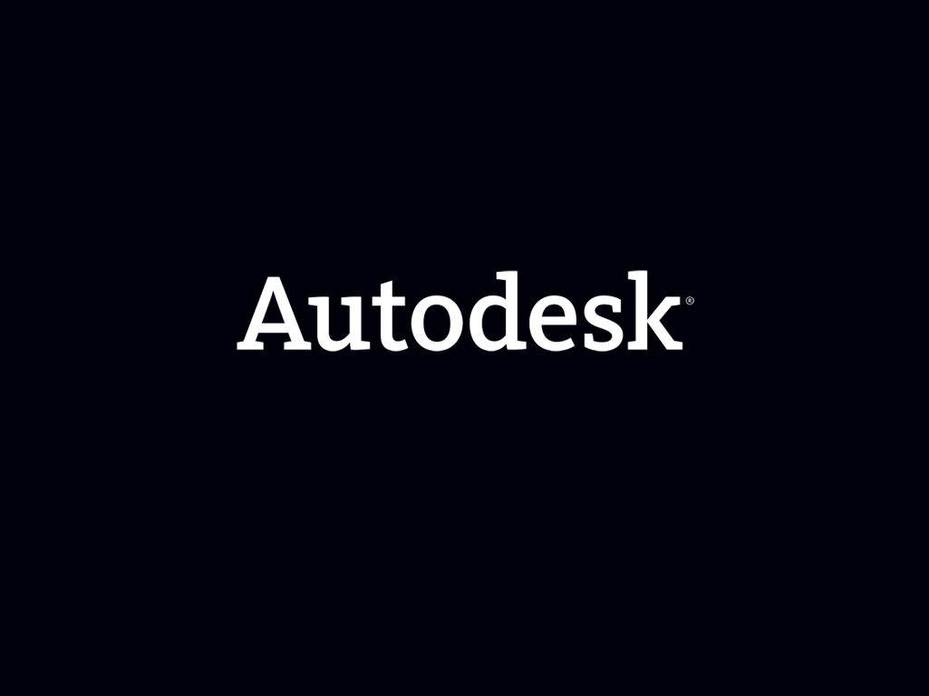
Autodesk, AutoCAD, Civil 3D, DWG, Green Building Studio, Navisworks, and Revit are registered trademarks or trademarks of Autodesk, Inc., and/or its subsidiaries and/or affiliates in the USA and/or other countries. All other brand names, product names, or trademarks belong to their respective holders. Autodesk reserves the right to alter product and services offerings, and specifications and pricing at any time without notice, and is not responsible for typographical or graphical errors that may appear in this document.
© 2012 Autodesk, Inc. All rights reserved.

