Slide 1







Revit Chronicle
Revit 2016
Revit 2015
Revit 2014
Revit 2013
Revit 2017
Revit 2012
Revit 2018
Revit 8.0
Revit 2011
Revit 2019
Revit 8.1
Revit 9.0
Revit 2009
Revit 1.0
Revit 2008
Revit 2010
Revit 2.0
Revit 2.1
Revit 3.1
Revit 4.0
Revit 4.1
Revit 4.5
Revit 3.0
Revit 5.0
Revit 5.1
Revit 6.1
Revit 6.0
Revit 7.0
2015
2010
2005
2000
Windows 8.1
Windows 10
Windows XP
Windows Vista
Windows 7
Windows 8
1995
64 bit
Windows NT 3.1
Windows 2000
Windows 10
Windows NT 4.0
Windows 8.1
Windows XP
Windows Vista
Windows 7
Windows 8
1990
32 bit
Windows 95
Windows 98
Windows Me
1985
32 & 16 bit
MS-DOS
Windows 3.1
Windows 3.0
16 bit

Slide 2
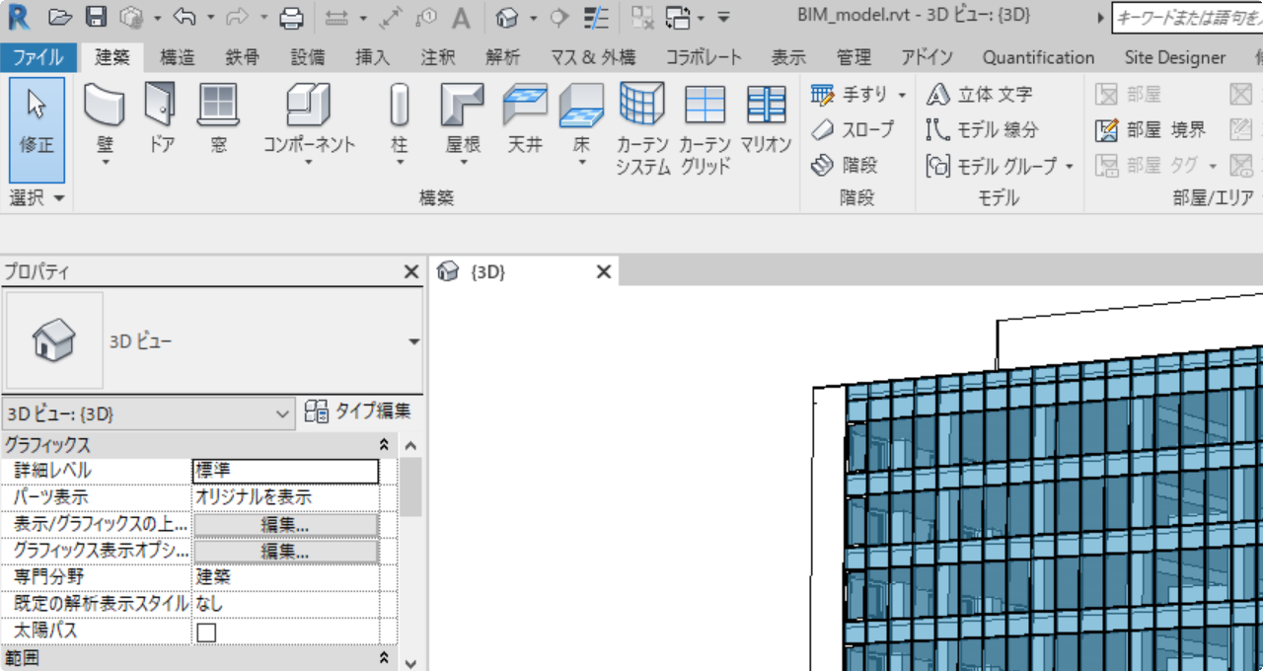
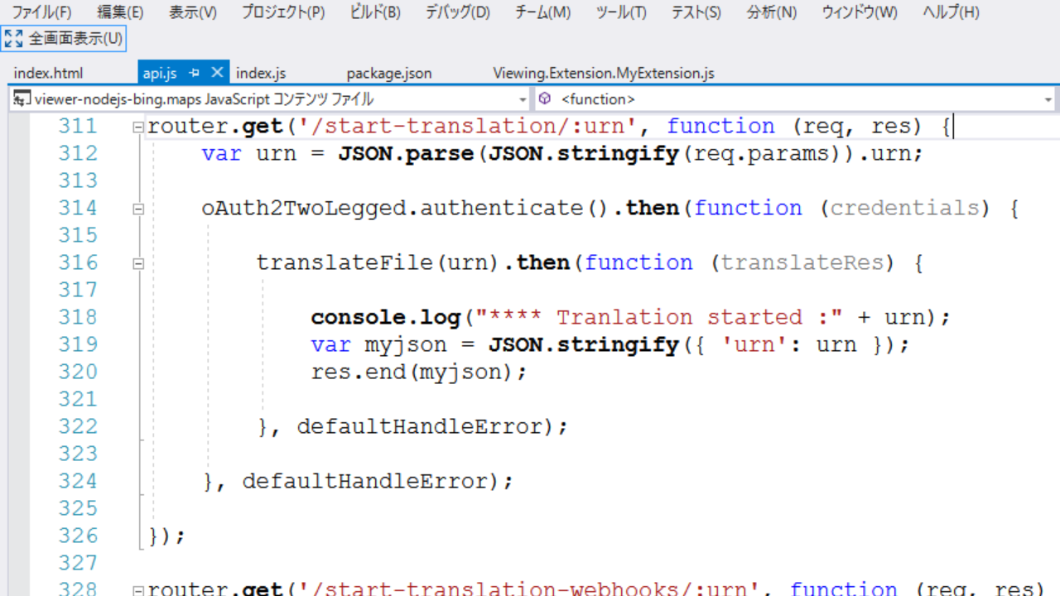


Revit Software
Two ways to access
Graphical
User Interface
Application Programming Interface

Slide 3



Programming Environment on Revit
Dynamo for Revit
Create Scripts using visual programming
Build-in development environment
SharpDevelop
Create Macros using programming language
Build-in development environment
Visual Studio
Create Add-ins using programming language
A.k.a, Add-on, Plug-in

Slide 4
Revit Chronicle
Add-In development
Revit 2016
Revit 2015
Revit 2014
Revit 2013
Revit 2017
Revit 2012
Revit 2018
Revit 8.0
Revit 2011
Revit 2019
Revit 8.1
Revit 9.0
Revit 2009
Revit 1.0
Revit 2008
Revit 2010
Revit 2.0
Revit 2.1
Revit 3.1
Revit 4.0
Revit 4.1
Revit 4.5
Revit 3.0
Revit 5.0
Revit 5.1
Revit 6.1
Revit 6.0
Revit 7.0
VSTA
2015
2010
Sharp Develop
2005
Dynamo for Revit
Revit API
2000
Windows 8.1
Windows 10
Windows XP
Windows Vista
Windows 7
Windows 8
1995
64 bit
Windows NT 3.1
Windows 2000
Macro development
Windows 10
Windows NT 4.0
Windows 8.1
Windows XP
Windows Vista
Windows 7
Windows 8
1990
32 bit
Windows 95
Windows 98
Windows Me
Script development
1985
32 & 16 bit
MS-DOS
Windows 3.1
Windows 3.0
16 bit

Slide 5



Technologies expose product functions as API
AutoCAD
AutoLISP: Original implementation within AutoCAD
ObjectARX: Native C++
AcviveX Automation: Component Object Model
AutoCAD .NET API: .NET Framework
Revit
Revit API: .NET Framework
Inventor
Inventor API: Component Object Model

Slide 6

Two sides .NET Framework has
Exposes functions
Exposed by assembly file(.dll)
Expoing Revit functions as API
RevitAPI.dll, RevitAPIUI.dll
Reuses exposed functions
Import assembly into IDE – Utilizing by programming
Create own assembly (.dll) by builing in IDE
>> Add-In file

Slide 7


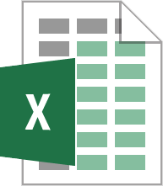
Programming Environment on Revit
Visual Studio
SharpDevelop
Dynamo
Revit API
Revit
.NET Framework
Windows
*.NET assembly perspective

Slide 8
Differences
 | Add-in | Macro | Dynamo Script
Programming method | Development Language C#,VB.NET | Development Language C#,VB.NET,Ruby,Python | Visual Programming Dynamo graph
Compile | X | X | -
Create Element | X | X | X
Modify Element | X | X | X
Select Element | X | X | X
Get Element Properties | X | X | X
Modify Element Properties | X | X | X
Import parameter file* | - | - | X
Export parameter file* | - | - | X
Revit UI Ribbon, Button | X | - | -
Scalability | .NET, COM Interop | .NET, COM Interop | Design Script,Python
*I/O to/from Excel or CSV file for elements proparties/parameters

