Slide 1
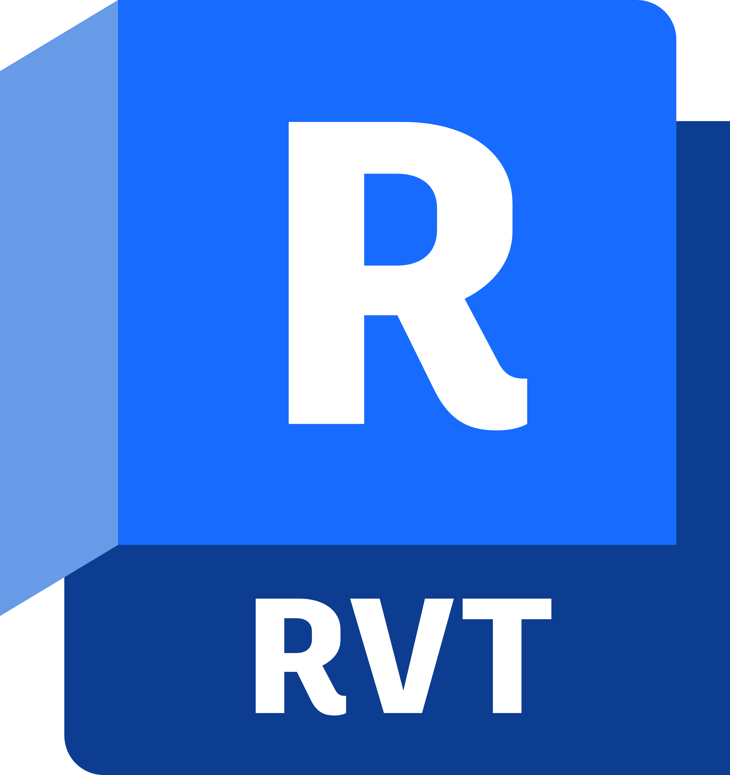

Revit 2025 Moving to Modern .NET Platform
.NET Core, NET 6.0 /7.0/8.0 and NET Platform all are synonyms indicating modern technology.
Managed API Layer
** No change in the product specific API, the underlying technology is changing.
Notes:
Revit 2025 is planning to target alphas for .NET 6.0 / .Net 7.0 and release versions to .NET 8.0.
Important - No change the API, only the underlying technology is changing.

Slide 2

Background Story
Since 2014 Microsoft has been on journey to transform .NET from a closed-source Windows-only technology to an open-source cross-platform set of libraries.
This new .NET was called .NET Core.
In 2020, the effort reached sufficient maturity that most "old" code targeting .NET could run on the new .NET Core.
To mark the occasion, the November 2020 release of .NET Core is branded ".NET 5.0". The "old" Windows-only .NET is now called ".NET Framework".
The last release of .NET Framework is versioned 4.8 hence the name ".NET 5.0" for the new release (they wanted to indicate that the new .NET supersedes the old one although its codebase is entirely different).

Slide 3
Motivation
Why we are moving to NET Platform
Growth Opportunity
Extinction Risk
Anticipated Performance Benefits
Notes:
Growth Opprutunity:
.NET is now cross platform. It is possible to run .NET code on MacOS, iOS, Android and even on the Web (using Web Assembly).
One day we could enable.NET development on all our platforms.
Developers with existing .NET code on Windows could port their code to Mac, Web, Mobile.
Extinction Risk:
Microsoft announced that NET framework 4.8.x will be the last major version of the .NET framework, and .NET Core is where future investments in .NET will happen.
While Microsoft promises to keep the .NET Framework alive (it is part of Windows!), staying on a technology foundation that is in maintenance mode will decline Autodesk appeal.

Slide 4
Growth Opportunity
.NET is now cross platform
The NET framework has been re-invented, and what was once limited to Windows is now officially portable and runnable on just about any platform you need.
One day we could enable .NET development on all our platforms.
Developers with existing .NET code on Windows could port their code to Mac, Web, Mobile.
One Consistent API
.NET provides a standard set of base class libraries and APIs that are common to all .NET applications.
Global Appeal
According to the latest Stack Overflow Survey, NET Core is one of the most used frameworks, being the second server-side development framework after Node.js.
To extend functionality, Microsoft and others maintain a healthy .NET package ecosystem.
Notes:
https://survey.stackoverflow.co/2022

Slide 5
Extinction Risk
Microsoft announced that NET framework 4.8.x will be the last major version of the .NET framework, and .NET Core is where future investments in .NET will happen.
While Microsoft promises to keep the .NET Framework alive (it is part of Windows!), staying on a technology foundation that is in maintenance mode will decline Autodesk appeal.

Slide 6
Anticipated Performance Benefits
.NET is anticipated to be fast.
That means applications may provide better response times and require less compute power.

Slide 7
Expectations from Revit 2025 Moving to Modern .NET Platform
Stay tuned for a Revit 2025 preview release with modern .NET platform in Fall 2023. Exact version of the .Net version used (6.0 or 7.0 or 8.0) will be announced closer to the preview release.
Revit Macro Manager will be updated to fit the modern .NET platform
The updated Revit Macro Manager will use Microsoft Visual Studio Code as the code editor. C# will be the only language users can choose to write macros in Revit 2025.
Macros created in the previous versions will not work in Revit 2025. Users can follow the guidance provided by the Revit team to upgrade these macros to fit the modern .NET platform manually.
Document Level Macros will no longer be supported. Any Doc macros embedded with Revit files will be deleted when these files upgrade to Revit 2025. Users can still access these macros in any Revit version before 2025 and follow the guidance to convert these macros to Application-level macros manually.

