Slide 1
Memory Access Analyzer
Jeremy Vestal

Slide 2
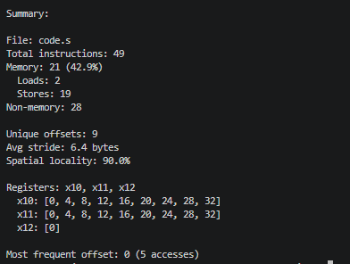
Purpose:
Reads a .s file (assembly file), traces and parses each instruction, and keeps track of all memory-specific instructions.
Counts (load/store)
Address accesses
Stride patterns
Registers and offsets used

Slide 3

Key code structure:
Once per file (start)
Handles all instructions
Checks for store/load, otherwise unknown
If empty or comment (//) skips
Stats tracked:
Instruction count (total, load, store, unknown)
Address Counts
Last offset
Strides
Registers used
Register Accesses
Stats calculated:
Memory % = (loads+stores)/100
Unique offsets = len(address_counts)
Avg stride = sum(strides)/len(strides)
Spatial locality = (strides<= 16)/ len(strides)*100
Most frequent offset max
Loops per instruction
Once per file (end)

Slide 4
Useful Definitions:
Temporal Locality - Same address accessed multiple times (Most frequent offset)
Spatial locality - Accessing nearby addresses sequentially (0,4,8,12…)
Stride - Distance between consecutive mem accesses
Load instructions: lw, lb, lh, lbu, lhu,
Store instructions: sw, sb, sh
Syntax: op rs2, imm(rs1) - load/store/unknown, offset, guide, register accessed

Slide 5
DEMO
Note: I did not make the code.s file

Slide 6
Results / Findings
Memory Instruction Mix
90% spatial locality is strong
Most access are 4 bytes apart
Better cache performance (time to prefetch data)
Good Temporal Locality
0 is the most frequent offset
Cache performs better if it can use the same data repeatedly
3 Registers used: 2 access sequentially, 1 doesnt
New concepts (locality/ strides)
Parsing had to be designed to work around commas comments, and empty lines
I had a double counting error with my unknown handling
Visible stride patterns through the first 90% of the program’s memory instructions

