Slide 1


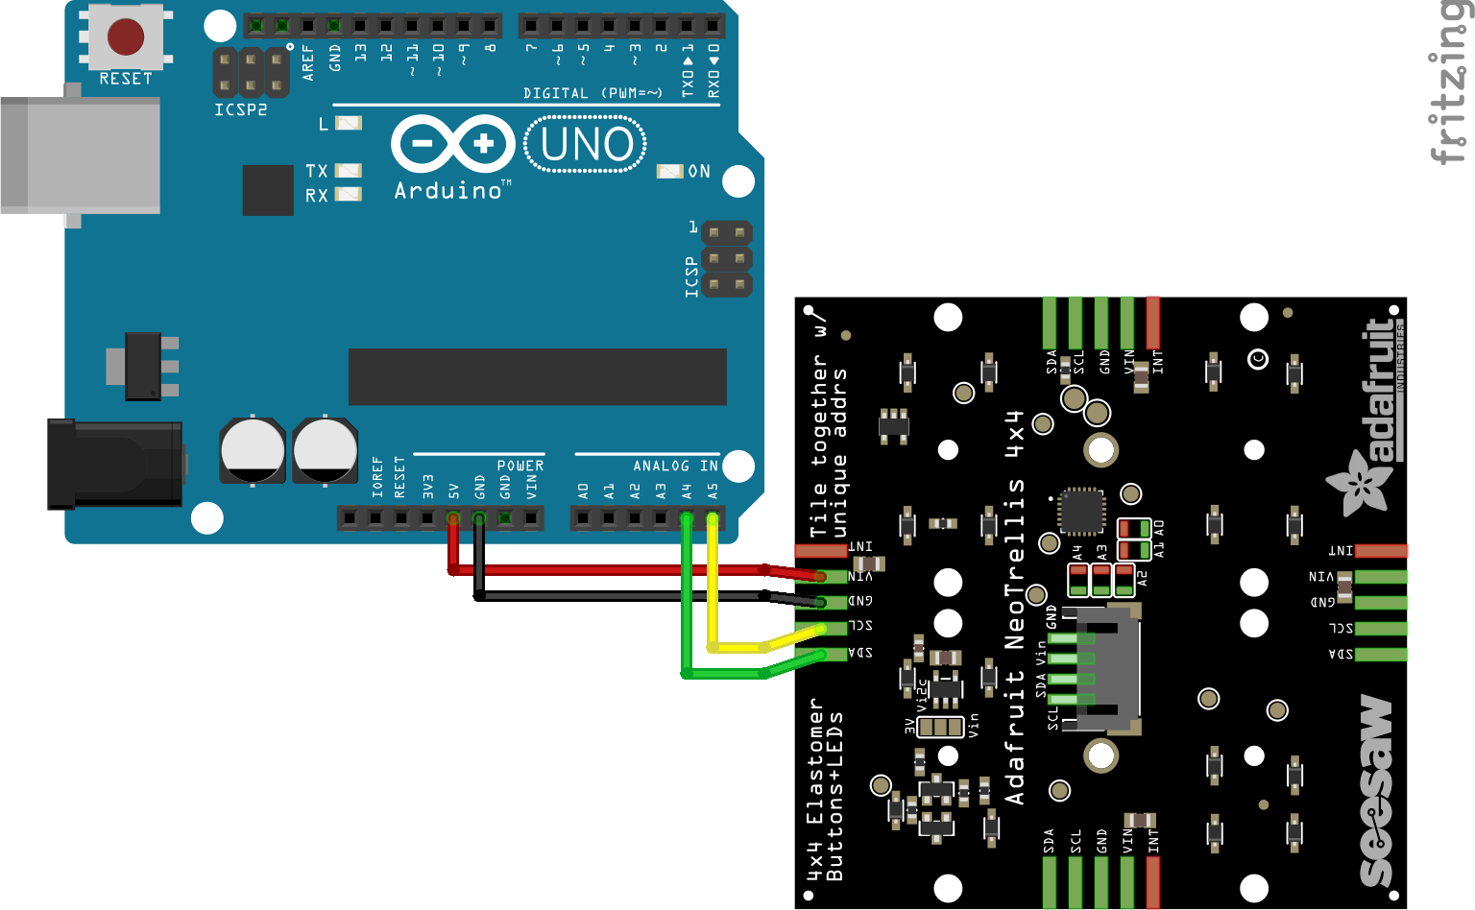
Button Hero
Jeremy Yew, Kristina Shia
Pseudocode
Goals and Implementation
Components
setup serial communication
load song file and button prompts
start music
for duration of song:
calculate current beat based on time elapsed and beats/second
if moving onto new beat:
light up buttons that should be pressed for current beat
light up buttons to hint for next beat
turn off all other button lights
read serial input to process incoming button presses
change button color based on correct/incorrect button press, and record score
calculate and display final score
Goal: build a simple music rhythm game in which a sequence of buttons must be pressed in time to the music being played.
Similar to Tap Tap Revenge/Guitar Hero/Dance Dance Revolution, but with a LED-lit button keypad, to combine visual and audio feedback with physical buttons.
Basic requirements:
Play music track
Light up sequence of buttons in time to music
Change light color and record score if button is pressed at correct time
Implementation:
Set up I2C communication between Arduino and NeoTrellis keypad
Poll button state/light up buttons with Trellis library
Set up serial communication between Arduino and PC, using Serial.write() on Arduino and pyserial for PC
Define single-byte serial messages (button press, light up button)
PC
Python program
“Light up button x with color c”
(Serial over USB)
“Button x pressed”
Arduino Uno
Sketch
send button state updates
poll NeoTrellis
for button state
Representation of button prompt sequence:
(I2C)
// Every prompt lasts one beat, and prompts can be inserted at any beat.
prompts = {
// beat : button numbers
0: [0, 4],
2: [1, 2], // On beat 2, prompt buttons 1 and 2.
8: [0]
10: [1, 2, 3, 5]
…
}
NeoTrellis Keypad
Challenges and Limitations
Initially intended to play notes or loops via MIDI (Musical Instrument Digital Interface) messages as audio feedback.
However, MIDI API is limited.
Furthermore, complicated to play specific notes in sync with music.
So we decided to go with visual feedback only.
Playing music from Arduino requires extra storage for sound files. So we decided to run game and play music from PC.
Circuit Schematic
Arduino Uno to Adafruit NeoTrellis

