Slide 1
LEGEND
How to read the next two slides
Deterministic
AI (LLM / vision)
Human / AT
Reads the file's own tags, metadata & colours and fixes by script. No human needed.
A model reads content or images to detect, judge or draft. A human then confirms.
A specialist or assistive-tech tester verifies and signs off the result.
ASSESSMENT TERMS (how we detect)
REMEDIATION TERMS (how we fix)
Static parse checks the document's own tags, metadata and colour values — gives a clear pass/fail.
Auto- deterministic platform fix (auto-tag, auto-set, auto-recolour) — runs without a human.
Static, flag only spots risk signals but can't confirm pass/fail without running the file; sent to a human.
AI draft / rewrite AI generates the fix (alt text, reworded cue, link text); a human then approves it.
AI detect / scan a model finds the issue: a foreign-language passage, a sensory instruction, text inside an image.
OCR → text converts an image of text into real, selectable, taggable text.
AI judge a model rates quality — is the heading descriptive? does the link text make sense?
+ Human / + Design a specialist (or designer) validates and signs off before it counts.
Why human? the specific reason a person must sign off, even when the platform does the heavy lifting. * interactive PDFs / fillable forms only — not static documents.
Mova iO AccessOps · Documents
1

Slide 2
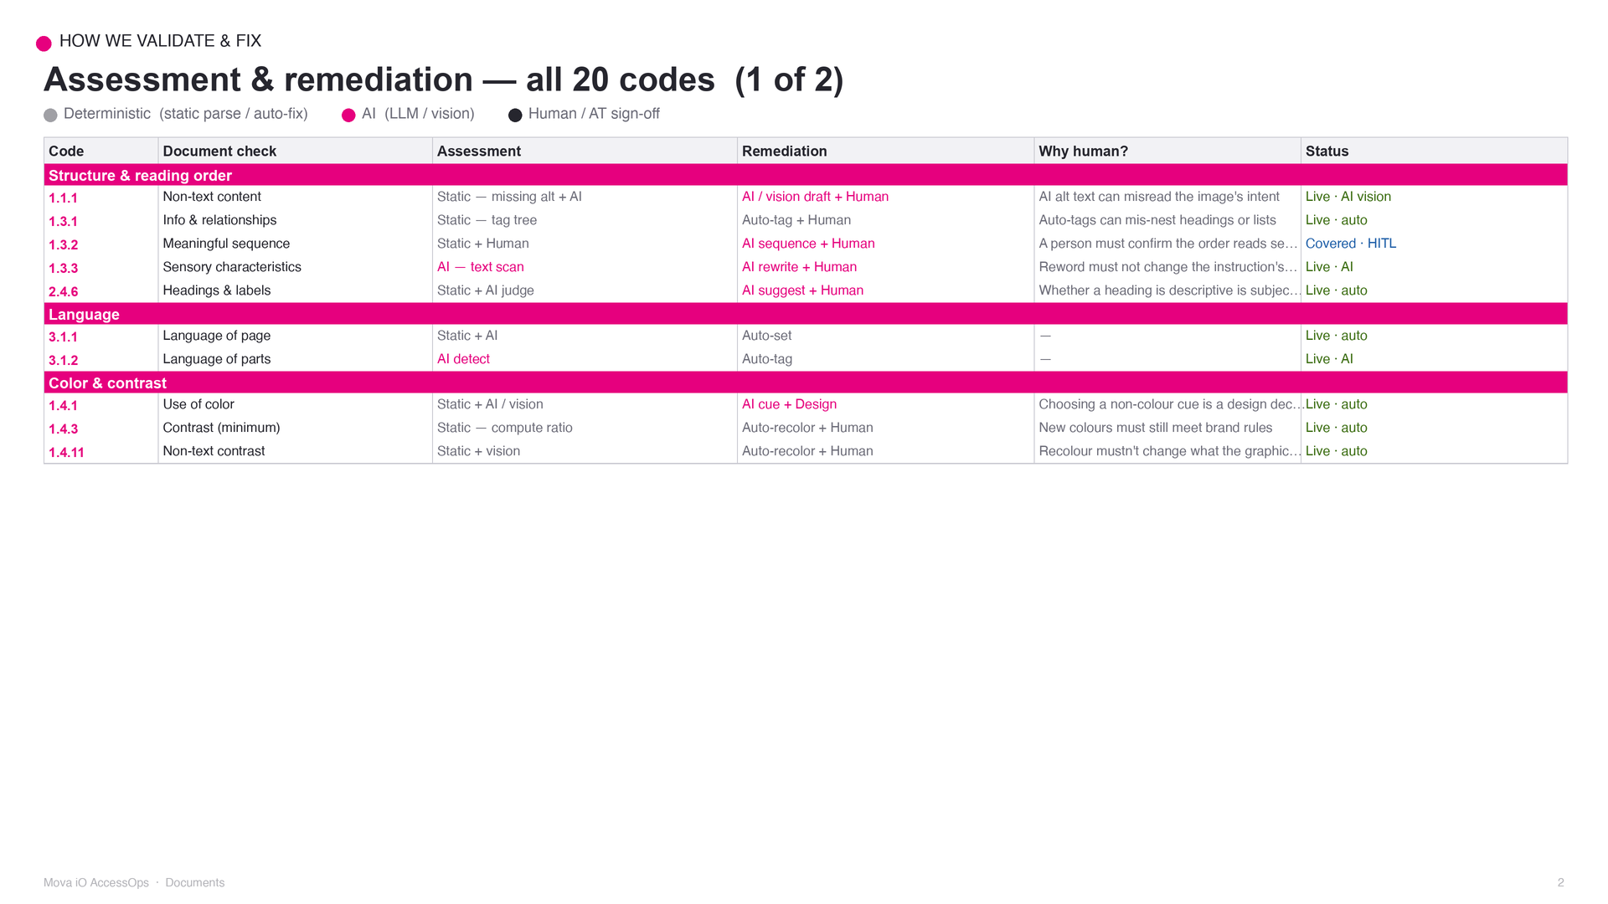

Slide 3
