Slide 1
Q2 2026 Quarterly Town Hall
UT Southwestern Medical Center · June 19, 2026
Presented by Jordan Rivera, Chief Operating Officer
CONFIDENTIAL — For internal distribution only

Slide 2
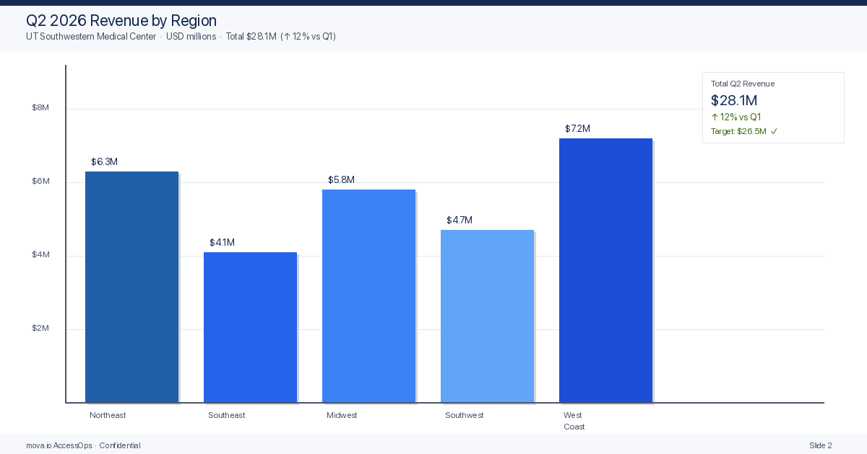

Slide 3
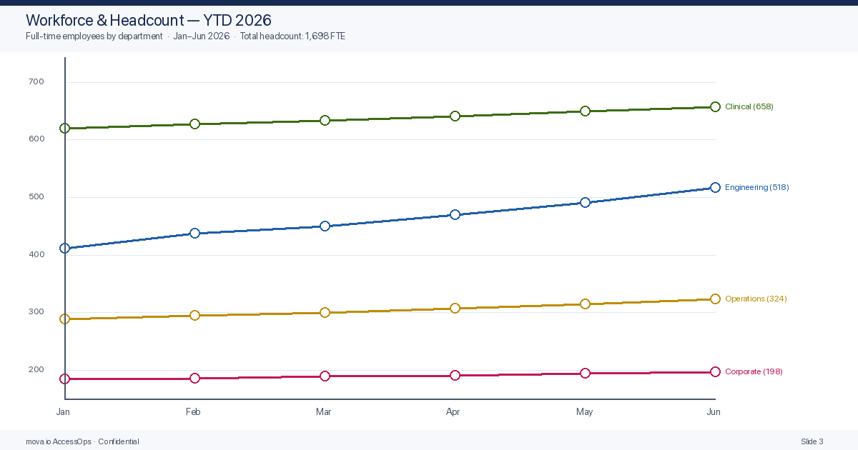
Workforce & Headcount

Slide 4
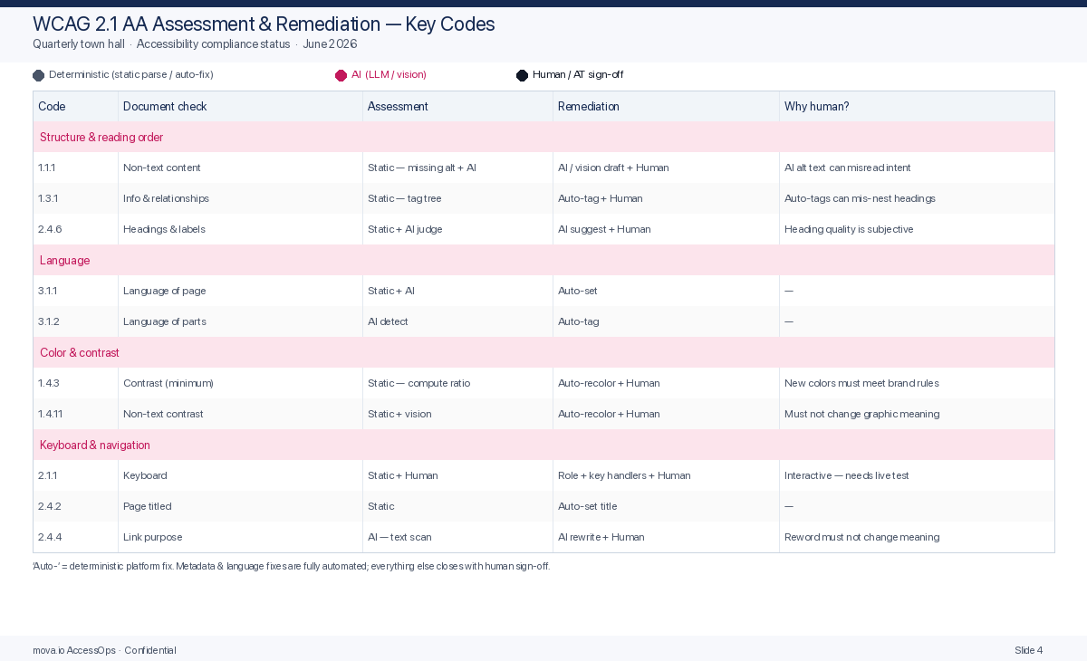

Slide 5
H2 2026 Strategic Priorities
Electronic Health Records migration — go-live August 1
Telehealth expansion — 4 new clinics in Southwest region
Staff retention program — $2.4M investment, Phase 1 active
WCAG 2.1 AA compliance — 100% of patient portals by Q4 2026

