Slide 1
Comprehensive Power BI Project Presentation
Data Drifters: Jereshan Sinan Fikile Noyila Lesedi Mphachake Kaylene Martins Thato Msina
Notes:
AI-generated content may be incorrect. ---

Slide 2
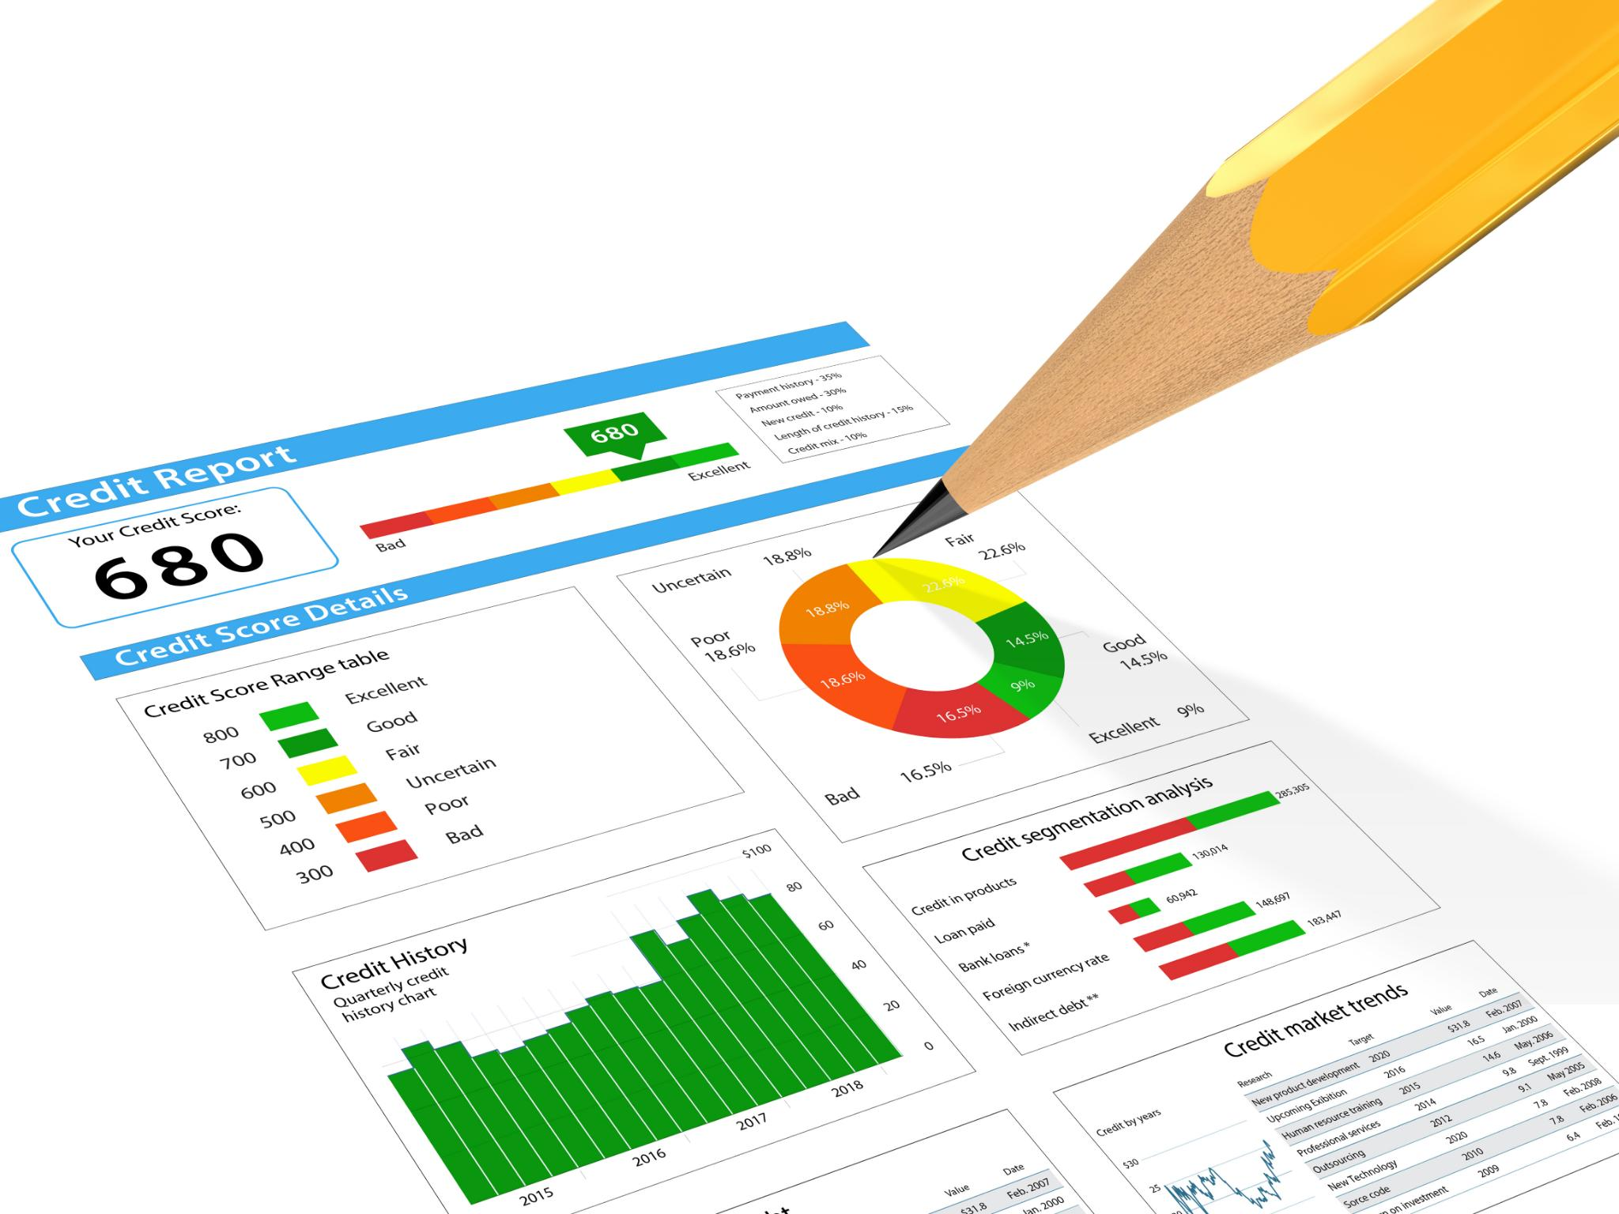
End-to-End Solution Summary
Data Engineering and Transformation
The solution uses Power Query to ingest and transform raw sales and business data into enriched datasets with calculated metrics.
Robust Data Governance
Governance ensures data integrity, access control with Role Level Security, and lineage tracking across development and production environments.
Semantic Data Modeling
Constructing a semantic model with fact and dimension tables to support high quality analytics and calculations using DAX.
Dynamic Analytical Dashboards
Two dashboards provide strategic and operational insights, highlighting trends in revenue, expenses, profit, and customer satisfaction.
Notes:
This slide provides a comprehensive summary of the end-to-end Power BI analytics solution developed across three integrated components: Data Engineering, Data Governance, and Business Intelligence. The project leverages Power BI as the central toolset, using Power Query for ETL operations, Power BI Desktop for data modelling and visualization, and DAX for analytical calculations. The solution begins with ingestion and transformation of raw sales and business performance datasets, focusing on combining multi‑year sales files, enriching them with product master data, and applying calculated transformations such as revenue metrics and temporal attributes. The project also includes constructing a robust semantic data model featuring a fact table and multiple dimension tables to support high‑quality analytical outputs. Governance principles were embedded into the build, ensuring that data integrity, access control, and lineage tracking are preserved throughout the analytics lifecycle. This includes the implementation of Role‑Level Security (RLS), documentation of dataset lineage, and appropriate workspace role assignments to maintain controlled access across development, testing, and production environments. The solution culminates in the creation of two dynamic dashboards: an Executive Summary designed for strategic, high‑level decision‑making and a Detail View supporting operational analysis with drill‑downs by department and region. Together, these dashboards highlight trends in revenue, expenses, profit, and customer satisfaction while enabling slice‑and‑dice analysis for deeper insight. By integrating engineering, governance, and reporting best practices, the completed Power BI solution demonstrates a full lifecycle analytics project that transforms raw, siloed data into actionable business intelligence suitable for organizational decision‑making.

Slide 3
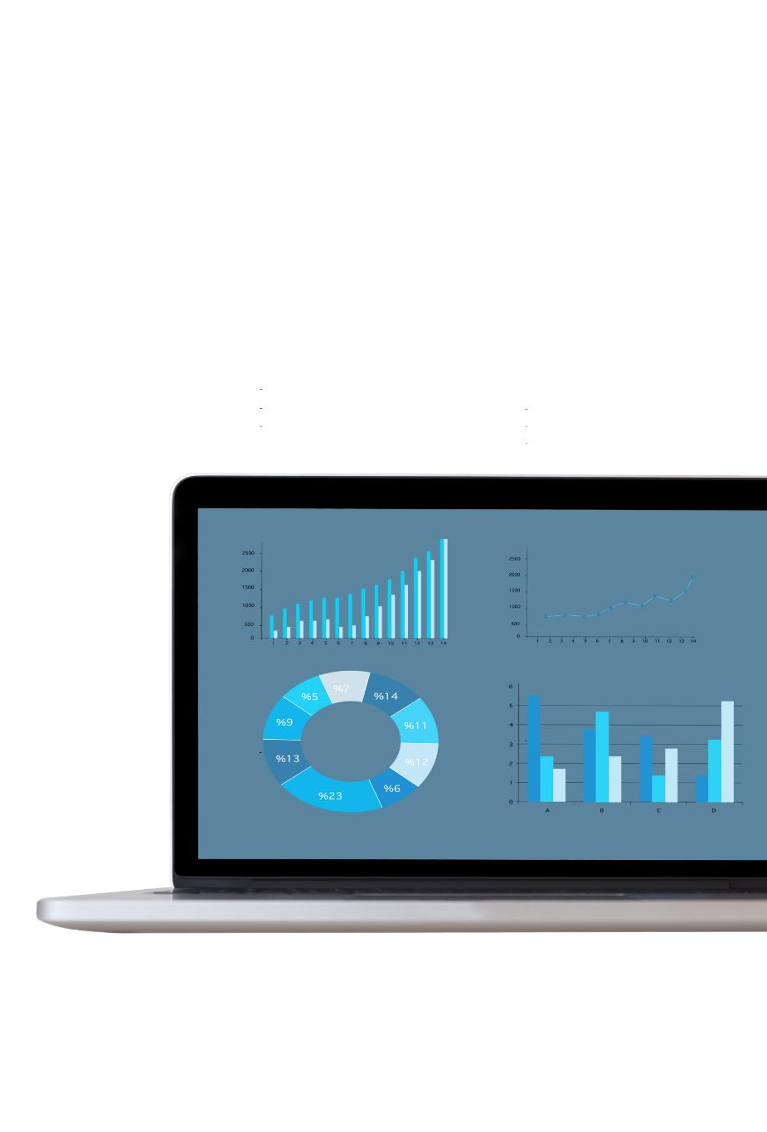
Tools and Technologies Applied
Central Development Environment
Power BI Desktop was the core tool for building data queries, models, DAX measures, and dashboards.
ETL and Data Transformation
Power Query enabled ETL tasks like appending sales data, merging metadata, and column transformations.
Data Modeling and Governance
Power BI’s data modeling supported star-schema designs; governance ensured compliance with role assignments and data lineage.
Analytical Measures and Navigation
DAX formulas created key measures; navigation buttons enhanced dashboard user experience.
Notes:
This slide details the primary tools and technologies used throughout the project, emphasizing their roles in ensuring a structured and efficient data analytics workflow. Power BI Desktop served as the central development environment, enabling the construction of data queries, data models, DAX measures, and visual dashboards. Power Query, embedded within Power BI, was instrumental for ETL operations including appending multi‑year sales data, merging with product metadata, and applying column transformations such as computed revenue fields and year extraction for time‑based analysis. Power BI’s data modelling features enabled the creation of a star‑schema‑aligned semantic model with a fact table and associated dimensions. Governance tools within Power BI Service, including role assignments and data lineage tracing, solidified compliance with data management requirements. Additional technologies included CSV data files used as the primary inputformat for sales, product, and business performance figures. These files illustrate common organizational data storage structures and highlight the importance of applying standard cleansing and combination techniques to yield unified datasets. DAX (Data Analysis Expressions) was employed for the creation of analytical measures—such as Total Revenue, Total Expenses, Profit, and Average Customer Satisfaction—which provide critical insights and calculations beyond basic transformations. Navigation elements such as on‑page and cross‑page buttons were incorporated to enhance user experience and create a seamless interaction flow between dashboards. Collectively, these tools formed a cohesive ecosystem allowing for integrated data ingestion, transformation, modelling, and reporting. Their combined use demonstrates the versatility and scalability of Power BI as an enterprise analytics solution.

Slide 4

Sales and Product Datasets
Sales Data Overview
Sales_2024.csv and Sales_2025.csv contain detailed transactional records over two years with key fields for analysis.
Data Consolidation
Power Query appends yearly sales datasets into a unified table enabling comprehensive longitudinal reporting.
Product Data Integration
Products.csv dataset is merged with sales data to enrich transactions with product names and categories.
ETL and Analytics Preparation
Append and merge operations demonstrate ETL workflows essential for creating analytics ready fact tables.
Notes:
This slide outlines the core datasets used for the project’s data engineering and modelling components. The Sales_2024.csv and Sales_2025.csv files provided transactional sales records across two calendar years. These datasets typically contain fields such as Date, Region, ProductID, Quantity, and UnitPrice, enabling multi‑dimensional analysis. The two yearly datasets required consolidation to support longitudinal reporting. Power Query was used to append both datasets into a unified table capturing all sales transactions. This consolidated dataset formed the basis for calculating important metrics, including TotalSales derived from multiplying Quantity and UnitPrice, and extracting temporal information such as Year from the transaction date. The Products.csv dataset contained product master data, such as ProductID, ProductName, and Category. Using Merge Queries, this dimension was joined with the appended sales table to enrich transactional records with descriptive product information. This join process supports advanced analytics such as product‑level performance, category‑level sales aggregation, and strategic decision‑making related to product mix optimization. The combination ofappend and merge operations demonstrates practical ETL workflows essential for creating well‑structured fact tables in Power BI. These source datasets were selected because they represent common enterprise data domains—sales and product information—making them highly relevant for demonstrating real‑world analytics practices. Working with multiple raw datasets also highlights typical challenges such as inconsistent formatting, varying date structures, and the need for standardized transformations to prepare data for downstream analysis and reporting.

Slide 5
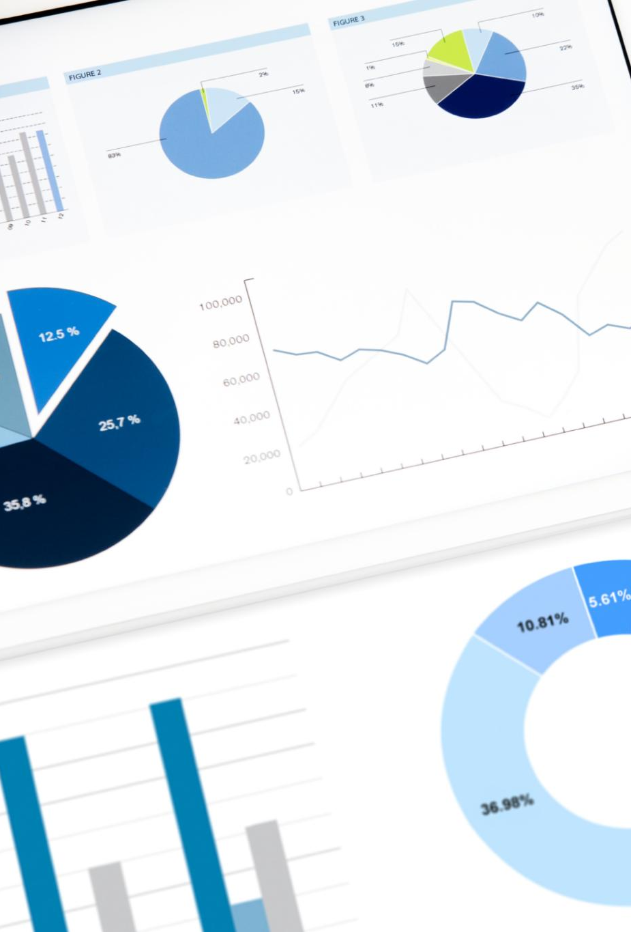
Business Performance Dataset
Dataset Contents
The dataset includes Revenue, Expenses, Profit, Department, Region, and Customer Satisfaction metrics for comprehensive analysis.
Analytical Measures
Power BI and DAX measures like Total Revenue, Expenses, Profit, and Average Satisfaction provide key business insights.
Dynamic Segmentation
Region and Department slicers enable interactive drill-downs for detailed performance segmentation.
Comprehensive Reporting
Combining financial and customer experience data delivers granular and aggregated insights for decision making.
Notes:
This slide describes the Business_Performance.csv dataset, which serves as the foundation for the business intelligence reporting developed in Part 3 of the project. The dataset contains organizational performance metrics such as Revenue, Expenses, Profit‑related fields, Department classifications, Region identifiers, and Customer Satisfaction ratings. These metrics are essential for constructing both the Executive Summary and Detail View dashboards. Power BI was used to ingest this dataset and build relevant DAX measures including Total Revenue, Total Expenses, Profit (defined as Revenue minus Expenses), and Average Customer Satisfaction. These measures provide high‑level insights into financial performance and customer experience trends. The dataset further supports departmental and regional analyses used for drill‑down capability. By incorporating region and department slicers, end‑users can dynamically segment performance results based on organizational structure. The structure of this dataset highlights the importance of having clean, well‑labeled attributes for business reporting. It also demonstrates how combining financial and customer experience data can yield comprehensive insights across multiple operational dimensions. The dataset's versatility enables both aggregated KPI views and granular departmental breakdowns, fulfilling the analytical needs of executives, analysts, and operational managers. This dataset forms the backbone of the dashboards created and helps illustrate how organizational data can be transformed into meaningful, decision‑supportive information through structured modelling and visualization practices.

Slide 6

Power Query Transformations
Data Import and Preparation
Imported raw datasets were cleaned with data type correction and column renaming to ensure consistency.
Appending Sales Data
Sales_2024 and Sales_2025 datasets were appended to create a unified dataset for multi year analysis.
Calculated Columns Creation
A TotalSales column was created by multiplying Quantity and UnitPrice for transaction revenue calculation.
Merging with Product Data
Merged sales data with Products table using ProductID to enrich transactions with product details.
Notes:
This slide provides a detailed walkthrough of the ETL processes implemented using Power Query. The workflow began with importing three raw datasets—Sales_2024.csv, Sales_2025.csv, and Products.csv—into Power BI. These datasets underwent standard data preparation steps such as data type correction, column renaming, and ensuring consistency in formats across the two sales files. The Append Queries feature was used to combine Sales_2024 and Sales_2025 into a single unified dataset that captures all sales activities across multiple years. This step is essential for ensuring longitudinal comparability and enabling year‑based aggregation in later analysis. Next, a calculated column named TotalSales was created in Power Query or via DAX to compute total revenue at the transaction level by multiplying Quantity and UnitPrice. A Year column was extracted from the Date field to support time intelligence and enable grouping of sales data by calendar year. Merge Queries was then used to join the unified sales table with the Products table on the ProductID field, enriching transactional data with product descriptions. Each applied step in Power Query was documented in the query pane, ensuring transparency and traceability for audit and governance purposes. These transformations illustrate industry‑standard ETL practices using Power Query, demonstrating how raw transactional files can be methodically transformed into well‑structured and analytics‑ready tables suitable for fact table construction, modelling, and dashboarding.

Slide 7

Fact and Dimension Structure
Central Fact Table
The Sales_Fact table holds transaction-level data including Date, ProductID, Region, Quantity, UnitPrice, and TotalSales for aggregation.
Dimension Tables
Dimension tables like Products and Regions contain descriptive attributes supporting detailed data slicing and filtering.
Star Schema Relationships
Fact and dimension tables are linked by keys such as ProductID and Region, optimizing for star schema and reducing redundancy.
Performance and Governance
Model supports efficient DAX calculations, scalable reporting, and row-level security for controlled data access.
Notes:
This slide explains the semantic data model created to support efficient reporting and analysis. The central component of the model is the Sales_Fact table, derived from the appended and enriched sales dataset. This fact table contains transaction‑level details including Date, ProductID, Region, Quantity, UnitPrice, and TotalSales. It provides the numerical values required for aggregation across multiple analytical perspectives. Dimension tables include the Products table, containing attributes such as ProductName and Category, and a Regions dimension derived from the sales records or an external source, depending on data availability. The Year attribute derived during ETL can also function as a time dimension attribute to support chronological reporting. Relationships between the fact and dimension tables were defined using key fields such as ProductID and Region. These relationships optimize the model for star‑schema architecture, reducing data redundancy and supporting performant DAX calculations. The structured model allows users to create visualizations that slice data by product, year, and region without performance degradation. This modelling approach showcases best practices in BI system design, enabling clarity, scalability, and flexibility in reporting workloads. It also supports downstream governance features such as row‑level security at the dimension attribute level.

Slide 8

Governance Practices Implemented
Role-Level Security
Role Level Security restricts data access based on user roles to ensure confidentiality and prevent unauthorized viewing.
Data Lineage Documentation
Data lineage tracks the flow of data from raw datasets through transformations to dashboards, supporting auditability.
Workspace Roles and Permissions
Workspace roles define clear access levels including administrators, contributors, and viewers to maintain separation of duties.
Alignment with SFIA DATM
Governance aligns with SFIA DATM level emphasizing data lifecycle management, integrity, and compliance.
Notes:
This slide outlines the governance measures applied to ensure data reliability, security, and compliance across the analytics workflow. The first governance component implemented is Role‑Level Security (RLS), which restricts data visibility based on user roles. For example, region‑specific managers can be limited to viewing data only for their assigned regions, ensuring confidentiality and preventing unauthorized access. Next, Data Lineage was documented using Power BI Service’s lineage view and supplementary documentation describing how raw datasets flow through transformations to the final dashboards. This lineage documentation supports auditability and helps stakeholders understand dependencies across datasets and reports. Workspace roles and permissions were configured to ensure proper separation of duties. Administrators were given full control, while contributors and viewers had limited access appropriate for their responsibilities. In addition to these measures, the project aligns with SFIA (Skills Framework for the Information Age) level DATM, emphasizing data management disciplines such as data lifecycle oversight, integrity preservation, and governance compliance. The combined governance features ensure that the analytics environment adheres to organizational policies, minimizes risk, promotes trust in insights generated, and provides a secure and transparent data ecosystem suitable for enterprise‑grade BI deployments.

Slide 9
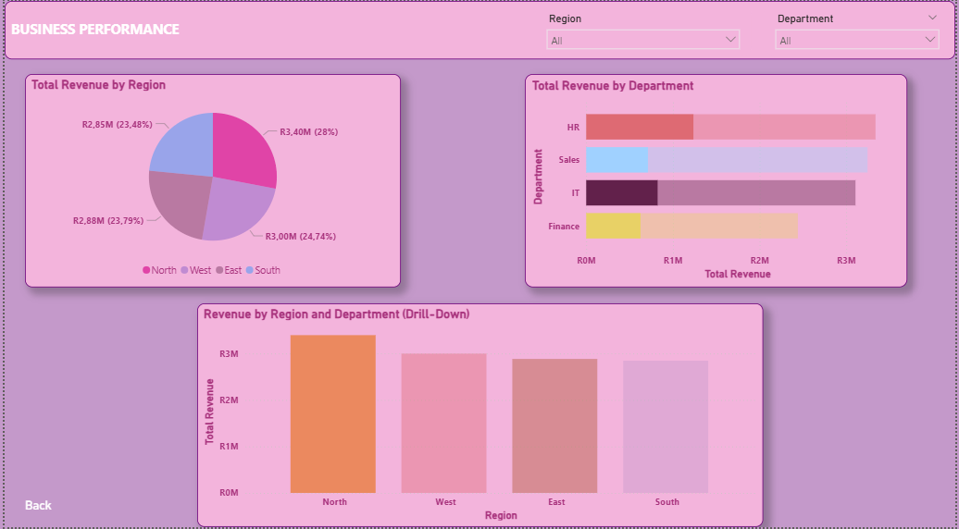
Executive Summary Dashboard
Key Performance Indicators Dashboard highlights Total Revenue, Expenses, Profit, and Customer Satisfaction using dynamic DAX calculations. User-Friendly Design Clean layout with card visuals, summarized charts, and slicers enables quick senior leader insights. Navigation and Usability Includes Next button for seamless transition from summary to detailed operational views. Rich Drill-Down Insights The dashboard provides detailed, drill-down insights into revenue and performance by department and region. Interactive Filtering Tools Interactive slicers allow filtering by department and region, enabling exploration of operational segment performance. Enhanced Navigation A Back button facilitates easy navigation to the Executive Summary, supporting iterative data exploration. Supports Root Cause Analysis This dashboard helps identify factors driving revenue, expense, and customer sentiment changes for better decisions.
Notes:
This slide presents the structure and key elements of the Executive Summary dashboard developed in Power BI. The page includes critical organizational KPIs such as Total Revenue, Total Expenses, Profit, and Average Customer Satisfaction. These KPIs are calculated using DAX measures, enabling aggregation across the entire dataset and dynamic recalculation when filters or slicers are applied. The design of the page focuses on delivering high‑level insights suitable for senior leaders who require a quick understanding of overall business performance without navigating through detailed analytical components. Visual elements such as card visuals for KPIs, summarized charts,and strategically placed slicers create a cohesive and visually appealing interface. This summary dashboard serves as the primary entry point for the BI solution and provides users with immediate clarity on financial and customer experience outcomes. It also includes navigation elements, specifically a Next button that directs users to the Detail View page, ensuring a seamless user experience while transitioning from strategic overview to operational insights.

Slide 10
Insights Discovered
Revenue Trends and Seasonality
Revenue trends reveal seasonal effects and peak periods to improve forecasting and planning accuracy.
Regional Performance Variations
Comparative regional analysis identifies distinct performance differences, guiding targeted sales strategies.
Product-Level Sales Insights
Product category analysis shows top contributors and those needing marketing or pricing adjustments.
Customer Satisfaction Patterns
Customer satisfaction metrics reveal patterns linked to departments or regions for service improvements.
Cost-Efficiency Opportunities
Analyzing revenue, expenses, and profit highlights areas with disproportionate costs for optimization.
Notes:
This slide summarizes the major analytical insights generated from the dashboards. Revenue trends across the two years demonstrate seasonality effects and highlight peak performance periods that can guide forecasting activities. Comparative analysis across regions reveals distinct performance variations, indicating opportunities for targeted sales strategies. Additionally, product‑level insights derived from the merged dataset show which product categories contribute most significantly to total sales and which may require marketing or pricing adjustments. Customer Satisfaction metrics indicate patterns linked to specific departments or regions, offering actionable intelligence regarding service improvements. The interplay between revenue, expenses, and profit allows the identification of cost‑efficiency opportunities, showing where expenses may be disproportionately high relative to revenue. These insights collectively demonstrate the value of combining multiple datasets into a unified analytics framework, enabling organizations to move from raw data toward meaningful interpretation and informed decision‑making.

Slide 11
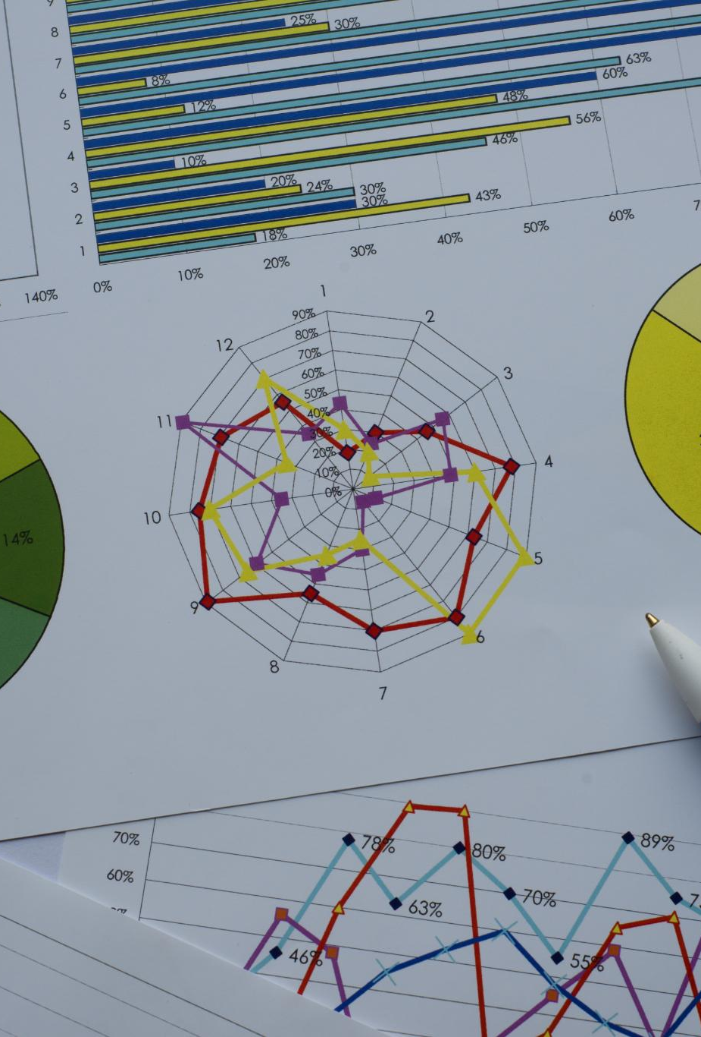
Business Recommendations and Project Learnings
Business Action Recommendations
Increase investments in high-performing regions and target improvements in underperforming areas based on sales data insights.
Product and Customer Strategy
Adjust product mix based on category performance and enhance customer satisfaction initiatives to improve sentiment metrics.
Project Execution Learnings
Maintain clean data, proper documentation, and apply governance early to ensure smooth project execution and compliance.
Technical Skill Advancements
Enhanced skills in Power Query, DAX, and dashboard design contribute to improved analytics project outcomes and usability.
Notes:
This slide provides actionable recommendations based on the insights derived from the analytics solution, as well as key learnings from the project. Recommended business actions include increasing investment in high‑performing regions where sales figures demonstrate strong upward trends and focusing targeted improvements on underperforming regions identified through the regional breakdown. Product mix adjustments are advised based on identifying top‑ and bottom‑performing product categories. Additionally, enhancing customer satisfaction initiatives may yield meaningful improvements in sentiment metrics, especially in departments showing lower‑than‑expected ratings. From a project execution perspective, several learnings emerged: the importance of maintaining clean and consistent data structures across datasets; the need for proper documentation throughout ETL, modelling, and dashboarding processes; and the value of applying governance practices early to avoid downstream issues. Implementing RLS and documenting lineage also emphasized the critical role governance plays in creating secure, compliant analytics environments. Technical learnings include improved proficiency in Power Query transformations, DAX measure creation, and designing intuitive, user‑friendly dashboards. These experiences contribute to stronger future project execution and reinforce the benefits of adopting a structured, governance‑aligned approach to enterprise analytics.

