Slide 1
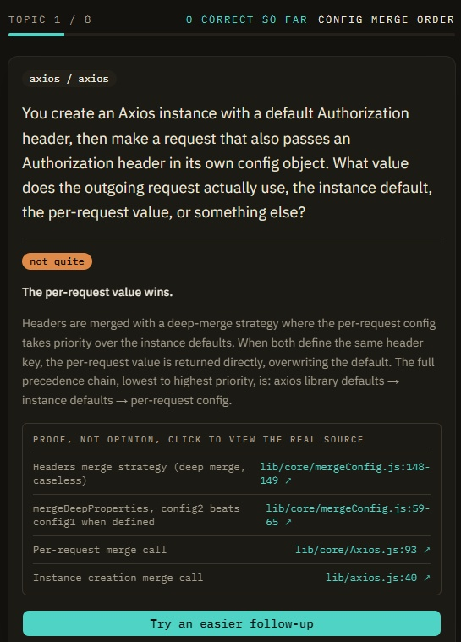
IBM BOB 2.0 HACKATHON
Prove Me Wrong
Onboarding as a conversation, powered by IBM Bob 2.0.
axios / axios - 8 real hotspots - 17 Bob tasks

Slide 2

THE PROBLEM, IN ONE MOMENT
Meet Mia.
It's her first day as a developer on a new team. Normally that means two silent weeks reading unfamiliar code, hoping it sinks in, with no one checking whether her assumptions are even right.
That gap is expensive and invisible, until it causes a bug months later.
2 / 10

Slide 3
WHY THIS MATTERS
The cost of silent onboarding
3-6 mo
$20K-$80K
28%
82% / 70%
to reach full productivity
cost per hire, first 90 days
of new hires quit within 90 days
retention / productivity gain with strong onboarding
Sources: Cycloid, AllenComm, HR Dive, Brandon Hall Group / Glassdoor
3 / 10

Slide 4
THE INSIGHT
Active recall beats passive review
Reading code passively doesn't build real understanding. Testing your own assumptions, and getting corrected, does. That's well established in how people actually learn.
Nobody applies that principle to codebase onboarding today.
4 / 10

Slide 5
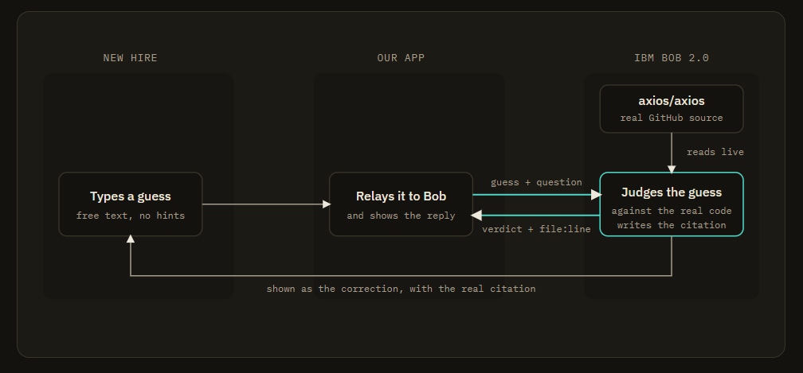
THE SOLUTION
How Prove Me Wrong works
5 / 10

Slide 6
WHY IBM BOB 2.0, SPECIFICALLY
Full-repository context, not a single file
1
Reads the live source
Not training knowledge, the current file, for the exact topic asked about.
2
Understands how pieces connect
What the code does, and why, across the whole codebase, not one file in isolation.
3
Even Bob can be wrong
It made the same reasoning error three times on one topic, caught only by tracing the cited line by hand.
6 / 10

Slide 7
THE DEMO
Real repo. Real reasoning. Real citations.
7 / 10

Slide 8
BUSINESS VALUE
Hours of proof, not weeks of silence
Every company hiring developers pays the onboarding cost today. Prove Me Wrong replaces weeks of silent, unverified reading with a focused session of active, proven understanding.
82%
retention improvement
70%
productivity improvement
8 / 10

Slide 9
ORIGINALITY
A different lane, on purpose
Crowded lanes
This project
Repo-visualizer tools
PR / change-risk scorers
Dozens of near-identical entries in round 1
Same full-repo-context capability
Pointed at active recall, how people learn
Proof-grounded verification, not a dashboard
9 / 10

Slide 10
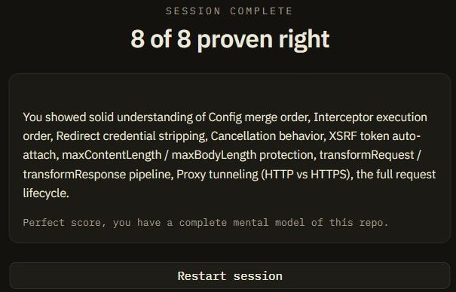
Prove Me Wrong
Hours of proven understanding, instead of weeks of silent reading.
github.com/jeretc/proof-me-wrong

