Slide 1
Option A
Gerardo Gamboa
Eros Smith
Aseal Yousef
Jeannette Tang

Slide 2
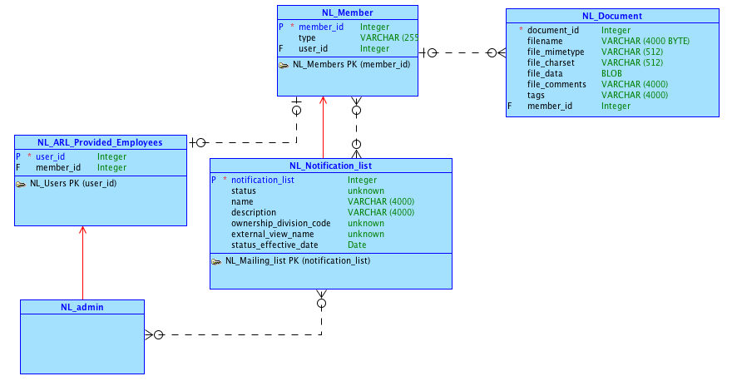
Conceptual Model

Slide 3
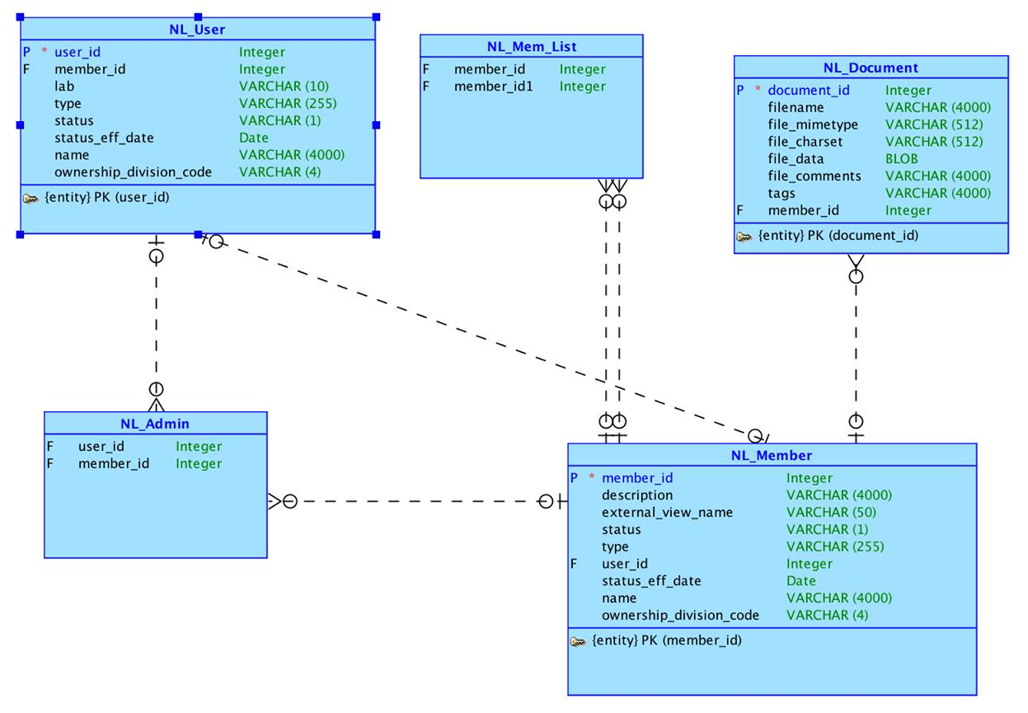
Logical Model

Slide 4
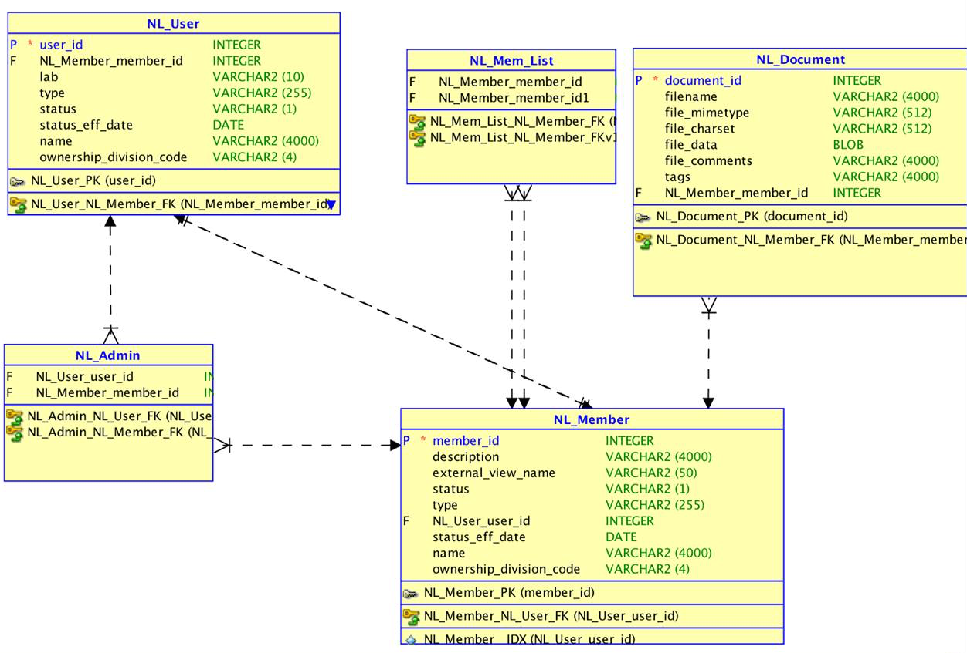
Relational Model

Slide 5
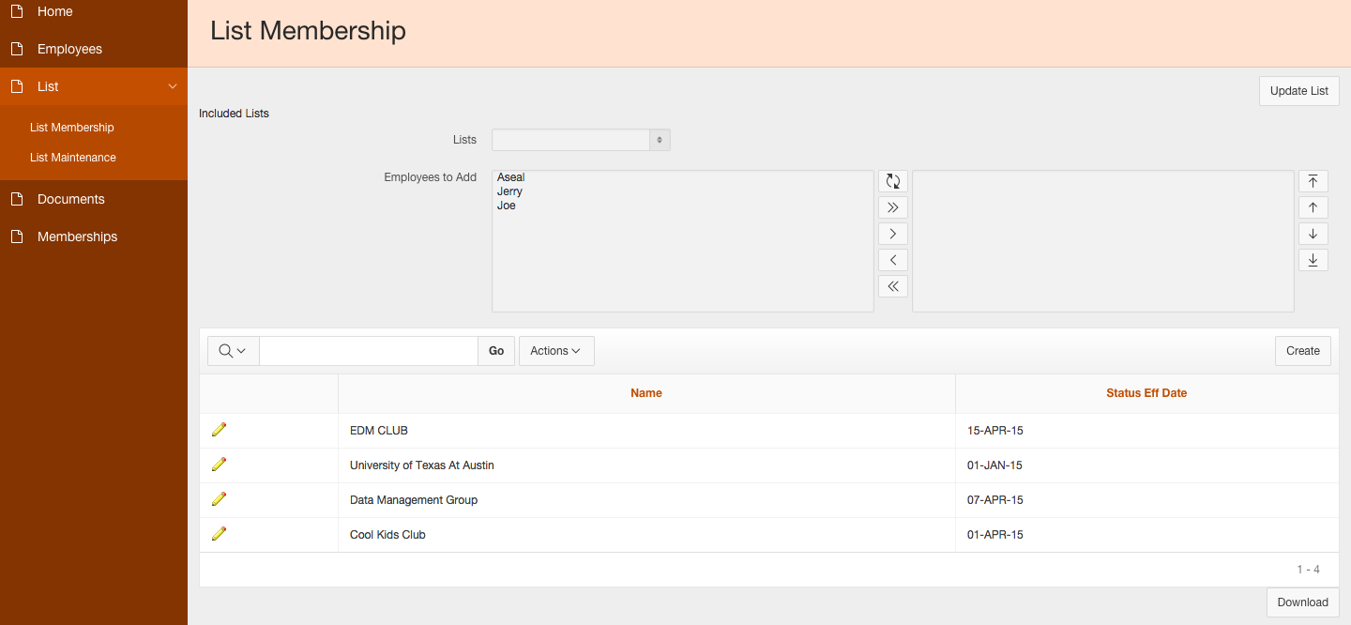
List Membership
This page allows the current user to create lists and add Active members to any Active List.
This page allows the user to create lists and add members to active lists.

Slide 6
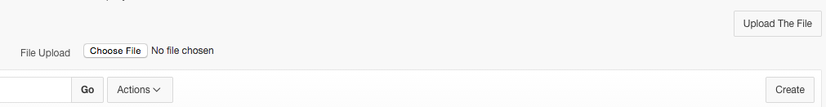
File Upload/Data Loading
Allows user to upload .csv files onto the form to create users.

Slide 7
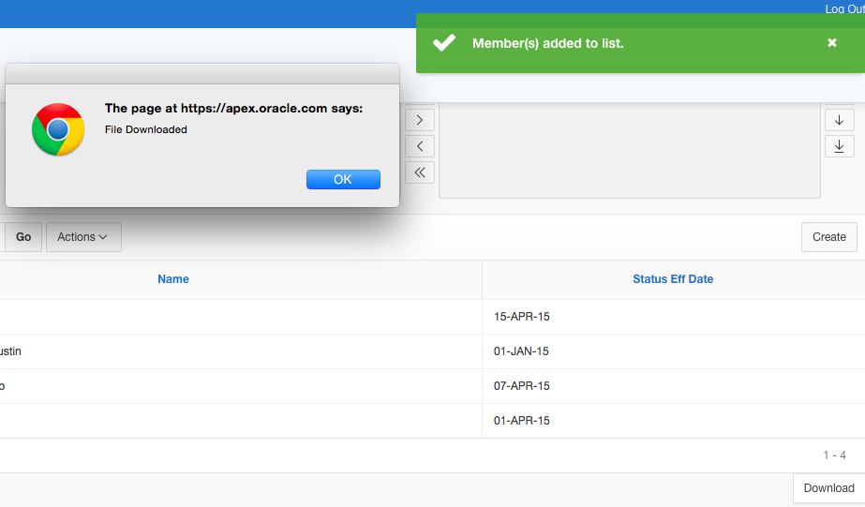
Download Button
Allows user to download .csv files of the table.

Slide 8
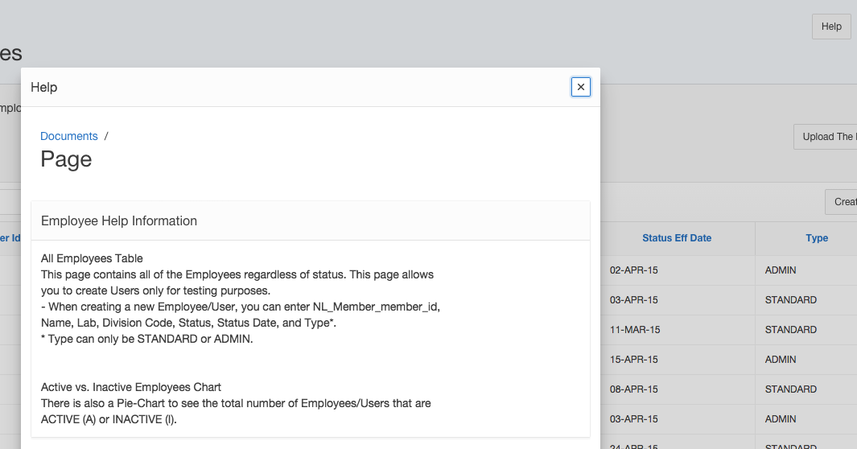
Help Button
Shows help information about the page.

Slide 9
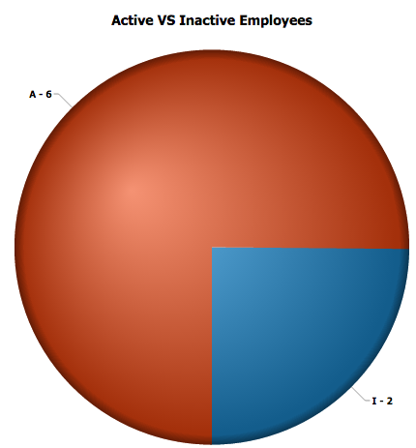
Pie Chart
Shows the percentages of active members versus inactive members.

Slide 10
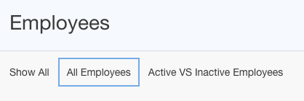
Region Display Selectors
Displays organized tabs for the user to easily navigate between regions on the page.

Slide 11
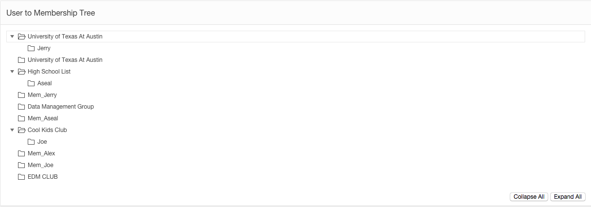
Relationship Tree
Allows user to see the relationships between lists and each of their memberships.

Slide 12
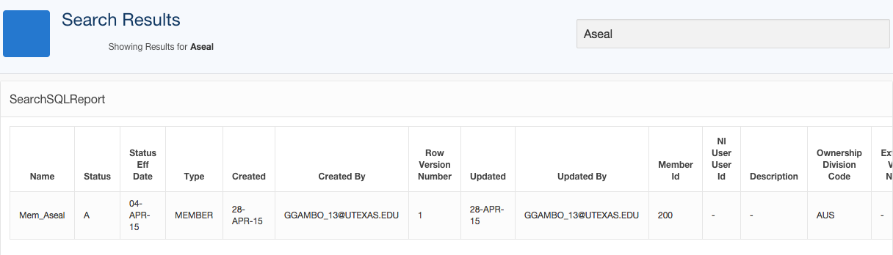
Search on Home Page
Allows the user to search the members table by Name, Type, or Status.

Slide 13
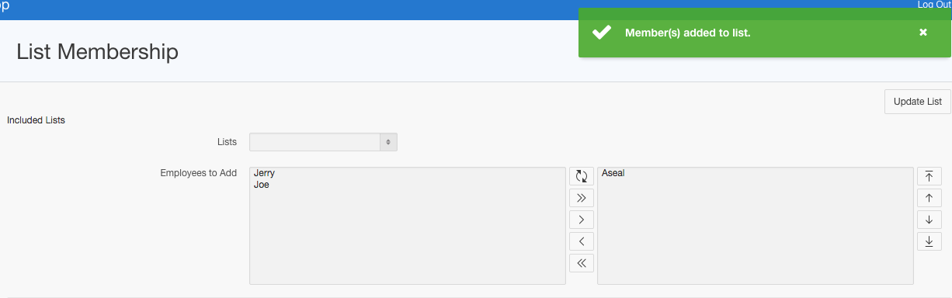
Shuttle Form Element
Allows user to add active member(s) to any active list they aren’t a member of already.

Slide 14
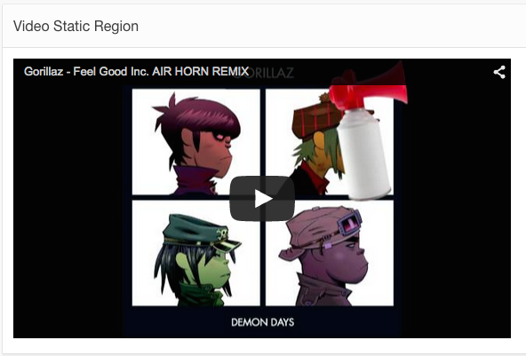
HTML5 Video
Shows a video on the page.

Slide 15
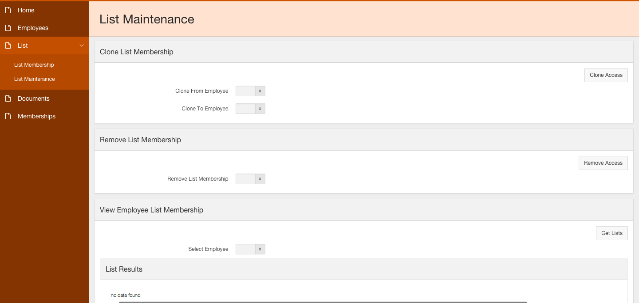
List Maintenance
This page allows the user to clone memberships, remove employees from all lists and see an employees memberships to lists.

Slide 16
Apex Application URL
https://apex.oracle.com/pls/apex/f?p=41386:1:118509572740059::NO:::
Check us out! ☺

