Slide 1

Do US Movies with Longer Running Times Tend to get Higher Ratings on IMDB?
An Analytical Analysis Using Python
Jerica Tripp
Bellevue University
DSC530-T301 Data Exploration and Analysis
August 14, 2021

Slide 2
Contents
Objective of Analysis
Conducting Analysis Overview
Data & Variables
Variable Overview
Analysis of Variable: startYear
Analysis of Variable: genres
Analysis of Variable: runtimeMinutes
Analysis of Variable: numVotes
Analysis of Variable: averageRating
Analysis of Variable: averageRatingGrpd
Analytical Analysis
Probability Mass Function
Cumulative Distribution Function
Normal Probability Plot
Scatterplot: Average Rating by Runtime Minutes
Scatterplot: Average Rating by Number of Votes
Testing the Hypothesis
Correlation Tests
Difference in Means
Cohen Effect Size
Linear Regression Analysis
Testing the Linear Regression & Conclusion

Slide 3
Objective of Analysis
To answer the question “Do Movies with Longer Running Times Tend to get Higher Ratings on IMDB?”, I will be using the below null and alternate hypothesis. “Running Time” is defined as the length in minutes of the film.
Ho: The slope of the regression line is equal to zero.
Ha: The slope of the regression line is not equal to zero.
Rejecting the Null hypothesis will mean that there is evidence of a relationship between movie runtime minutes and ratings. A positive slope will indicate that the relationship is positive, meaning that longer runtimes tend to have higher ratings.

Slide 4
Conducting Analysis
To define “longer” running movies, a new variable will be created called ‘quantile_4’ that breaks up the data into 4 quantiles using the pd.qcut function.
The top 75% quartile will be the records identified as “longer” movies. The rest of the data will be categorized as “other”.
A correlation and regression analysis will be conducted.

Slide 5
Data Overview
IMDB or ‘Internet Movie Database’ is a private company that maintains a robust inventory of media as well as their user’s ratings of the media.
For this analysis, I will be using the below datasets.
title.akas
title.basics
title.ratings
I will be applying the following limits to the data:
Data will be limited to the United States region
Data will not include adult films
Data will be limited to title types of "movie"
Data will only include films with a release year between 2010 and 2020, inclusive

Slide 6
Variable Overview
Final Variables
tconst (string) - alphanumeric unique identifier of the title
title (string) – the localized title
region (string) - the region for this version of the title
startYear (YYYY) – represents the release year of a title. In the case of TV Series, it is the series start year
runtimeMinutes – primary runtime of the title, in minutes
averageRating – weighted average of all the individual user ratings
averareRatingGrpd- Quartile groupings of averageRating
numVotes - number of votes the title has received
genre_1 (string) – first genre listed in genres field
genre_2 (string) – second genre listed in genres field
genre_3 - string) – third genre listed in genres field
quantile_4- indicator for record for quartile it belongs to for averageRating (0-25%, 1-50%, etc.)
The variables used in the analysis are retrieved from: https://datasets.imdbws.com/
Data is joined on the unique identifier of the film ‘tconst’ or ‘titleId’ to create one dataset
Input Variables
title.akas | title.basics | title.ratings
titleId (string) - a tconst, an alphanumeric unique identifier of the title | tconst (string) - alphanumeric unique identifier of the title | tconst (string) - alphanumeric unique identifier of the title
title (string) – the localized title | titleType (string) – the type/format of the title (e.g. movie, short, tvseries, tvepisode, video, etc) | averageRating – weighted average of all the individual user ratings
region (string) - the region for this version of the title | isAdult (boolean) - 0: non-adult title; 1: adult title | numVotes - number of votes the title has received
language (string) - the language of the title | startYear (YYYY) – represents the release year of a title. In the case of TV Series, it is the series start year
 | runtimeMinutes – primary runtime of the title, in minutes
 | genres (string array) – includes up to three genres associated with the title

Slide 7
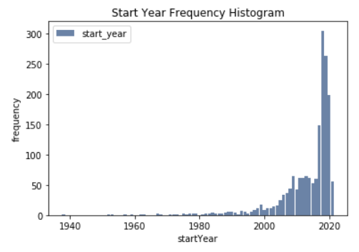
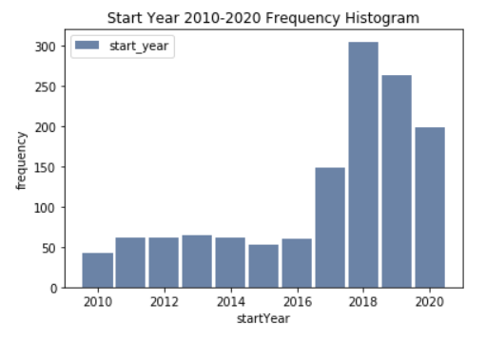
Analysis of Variables: startYear
startYear represents the release year of a title
Analysis:
The distribution is left-skewed. More movies are released each year. There are clear outliers for movies released prior to 1960. Also, there should not be any films in the dataset not yet released
Analysis:
The distribution is still left-skewed. More movies are released each year. Focusing on this decade removes obvious outliers.

Slide 8
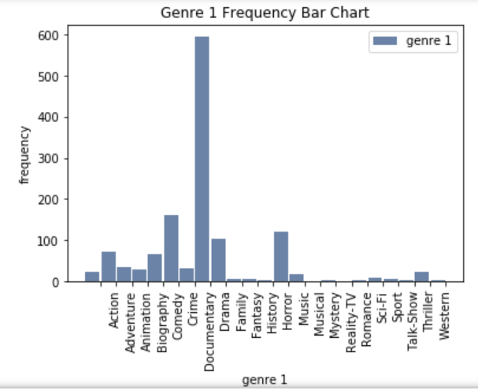
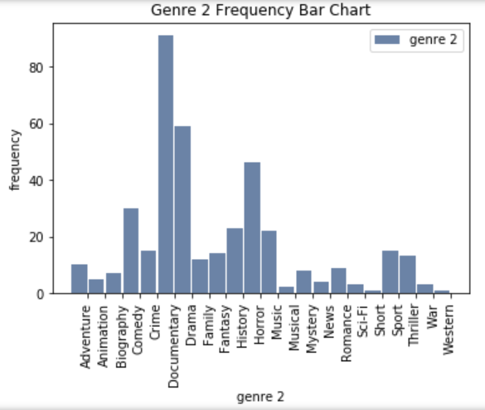
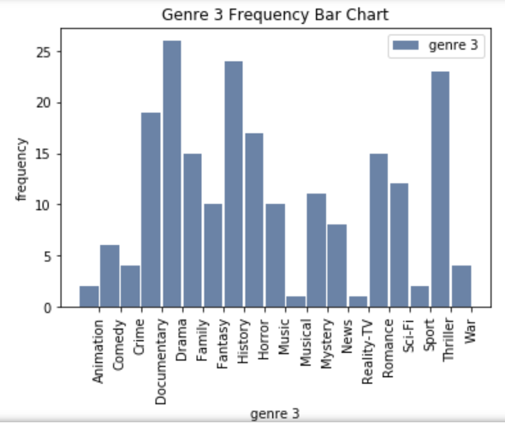
Analysis of Variables: genres
genres (string array) – includes up to three genres associated with the title. I separated this variable into 3 new variables, genre_1, genre_2, & genre_3
Genre 1
Genre 2
Genre 3
Analysis: The documentary genre has the highest frequency across all 3 genre variables.
The second most frequent genre is drama for genre 1 & 2 and history for genre 3.

Slide 9
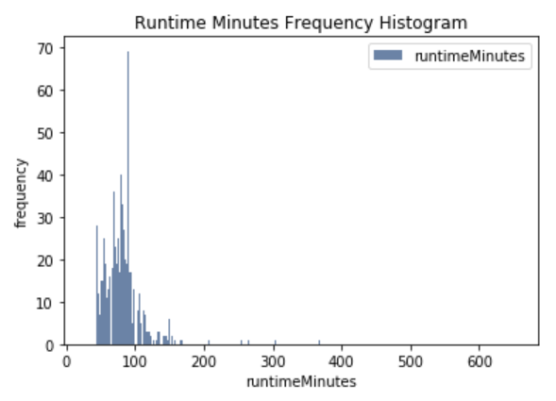
1.2 Analysis of Variables: runtimeMinutes
runtimeMinutes – primary runtime of the title, in minutes
Frequency Histogram
Summary Statistics
Analysis:
The distribution is right-skewed. There are obvious outliers in the data.
I will not be excluding any data, as all movies, no matter the length, receive ratings.
Count | 5499
Mean | 80.84
Standard Deviation | 41.95
Min | 4
25% (Lower Tail) | 59
50% (Median) | 75
75% (Upper Tail) | 91
Max | 1699
Mode | 60
Variance (Spread) | 1759.55

Slide 10
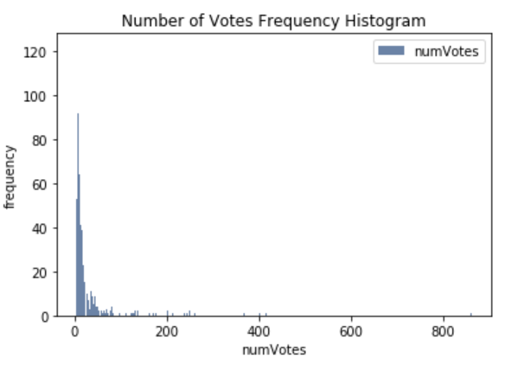
1.3 Analysis of Variables: numVotes
numVotes - number of votes the title has received
Frequency Histogram
Summary Statistics
Analysis
Count | 1544
Mean | 28.89
Standard Deviation | 65
Min | 5
25% (Lower Tail) | 8
50% (Median) | 13
75% (Upper Tail) | 24
Max | 941
Mode | 6
Variance (Spread) | 4225.69
The distribution is right-skewed. There are obvious outliers in the data.
I will not be excluding any data, as all movies have received at least 5 votes and the final rating metric is weighted.

Slide 11
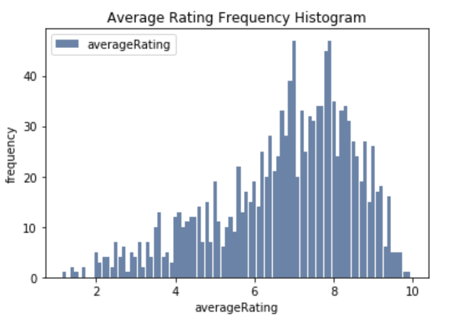
1.4 Analysis of Variables: averageRating
averageRating – weighted average of all the individual user ratings
Frequency Histogram
Summary Statistics
Analysis
The distribution is slightly left-skewed.
There aren’t any outliers I think should be removed, as all movies have an average rating.
Count | 1544
Mean | 6.80
Standard Deviation | 1.78
Min | 1
25% (Lower Tail) | 5.80
50% (Median) | 7.20
75% (Upper Tail) | 8.10
Max | 9.90
Mode | 7.9
Variance (Spread) | 3.15

Slide 12
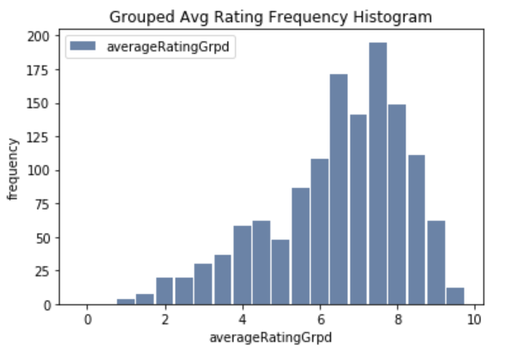
Creation & Analysis of Variables: averageRatingGrpd
averageRatingGrpd – this is a new variable constructed from the averageRating variable. The
Frequency Histogram
New Ranges
Analysis
Range Min | Range Max | Category
0 | 0.5 | 0.5
0.5 | 1 | 1
1 | 1.5 | 1.5
1.5 | 2 | 2
2 | 2.5 | 2.5
2.5 | 3 | 3
3 | 3.5 | 3.5
3.5 | 4 | 4
4 | 4.5 | 4.5
4.5 | 5 | 5
5 | 5.5 | 5.5
5.5 | 6 | 6
6 | 6.5 | 6.5
6.5 | 7 | 7
7 | 7.5 | 7.5
7.5 | 8 | 8
8 | 8.5 | 8.5
8.5 | 9 | 9
9 | 9.5 | 9.5
9.5 | 10 | 10
The grouping of these fields will allow for easier identification of high and low scoring
Shape of distribution is easier to identify as slightly left-skewed

Slide 13
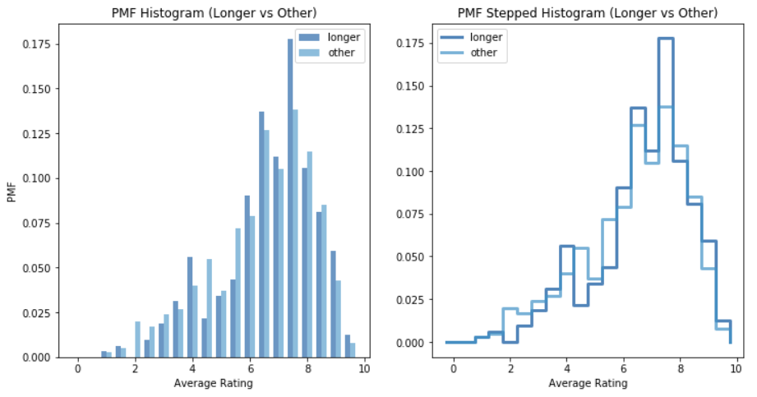
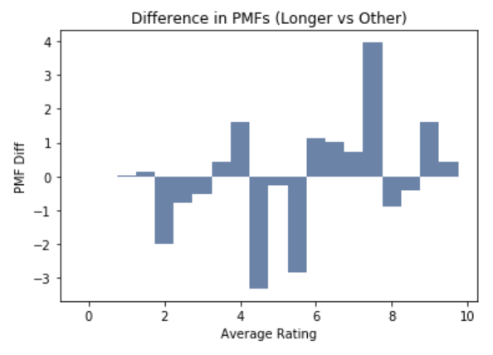
Probability Mass Function Analysis
The probability mass function shows the likelihood longer vs other receiving a given rating
The charts to the left show the PMF for longer vs other, but they are a bit hard to read
The chart to the right shows the difference of the PMFs for longer vs other and more clearly shows the tend of longer running films having higher ratings (the majority of scores over 5)

Slide 14
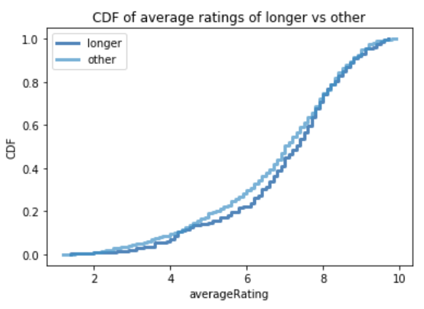
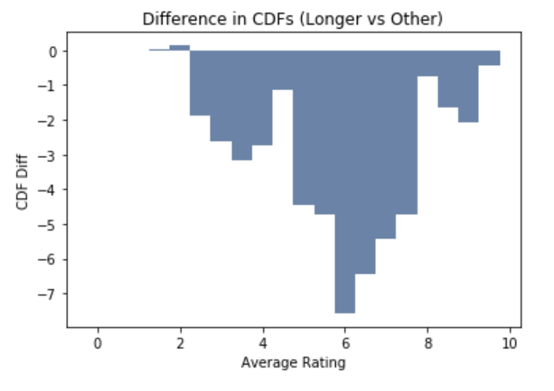
Cumulative Distribution
The cumulative distribution function shows the percentile rank for any given value, in this case, average rating
The chart below shows the percentile rank on average ranking for longer and other films. This chart appears to show other having a higher percentile rank most of the averageRatings – the chart to the right confirms this

Slide 15
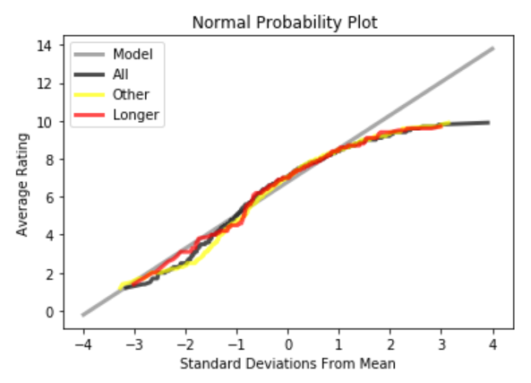
Analytical Distribution: Normal Probability Plot
The below normal probability plot shows that the data for all duration of movies (all, other, & longer) tend to deviate from the mean as the rating increases

Slide 16
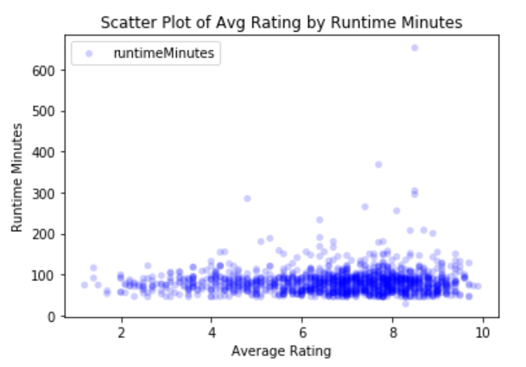
Scatter Plot: Average Rating by Runtime Minutes
The scatterplot below shows the relationship between runtime minutes and average rating.
It is a bit difficult to decipher exactly the relationship, but it appears that there is a positive relationship between the two variables

Slide 17
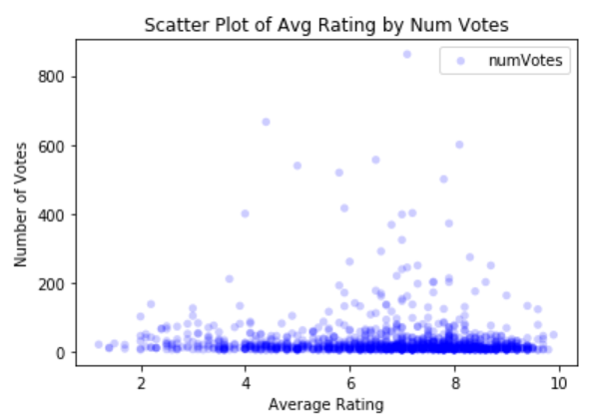
Scatter Plot: Average Rating by Number of Votes
The scatterplot below shows the relationship between number of votes and average rating.
Again, It is a bit difficult to decipher exactly the relationship, but it appears that there is a positive relationship between the two variables

Slide 18
Testing the Hypothesis: with Correlation
I calculated the correlation covariance and performed two correlation tests on average rating & runtime minutes.
The results and analysis are below.
The correlations are small, but are still statistically significant
Correlation Test | Result | Analysis
Correlation Covariance | 2.728 | There is a positive relationship
Pearson’s Correlation | 0.0481 | This score indicates a strong correlation
Spearman’s Correlation | 0.0153 | This score indicates a strong relationship

Slide 19
Testing the Hypothesis: Difference in Means
By comparing the difference in means, I am able to better tell the effect size
The effect size is smaller
Correlation Test | Result | Analysis
Data Mean of Avg Rating | 6.7908 | Second Highest Mean
Longer Mean of Avg Rating | 6.9598 | Highest Mean
Other Mean of Avg Rating | 6.7365 | Third Highest Mean
Difference in Means of Avg Rating | 0.2233 | There is a positive difference between means of longer and other runtimes
Effect Percent | 3.29% | The difference is about 3.29%, as a fraction of the typical average rating

Slide 20
Testing the Hypothesis: Cohen Effect Size
The Cohen Effect Size is used to compare the difference in variability between two groups
Cohen’s d comes out to 0.003633 when average rating of the longer records are compared to the average rating of all records. This means that the effect size between the longer type records and all records is small.
When comparing average rating of longer records to average rating of other records, Cohen’s d comes out to 0.004872. This means that the effect size between the longer type records and the other type records is small.

Slide 21
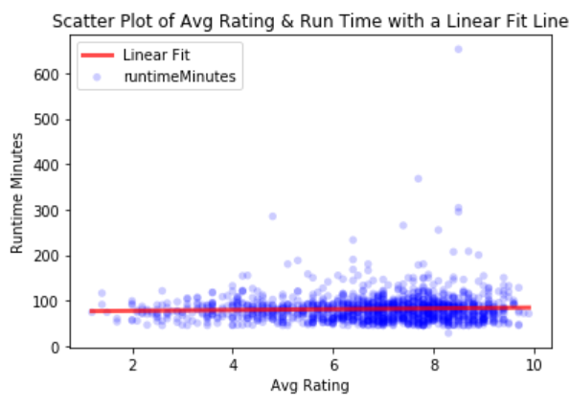
Linear Regression Analysis
The scatter plot shows the relationship of average rating and runtime minutes for the dataset
A linear fit line has been added
The regression line details are below:
Slope: 0.89
Intercept: 75.372
R Value (Correlation Coefficient): 0.048
P Value 0.08 (8% change null hypothesis is true)
Standard Error: 0.509

Slide 22
Testing the Linear Regression
I ran a test on the slope to determine the likelihood that the apparent slope is due to chance
To test, I ran 1000 permutations using random variations of the average rating to get the test statistic of the slope, as estimated by the LeastSquares function
I ran 5 tests
The p-values came to 0.041, 0.027, 0.034, 0.033, 0.027
All above test returned values less than 0.05, thus allowing me to reject the null hypothesis and conclude that the estimated slope of 0.89 of the linear fit model is not likely due to chance.
The outcome of the analysis is that as the average rating of films goes up, the runtime minutes tend to increase as well. This is at a rate of 0.89 minutes increase per 0.1 rating increase.
This can be more easily described as the rating of films tends to increase by 1 integer for every roughly 9 minutes longer the films are

