Slide 1


Why ForexMart?
A step-by-step guide to trading with ForexMart

Slide 2

ForexMart
ForexMart is a Cypriot investment company operating globally
The industry’s most trusted dependable trading partner.

Slide 3
Licenses and Regulations
Regulated by the Cyprus Securities and Exchange Commission (with license number 266/15)
Member of European Securities and Markets Authority

Slide 4
Types of Trading Accounts
Demo Account - Practice trading in a risk-free environment
Live Account - Start trading and experience instant trade executions

Slide 5
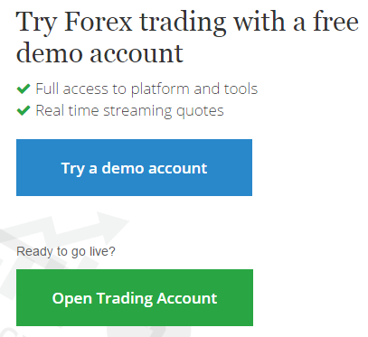
Opening a Live Account
Go to forexmart.com and click ‘Open Trading Account’.

Slide 6
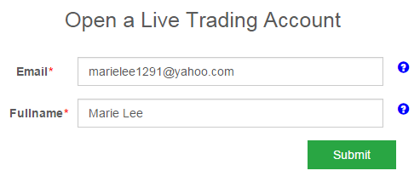
Provide email address and full name in the registration page, then hit ‘Submit’.

Slide 7
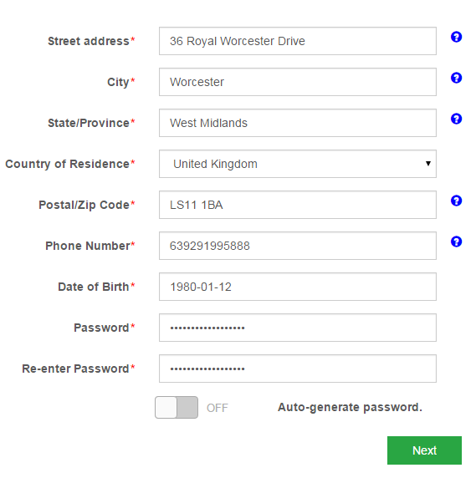
Provide personal information and click ‘Next’.

Slide 8
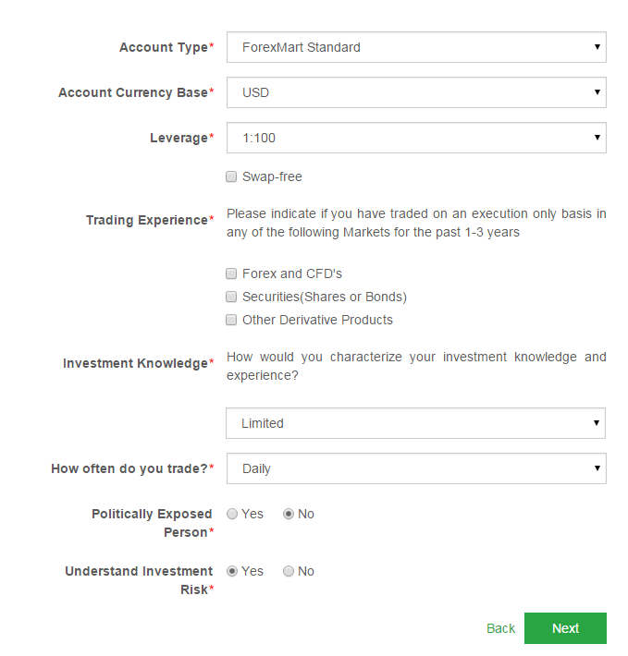
Set account preferences and hit ‘Complete’.

Slide 9
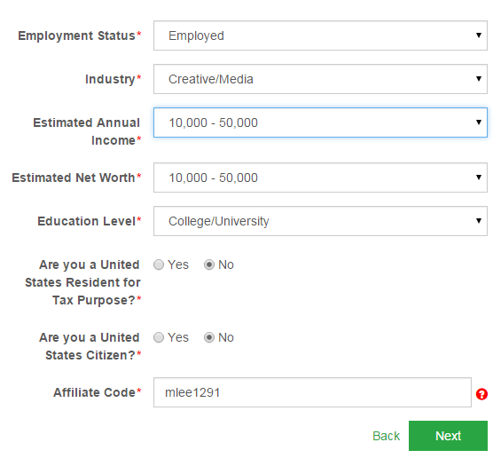
Indicate employment details and click ‘Next’.

Slide 10
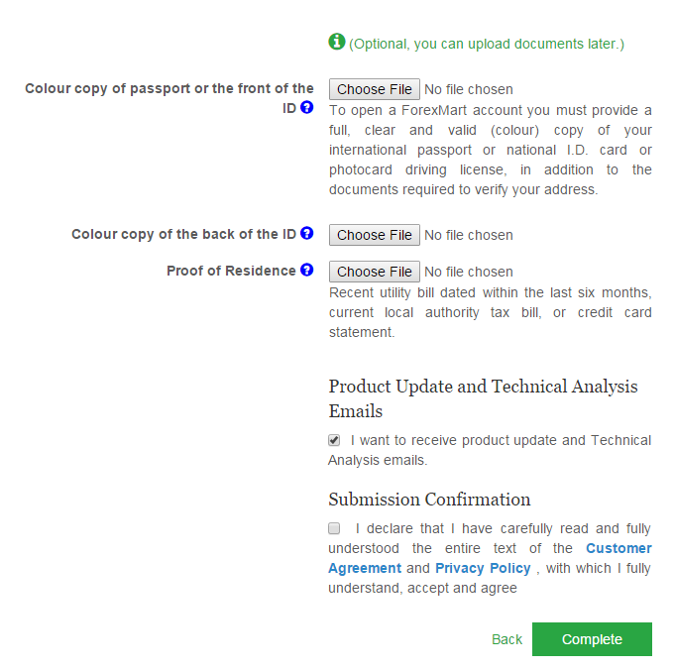
Upload scanned copy of documents and IDs and hit ‘Complete’.

Slide 11
Types of Bonus
30% Bonus - For each deposit, the client gets 30% of the total amount deposited.
No Deposit Bonus - Try trading without experiencing any risk.

Slide 12
Downloading Trading Platform
Download the trading platform from our website by visiting forexmart.com/metatrader4.

Slide 13
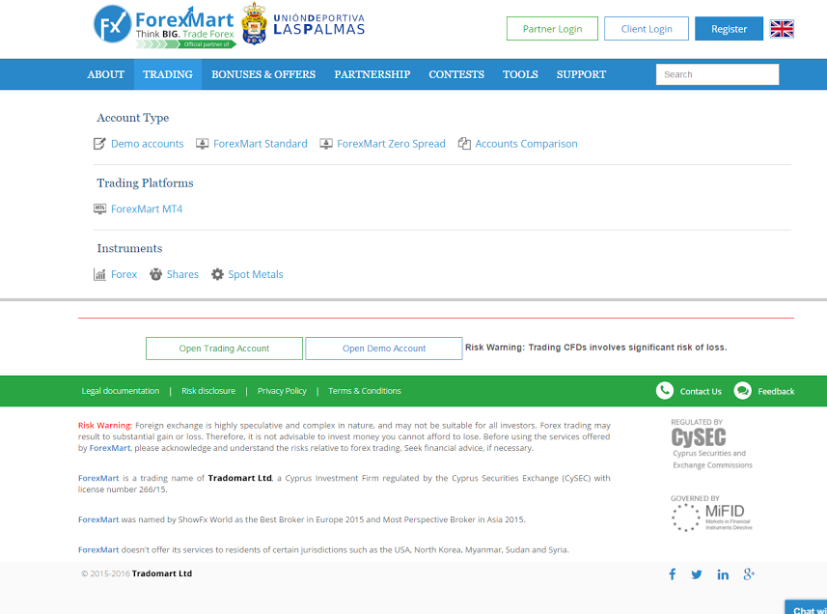
Fill in your personal details and click ‘Get Free Demo’.

Slide 14
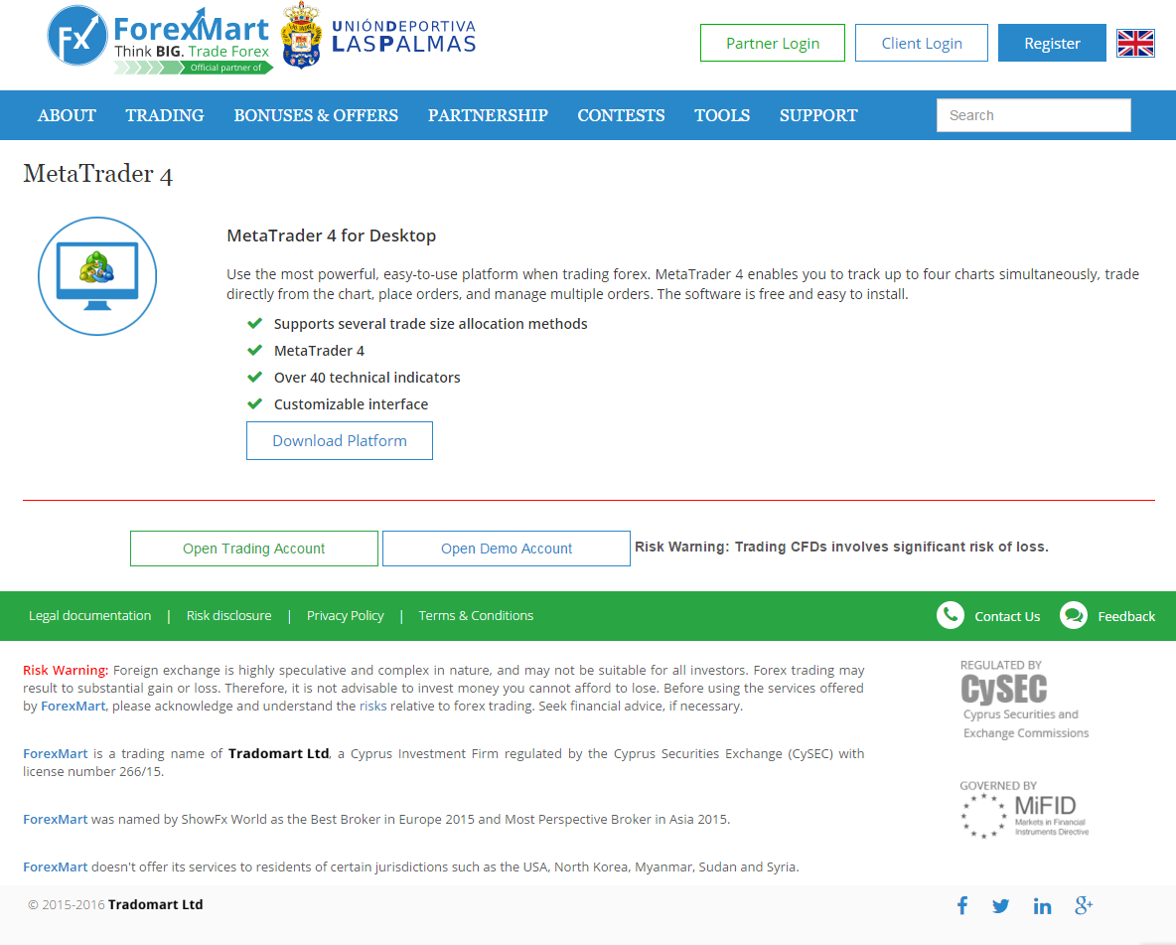
Save the platform downloader and hit ‘Run’.

Slide 15
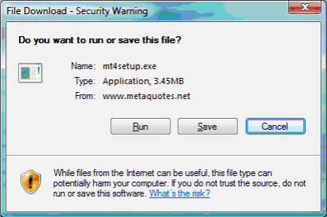
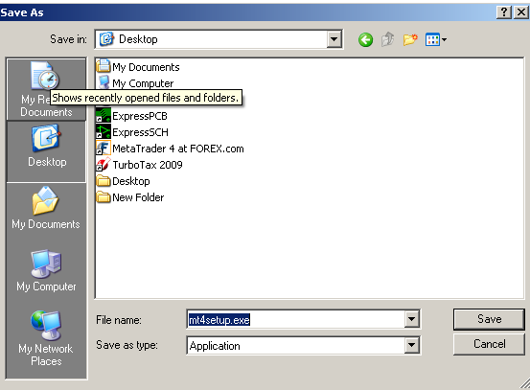
Download and save the platform installer.

Slide 16

Opening and Closing Trade
To open a trade, click “New Order” or press F9.

Slide 17
In case the window does not appear, open it by going to the View tab and click Market Watch.
Choose the currency you wish to trade. An Order Window will open.

Slide 18
Here are the following fields in this window:
Symbol – Choose the instrument to be traded.
Volume – Set the number of lots to buy from the selected instrument.

Slide 19
Stop-Loss – Indicate a stop-loss price to close a trade.
Take Profit – Select the take profit to exit a trade.
Comment – Specify the remarks for a specific order or trade.

Slide 20
Types of Trade
Instant – Opens a position quickly
Pending – Opens a position in the future and preferred price
All orders are listed in the Trade section of the Terminal window.

Slide 21
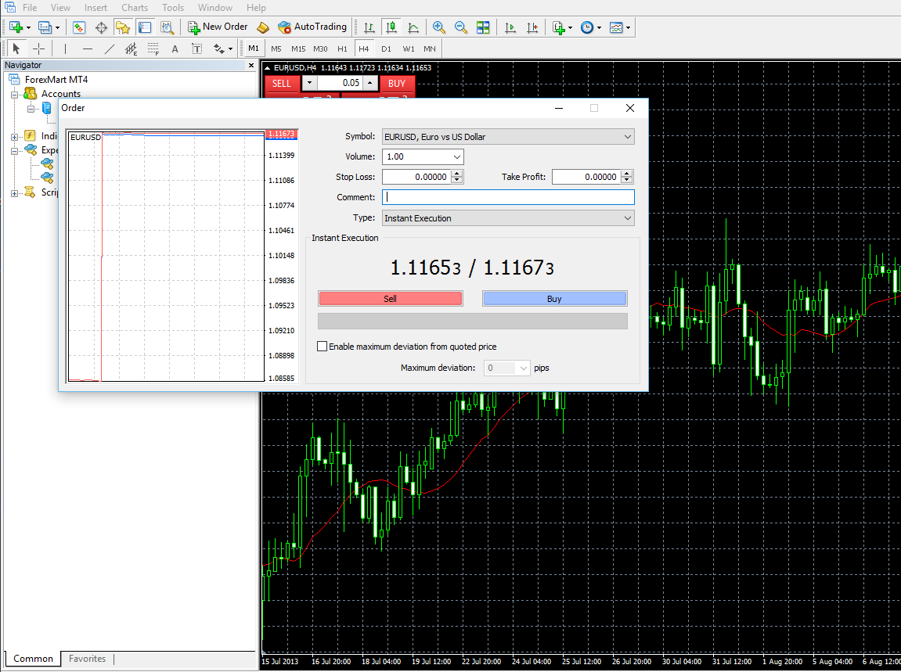
In the Order Window, set the instrument to be traded, volume, and stop loss.

Slide 22
Execute the order by setting the instrument to be traded, volume, and stop loss.

Slide 23
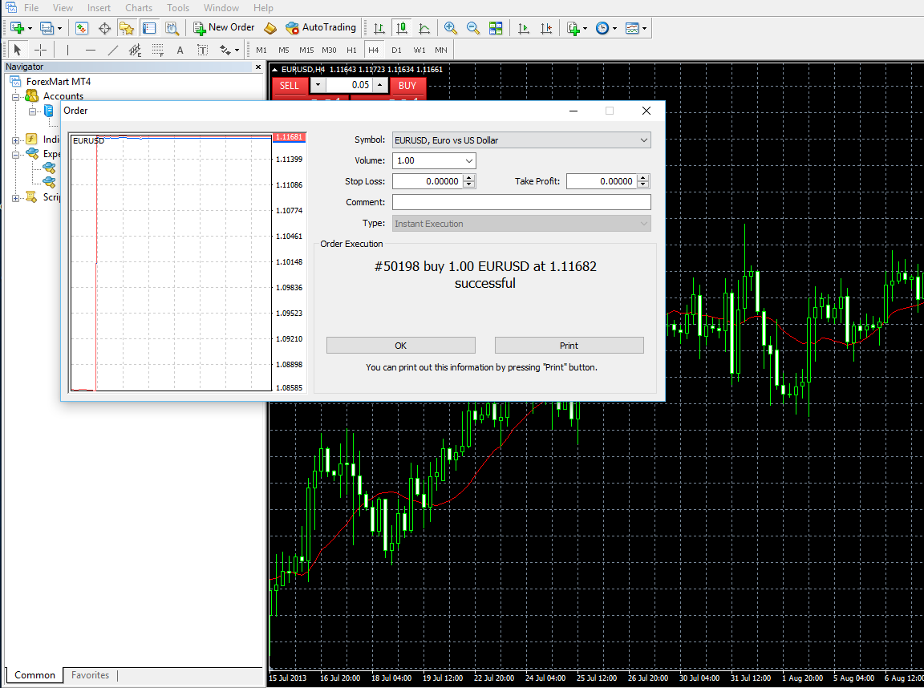
You can print out your trade information by clicking “Print”.

Slide 24
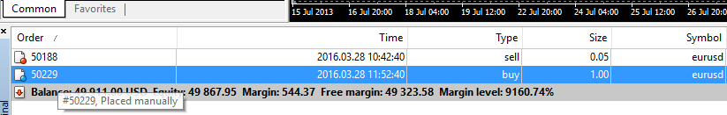
To close a position, go to the Trade tab found in the Terminal window and double-click the position you want to exit.

Slide 25
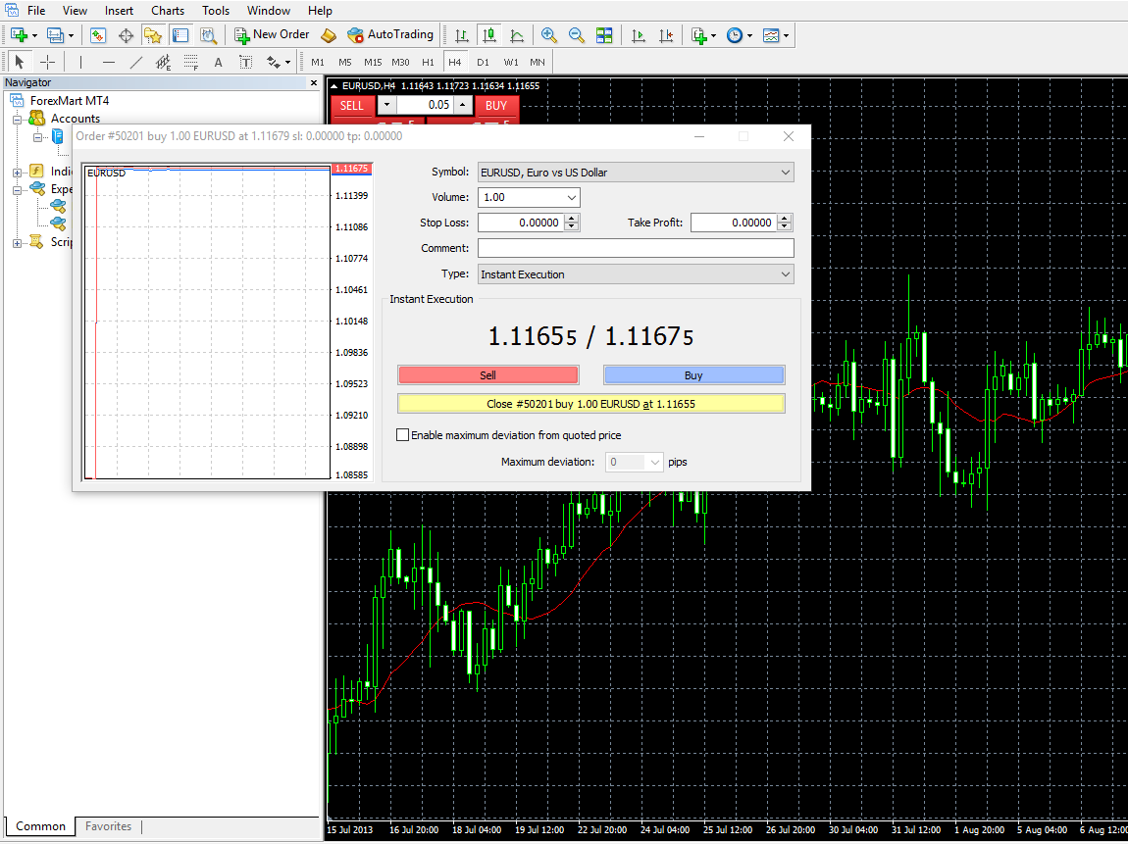
Hit “Close Order” seen on the lower portion of the window.

Slide 26
You can close a portion of the position partially. For instance, if you purchased 1 Lot of USD/JPY and wanted to sell 0.5 lots, indicate the amount to be sold in the Volume tab and hit “Close”.

Slide 27
You can also modify a position by double-clicking the position in the Trade portion. In the Position Window, hit Type drop-down list and select Modify Order.

Slide 28
Useful Tools
Forex Calculator - Compute the value of one pip using the latest rates.
Forex Chart - Advanced professional chart providing an in-depth look at world’s major currency pairs.

Slide 29
Currency Converter - Compute live currency and real-time foreign exchange rates.
VPS Hosting - A free service aimed at bolstering a client’s trading experience.

Slide 30
For concerns, inquiries, or suggestions, call us or send an email. We are looking forward to assisting you!
info@forexmart.com

